Slide 2
Bose Connected Music
Cloud Infrastructure, Team, Strategy
Josh West <josh_west@bose.com>
Cloud Architect
Home Entertainment Division

Slide 3
Bose Connected Music Project
Home Entertainment Division
Research and Advanced Development
Product Owner & Manager: Keith Martin
Algorithms and Cloud Experience

Slide 4
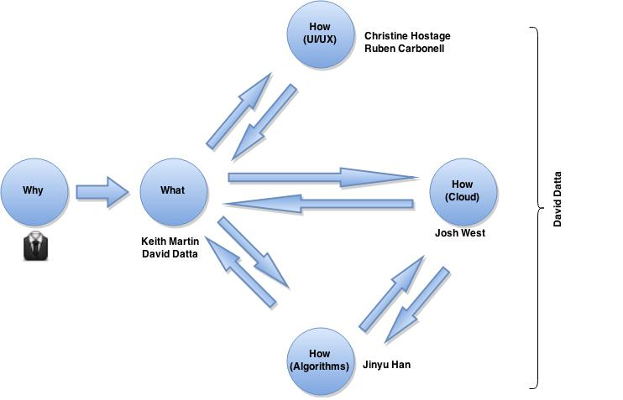
ACE Organization
Notes:
- Why:
- Better music experience for customers
- Increase/diversify product portfolio
- Make money!
- What:
- Smart recommendatoin engine
- Context aware
- Learn about our customers

Slide 5
How: Cloud
Strategy
DevOps Team
Cloud & App
Infrastructure

Slide 6
How : Cloud : Infrastructure
Introduction to Cloud Computing
Infrastructure as a Service
Amazon Web Services
Pioneered IaaS in 2006 (Xen)
Multiple cloud providers available today:
Microsoft Azure
Google Compute Engine
Rackspace Cloud, HP Helion, etc....

Slide 7
Jeff Bezos AWS Memo
All teams will henceforth expose their data and functionality through service interfaces.
Teams must communicate with each other through these interfaces.
There will be no other form of inter-process communication allowed: no direct linking, no direct reads of another team’s data store, no shared-memory model, no back-doors whatsoever. The only communication allowed is via service interface calls over the network.
It doesn’t matter what technology they use.
All service interfaces, without exception, must be designed from the ground up to be externalizable. That is to say, the team must plan and design to be able to expose the interface to developers in the outside world. No exceptions.
Anyone who doesn’t do this will be fired. Thank you; have a nice day!

Slide 8
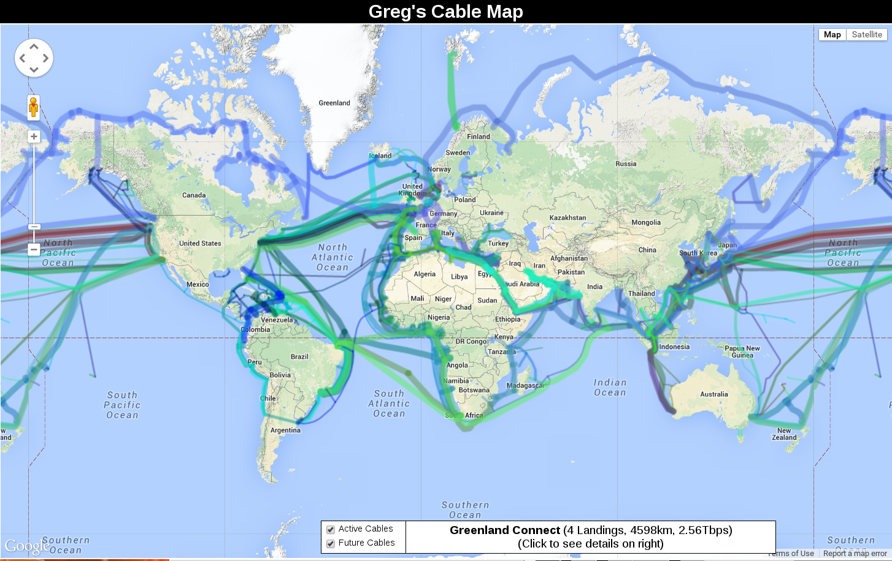
Notes:
- Latency from points across the world can easily be 200ms+
- this is a problem. This is a bad experience.
- Could build datacenters around the world, and then start building BCM system … but hat is a very big CapEx
- IaaS lets us rent capacity around the world without the massive CapEx
- IaaS is much more expensive in the long run but much cheaper (and quicker) in the short term

Slide 9
Amazon Web Services Concepts
Instance: virtual server
Region: collection of datacenters proximally located
network is one fabric (connected)
Availability Zone: datacenter with a region
Billing: chaged based on usage
Cpu time
Network traffic
Storage
Everything and anything...

Slide 10
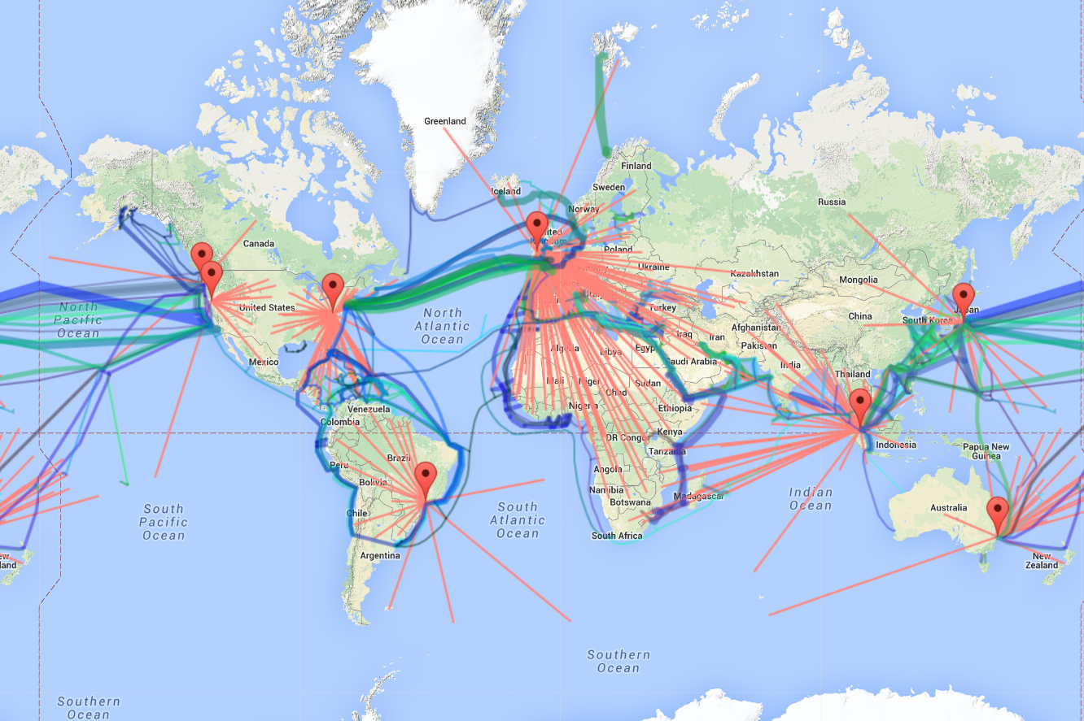

Slide 11
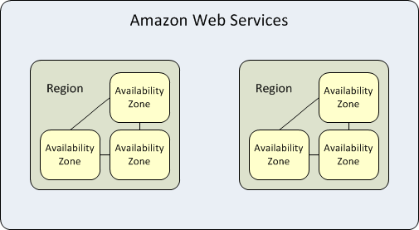
AWS Regions and Availabilty Zones

Slide 12
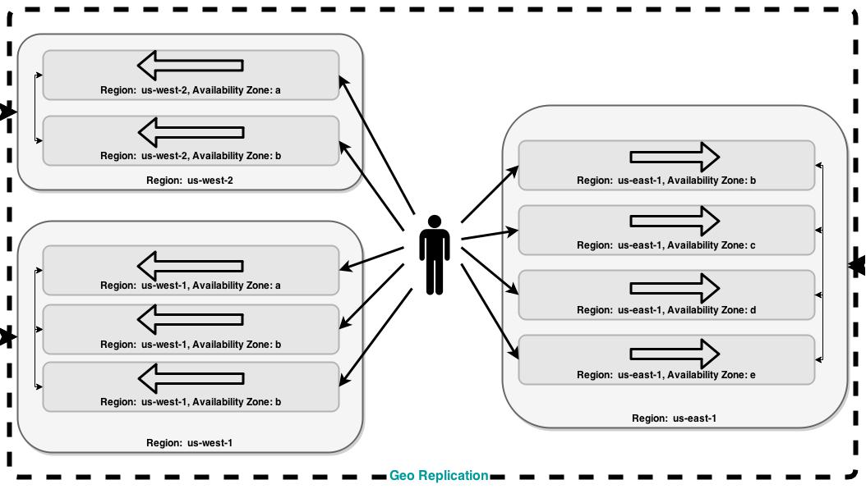

Slide 13
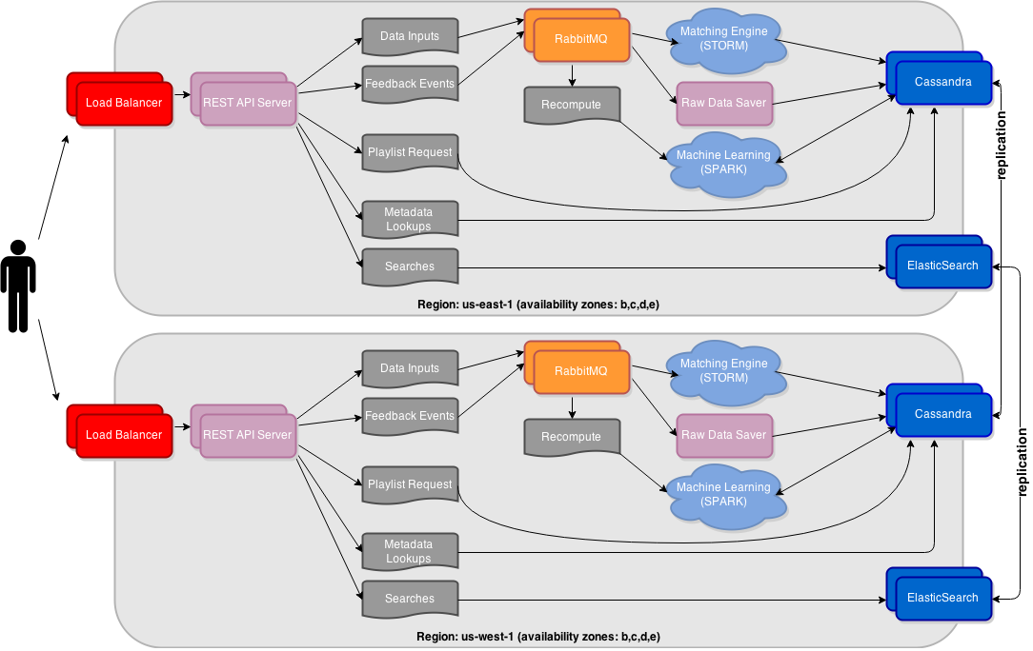

Slide 14
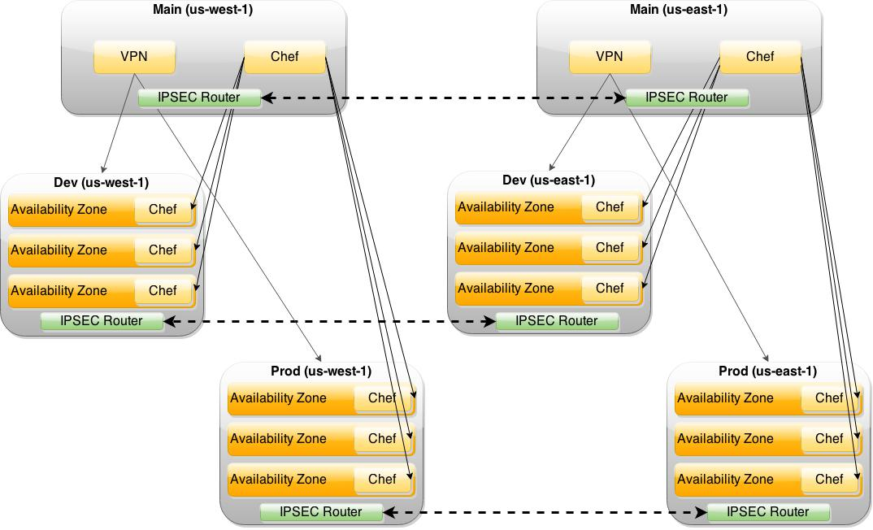

Slide 15
How: Cloud
Strategy
DevOps Team
Cloud & App
Infrastructure

Slide 16
How : Cloud : Team
People!
Hiring!
Looking for Cassandra, NoSQL, big data, cloud engineering, high availabilty rockstars!
Looking for machine learning experts!
Software: git, chef, scrum/sprint planning tools
Notes:
- Making our way through software which will support the team.

Slide 17
How: Cloud
Strategy
DevOps Team
Cloud & App
Infrastructure

Slide 18
How : Cloud : Strategy
Must think about global scale
Must be budget/cost sensitive
Must be risk averse
Must think about the future!
Notes:
- Now onto the strategy of our cloud initiative
- We must think about global domination^Hscale
- We must be budget/cost sensitive
- We must think about the future! Not just solving the problem at hand right this moment right now!

Slide 19
Belt AND Suspenders!
Build cloud & app infrastructure to be portable
Avoid vendor lock-in, but find right balance
Nothing worse than rigid infrastructure
So our pants don't fall down :-)
Notes:
- Build cloud & app infrastructure to be portable
- Avoid vendor lockin ,but find the right balance
- Nothing worse than a rigid infrastructure that cannot be modified without a full rebuild/redesign/redeploy.
- Not the times we live in anymore and we must remain flexible.
- Cloud landscape is in a boom. Rapidly evolving.
- Have to remian open to change once the dust settles.

Slide 20
(Not) Invented Here Syndrome
With invent of {I,P,M,S}aaS, now seeing IHS
Bad trap, but easy to fall into:
Vendor and solution lock-in
Great for startups (few people, no time)
We are not a startup.
We can have the expertise to “Do It Right”™

Slide 21
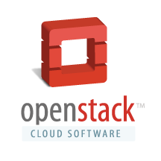

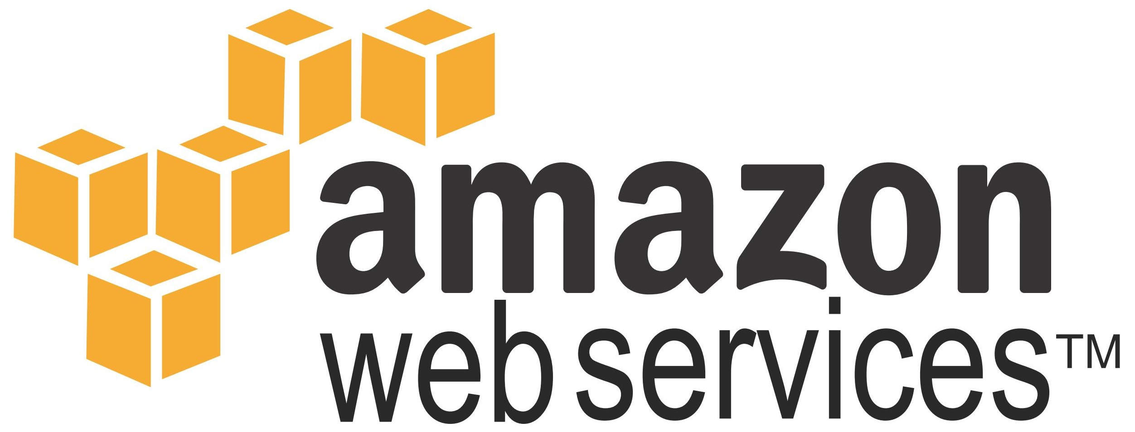
Cloud Strategy
Multiple cloud providers, at the same time
Notes:
- Build cloud & app infrastructure to be portable
- Avoid vendor lockin ,but find the right balance
- Nothing worse than a rigid infrastructure that cannot be modified without a full rebuild/redesign/redeploy.
- Not the times we live in anymore and we must remain flexible.
- Cloud landscape is in a boom. Rapidly evolving.
- Have to remian open to change once the dust settles.

