Slide 1

Anisotropic Cerebral Vasculature causes Orientation Dependency in MR Signal
Simulation in the Human Brain
Jonathan Doucette, Luxi Wei, Christian Kames, Enedino Hernandez-Torres,
Rasmus Aamand, Torben E. Lund, Brian Hansen, and Alexander Rauscher

Slide 2

Declaration of Financial Interests or Relationships
Speaker Name: Jonathan Doucette
I have no financial interests or relationships to disclose with regard to the subject matter of this presentation.

Slide 3
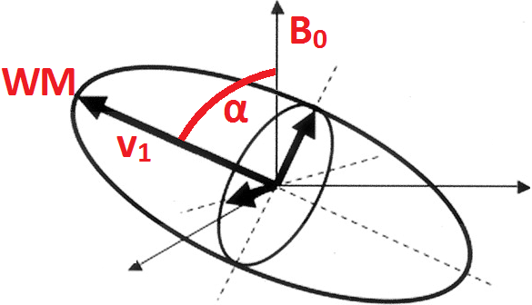
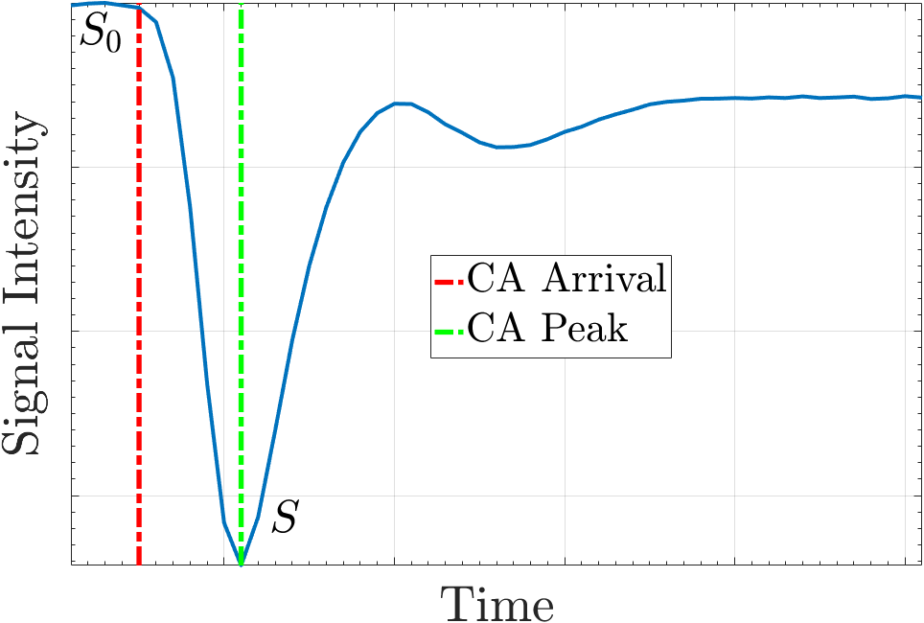
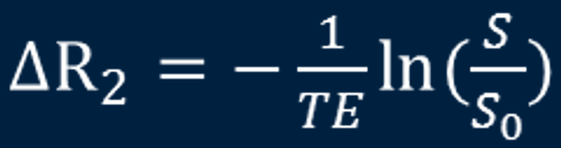
Introduction and Motivation
Subject Data
DTI and Spin Echo DSC scans obtained for 19 healthy subjects
WM Fibre orientation angle α determined from DTI data, correlated with change in R₂ with and without CA
Change in decay rate ΔR₂ at points S₀ and S can be calculated via:
CA: Contrast Agent

Slide 4
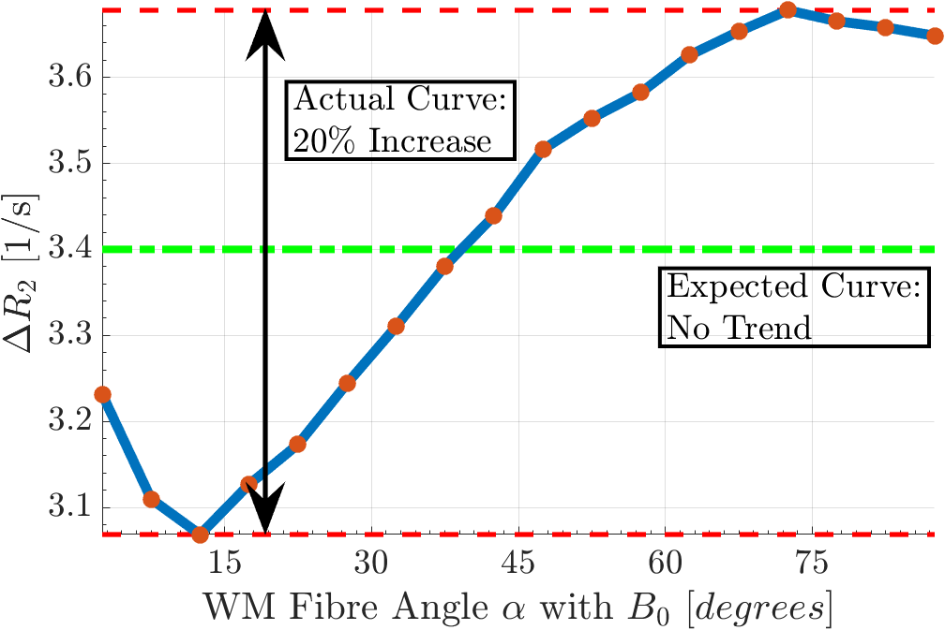
Introduction and Motivation
Expected Spin Echo DSC Signal:
SE spins should be refocused by TE
Decay should be due only to local (CA dependent) R₂-value
Decoherence should be negligible
Actual Spin Echo DSC Signal:
There is extra signal decay!
Even more peculiar: extra decay depends on the local fibre orientation

Slide 5
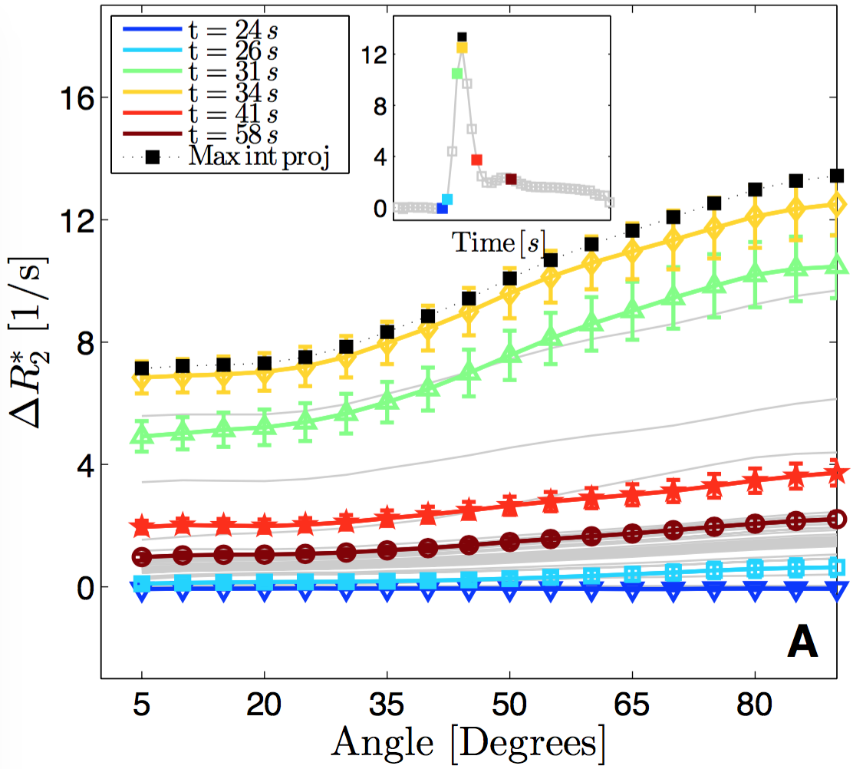
Introduction and Motivation
Comparison with Gradient Echo DSC case:
Our previous study* showed that orientation dependency is strong in GRE-DSC
This is expected for GRE-DSC
For larger angles, the extravascular inhomogeneities occupy larger volume fractions of a voxel
We now aim to explain why this same effect is present in SE-DSC
*Hernandez-Torres, et al. JCBFM (2016)

Slide 6
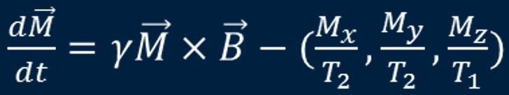

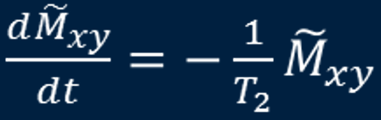

The Bloch Equations for SE-DSC WITH INHOMOGENEITIES
We start by considering the Bloch Equations:
In a rotating frame with constant
Where we define the complex magnetization:

Slide 7
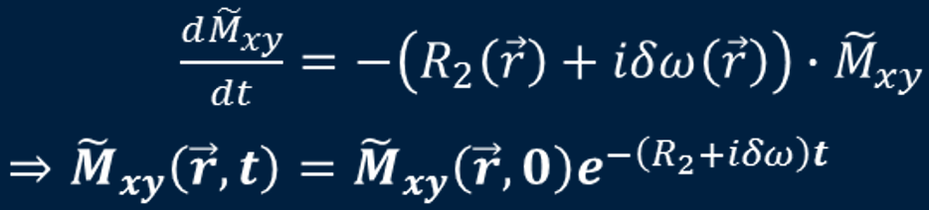

The Bloch Equations for SE-DSC WITH INHOMOGENEITIES
We can add induced field inhomogeneities through incorporating susceptibility changes $δχ$ and using the unit dipole kernel $G(\vec{r})$:
The resulting differential equation and solution are then:

Slide 8

The Bloch Equations for SE-DSC WITH INHOMOGENEITIES
However, this solution can only produce the Expected Curve, not the Actual Curve
This is because this solution completely refocuses by time TE (as it should for SE!):

Slide 9

The Bloch-TorRey Equation for SE-DSC
Remedying this model
So far, we have implicitly assumed that all spins are stationary
If spins are allowed to move, they will see different local inhomogeneities and will not perfectly rephase – there will be extra decay
We add diffusion to the equation:
Where ∇² is the 3D Laplacian operator. This is the so-called Bloch-Torrey equation, and has no closed form solution and must be solved numerically

Slide 10
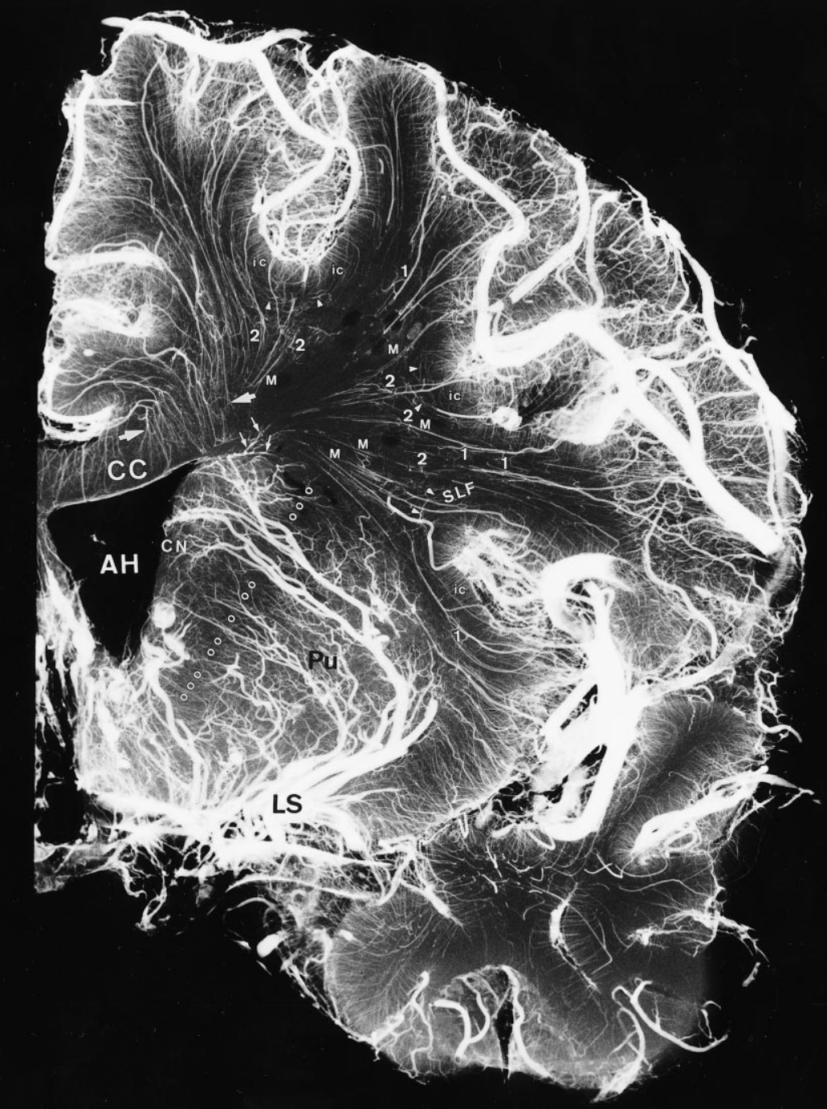
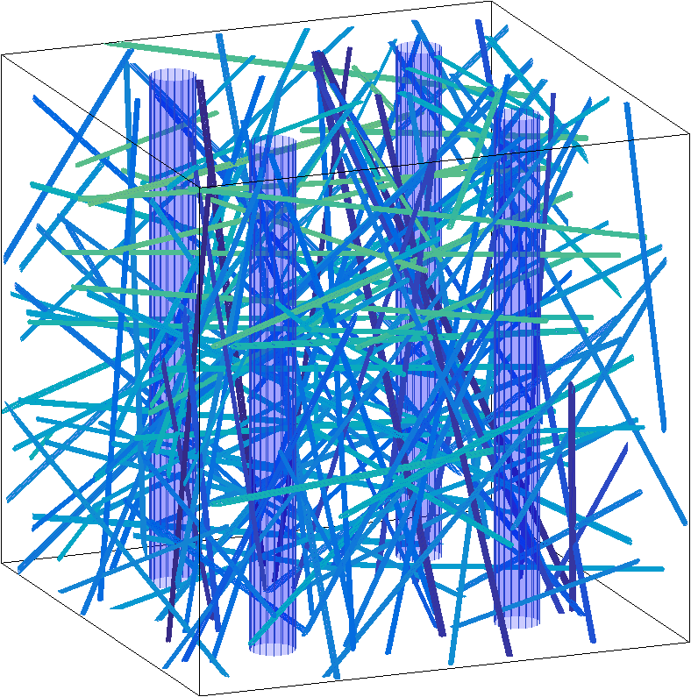
Geometry of the SE-DSC problem
Now, we consider the geometry of the problem within a single voxel
The geometry is simulated as follows:
Create an isotropic vascular bed of small vessels
Add anisotropic large vessels to simulate large vasculature running in parallel to WM tracks*
These large vessels introduce the possibility of angular dependence
*Okudera, et al. Neuropathology (1999)

Slide 11
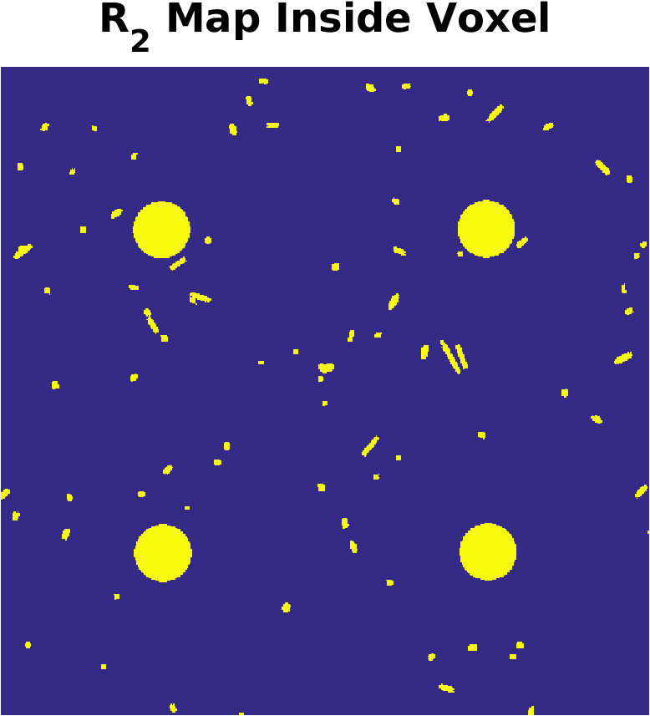
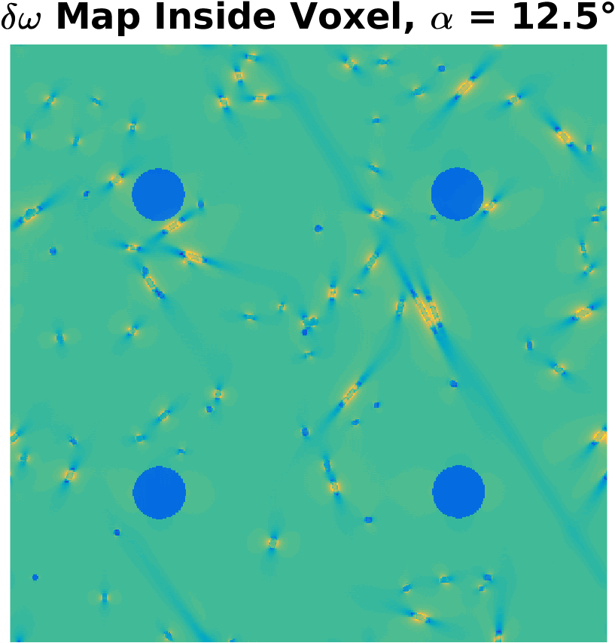


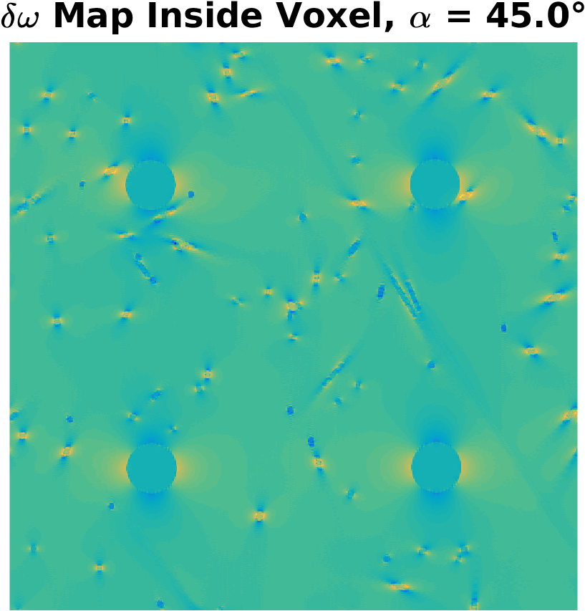
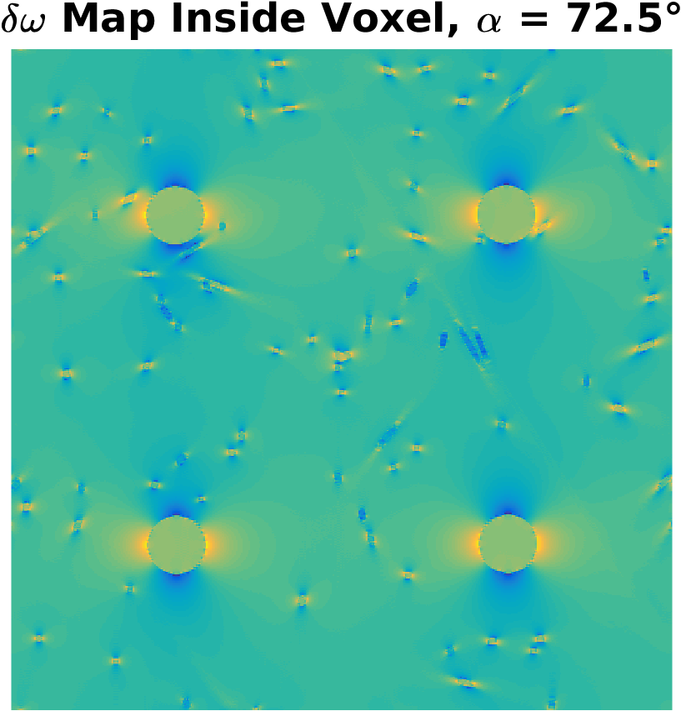
Geometry of the SE-DSC problem
Given the geometry, we now calculate
Each are piecewise constant, taking different values in tissue and in blood
Value in blood depends on CA
Choose a WM fibre angle
This represents the orientation of the whole voxel
Calculate the dephasing:

Slide 12



Formalizing the SE-DSC problem
Initialize
Choose parameters: BVF, iBVF, CA concentration
Calculate geometry:
Initialize magnetization:
Propagate
Solve the Bloch-Torrey equation for $M(\vec{r},TE)$
Sum
The final signal is given by:

Slide 13

Formalizing the SE-DSC problem
Repeat
The simulation is executed for each angle in the range both with and without contrast agent
Fit
Given compare with observed data
If fit is poor, adjust parameters (BVF, iBVF, CA) and go to step 1

Slide 14
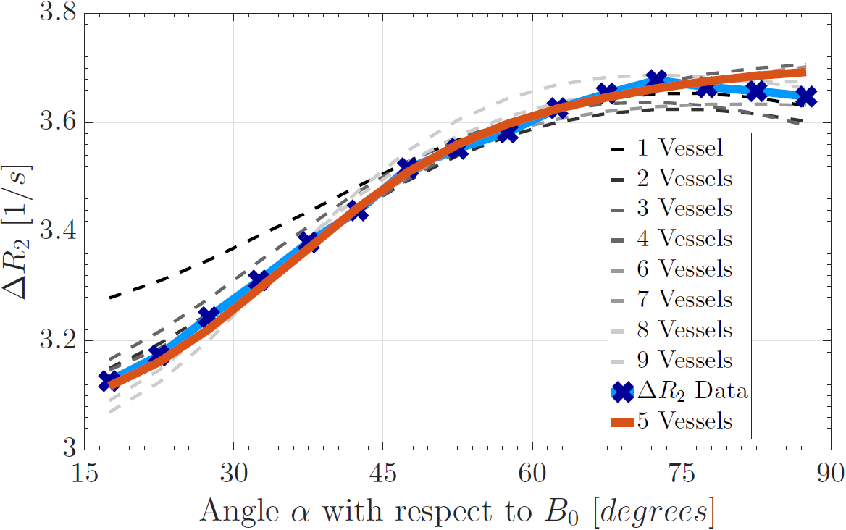
SE-DSC SIMULATION Results and Discussion
Simulation matches Actual Curve well
Simulation was ran for a variable number of large anisotropic vessels
Best results occurred for 4-6 anisotropic vessels
Corresponding radii of approx. 90 μm, 80 μm, 70 μm
Resulting Fit Parameters:
BVF: 3.49%
iBVF: 2.30%
CA: 6.23 mM

Slide 15
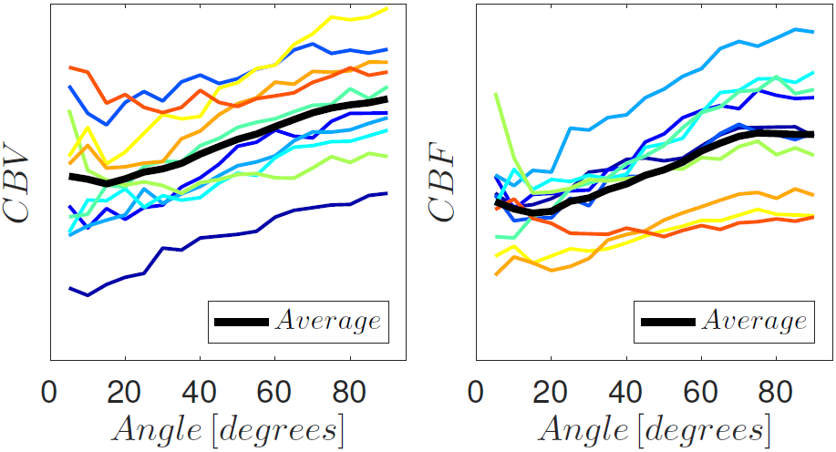
SE-DSC SIMULATION Results and Discussion
Quantities that are derived from R₂ are affected, too!
Perfusion parameters such as CBV and CBF exhibit orientation dependencies on the order of 20%, similar to R₂

Slide 16


Acknowledgements
UBC MRI Research Centre
Research performed as a Co-op student under Dr. Alexander Rauscher
NSERC Undergraduate Student Research Award
Provided funding for my Co-op research term
University of British Columbia

