Slide 1

Fast solutions to the bloch-torrey partial differential equation
Simulation of Cerebral Magnetization
Jonathan Doucette

Slide 2


The Bloch-TorRey Equation
The Bloch-Torrey equation is a fundamental equation in MRI physics which describes how the complex transverse magnetization changes through time
Where
Therefore, this problem must be solved in complex variables
$$\frac{dM}{dt}=D∇^{2}M−\left(R_{2}+iδω\right)M$$
$$M≝M_{x}+iM_{y}$$

Slide 3
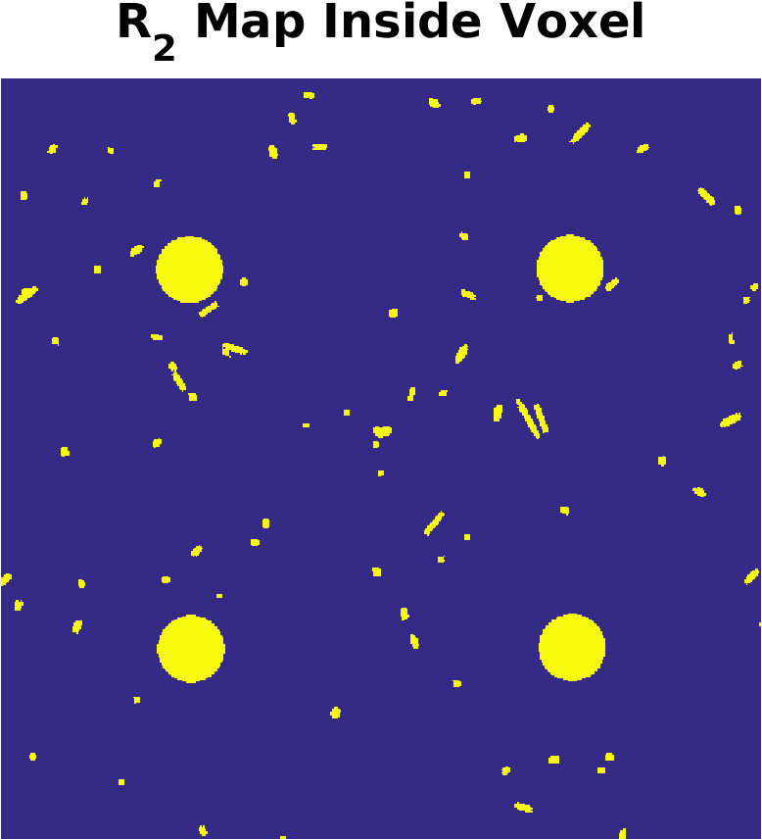
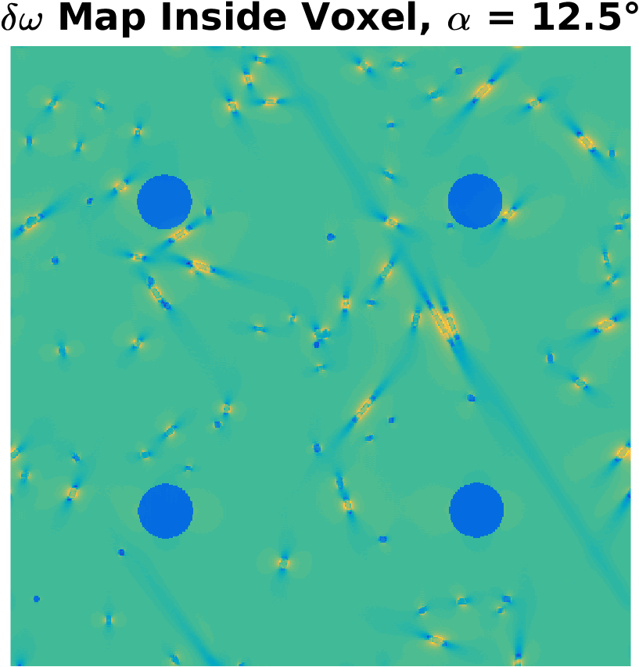

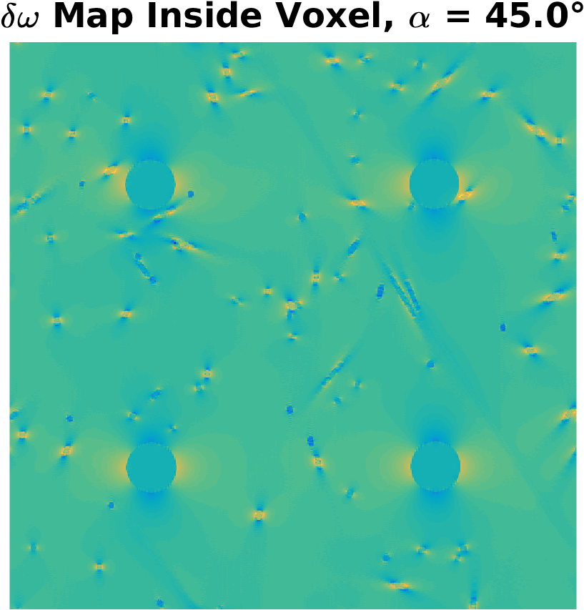
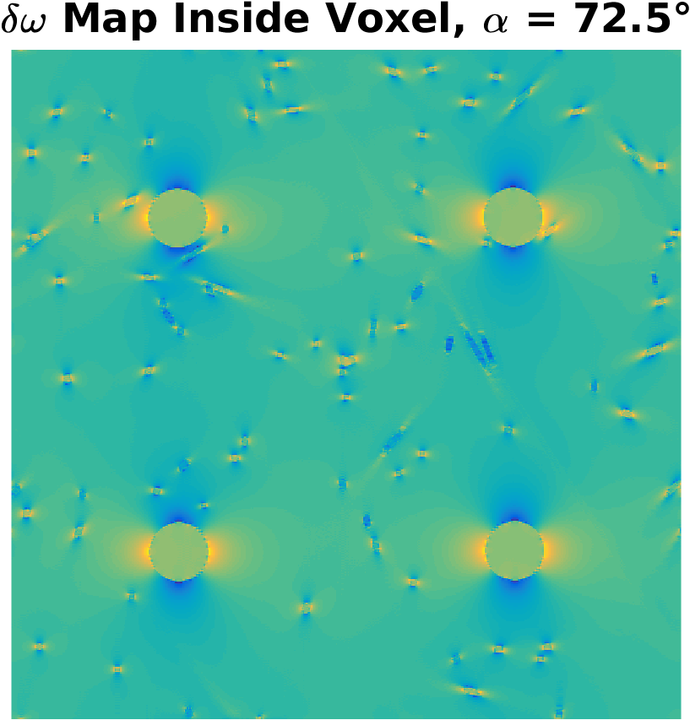
Geometry
Equation is solved in a finely discretized 3D box, called a “voxel”
is piecewise constant, and is piecewise smooth
Problem is very discontinuous!

Slide 4
FAST SOLutions
In addition to solving the equation, the resulting signal (integral of M) must be fit to observed data
Involves thousands of system solves

Slide 5


FAST SOLutions
Currently, the best trade off of accuracy vs. speed is to use (relatively crude) “splitting methods”
Essentially, based on the approximation
For linear operators A and B
We take $A=−(R_{2}+iδω)$ and $B=D∇^{2}$, and use the fact that the action of the exponential of $D∇^{2}t$ (i.e. the solution of the heat equation) is the convolution with a Gaussian kernel, and can be performed efficiently via the FFT
$$e^{\left(A+B\right)t}≈e^{\frac{At}{2}}e^{Bt}e^{\frac{At}{2}}$$

