Slide 1
Hypermedia Design
Web 420
Bellevue University
Jonathan Disla

Slide 2
Business Use Case
Pembrook college needs a system for students to submit assignments
The old system did not have a good way to track assignment submission
Students found the old system confusing and outdated due to the lack of tracking of assignments
Would need an easier way to track assignments
The formats necessary in a submission will be provided
A student shall be able to EDIT their submission before the assignemtn submittal time

Slide 3
Use Case Requisites
A system to allow students to submit course work
Assigned course work shall be displayed per user
Track submitted or assignements due
Allow different types of data to be submitted (text/file)
Assignments can be edited
Allow user to save draft

Slide 4
Semantic Descriptors
A class or list of classes
An assignment
Title of assignment
Assignment descriptions
Additional files provided by instructor
Input including text/file or other formats
Cancel, save, submit options

Slide 5
State Diagram
User has logged in and enters the classes endpoint
The assigned classes are displayed
Assignments are only displayed if due, else it is not displayed
The assignment displays the instructions and ways to complete it
If additional files exists, the user can view them
If before deadline for assigment submission user can edit assignment else only able to submit

Slide 6
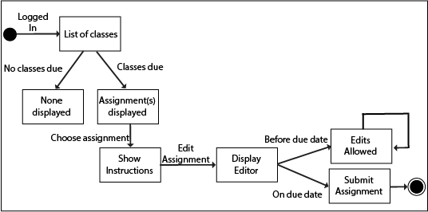
State Diagram

Slide 7
Reconciliation
Simplify the first state as just a class
The user due date is a yes or a has a third (pending) choice
Change first condition to is due
Change second condition to not due
Third condition pending is not necesarily considered
Drafts are indpendent of due condition

Slide 8
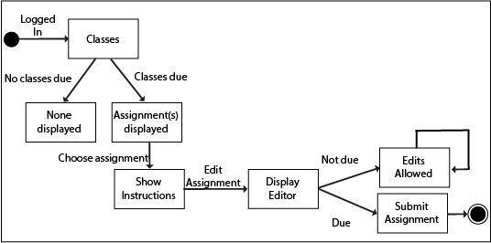
Rencociled Names

Slide 9
Media type
The media type shall be simple
The media type shall be readible
The media type should be handled easily in the server and client
The media type should be quick to parse
XML and Collection+JSON are the two two choices
JSON shall be selected as framework is specific

Slide 10
Profile: Link relations
The list of classe route contains url’s of each class
A no assignemtn due route displays no assignments
After checking due assignments, each assignment has a link to show the instructions
The instructions link to editing an assignment for submission
The editor page contains the save, submit and cancel routes
The save route checks if due date is not reached yet

Slide 11
Implementation
The PHP framework Laravel shall be used for implementation
Artisan allows for an easily created user route on the database
Tables must include classes and assignment formats
Due dates table allows for the updating of assignments
Use CSRF tokens to ensure secure when editing and submitting
The submission controller should route back to assignemtns

Slide 12
Publication
Home page URL established
Documentation placed in: www.submitassignment/api/doc
Register the media type with IANA
For due use: api/due/
Else use: api/notdue/
An editable route available when assignment is not due

Slide 13
ROI
Education in integration and usage
Application is handled in house
JSON is the endpoint environment
An integration is necessary instead of just a connection due to the amount of bulk data
Time to market going for speed employing both features and integrations
An editable route available when assignment is not due

