Slide 1
Find my electorate
Spatial web app
By Jonathan Doig

Slide 2
Skills demonstrated
Analysis & software design
Interface design – wireframes & SVG
Data wrangling - spreadsheets
Python scripting
Javascript + CSS3 + HTML
Web cartography (ArcGIS for Javascript)

Slide 3
The problem
People want to know:
  Who their MP is
  Who to vote for
So they need to know their electorate
  Boundaries change
  Boundaries cut through postcodes and localities
No complete solution is available
  Most websites just offer a choice of electorates for your postcode
  Even the AEC says “contact us” in these cases

Slide 4
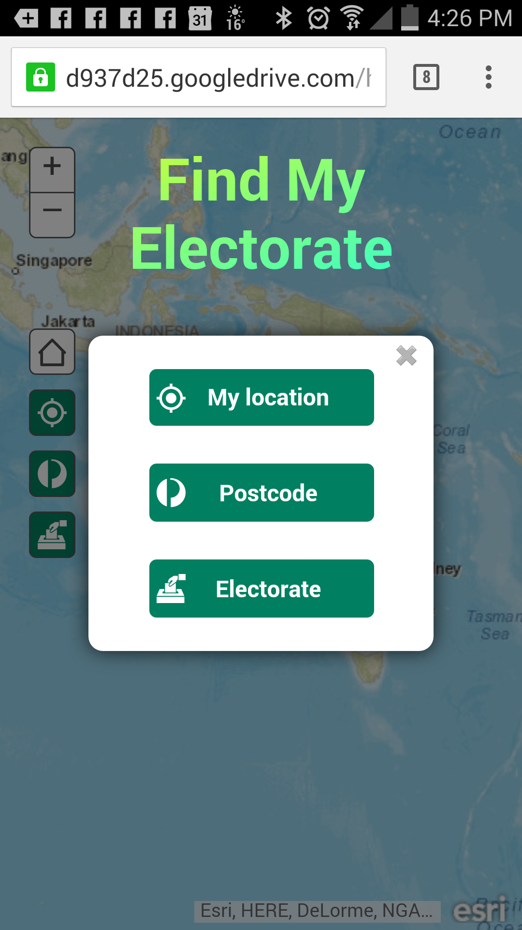
The solution

Slide 5
Source data
AEC website:
  Electoral boundaries (shapefiles)
  Postcodes, localities, electorates (HTML tables)
  Candidates (csv)
Party websites:
  Candidate photos (JPG & PNG)
  Candidate pages (URLs)
ArcGIS Online:
  Basemap (tiled map service)

Slide 6
Programs
Postcodes2Electorates spreadsheet
Candidates spreadsheet
scrapeHtml.py
sortCands.py
geocode.py
findelec.js

Slide 7


Data flow
Party websites
Google Drive
Photos
(rename)
Photos
AEC
sortCands.py
electorates.json
Candidates
parties.json
Localities
scrapeHTML.py
geocode.py
localities.json
ArcGIS Online
Map
Electoral boundaries
Feature service

Slide 8
Locality logic
Select
postcode
Whole postcode in one electorate?
Many localities in one electorate?
Group
localities
Select
locality
Whole locality in one electorate?
Click map
ELECTORATE

