Slide 1
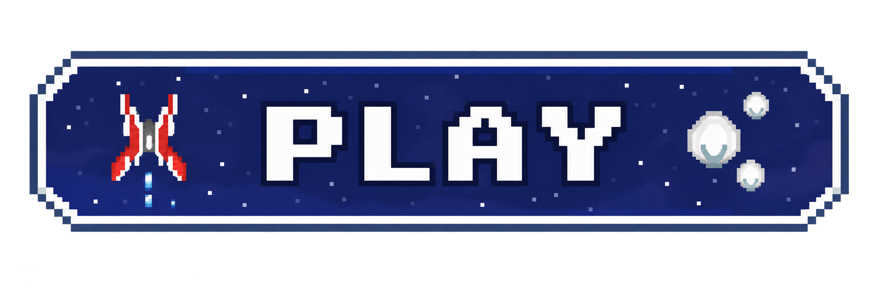

Alien Invasion
JonD Development | Jonathan Dotse

Slide 2
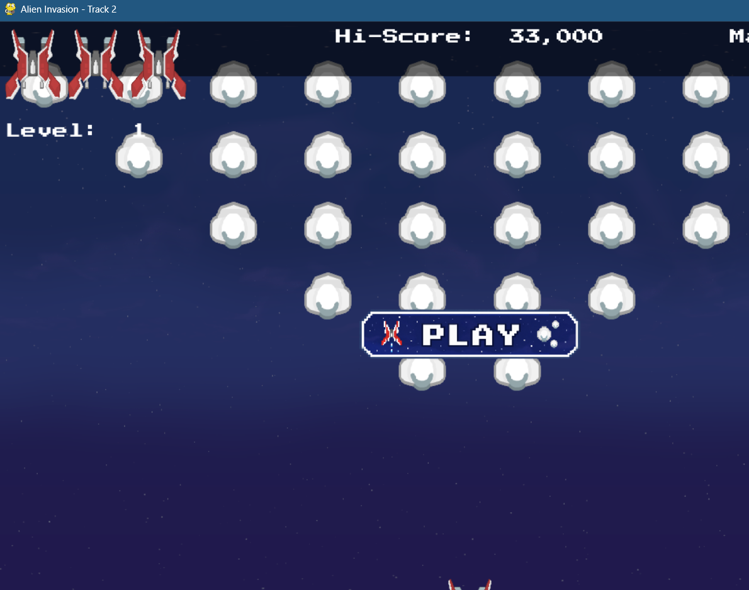
Track: Custom Asset
Replaced core game assets with custom-designed assets(player ship, alien sprites, background).
Integrated new image formats and adjusted scaling
Updated visuals while preserving original gameplay loop

Slide 3
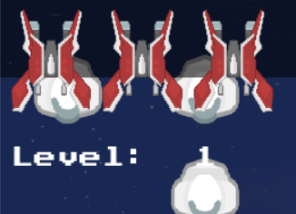
Architectural Successes
Clean class Integration
Single Responsibility Principle
Open/Closed Principle
Consistent design Flow

Slide 4

Technical Challenges
Time management
Non-Rectangular Collision Issues
Bug Fixing

Slide 5
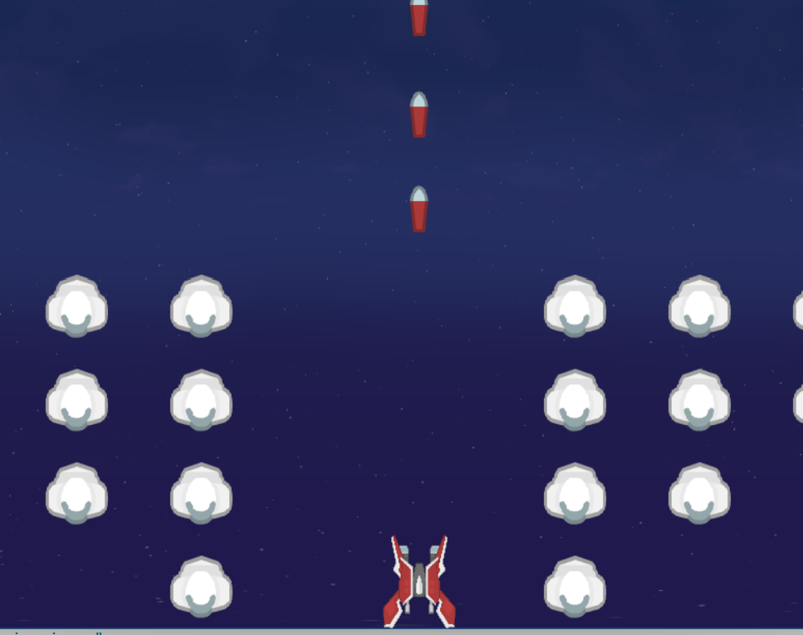
Version Control & Risk Management
Frequent commits
Asset loading errors
Time pressure

Slide 6
Actionable Lessons
Visual Changes Still Require Architectural Thinking
Debugging is faster when you commit small and Test often

