Slide 1
MAIN SLIDES

Slide 2

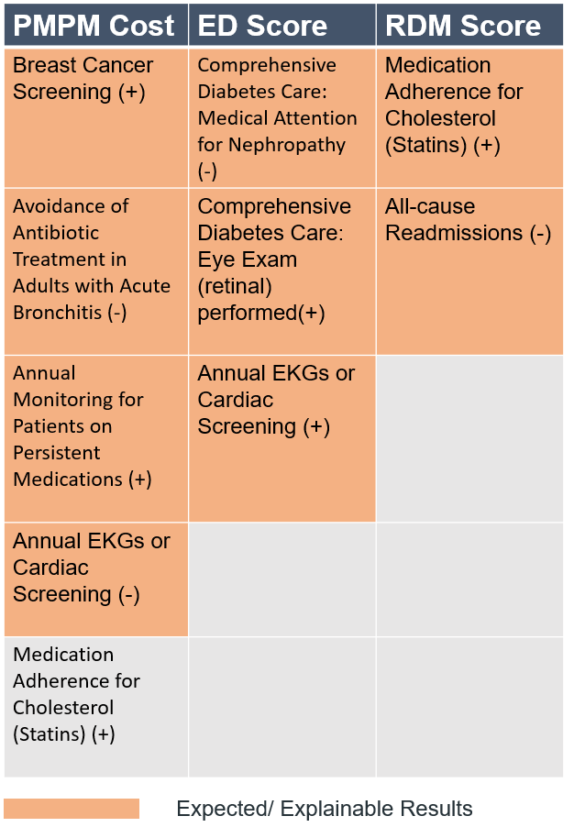
Forward Stepwise Selection
Notes:
Medication adherence should not be orange, correlation matrix (just with breast cancer screening collinearities)
Ekg and eye exam in ED score should be orange
Breast cancer screening highly collinear with almost everything
Potential metrics to look out for

Slide 3
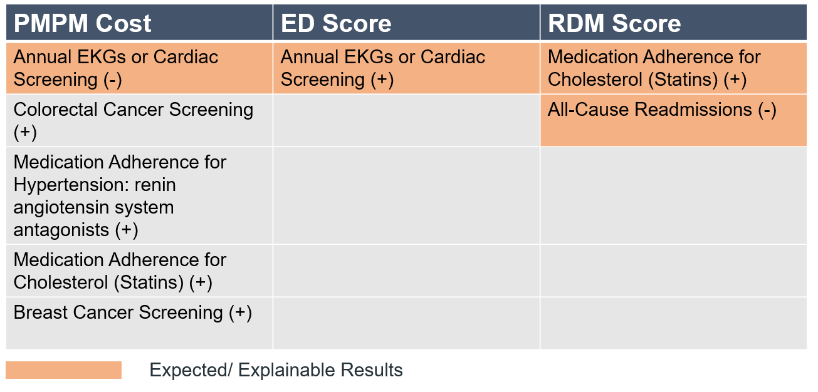
Lasso Regression
Investment in screening may yield a long-term return notwithstanding short-term cost increases.
Notes:
The quality metrics increase the PMPM cost in short term but probably drive down costs long term.
Cardiac issues are short term diseases and hence they might affect the cost sooner than breast or colorectal screening.

Slide 4
APPEDIX SLIDES

Slide 5
T-test Results by Region (α = 0.05)
PMPM Score
PA regions had lower scores than all other regions
WPA had higher scores than NEPA
QA Score
PA had a much higher score than all other regions
WPA greatly outperformed NEPA and WV

Slide 6
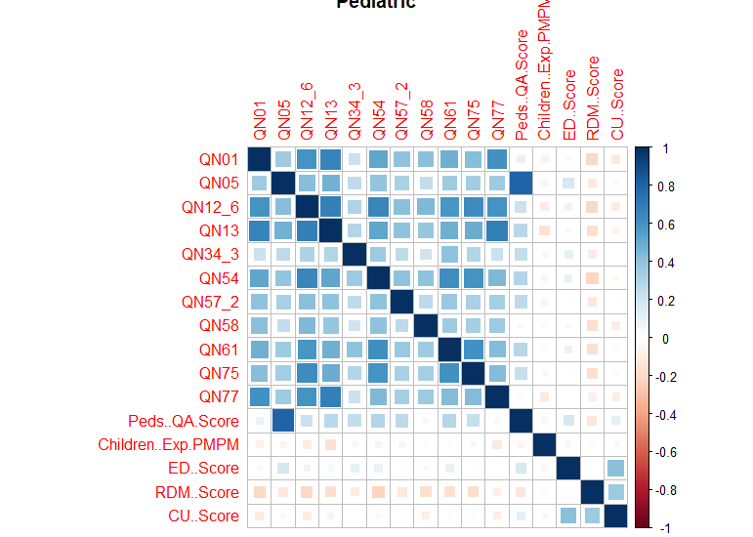
Pediatric Correlation
Notes:
The quality metrics increase the PMPM cost in short term but probably drive down costs long term.
Cardiac issues are short term diseases and hence they might affect the cost sooner than breast or colorectal screening.

Slide 7
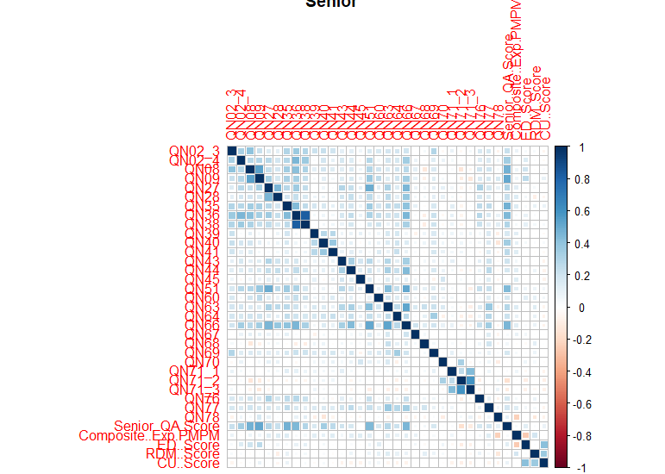

Slide 8
Senior Correlation
Notes:
The quality metrics increase the PMPM cost in short term but probably drive down costs long term.
Cardiac issues are short term diseases and hence they might affect the cost sooner than breast or colorectal screening.

Slide 9
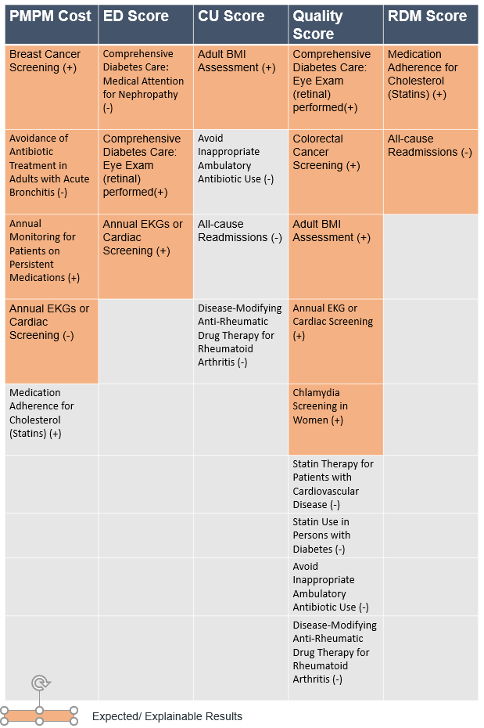
Forward Stepwise Selection
Notes:
Medication adherence should not be orange, correlation matrix (just with breast cancer screening collinearities)
Ekg and eye exam in ED score should be orange
Breast cancer screening highly collinear with almost everything
Potential metrics to look out for

Slide 10
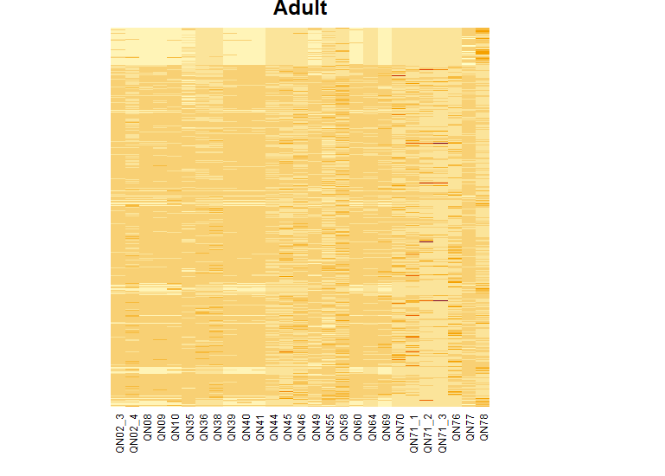
Adult Heatmap
Notes:
Medication adherence should not be orange, correlation matrix (just with breast cancer screening collinearities)
Ekg and eye exam in ED score should be orange
Breast cancer screening highly collinear with almost everything
Potential metrics to look out for

Slide 11
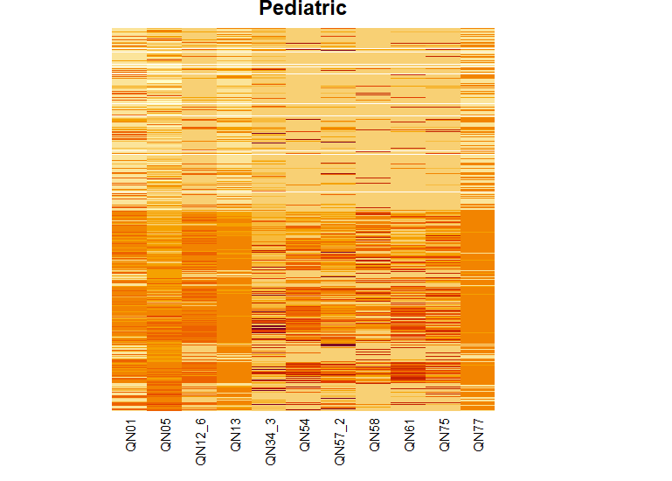
Pediatric Heatmap
Notes:
Medication adherence should not be orange, correlation matrix (just with breast cancer screening collinearities)
Ekg and eye exam in ED score should be orange
Breast cancer screening highly collinear with almost everything
Potential metrics to look out for

Slide 12
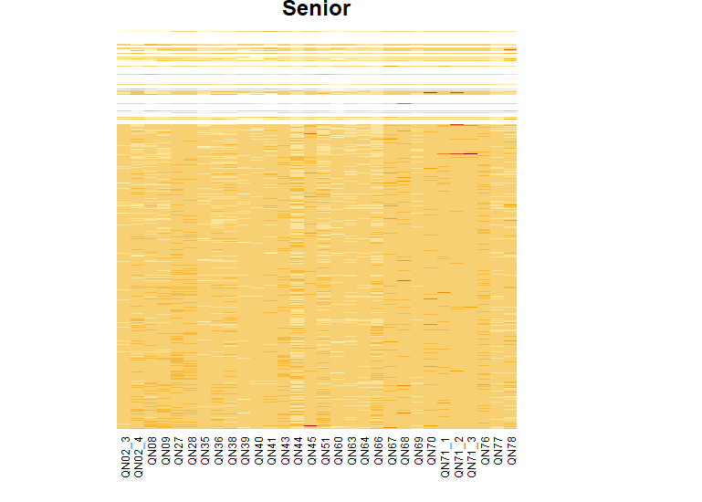
Senior Heatmap
Notes:
Medication adherence should not be orange, correlation matrix (just with breast cancer screening collinearities)
Ekg and eye exam in ED score should be orange
Breast cancer screening highly collinear with almost everything
Potential metrics to look out for

Slide 13
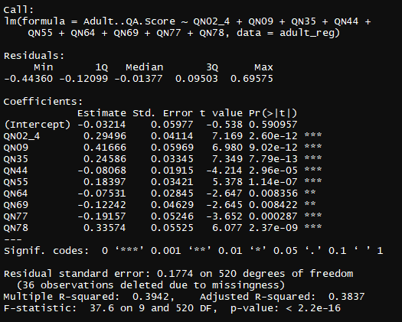
Adult QA Forward Stepwise
Notes:
Medication adherence should not be orange, correlation matrix (just with breast cancer screening collinearities)
Ekg and eye exam in ED score should be orange
Breast cancer screening highly collinear with almost everything
Potential metrics to look out for

Slide 14
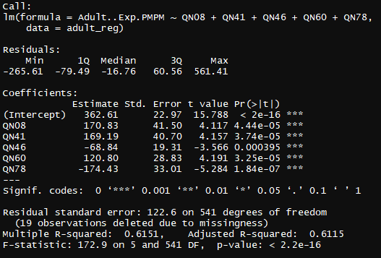
Adult PMPM Forward Stepwise
Notes:
Medication adherence should not be orange, correlation matrix (just with breast cancer screening collinearities)
Ekg and eye exam in ED score should be orange
Breast cancer screening highly collinear with almost everything
Potential metrics to look out for

Slide 15
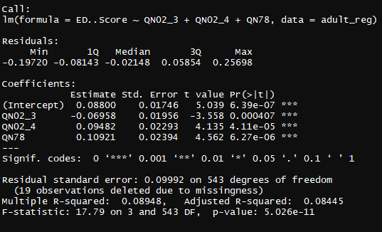
Adult ED Forward Stepwise
Notes:
Medication adherence should not be orange, correlation matrix (just with breast cancer screening collinearities)
Ekg and eye exam in ED score should be orange
Breast cancer screening highly collinear with almost everything
Potential metrics to look out for

Slide 16
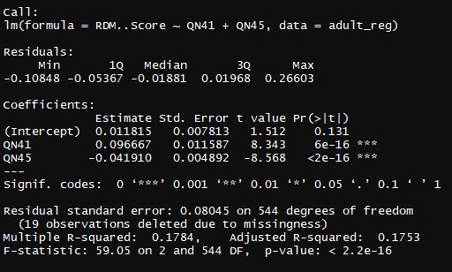
Adult RDM Forward Stepwise
Notes:
Medication adherence should not be orange, correlation matrix (just with breast cancer screening collinearities)
Ekg and eye exam in ED score should be orange
Breast cancer screening highly collinear with almost everything
Potential metrics to look out for

Slide 17
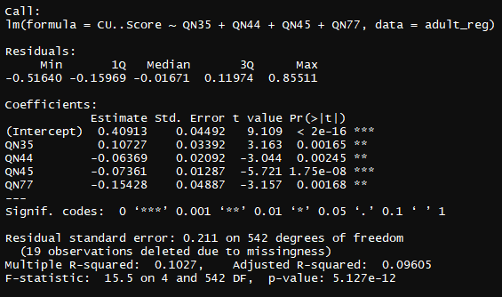
Adult CU Forward Stepwise
Notes:
Medication adherence should not be orange, correlation matrix (just with breast cancer screening collinearities)
Ekg and eye exam in ED score should be orange
Breast cancer screening highly collinear with almost everything
Potential metrics to look out for

Slide 18
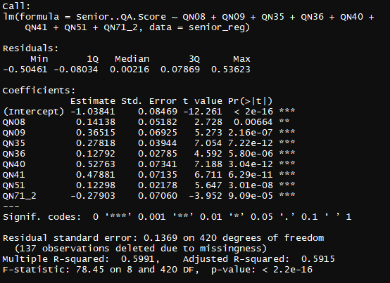
Senior QA Forward Stepwise
Notes:
Medication adherence should not be orange, correlation matrix (just with breast cancer screening collinearities)
Ekg and eye exam in ED score should be orange
Breast cancer screening highly collinear with almost everything
Potential metrics to look out for

Slide 19
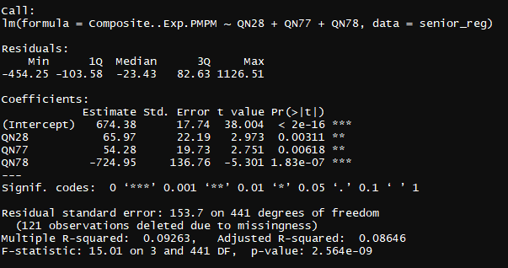
Senior PMPM Forward Stepwise
Notes:
Medication adherence should not be orange, correlation matrix (just with breast cancer screening collinearities)
Ekg and eye exam in ED score should be orange
Breast cancer screening highly collinear with almost everything
Potential metrics to look out for

Slide 20
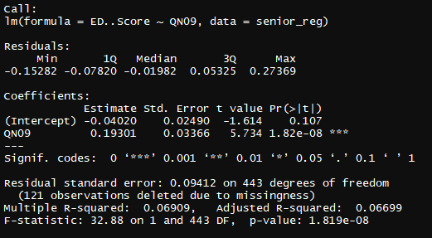
Senior ED Forward Stepwise
Notes:
Medication adherence should not be orange, correlation matrix (just with breast cancer screening collinearities)
Ekg and eye exam in ED score should be orange
Breast cancer screening highly collinear with almost everything
Potential metrics to look out for

Slide 21
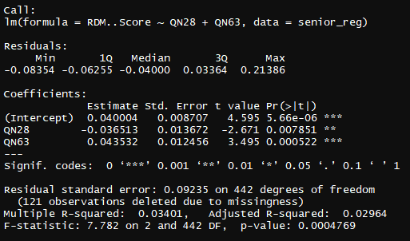
Senior RDM Forward Stepwise
Notes:
Medication adherence should not be orange, correlation matrix (just with breast cancer screening collinearities)
Ekg and eye exam in ED score should be orange
Breast cancer screening highly collinear with almost everything
Potential metrics to look out for

Slide 22
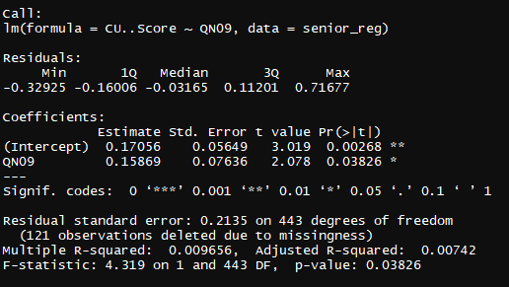
Senior CU Forward Stepwise
Notes:
Medication adherence should not be orange, correlation matrix (just with breast cancer screening collinearities)
Ekg and eye exam in ED score should be orange
Breast cancer screening highly collinear with almost everything
Potential metrics to look out for

Slide 23
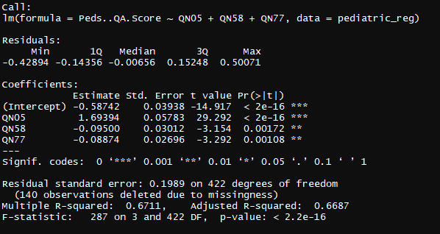
Pediatric QA Forward Stepwise
Notes:
Medication adherence should not be orange, correlation matrix (just with breast cancer screening collinearities)
Ekg and eye exam in ED score should be orange
Breast cancer screening highly collinear with almost everything
Potential metrics to look out for

Slide 24
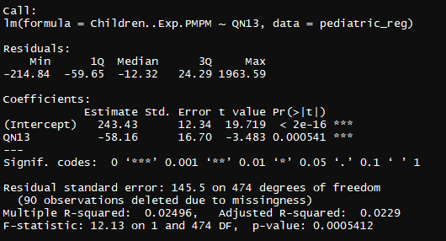
Pediatric PMPM Forward Stepwise
Notes:
Medication adherence should not be orange, correlation matrix (just with breast cancer screening collinearities)
Ekg and eye exam in ED score should be orange
Breast cancer screening highly collinear with almost everything
Potential metrics to look out for

Slide 25
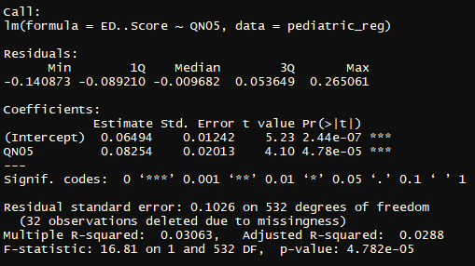
Pediatric ED Forward Stepwise
Notes:
Medication adherence should not be orange, correlation matrix (just with breast cancer screening collinearities)
Ekg and eye exam in ED score should be orange
Breast cancer screening highly collinear with almost everything
Potential metrics to look out for

Slide 26
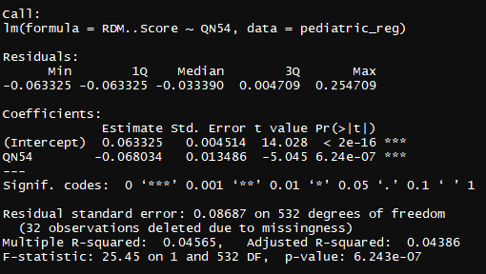
Pediatric RDM Forward Stepwise
Notes:
Medication adherence should not be orange, correlation matrix (just with breast cancer screening collinearities)
Ekg and eye exam in ED score should be orange
Breast cancer screening highly collinear with almost everything
Potential metrics to look out for

Slide 27
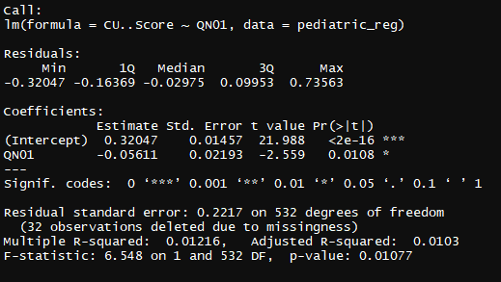
Pediatric CU Forward Stepwise
Notes:
Medication adherence should not be orange, correlation matrix (just with breast cancer screening collinearities)
Ekg and eye exam in ED score should be orange
Breast cancer screening highly collinear with almost everything
Potential metrics to look out for

Slide 28
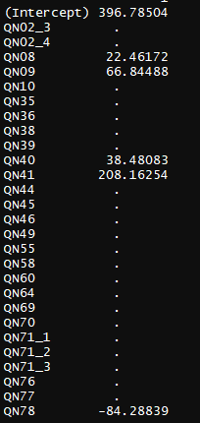
Adult PMPM LASSO
Notes:
Medication adherence should not be orange, correlation matrix (just with breast cancer screening collinearities)
Ekg and eye exam in ED score should be orange
Breast cancer screening highly collinear with almost everything
Potential metrics to look out for

Slide 29
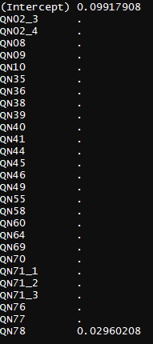
Adult ED LASSO
Notes:
Medication adherence should not be orange, correlation matrix (just with breast cancer screening collinearities)
Ekg and eye exam in ED score should be orange
Breast cancer screening highly collinear with almost everything
Potential metrics to look out for

Slide 30
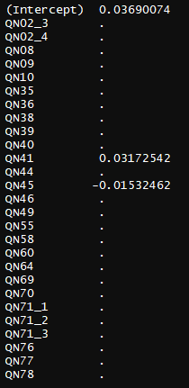
Adult RDM LASSO
Notes:
Medication adherence should not be orange, correlation matrix (just with breast cancer screening collinearities)
Ekg and eye exam in ED score should be orange
Breast cancer screening highly collinear with almost everything
Potential metrics to look out for

Slide 31
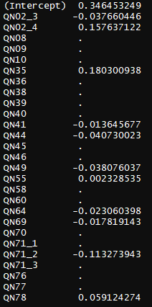
Adult QA LASSO
Notes:
Medication adherence should not be orange, correlation matrix (just with breast cancer screening collinearities)
Ekg and eye exam in ED score should be orange
Breast cancer screening highly collinear with almost everything
Potential metrics to look out for

Slide 32
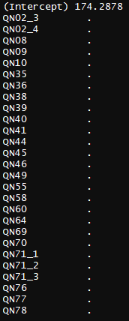
Pediatric PMPM LASSO
Notes:
Medication adherence should not be orange, correlation matrix (just with breast cancer screening collinearities)
Ekg and eye exam in ED score should be orange
Breast cancer screening highly collinear with almost everything
Potential metrics to look out for

Slide 33
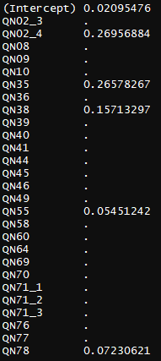
Senior QA LASSO
Notes:
Medication adherence should not be orange, correlation matrix (just with breast cancer screening collinearities)
Ekg and eye exam in ED score should be orange
Breast cancer screening highly collinear with almost everything
Potential metrics to look out for

Slide 34
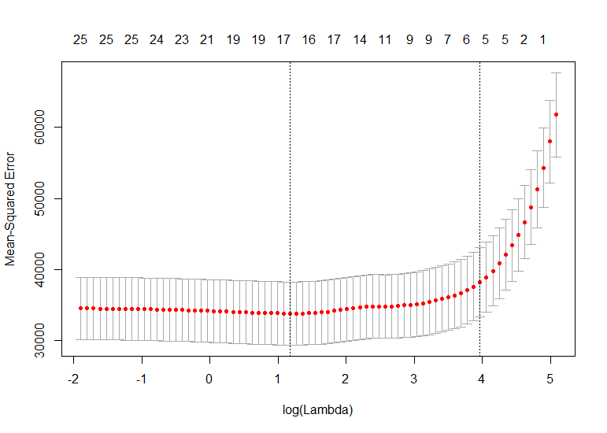
Adult PMPM Representative LASSO Cross Vaidation
Notes:
Medication adherence should not be orange, correlation matrix (just with breast cancer screening collinearities)
Ekg and eye exam in ED score should be orange
Breast cancer screening highly collinear with almost everything
Potential metrics to look out for

Slide 35
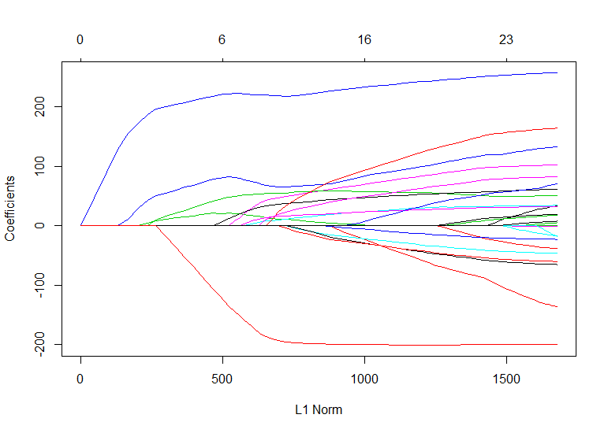
Adult PMPM Representative LASSO L1 Plot
Notes:
Medication adherence should not be orange, correlation matrix (just with breast cancer screening collinearities)
Ekg and eye exam in ED score should be orange
Breast cancer screening highly collinear with almost everything
Potential metrics to look out for

