Slide 1
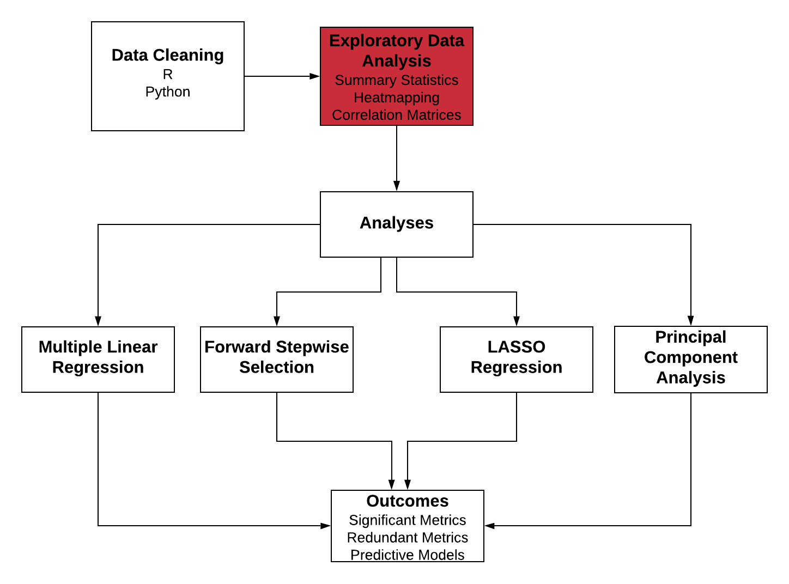
Quantitative Methods

Slide 2
Descriptive Statistics
Overall distribution of scores
Check if scores are significantly different in regions (could be attributed to rural vs urban, other social determinants) - slice it based on population
Check if scores were different per population

Slide 3
Many TPP Metrics are Collinear
Correlation tells us which metrics to include in analyses and gives info about their relationships
Most metrics had a relatively high degree of correlation
Outcomes showed no strong correlation with metrics or with each other
Need to choose methods that deal with collinearity well.
Too many metrics and outcome combinations to choose an effective subset manually

Slide 4
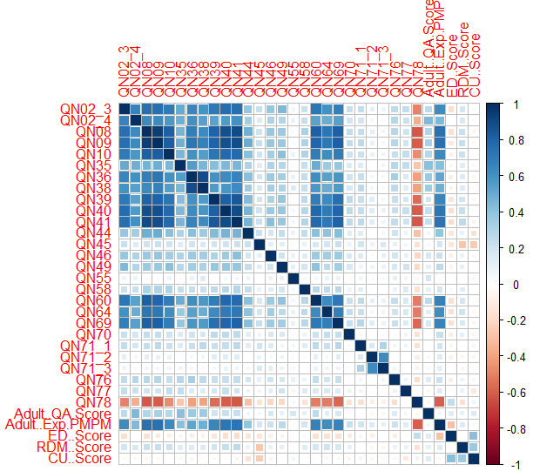
Adult Metric Correlation
Most metrics were correlated to a relatively high degree
This could lead to poor results in standard regression
Lasso regression and PCA can account for this problem

Slide 5
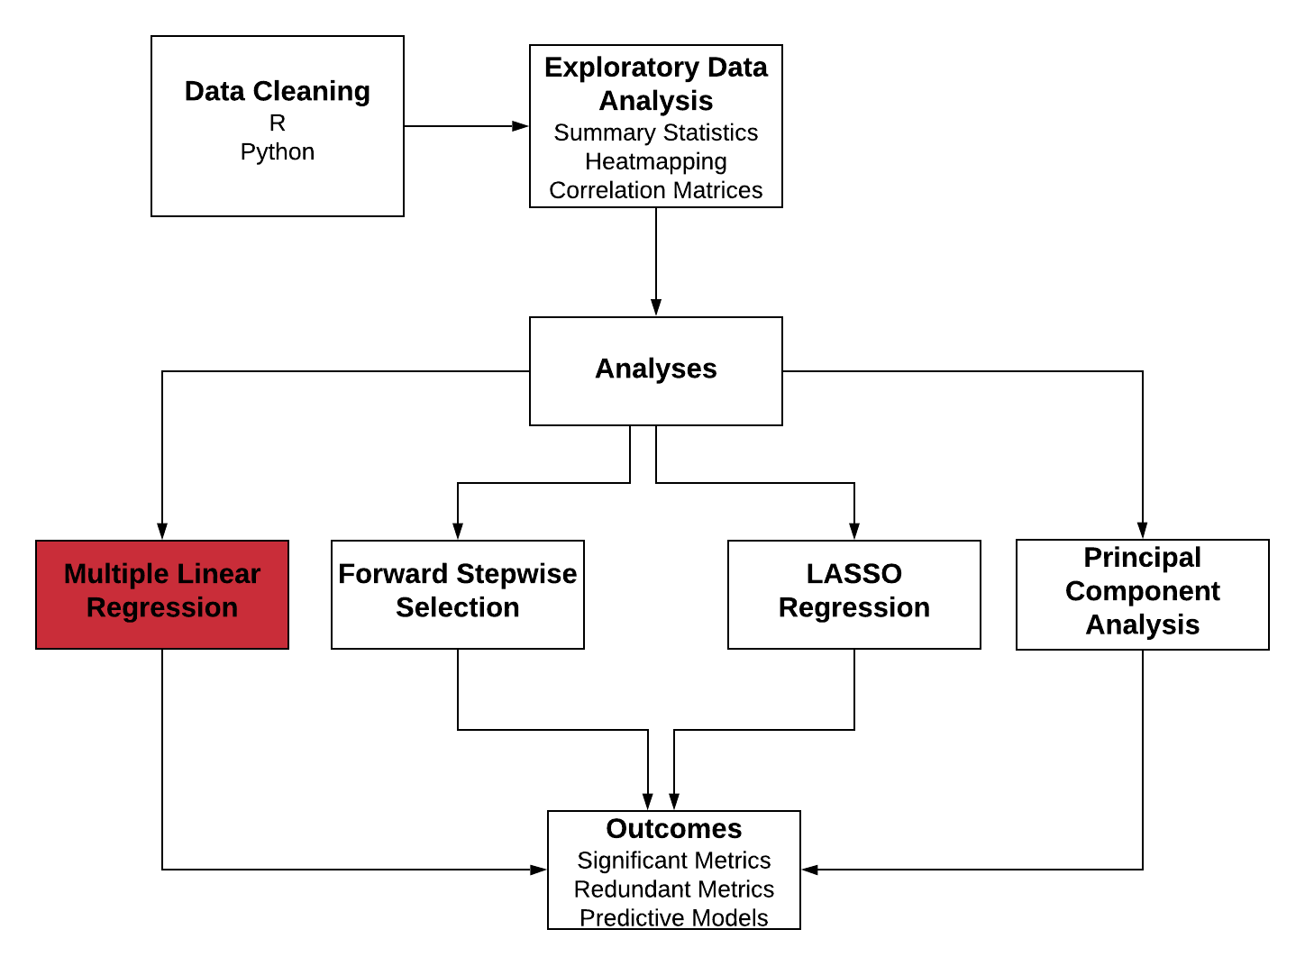
Quantitative Methods

Slide 6
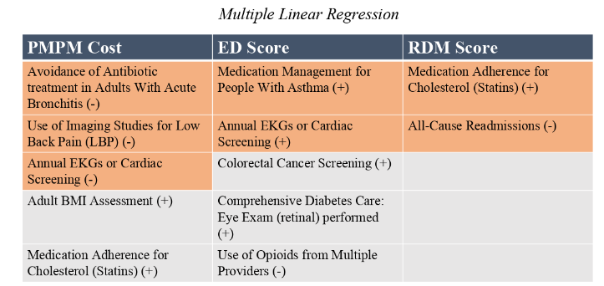

Multiple Linear Regression

Slide 7
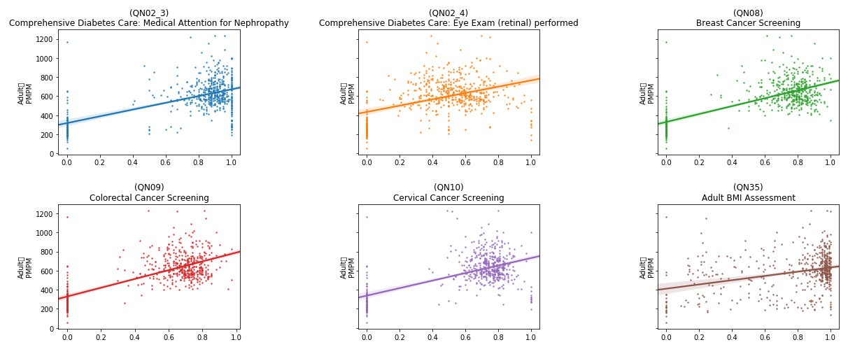
Rates vs. Adult PMPM
Adult
PMPM
Adult
PMPM
Adult
PMPM
Adult
PMPM
Adult
PMPM
Adult
PMPM
Rate
Rate
Rate

Slide 8
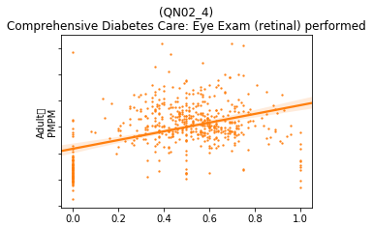
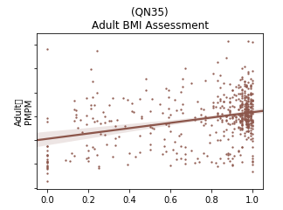
Rates vs. Adult PMPM, zoomed in
Adult
PMPM
Adult
PMPM
High variability
Low confidence

Slide 9
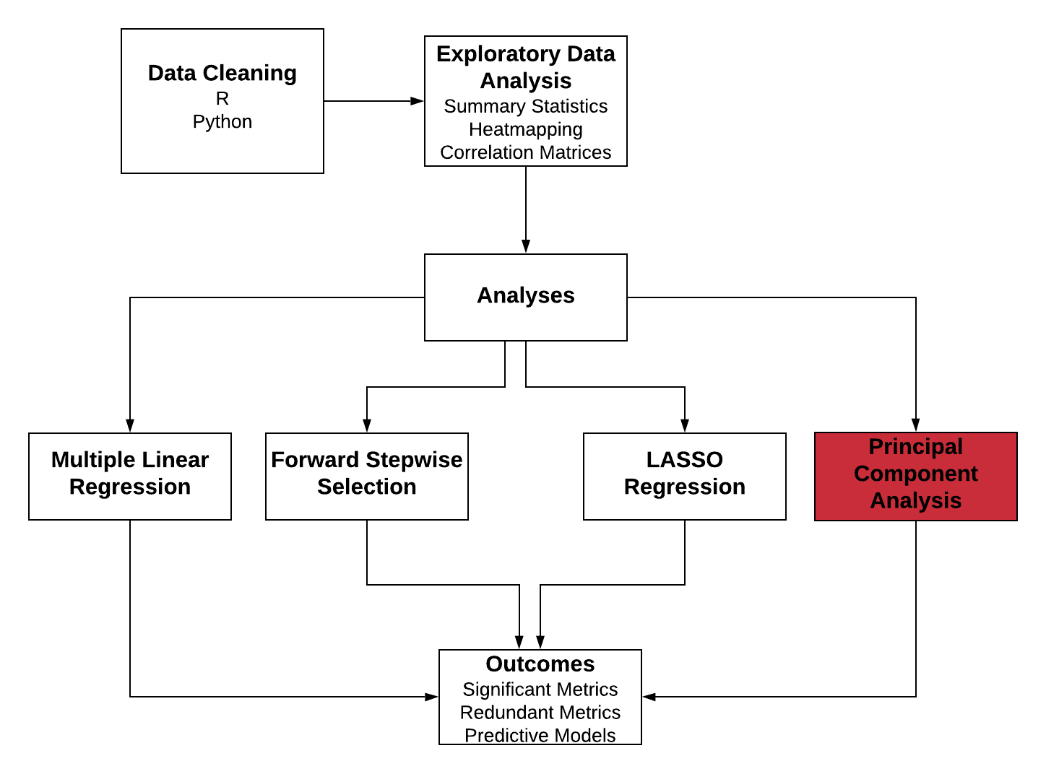
Quantitative Methods

Slide 10
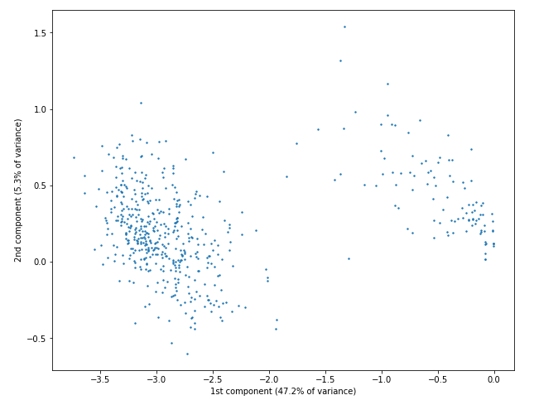
Principal Component Analysis
Top contributors to the first component, which explains 47.22% of the variance in the adult data:
QN09 - Colorectal Cancer Screening
QN08 - Breast Cancer Screening
QN41 - Drug Therapy for Rheumatoid Arthritis
QN40 - Medication Adherence for Cholesterol (Statins)
QN39 - Medication Adherence for Hypertension: RASA
Top contributors to the second component, which explains 5.3% of the variance in the adult data:
QN76 - Controlling High Blood Pressure
QN55 - Annual Monitoring for Patients on Persistent Medications
QN35 - Adult BMI Assessment

Slide 11
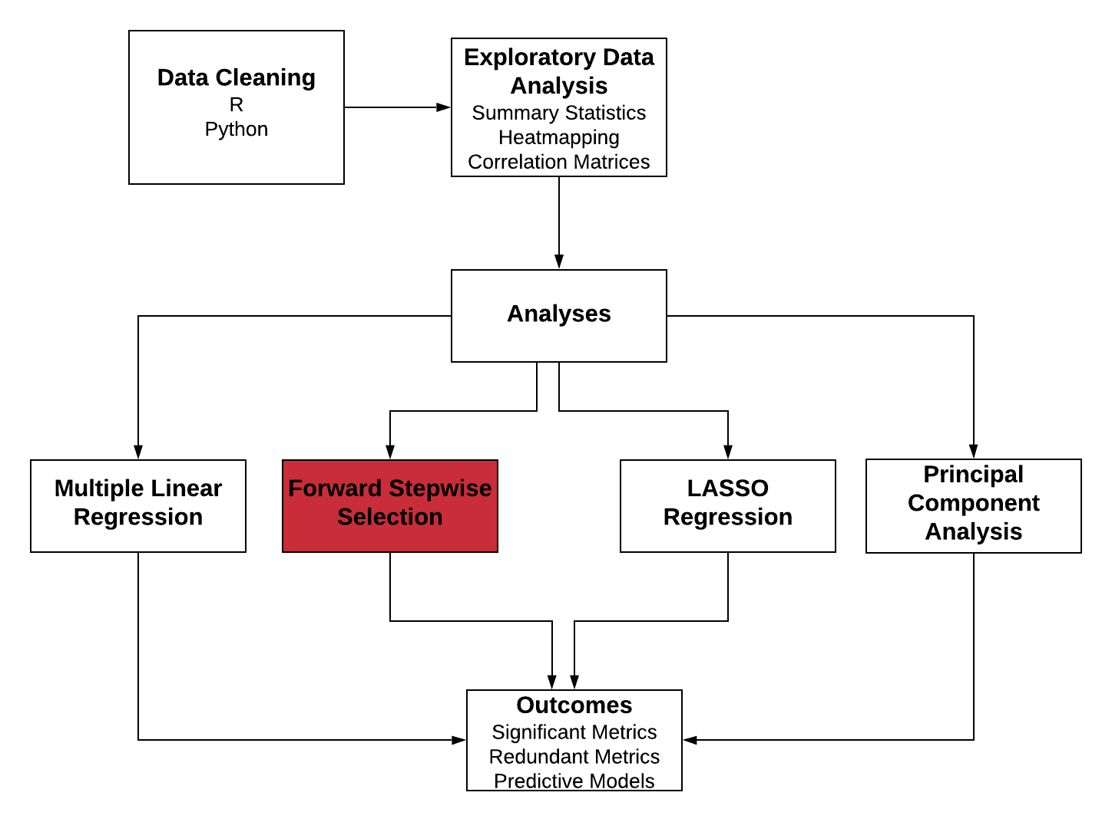
Quantitative Methods

Slide 12
Forward Stepwise Selection Improved Models
Adult Pop.: Selection usually cut 2-3 significant variables
7 cut from ED score
Senior Pop.: Usually cut between 0-2
Tended to have a lower number of significant metrics
Pediatric Pop.: Same as seniors

Slide 13
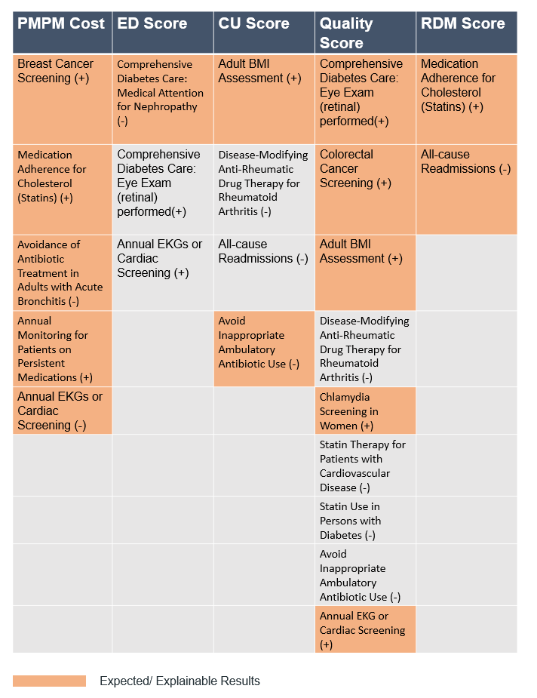
Forward Stepwise Selection

Slide 14
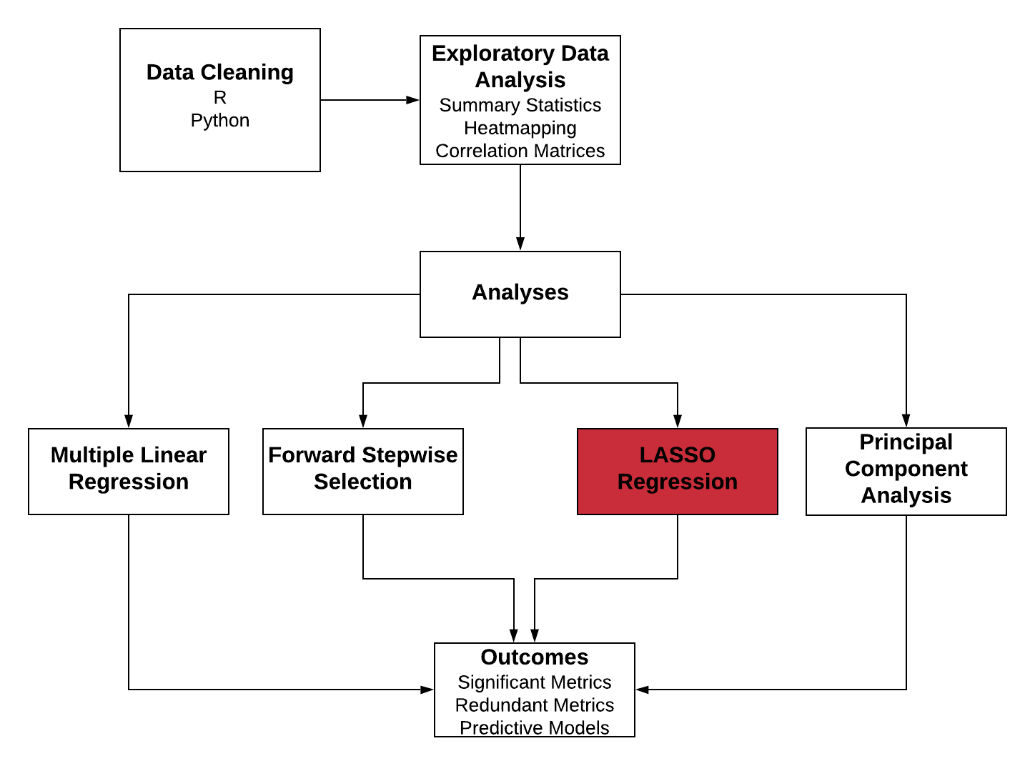
Quantitative Methods

Slide 15
LASSO Also Improved Variable Selection
Represents our best approximation of significant metrics
Generally agreed with our other regressions
ED only had 1 significant metric
Pediatric PMPM had none
In general, ED, RDM, and CU always had less metric associated compared to PMPM

Slide 16
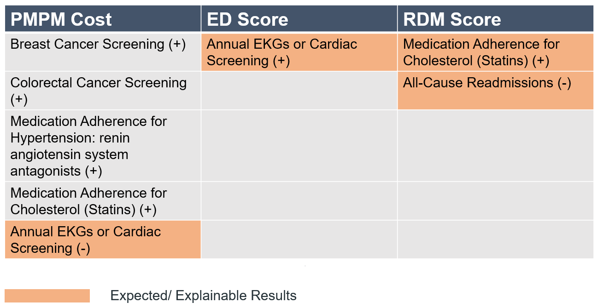
LASSO Results

Slide 17
APPENDIX SLIDES

Slide 18
T-test Results by Region (α = 0.05)
PMPM Score
PA regions had lower scores than all other regions
WPA had higher scores than NEPA
QA Score
PA had a much higher score than all other regions
WPA greatly outperformed NEPA and WV

