Slide 2
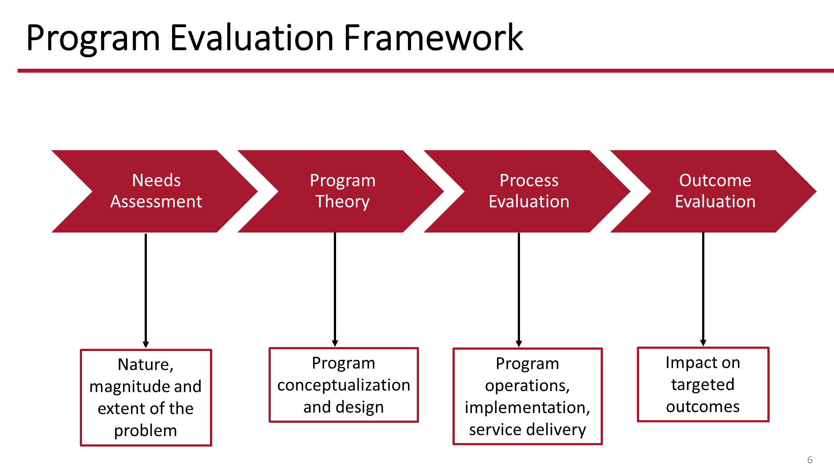
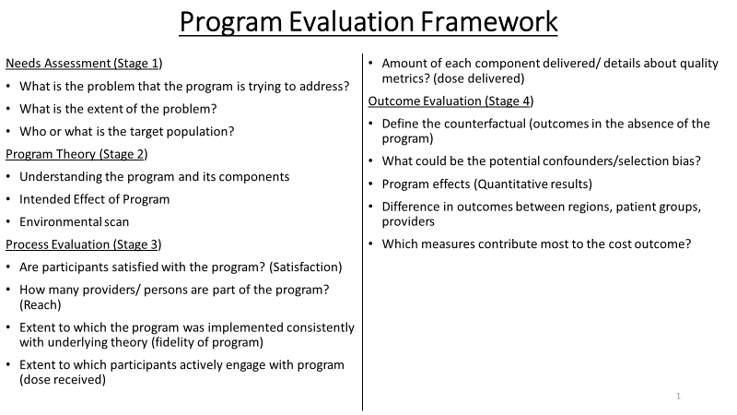
Notes:
Detailed framework and further readings included in appendix
This framework can be used in future evaluations of TPP

