Slide 1
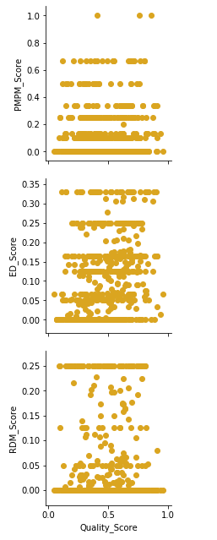
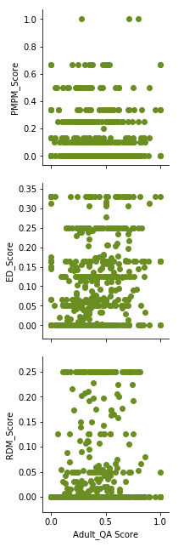
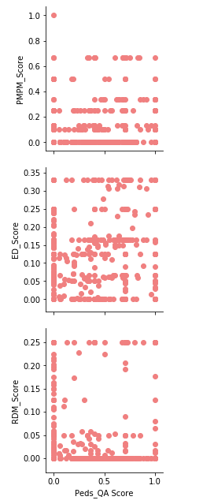
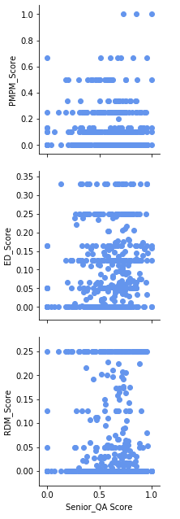
Quality vs Outcomes

Slide 2
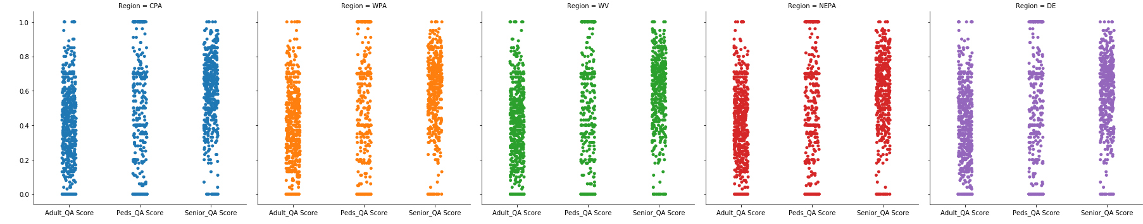
QA Score per Region – by pop

Slide 3
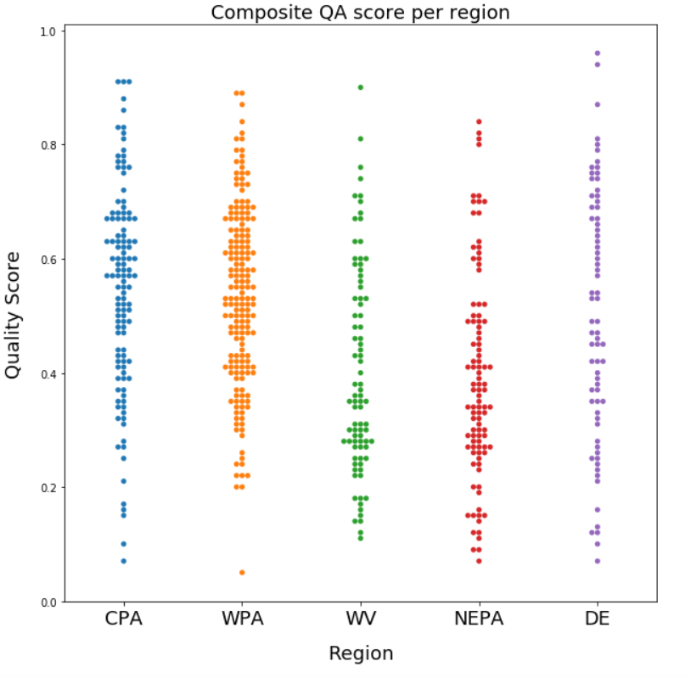
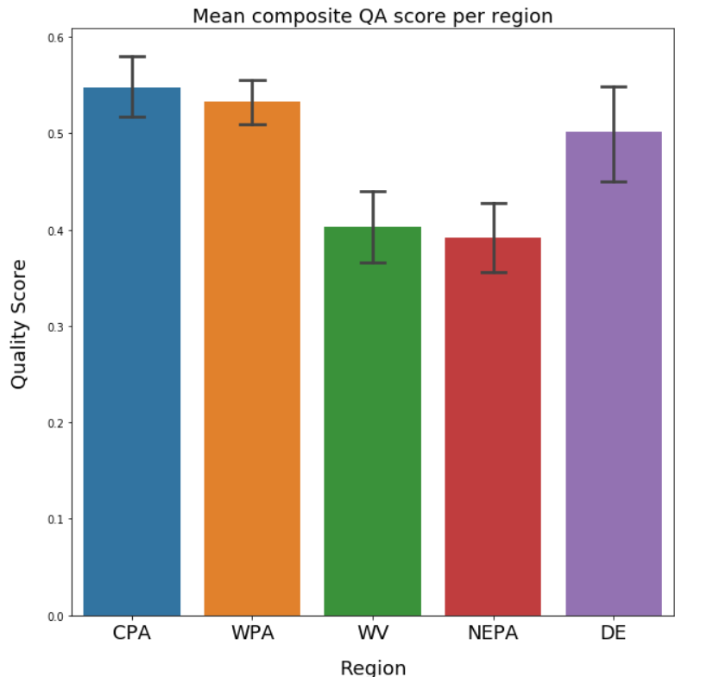
QA Score per Region

Slide 4
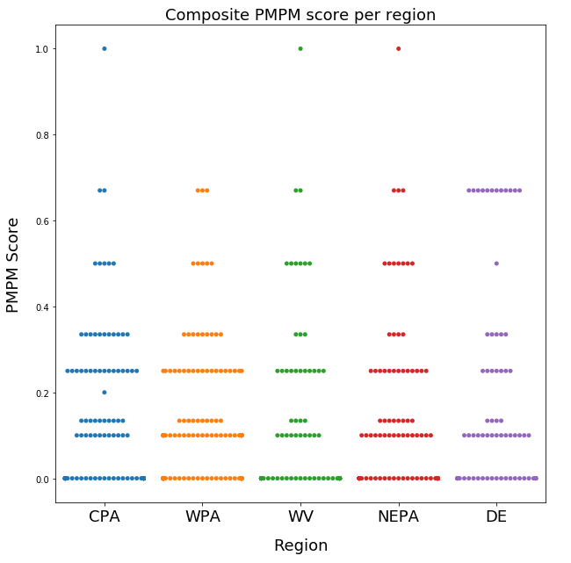
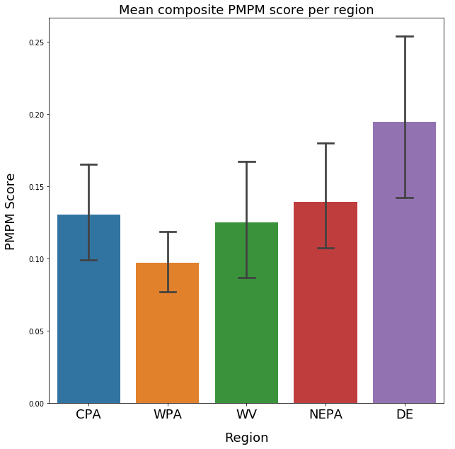
PMPM Score per Region

Slide 5
T-test Results by Region (α = 0.05)
PMPM Score
PA regions had lower scores than all other regions
WPA had higher scores than NEPA
QA Score
PA had a much higher score than all other regions
WPA greatly outperformed NEPA and WV

Slide 6
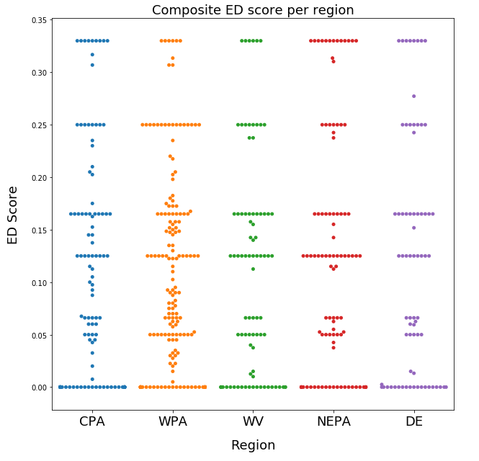
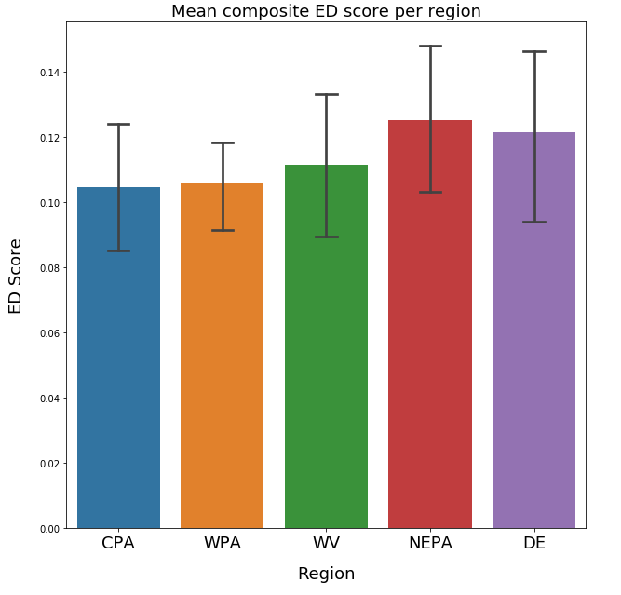
ED Score per Region

Slide 7
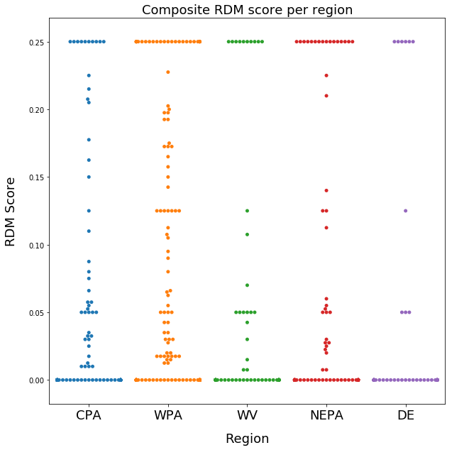
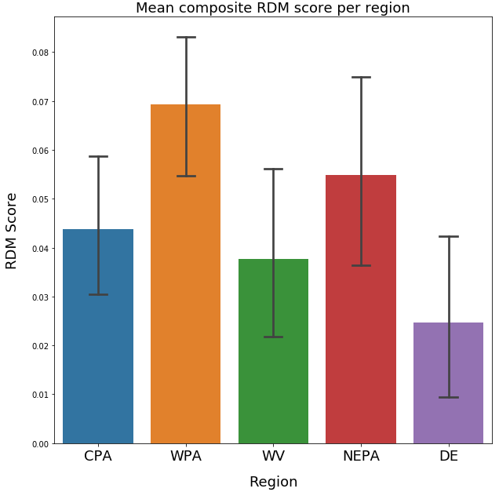
RDM Score per Region

Slide 8
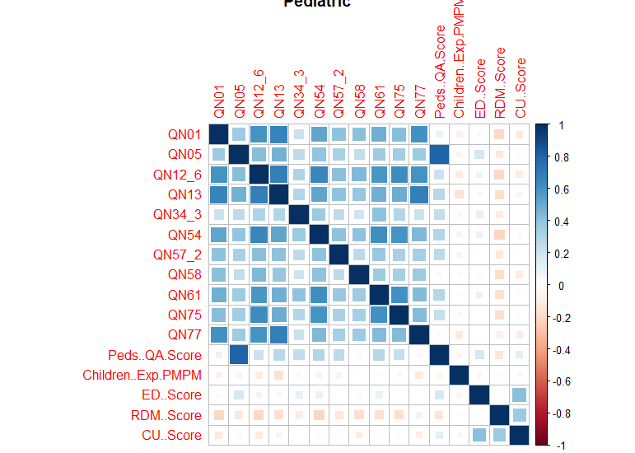
Pediatric Correlation
Notes:
The quality metrics increase the PMPM cost in short term but probably drive down costs long term.
Cardiac issues are short term diseases and hence they might affect the cost sooner than breast or colorectal screening.

Slide 9
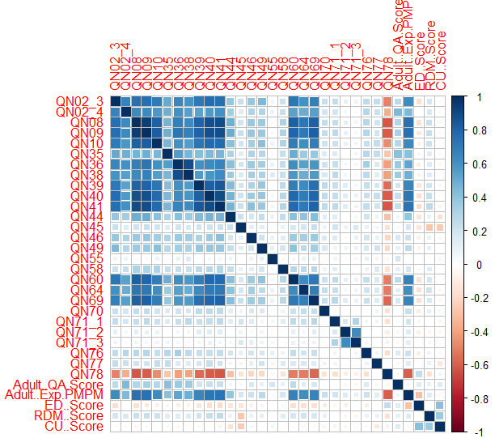
Adult Correlation
Notes:
The quality metrics increase the PMPM cost in short term but probably drive down costs long term.
Cardiac issues are short term diseases and hence they might affect the cost sooner than breast or colorectal screening.

Slide 10
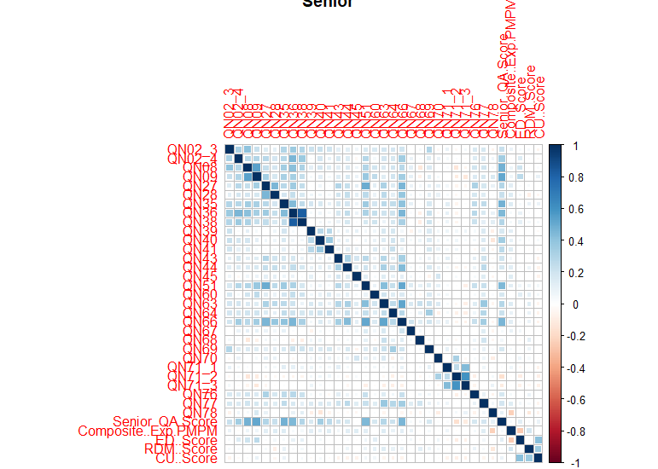
Senior Correlation
Notes:
The quality metrics increase the PMPM cost in short term but probably drive down costs long term.
Cardiac issues are short term diseases and hence they might affect the cost sooner than breast or colorectal screening.

Slide 11
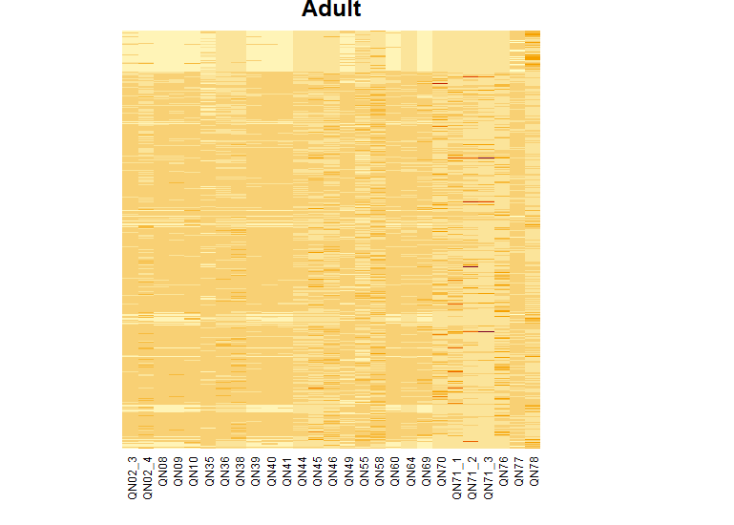
Adult Heatmap
Notes:
Medication adherence should not be orange, correlation matrix (just with breast cancer screening collinearities)
Ekg and eye exam in ED score should be orange
Breast cancer screening highly collinear with almost everything
Potential metrics to look out for

Slide 12
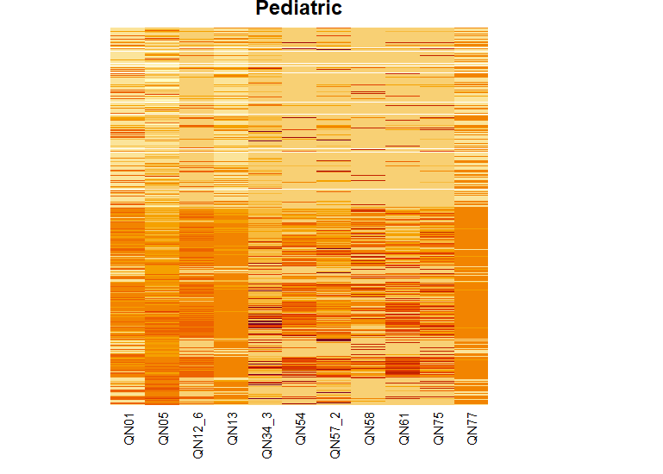
Pediatric Heatmap
Notes:
Medication adherence should not be orange, correlation matrix (just with breast cancer screening collinearities)
Ekg and eye exam in ED score should be orange
Breast cancer screening highly collinear with almost everything
Potential metrics to look out for

Slide 13
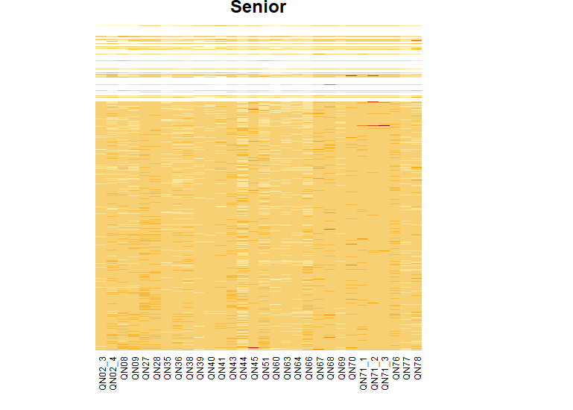
Senior Heatmap
Notes:
Medication adherence should not be orange, correlation matrix (just with breast cancer screening collinearities)
Ekg and eye exam in ED score should be orange
Breast cancer screening highly collinear with almost everything
Potential metrics to look out for

Slide 14
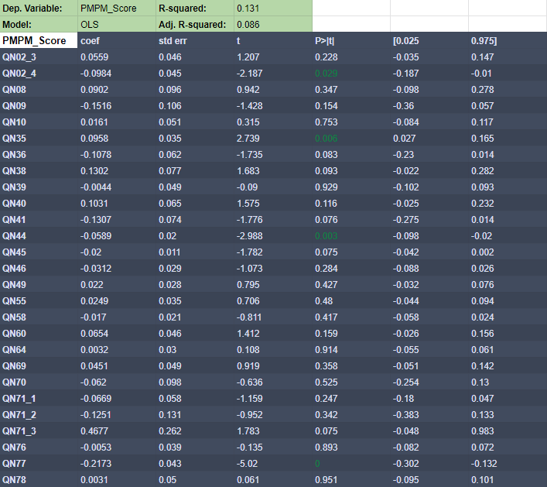
Notes:
ML Regression

Slide 15
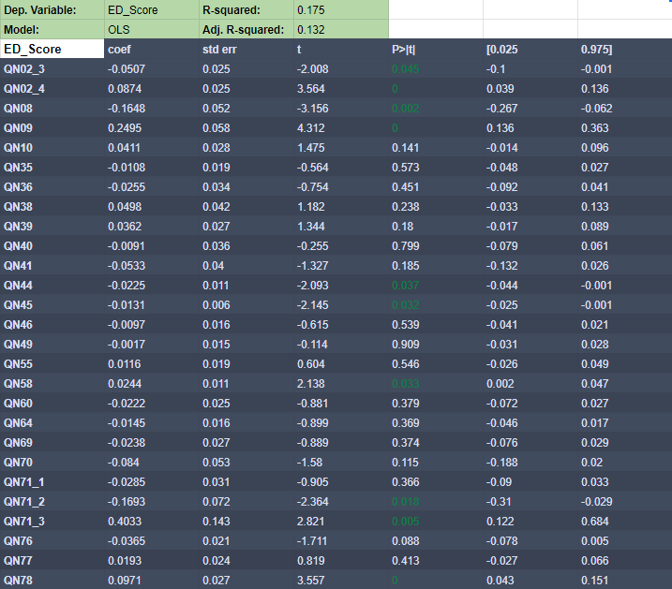
Notes:
ML Regression

Slide 16
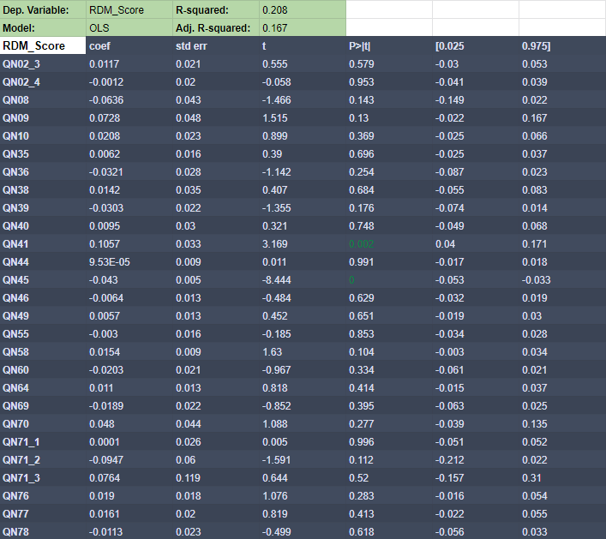
Notes:
ML Regression

Slide 17
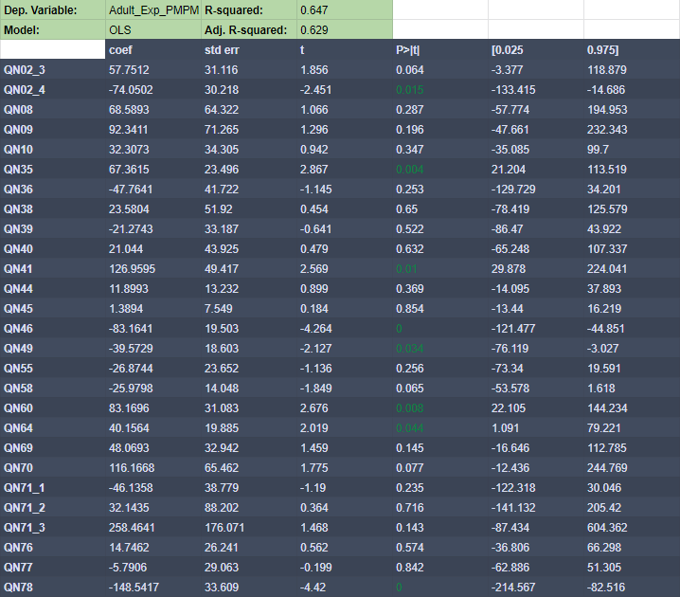
Notes:
ML Regression

Slide 18
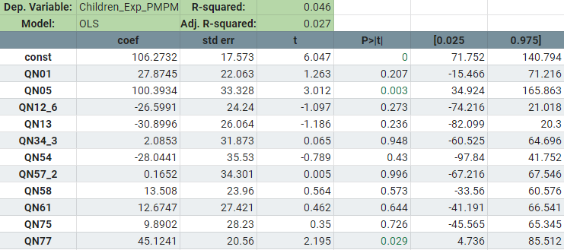

Slide 19
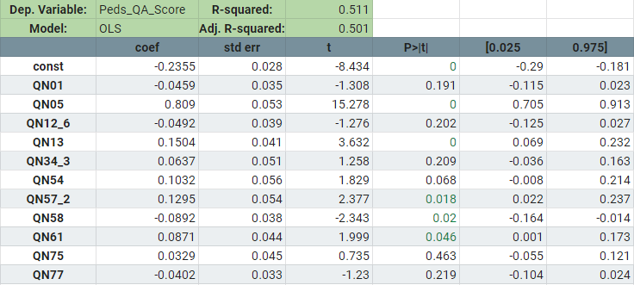

Slide 20
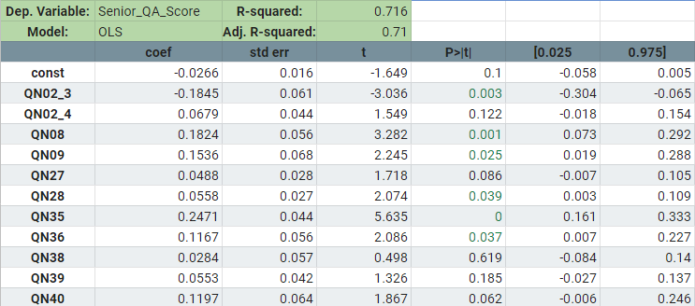

Slide 21
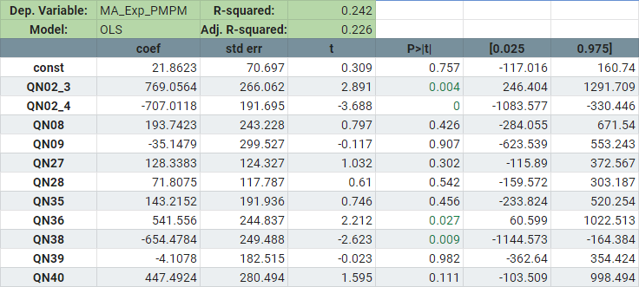

Slide 22
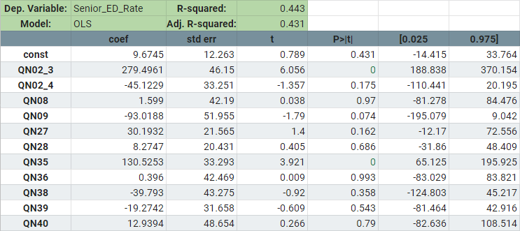

Slide 23
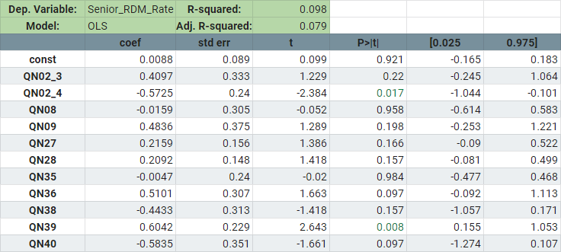

Slide 24
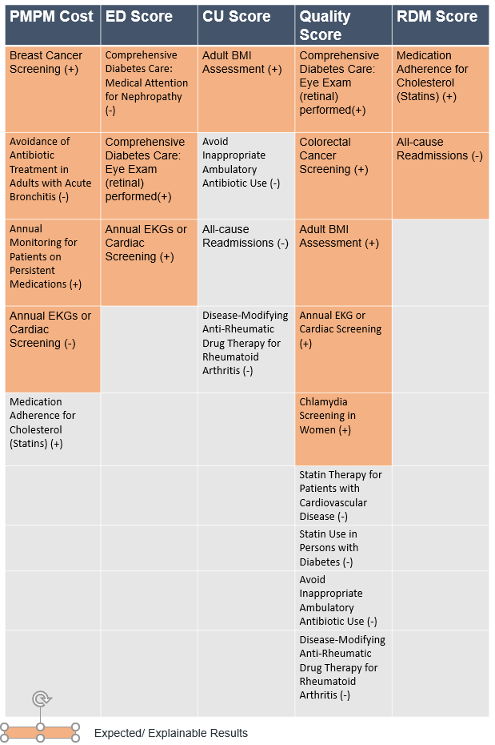
Forward Stepwise Selection
Notes:
Medication adherence should not be orange, correlation matrix (just with breast cancer screening collinearities)
Ekg and eye exam in ED score should be orange
Breast cancer screening highly collinear with almost everything
Potential metrics to look out for

Slide 25
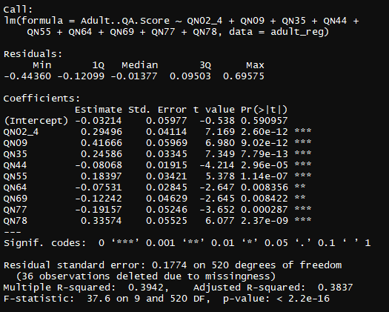
Adult QA Forward Stepwise
Notes:
Medication adherence should not be orange, correlation matrix (just with breast cancer screening collinearities)
Ekg and eye exam in ED score should be orange
Breast cancer screening highly collinear with almost everything
Potential metrics to look out for

Slide 26
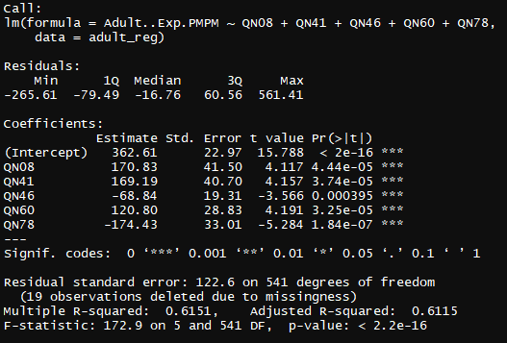
Adult PMPM Forward Stepwise
Notes:
Medication adherence should not be orange, correlation matrix (just with breast cancer screening collinearities)
Ekg and eye exam in ED score should be orange
Breast cancer screening highly collinear with almost everything
Potential metrics to look out for

Slide 27
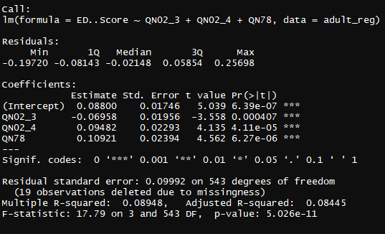
Adult ED Forward Stepwise
Notes:
Medication adherence should not be orange, correlation matrix (just with breast cancer screening collinearities)
Ekg and eye exam in ED score should be orange
Breast cancer screening highly collinear with almost everything
Potential metrics to look out for

Slide 28
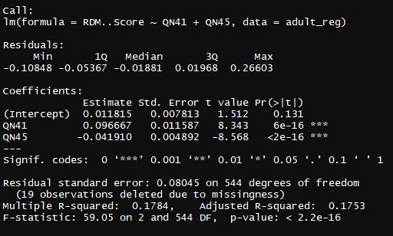
Adult RDM Forward Stepwise
Notes:
Medication adherence should not be orange, correlation matrix (just with breast cancer screening collinearities)
Ekg and eye exam in ED score should be orange
Breast cancer screening highly collinear with almost everything
Potential metrics to look out for

Slide 29
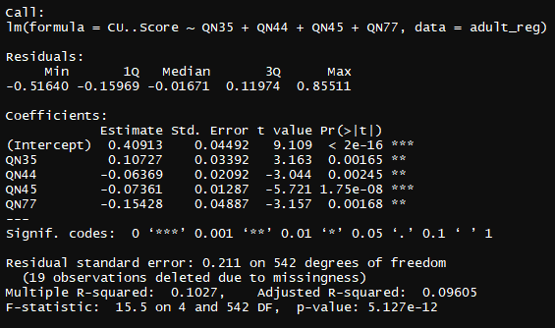
Adult CU Forward Stepwise
Notes:
Medication adherence should not be orange, correlation matrix (just with breast cancer screening collinearities)
Ekg and eye exam in ED score should be orange
Breast cancer screening highly collinear with almost everything
Potential metrics to look out for

Slide 30
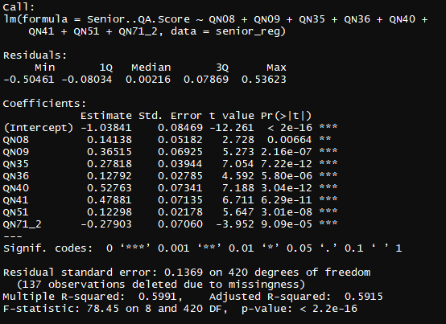
Senior QA Forward Stepwise
Notes:
Medication adherence should not be orange, correlation matrix (just with breast cancer screening collinearities)
Ekg and eye exam in ED score should be orange
Breast cancer screening highly collinear with almost everything
Potential metrics to look out for

Slide 31
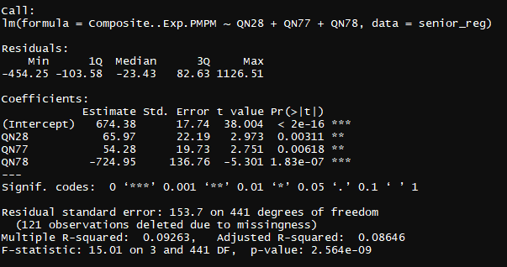
Senior PMPM Forward Stepwise
Notes:
Medication adherence should not be orange, correlation matrix (just with breast cancer screening collinearities)
Ekg and eye exam in ED score should be orange
Breast cancer screening highly collinear with almost everything
Potential metrics to look out for

Slide 32
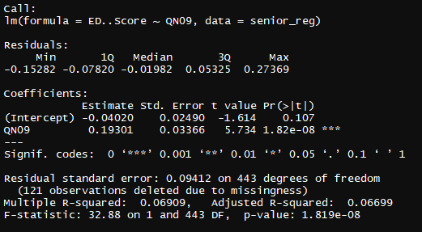
Senior ED Forward Stepwise
Notes:
Medication adherence should not be orange, correlation matrix (just with breast cancer screening collinearities)
Ekg and eye exam in ED score should be orange
Breast cancer screening highly collinear with almost everything
Potential metrics to look out for

Slide 33
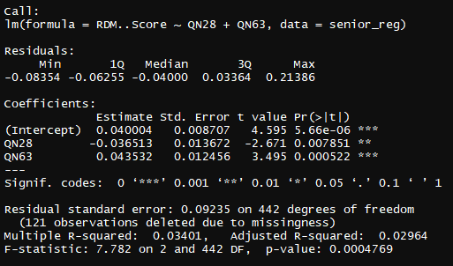
Senior RDM Forward Stepwise
Notes:
Medication adherence should not be orange, correlation matrix (just with breast cancer screening collinearities)
Ekg and eye exam in ED score should be orange
Breast cancer screening highly collinear with almost everything
Potential metrics to look out for

Slide 34
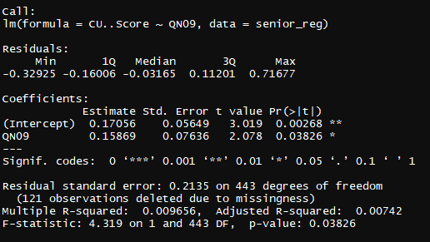
Senior CU Forward Stepwise
Notes:
Medication adherence should not be orange, correlation matrix (just with breast cancer screening collinearities)
Ekg and eye exam in ED score should be orange
Breast cancer screening highly collinear with almost everything
Potential metrics to look out for

Slide 35
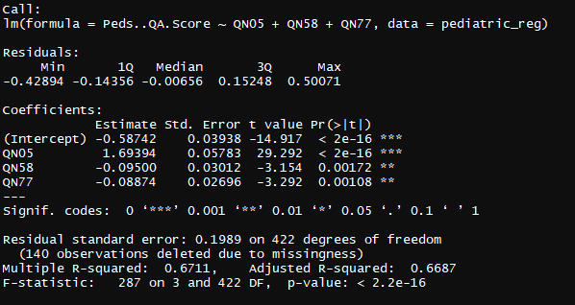
Pediatric QA Forward Stepwise
Notes:
Medication adherence should not be orange, correlation matrix (just with breast cancer screening collinearities)
Ekg and eye exam in ED score should be orange
Breast cancer screening highly collinear with almost everything
Potential metrics to look out for

Slide 36
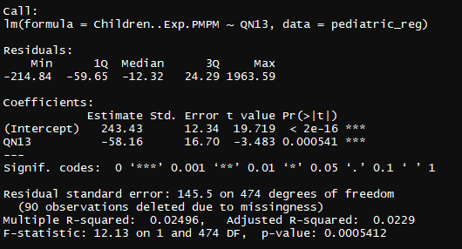
Pediatric PMPM Forward Stepwise
Notes:
Medication adherence should not be orange, correlation matrix (just with breast cancer screening collinearities)
Ekg and eye exam in ED score should be orange
Breast cancer screening highly collinear with almost everything
Potential metrics to look out for

Slide 37
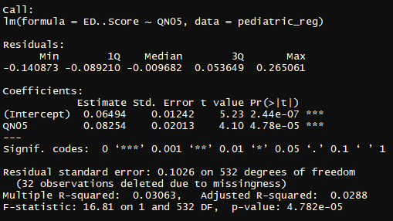
Pediatric ED Forward Stepwise
Notes:
Medication adherence should not be orange, correlation matrix (just with breast cancer screening collinearities)
Ekg and eye exam in ED score should be orange
Breast cancer screening highly collinear with almost everything
Potential metrics to look out for

Slide 38
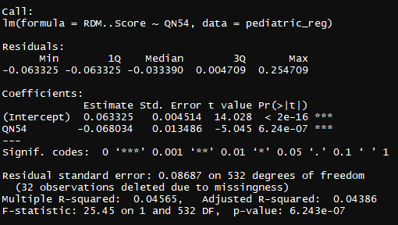
Pediatric RDM Forward Stepwise
Notes:
Medication adherence should not be orange, correlation matrix (just with breast cancer screening collinearities)
Ekg and eye exam in ED score should be orange
Breast cancer screening highly collinear with almost everything
Potential metrics to look out for

Slide 39
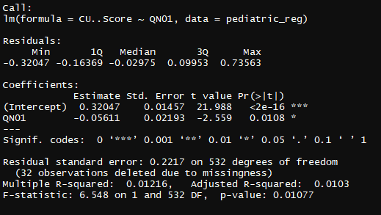
Pediatric CU Forward Stepwise
Notes:
Medication adherence should not be orange, correlation matrix (just with breast cancer screening collinearities)
Ekg and eye exam in ED score should be orange
Breast cancer screening highly collinear with almost everything
Potential metrics to look out for

Slide 40
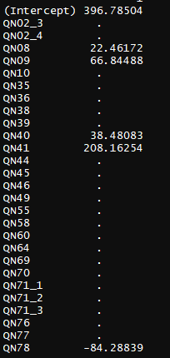
Adult PMPM LASSO
Notes:
Medication adherence should not be orange, correlation matrix (just with breast cancer screening collinearities)
Ekg and eye exam in ED score should be orange
Breast cancer screening highly collinear with almost everything
Potential metrics to look out for

Slide 41
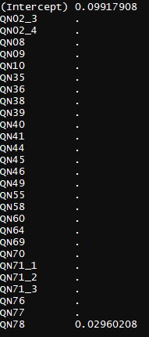
Adult ED LASSO
Notes:
Medication adherence should not be orange, correlation matrix (just with breast cancer screening collinearities)
Ekg and eye exam in ED score should be orange
Breast cancer screening highly collinear with almost everything
Potential metrics to look out for

Slide 42
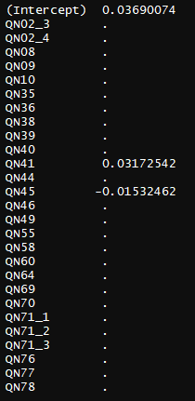
Adult RDM LASSO
Notes:
Medication adherence should not be orange, correlation matrix (just with breast cancer screening collinearities)
Ekg and eye exam in ED score should be orange
Breast cancer screening highly collinear with almost everything
Potential metrics to look out for

Slide 43
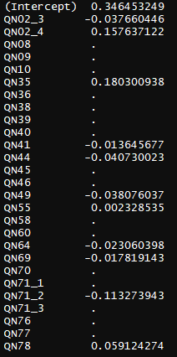
Adult QA LASSO
Notes:
Medication adherence should not be orange, correlation matrix (just with breast cancer screening collinearities)
Ekg and eye exam in ED score should be orange
Breast cancer screening highly collinear with almost everything
Potential metrics to look out for

Slide 44
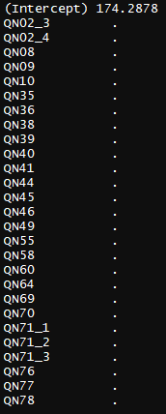
Pediatric PMPM LASSO
Notes:
Medication adherence should not be orange, correlation matrix (just with breast cancer screening collinearities)
Ekg and eye exam in ED score should be orange
Breast cancer screening highly collinear with almost everything
Potential metrics to look out for

Slide 45

Senior QA LASSO
Notes:
Medication adherence should not be orange, correlation matrix (just with breast cancer screening collinearities)
Ekg and eye exam in ED score should be orange
Breast cancer screening highly collinear with almost everything
Potential metrics to look out for

Slide 46

Adult PMPM Representative LASSO Cross Vaidation
Notes:
Medication adherence should not be orange, correlation matrix (just with breast cancer screening collinearities)
Ekg and eye exam in ED score should be orange
Breast cancer screening highly collinear with almost everything
Potential metrics to look out for

Slide 47

Adult PMPM Representative LASSO L1 Plot
Notes:
Medication adherence should not be orange, correlation matrix (just with breast cancer screening collinearities)
Ekg and eye exam in ED score should be orange
Breast cancer screening highly collinear with almost everything
Potential metrics to look out for

Slide 48

PCA Results Adult

Slide 49

PCA Results Adult

Slide 50


Slide 51


Slide 52


Slide 53


Slide 54


Slide 55

PCA Results Ped

Slide 56

PCA Results Ped

Slide 57


Slide 58


Slide 59


Slide 60


Slide 61


Slide 62

PCA Results Senior

Slide 63

PCA Results Senior

Slide 64


Slide 65


Slide 66


Slide 67


Slide 68


