Slide 1
Raw PMPM quantities
548 providers
1,156,854 members (702,548 adult | 239,540 pediatric | 214,766 senior)
- AVG: 2,111 members (per provider)
Total Potential $: 111,017,718 (!)
QA Potential $: 37,005,906
- AVG: 67,529 (per provider)
QA Earned $: 18,339,610
- AVG: 33,466 (per provider)
I WILL TRY TO MAKE THESE VISUAL!!!

Slide 2
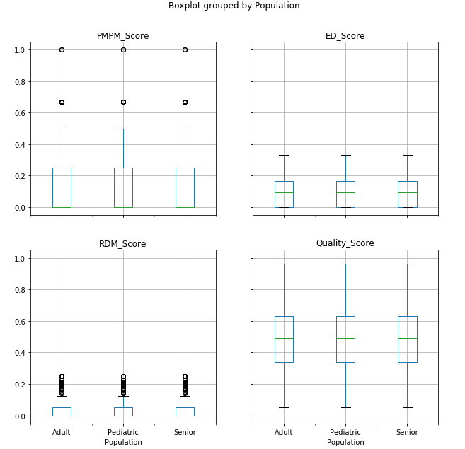

Slide 3
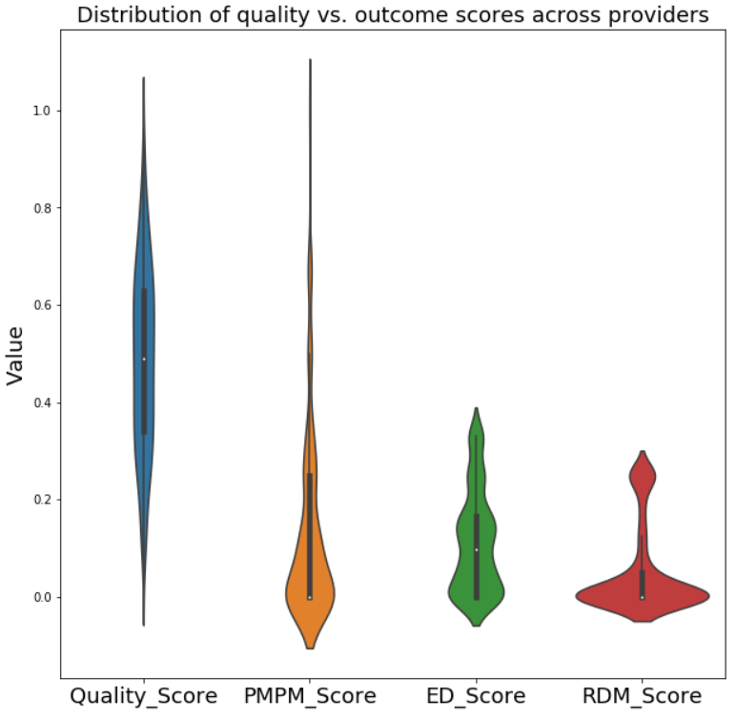
Stats for scores v1

Slide 4
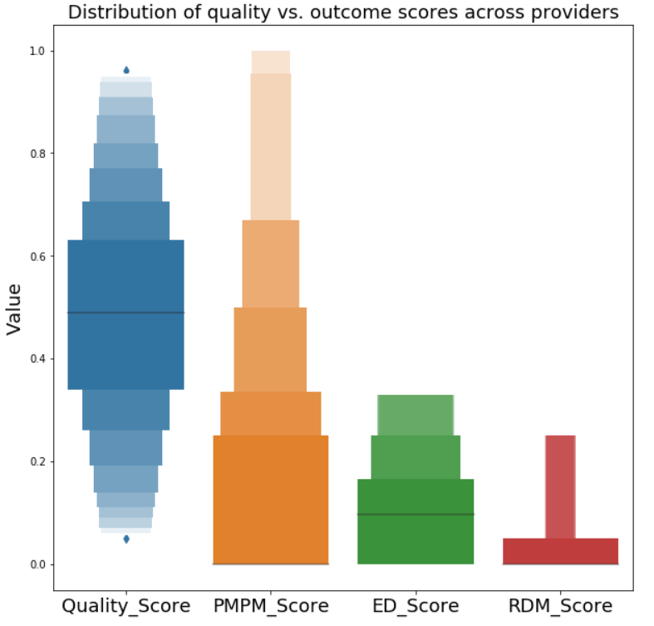
Stats for scores v2 (percentage)

Slide 5
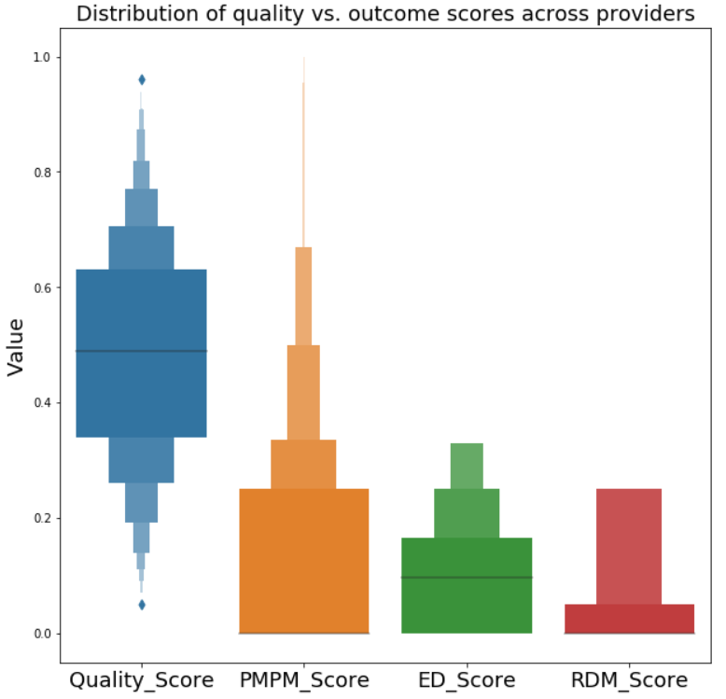
Stats for scores v2.5 (proportion)

Slide 6
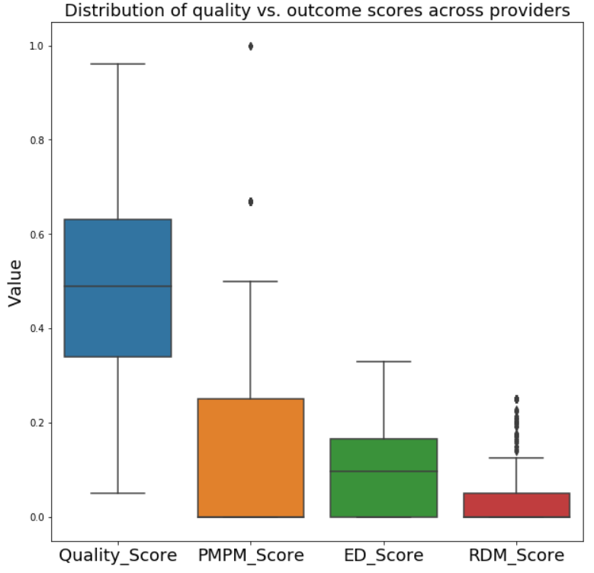
Stats for scores v3

Slide 7
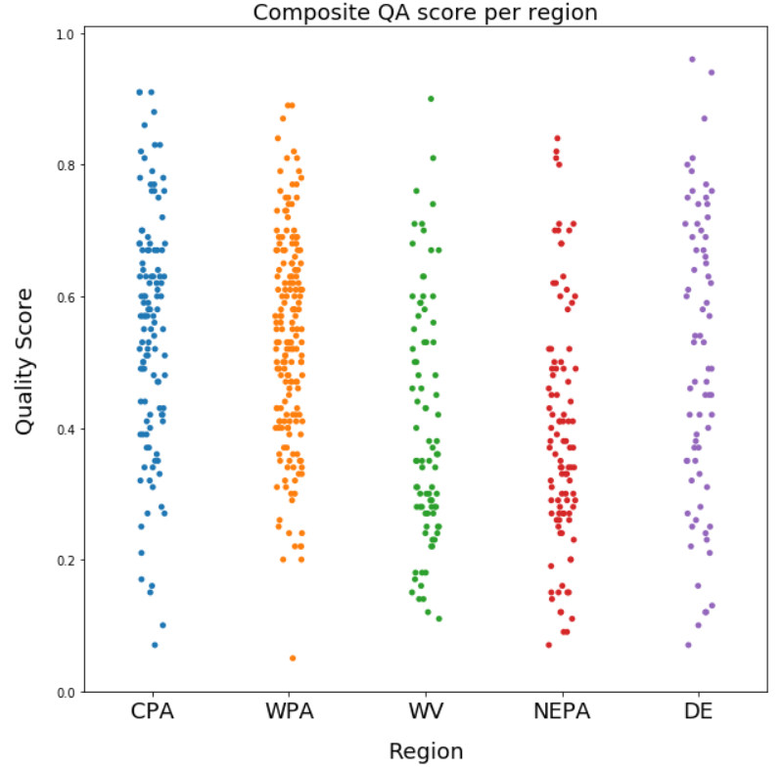
QA Score per Region v1

Slide 8
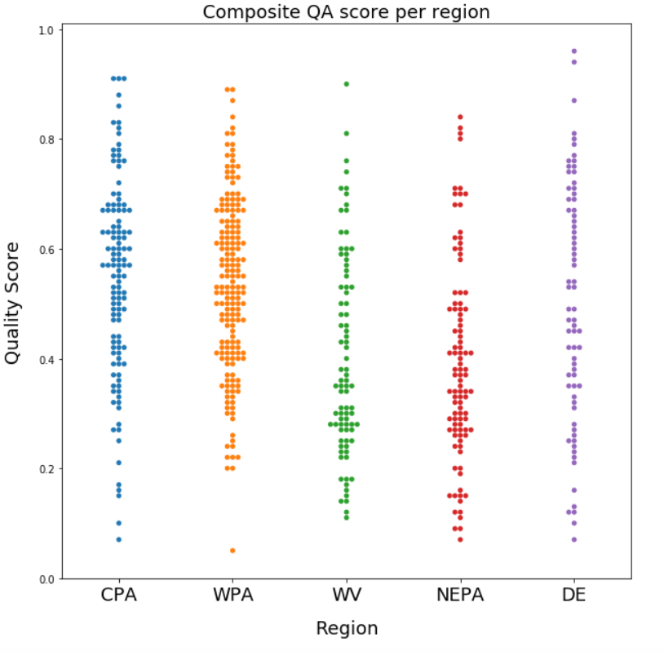
QA Score per Region v2

Slide 9
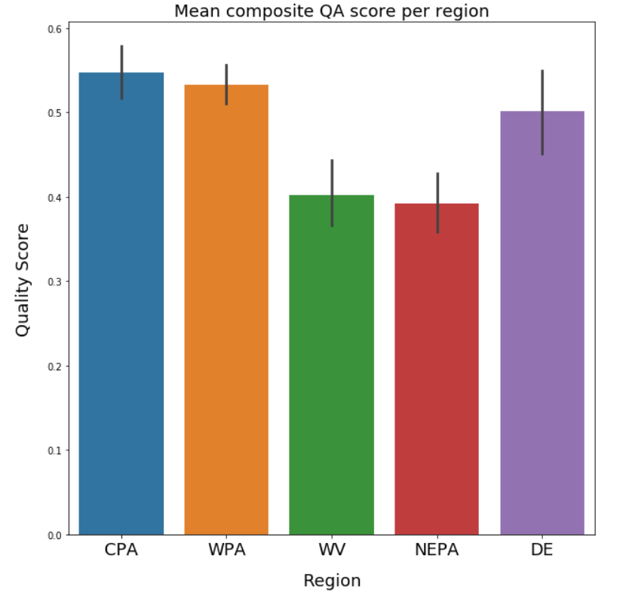
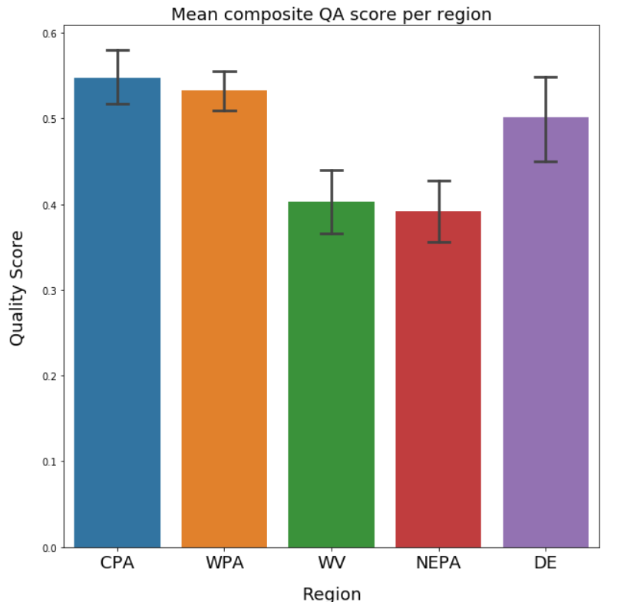
QA Score per Region v3 – mean w/ without caps

Slide 10
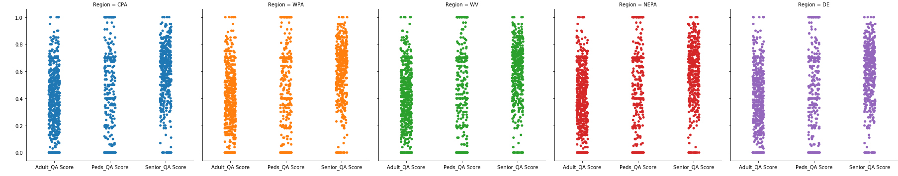
QA Score per Region v4 – by pop

Slide 11
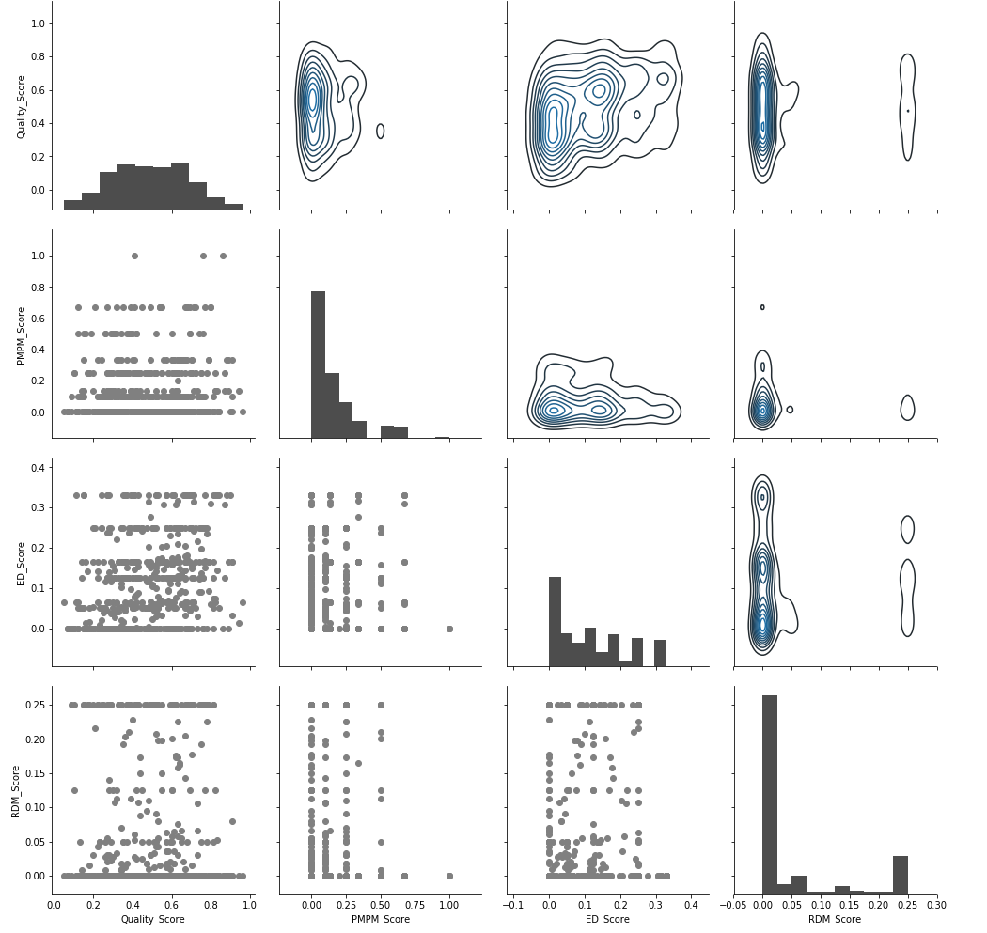
Quality vs Outcomes

Slide 12
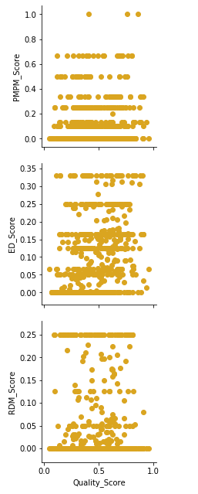
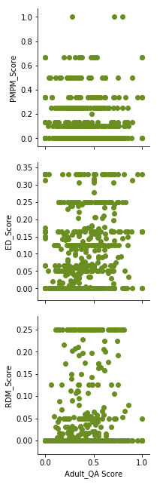
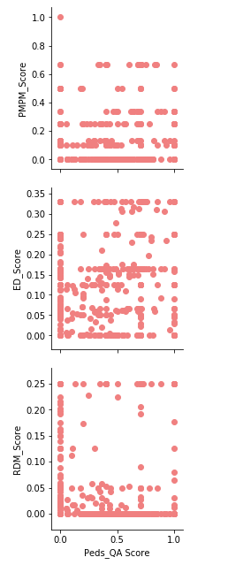
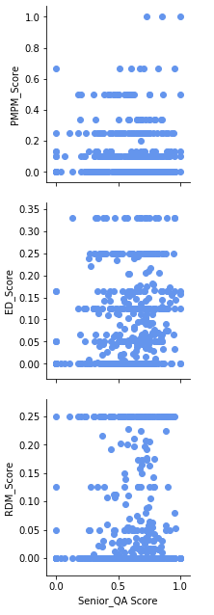
Quality vs Outcomes

Slide 13
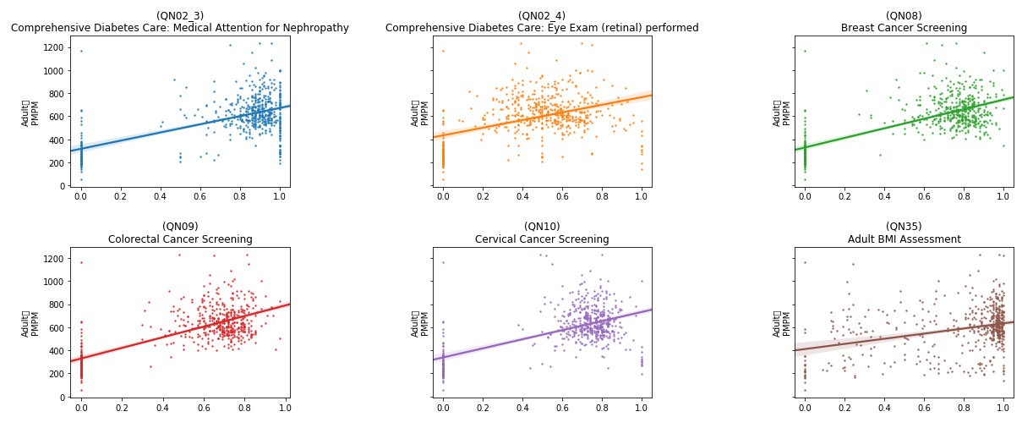
Rates vs. Adult PMPM
Adult
PMPM
Adult
PMPM
Adult
PMPM
Adult
PMPM
Adult
PMPM
Adult
PMPM
Rate
Rate
Rate

Slide 14
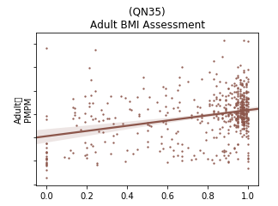
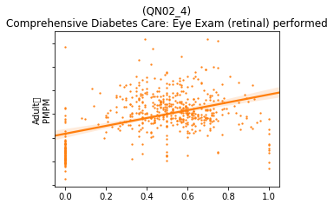
Rates vs. Adult PMPM, zoomed in
Adult
PMPM
Adult
PMPM
High variability
Low confidence

Slide 15
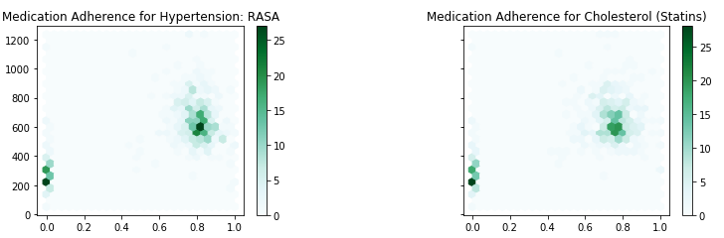
Hexbin rate vs. PMPM

Slide 16
Next steps
Deep inspection of differences across providers
Region
Population
Number of members
PCA or other dimensionality reduction to reduce multicollinearity between metrics
Key driver analysis
Multiple linear regression
Predictive models, if possible
Linear / lasso regression
Random forest / regression tree
Note: Make these four bullets into four icons side-by-side w/ text below them?

