Slide 1
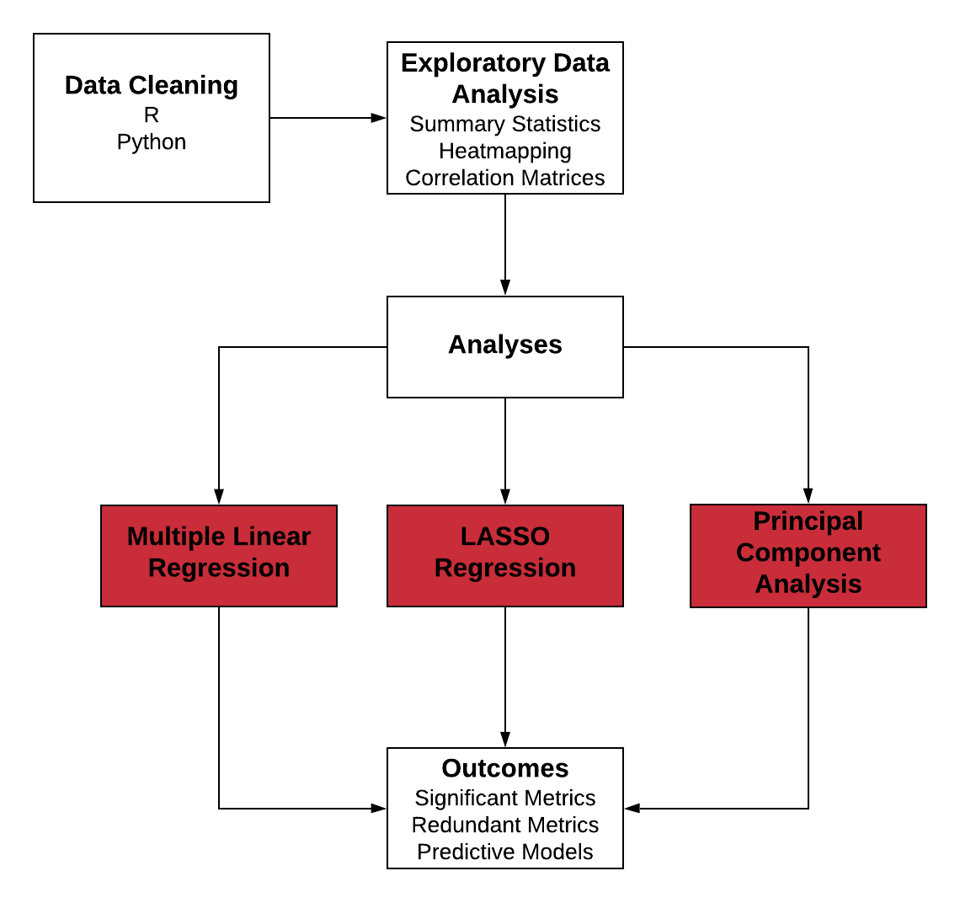
Quantitative Methods

Slide 2
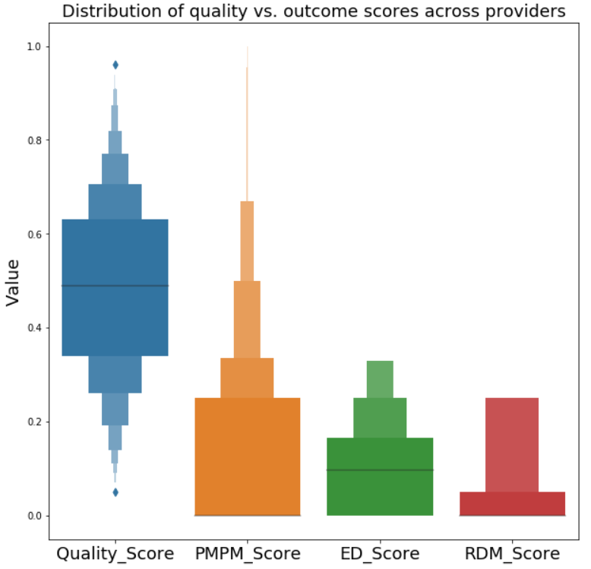
Quality and Outcomes

Slide 3
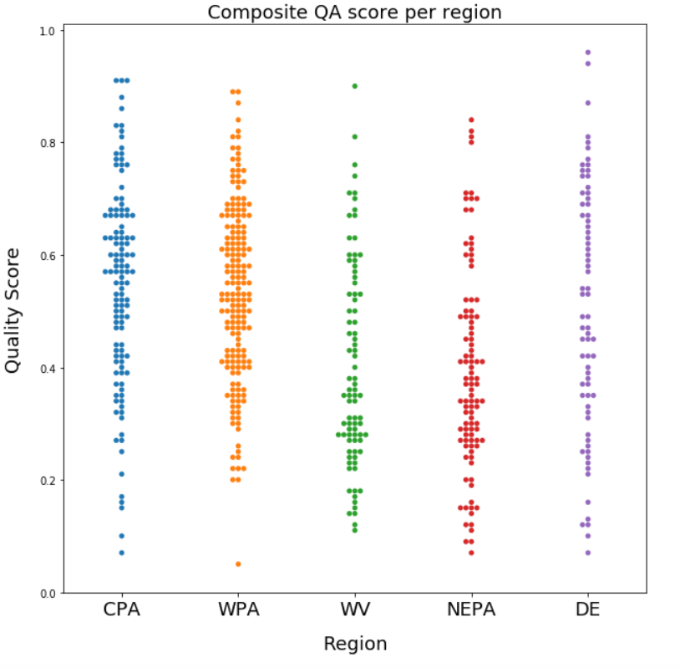
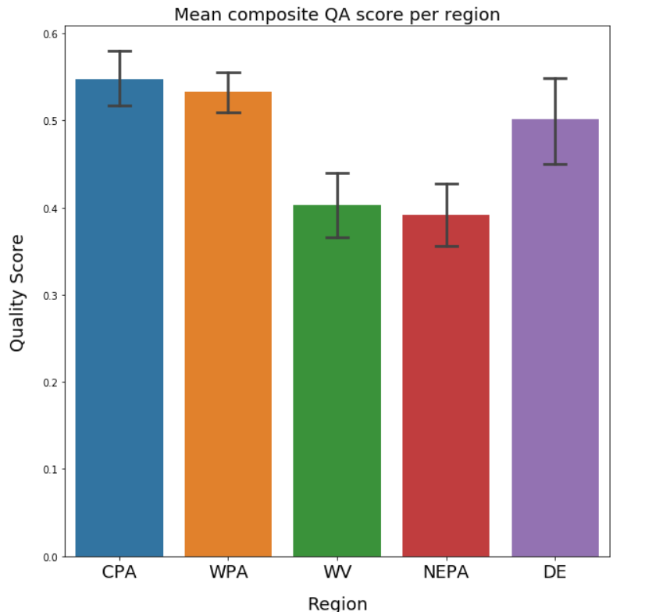
QA Score per Region

Slide 4
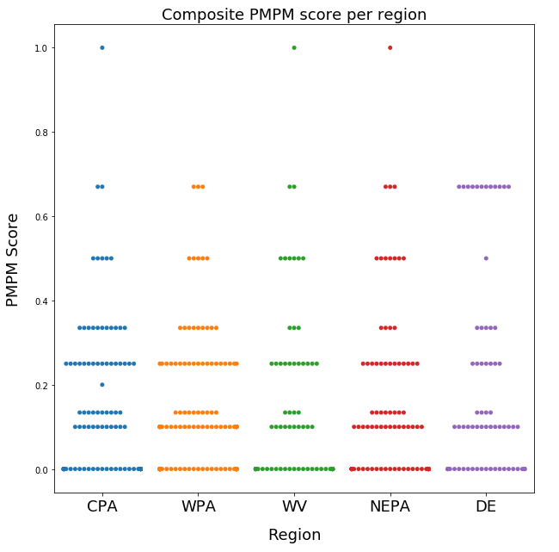
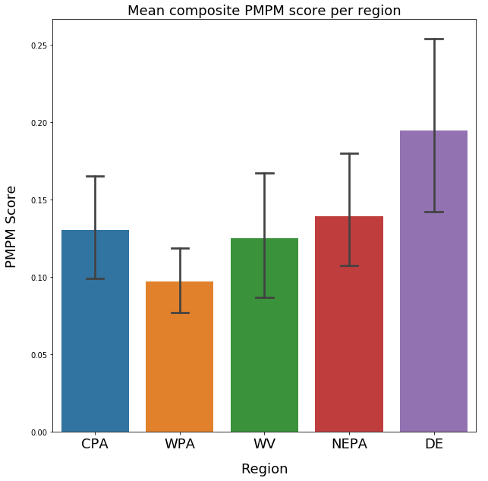
PMPM Score per Region

Slide 5
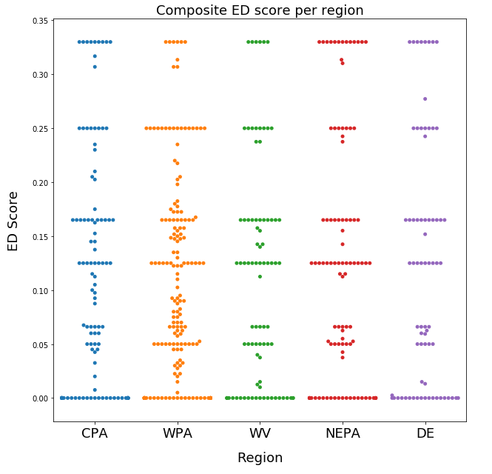
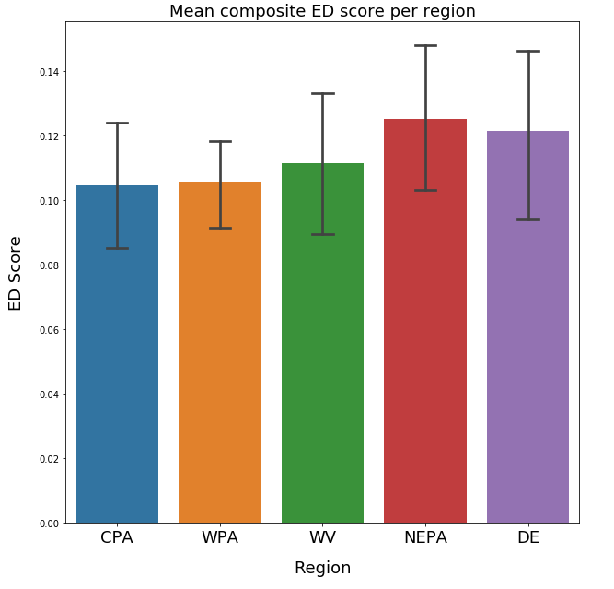
ED Score per Region

Slide 6
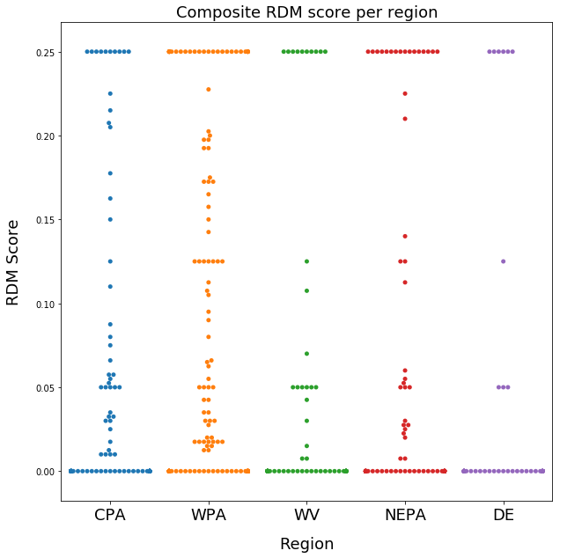
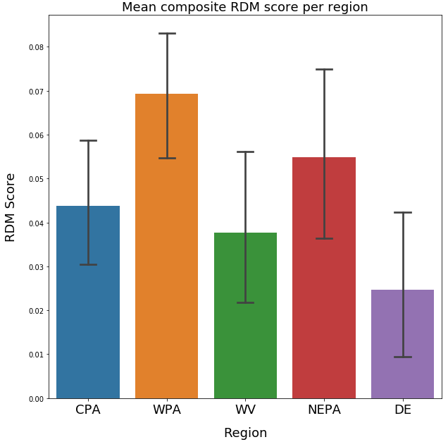
RDM Score per Region

Slide 7
Program Effects

Slide 8
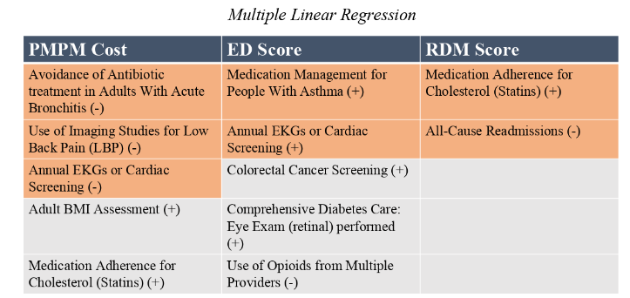

Multiple Linear Regression

Slide 9
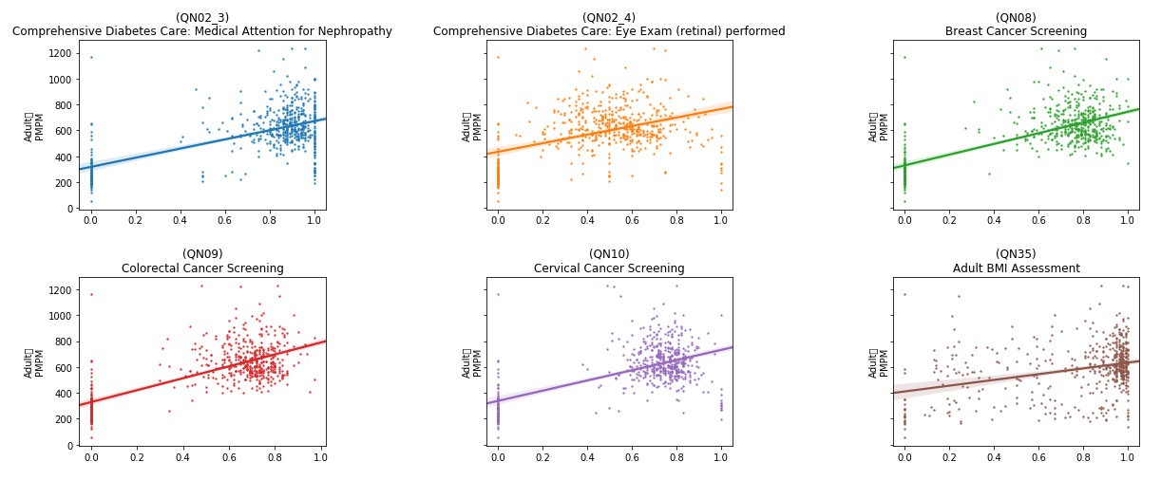
Rates vs. Adult PMPM
Adult
PMPM
Adult
PMPM
Adult
PMPM
Adult
PMPM
Adult
PMPM
Adult
PMPM
Rate
Rate
Rate

Slide 10
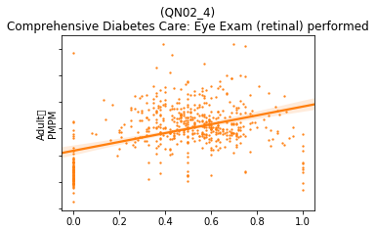
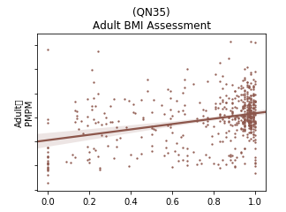
Rates vs. Adult PMPM, zoomed in
Adult
PMPM
Adult
PMPM
High variability
Low confidence

Slide 11
Findings
The analysis for the Adult population shows mixed results.
Several variables showed a high statistical correlation with the three outcomes. Some of these were expected, while a number were inversely correlated or unexplained.
Ultimately the high variance in the data and the low confidence values indicate that more collection and study should be done.
Detailed results are given in the appendix.

Slide 12
Findings v2
The analysis for the Adult population shows mixed results.
Several variables showed a high statistical correlation with the three outcomes. Some of these were expected, while a number were inversely correlated or unexplained.
Ultimately the high variance in the data and the low confidence values indicate that more collection and study should be done.
Detailed results are given in the appendix.

Slide 13
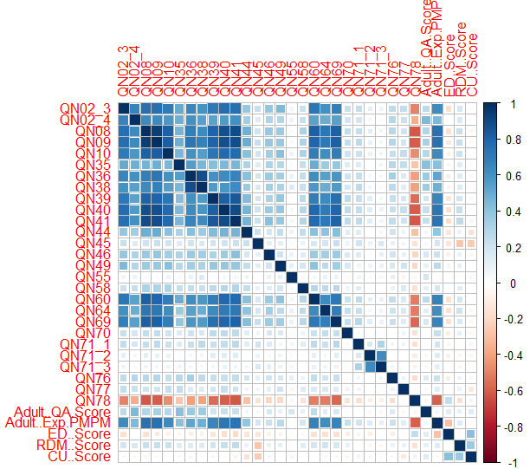
Collinearities in the data
Several variables were found to be correlated with each other
This could lead to skewed results in a standard regression test
Lasso regression and PCA can account for this problem

Slide 14
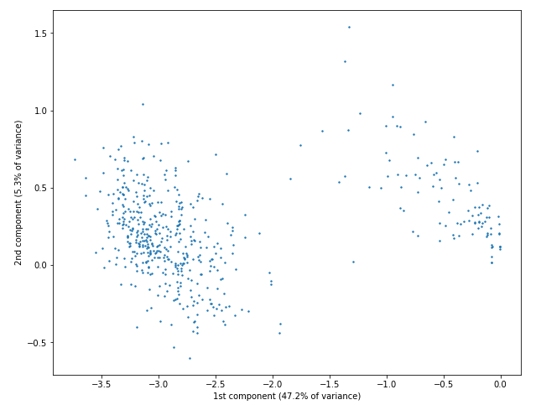
Principal Component Analysis
Top contributors to the first component, which explains 47.22% of the variance in the adult data:
QN09 - Colorectal Cancer Screening
QN08 - Breast Cancer Screening
QN41 - Drug Therapy for Rheumatoid Arthritis
QN40 - Medication Adherence for Cholesterol (Statins)
QN39 - Medication Adherence for Hypertension: RASA
Top contributors to the second component, which explains 5.3% of the variance in the adult data:
QN76 - Controlling High Blood Pressure
QN55 - Annual Monitoring for Patients on Persistent Medications
QN35 - Adult BMI Assessment

Slide 15
Principal Component Analysis v2
Top contributors to the first component, which explains 47.22% of the variance in the adult data:
QN09 - Colorectal Cancer Screening
QN08 - Breast Cancer Screening
QN41 - Drug Therapy for Rheumatoid Arthritis
QN40 - Medication Adherence for Cholesterol (Statins)
QN39 - Medication Adherence for Hypertension: RASA
Top contributors to the second component, which explains 5.3% of the variance in the adult data:
QN76 - Controlling High Blood Pressure
QN55 - Annual Monitoring for Patients on Persistent Medications
QN35 - Adult BMI Assessment

Slide 16
Next (quantitative) steps
Collect data over time to enable time series analyses
Follow providers who are not participating in the program in order to study counterfactual
Focus on metrics that are highly colinear to identify potential candidates for removal
Diversify metrics across CMS-recommended “meaningful measures” areas of focus
Anything you/Jake want to add :)

Slide 17
Next (quantitative) steps v2
Collect data over time to enable time series analyses
Follow providers who are not participating in the program in order to study counterfactual
Focus on metrics that are highly colinear to identify potential candidates for removal
Diversify metrics across CMS-recommended “meaningful measures” areas of focus
Anything you/Jake want to add :)

Slide 18
Next (quantitative) steps
Collect data over time to enable time series analyses
Follow providers who are not participating in the program in order to study counterfactual
Focus on metrics that are highly colinear to identify potential candidates for removal
Diversify metrics across CMS-recommended “meaningful measures” areas of focus
Anything you/Jake want to add :)

