Slide 1
Program Impact on Outcomes
Needs Assessment
Program Theory
Process Evaluation
Outcome Evaluation
Did the program have the intended impact on the correct population?
What were the key metrics that caused the observed effect?

Slide 2
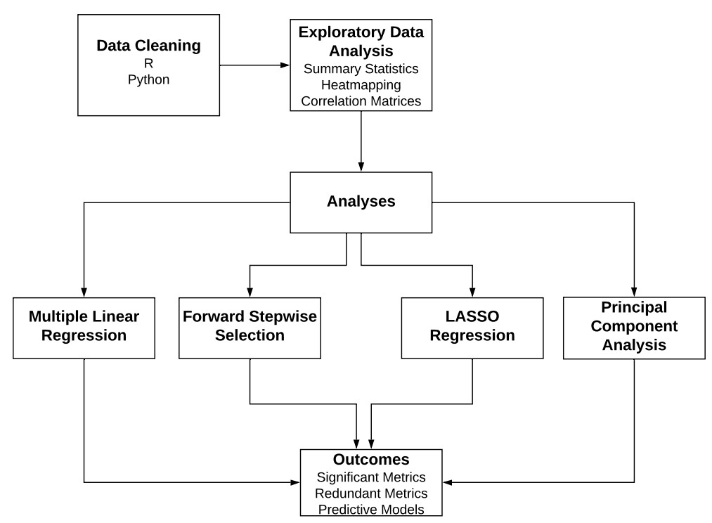
Quantitative Methods

Slide 3
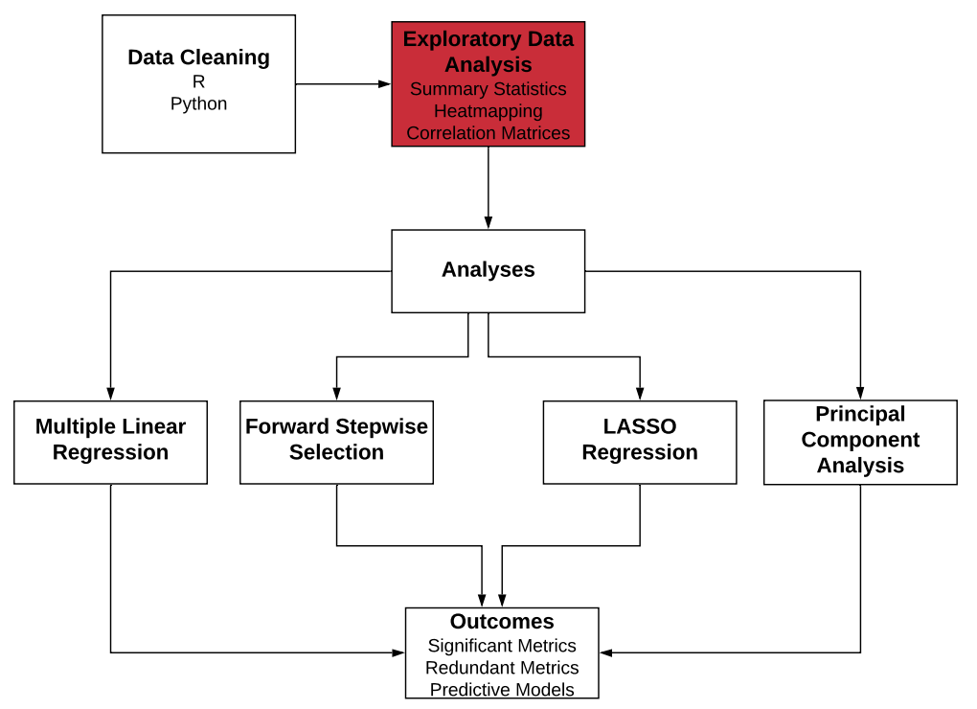

Slide 4
Dataset Overview
38,000+ rows
Over 500 healthcare providers across 5 regions
~40 quality metrics per provider
1 year, one data point per provider per population
3 outcomes of interest:
PMPM – Per member per month cost of care
ED – Emergency department utilization
RDM – Readmission rates
3 populations: Pediatric, Adult, Senior

Slide 5
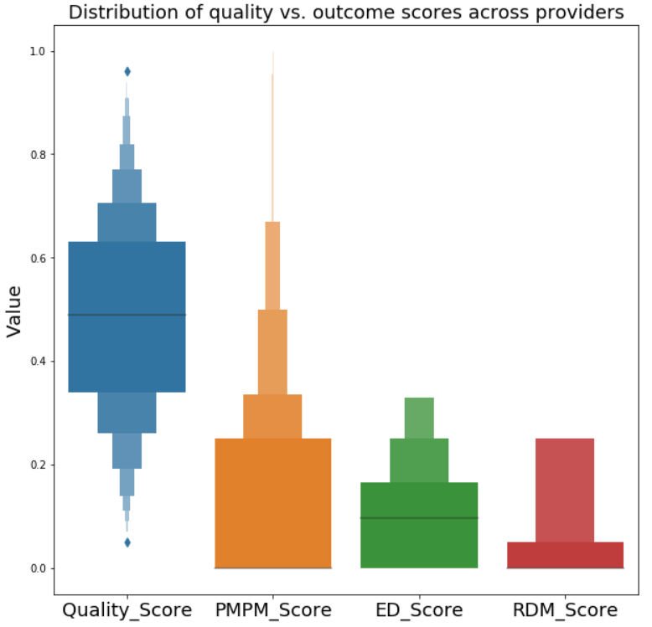
Quality and Outcomes
Notes:
Looks unimodal. The scores are mostly at the lower end (not exceeding 0.5 of the scores)

Slide 6
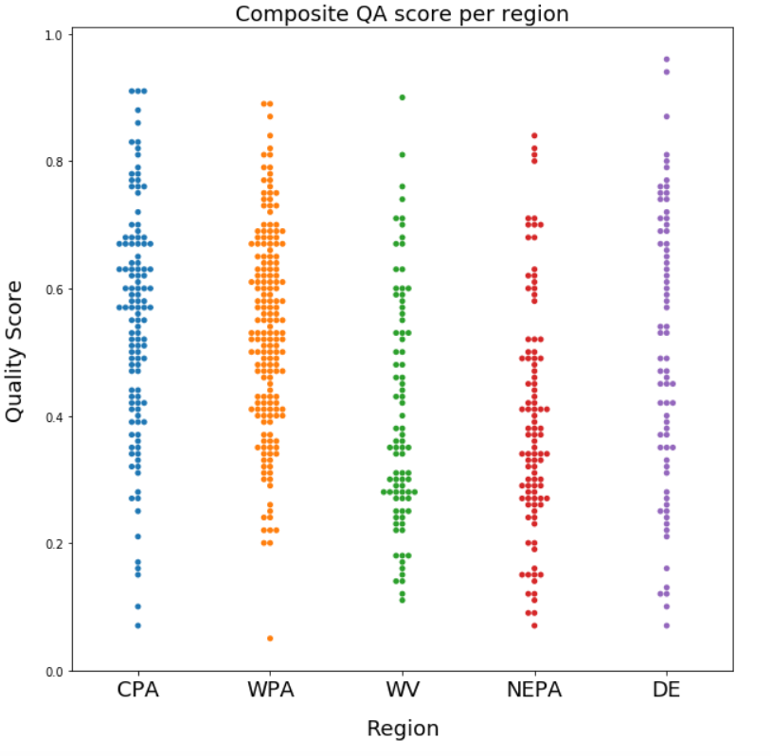
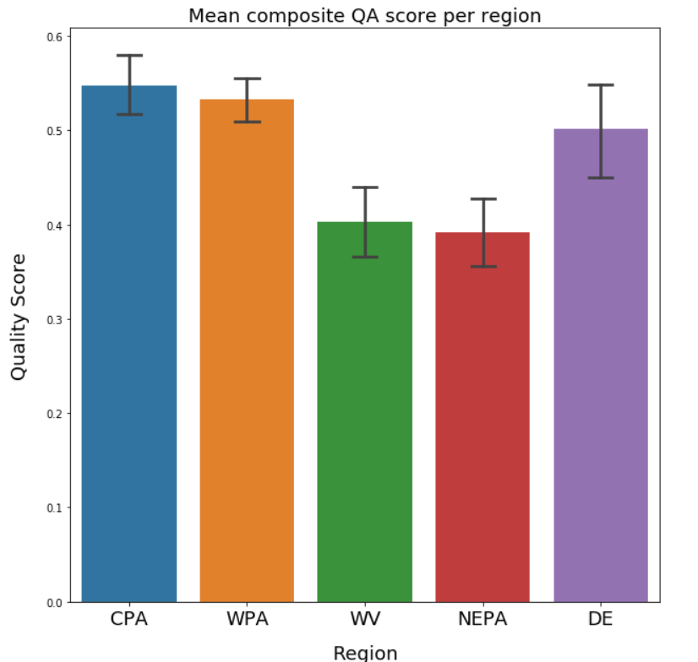
QA Score per Region

Slide 7
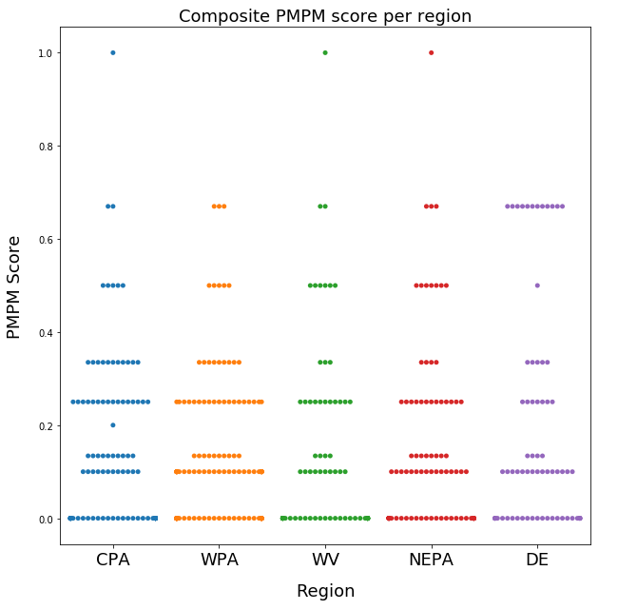
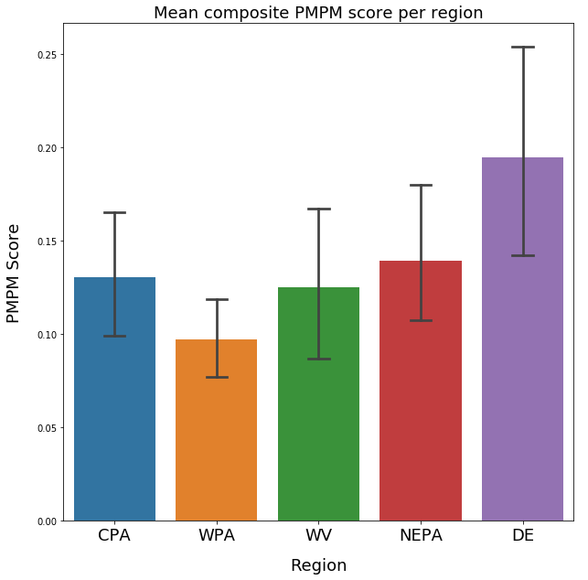
PMPM Score per Region

Slide 8
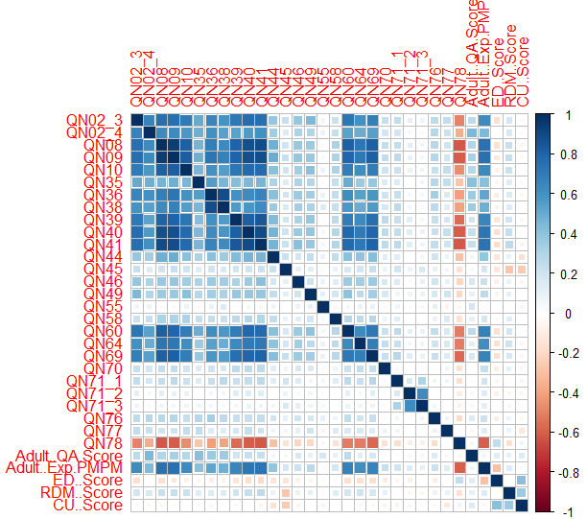
Collinearities in the data
Most metrics were found to be highly correlated with each other
Outcomes did not show this correlation
This could lead to skewed results in a standard regression test
Lasso regression and PCA can account for this problem

Slide 9
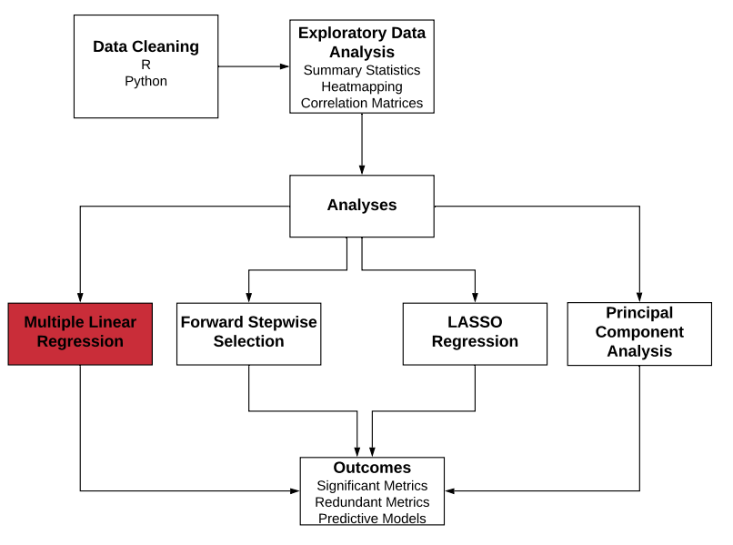

Slide 10
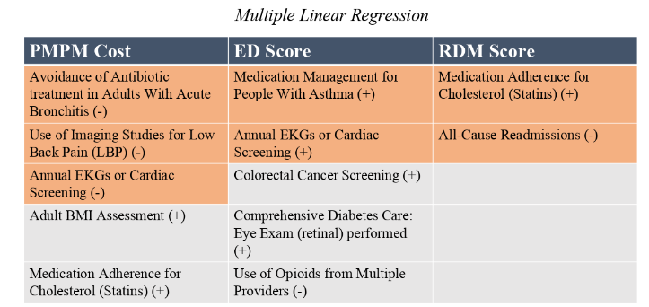

Multiple Linear Regression

Slide 11
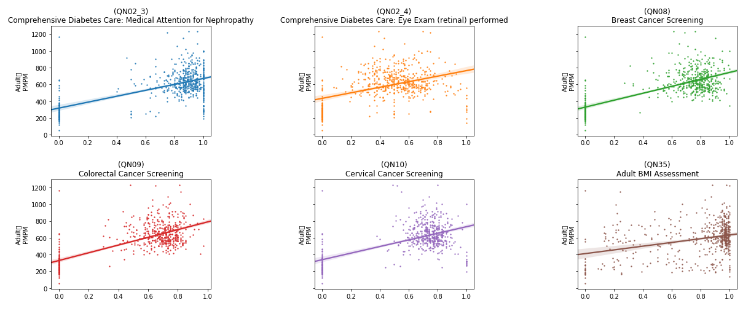
Rates vs. Adult PMPM
Adult
PMPM
Adult
PMPM
Adult
PMPM
Adult
PMPM
Adult
PMPM
Adult
PMPM
Rate
Rate
Rate

Slide 12
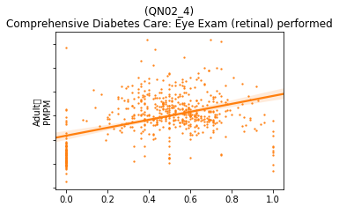
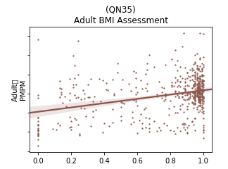
Adult
PMPM
Adult
PMPM
High variability
Low confidence

Slide 13
MLR: Findings
The analysis for the Adult population shows mixed results.
Several variables showed a high statistical correlation with the three outcomes. Some of these were expected, while a number were inversely correlated or unexplained.
Ultimately the high variance in the data and the low confidence values indicate that more collection and study should be done.
Detailed results are given in the appendix.

Slide 14
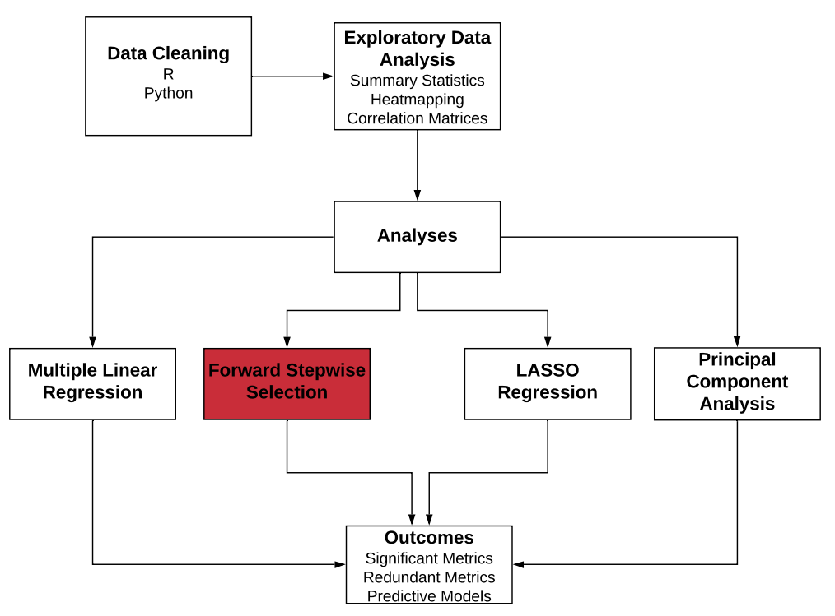

Slide 15
Forward Stepwise Selection
Further Refinement of Regression Models (Adult Population Shown, selected with BIC criteria)
QA | PMPM | ED | RDM | CU
QN02.4 | QN08 | QN02.3 | QN41 | QN35
QN09 | QN41 | QN02.4 | QN45 | QN44
QN35 | QN46 | QN78 |  | QN45
QN44 | QN60 |  |  | QN77
QN55 | QN78
QN64
QN69
QN77
QN78

Slide 16
Key Insights
Adult Pop.: Selection usually cut 2-3 significant variables
  7 cut from ED score
Senior Pop.: Usually cut between 0-2
  Tended to have a lower number of significant metrics
Pediatric Pop.: Same as seniors

Slide 17
Key Insights
Represents our best approximation of significant metrics
Generally agreed with our other regressions
ED only had 1 significant metric
Pediatric PMPM had none
In general, ED, RDM, and CU always had less metric associated compared to PMPM

Slide 18
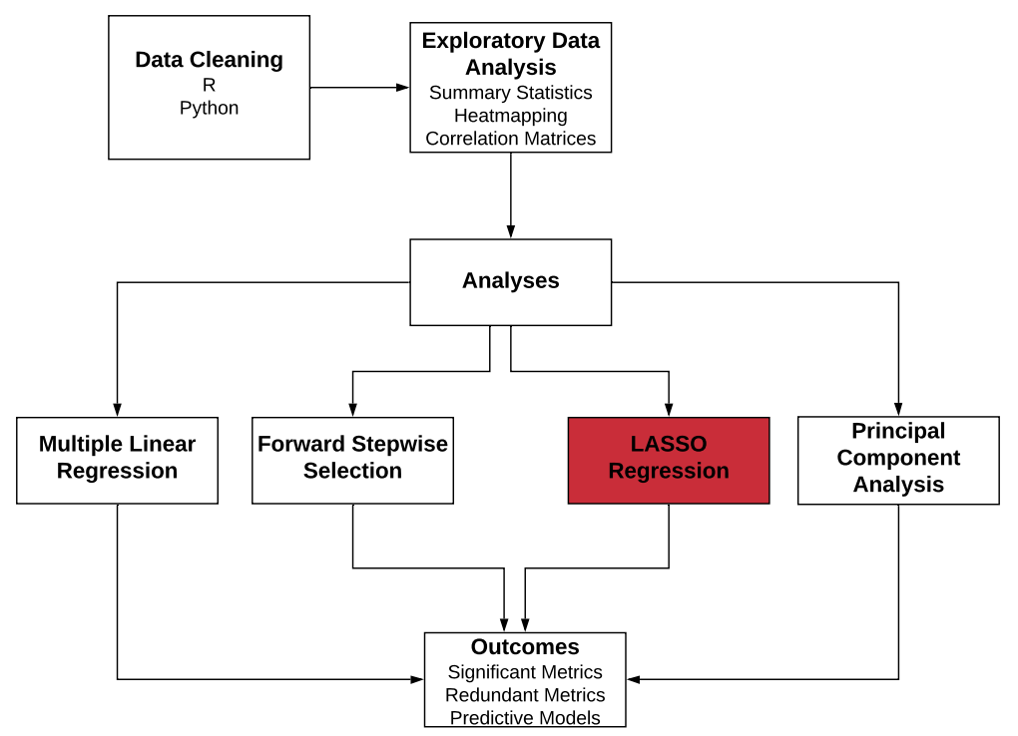

Slide 19
LASSO Regression
PMPM | QA | ED | RDM
QN08 | QN02.3 | QN78 | QN41
QN09 | QN02.4 |  | QN45
QN40 | QN35
QN41 | QN41
QN78 | QN44
 | QN9
 | QN55
 | QN64
 | QN69
 | QN71.2
 | QN78

Slide 20
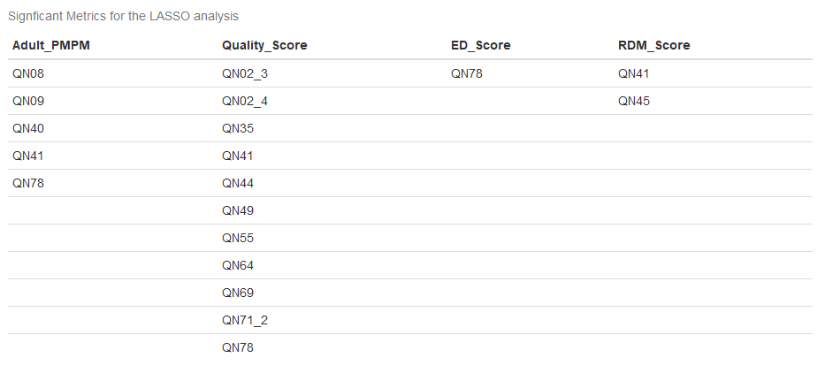
LASSO Regression (other chart if this looks better)

Slide 21
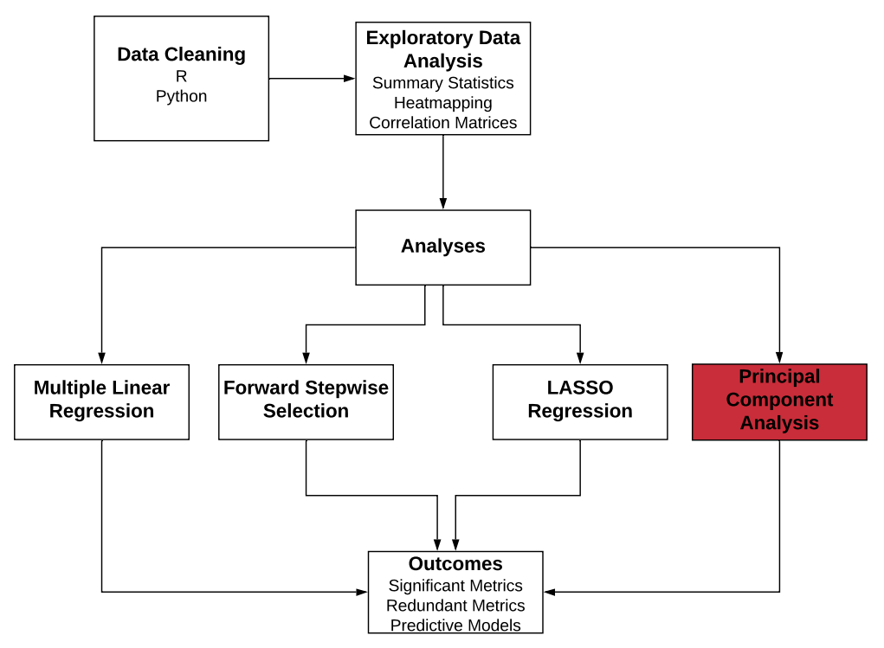

Slide 22
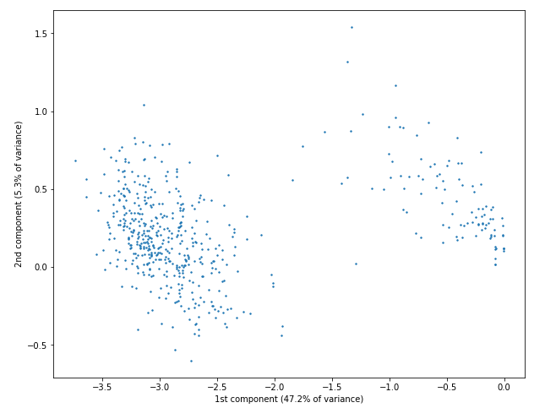
Principal Component Analysis
Top contributors to the first component, which explains 47.22% of the variance in the adult data:
  QN09 - Colorectal Cancer Screening
  QN08 - Breast Cancer Screening
  QN41 - Drug Therapy for Rheumatoid Arthritis
  QN40 - Medication Adherence for Cholesterol (Statins)
Top contributors to the second component, which explains 5.3% of the variance in the adult data:
  QN76 - Controlling High Blood Pressure
  QN55 - Annual Monitoring for Patients on Persistent Medications
  QN35 - Adult BMI Assessment

Slide 23
Outcomes of Analysis

Slide 24
Next steps with Data
Collect data over time to enable time series analyses
Follow providers who are not participating in the program in order to study counterfactual
Focus on metrics that are highly colinear to identify potential candidates for removal
Diversify metrics across CMS-recommended “meaningful measures” areas of focus
Anything you/Jake want to add :)

Slide 25
End of Program Eval Framework
Needs Assessment
Program Theory
Process Evaluation
Outcome Evaluation

Slide 26
Program Effects

Slide 27
Recommendations

Slide 28
References

Slide 29
Questions?

Slide 30
Appendix

Slide 31
Quality and Outcomes
Notes:
Looks unimodal. The scores are mostly at the lower end (not exceeding 0.5 of the scores)

Slide 32
QA Score per Region

Slide 33
PMPM Score per Region

Slide 34
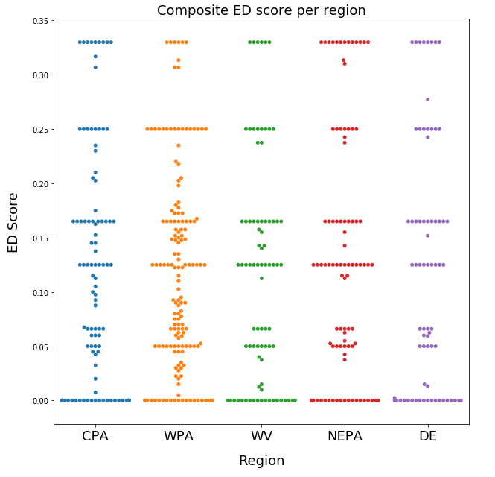
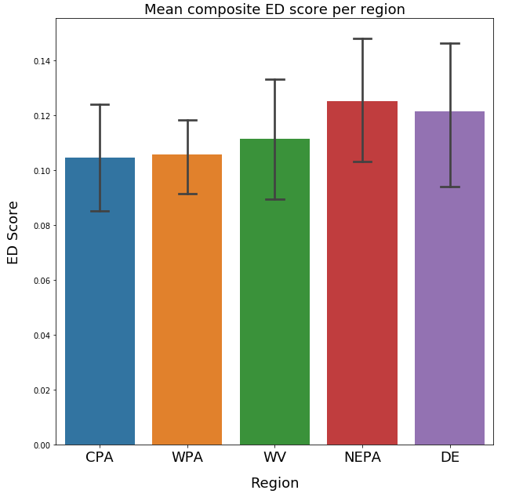
ED Score per Region

Slide 35
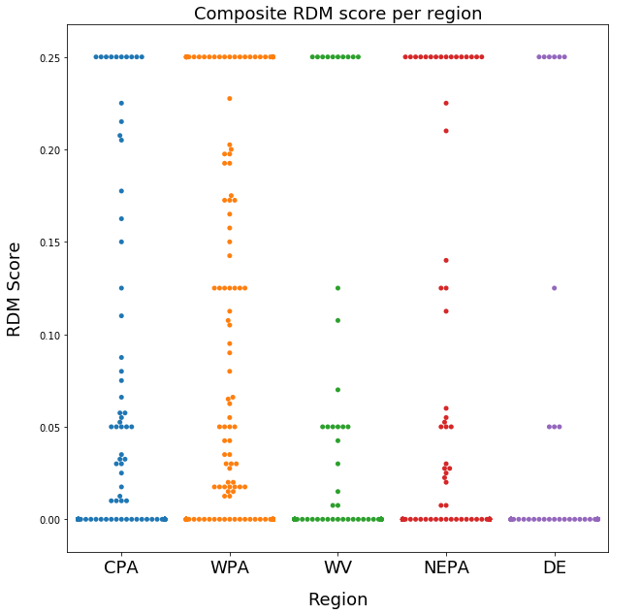
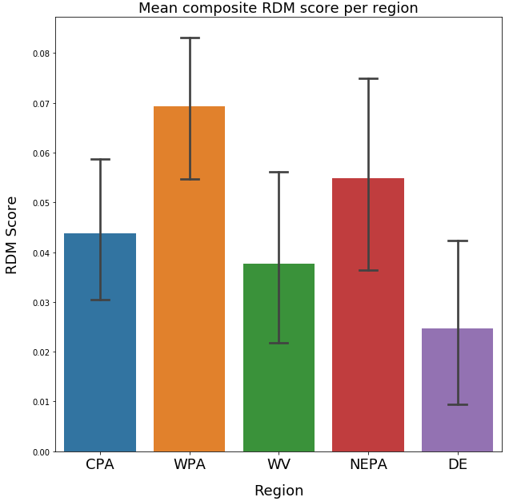
RDM Score per Region

Slide 36
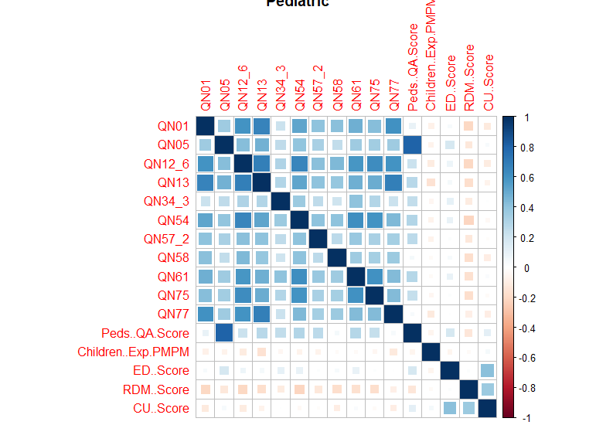
Correlation Matrices (Pediatric shown)

Slide 37
Program Eval in detail

