Slide 1
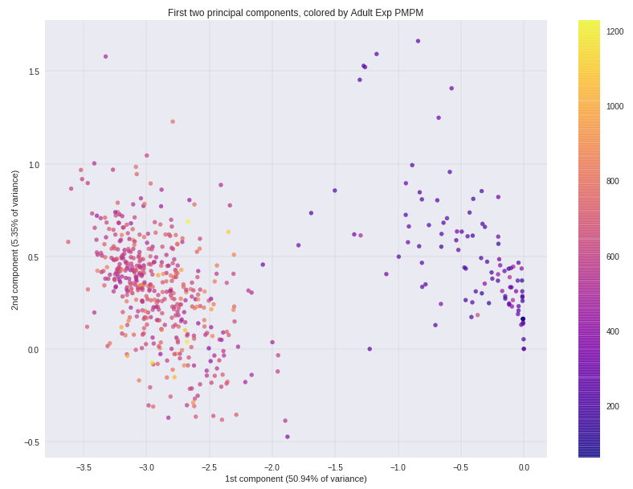
PCA reveals clusters of similar providers
First component:
QN09 – Colorectal Cancer Screening
QN08 – Breast Cancer Screening
QN41 – Drug Therapy for Rheumatoid Arthritis
QN40 – Medication Adherence for Cholesterol (Statins)
QN39 – Medication Adherence for Hypertension: RASA
QN10 – Cervical Cancer Screening
…

Slide 2
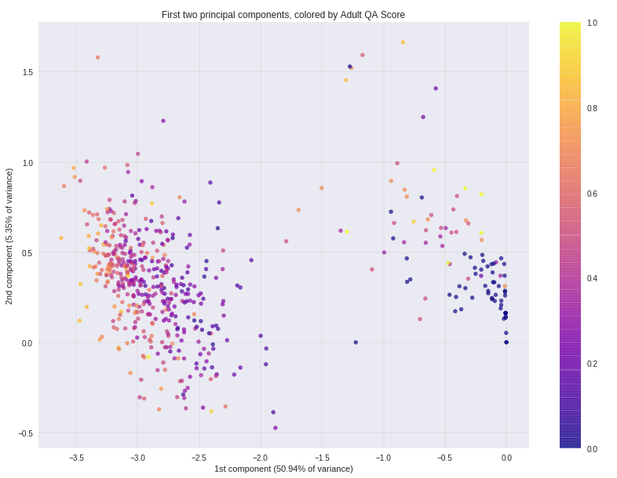
PCA reveals clusters of similar providers
First component:
QN09 – Colorectal Cancer Screening
QN08 – Breast Cancer Screening
QN41 – Drug Therapy for Rheumatoid Arthritis
QN40 – Medication Adherence for Cholesterol (Statins)
QN39 – Medication Adherence for Hypertension: RASA
QN10 – Cervical Cancer Screening
…

