Slide 1
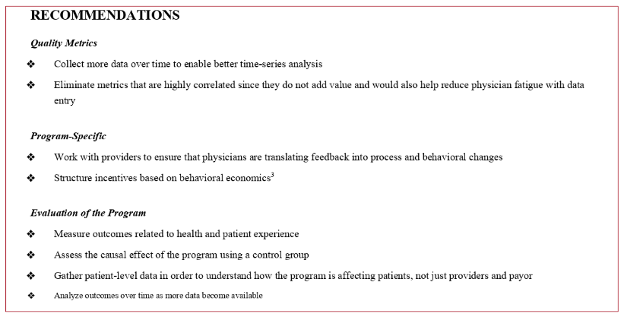
Recommendations

Slide 2
Recommendations
Quality Metrics
Collect more data over time to enable better time-series analysis
Eliminate metrics that are highly correlated since they do not add value and would also help reduce physician fatigue with data entry
Program-Specific
Work with Providers to ensure that physicians are translating feedback into process and behavioral changes
Structure incentives based on behavioral economics
Evaluation of the Program
Measure outcomes related to health and patient experience
Assess the causal effect of the program using a control group

Slide 3
Recommendations
Quality Metrics
Collect more data over time to enable better time-series analysis
Eliminate metrics that are highly correlated since they do not add value and would also help reduce physician fatigue with data entry
Program-Specific
Work with Providers to ensure that physicians are translating feedback into process and behavioral changes
Structure incentives based on behavioral economics
Evaluation of the Program
Measure outcomes related to health and patient experience
Assess the causal effect of the program using a control group

Slide 4
Recommendations
Quality Metrics
Collect more data over time to enable better time-series analysis
Eliminate metrics that are highly correlated since they do not add value and would also help reduce physician fatigue with data entry
Program-Specific
Work with Providers to ensure that physicians are translating feedback into process and behavioral changes
Structure incentives based on behavioral economics
Evaluation of the Program
Measure outcomes related to health and patient experience
Assess the causal effect of the program using a control group

Slide 5
Recommendations
Quality Metrics
Collect more data over time to enable better time-series analysis
Eliminate metrics that are highly correlated since they do not add value and would also help reduce physician fatigue with data entry
Program-Specific
Work with Providers to ensure that physicians are translating feedback into process and behavioral changes
Structure incentives based on behavioral economics
Evaluation of the Program
Measure outcomes related to health and patient experience
Assess the causal effect of the program using a control group

