Slide 1
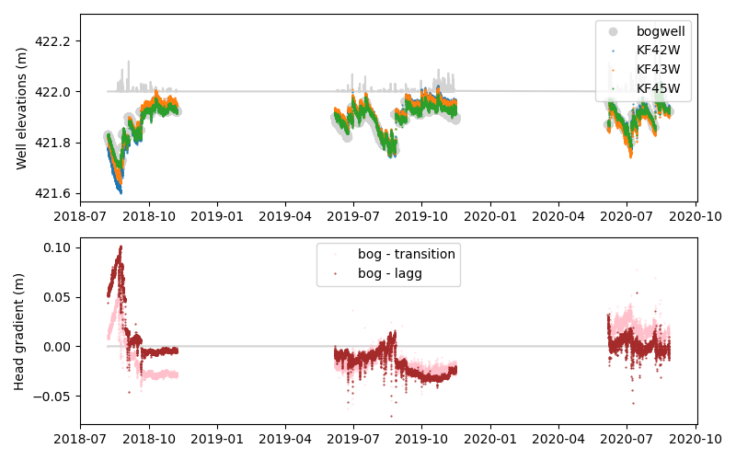

Slide 2
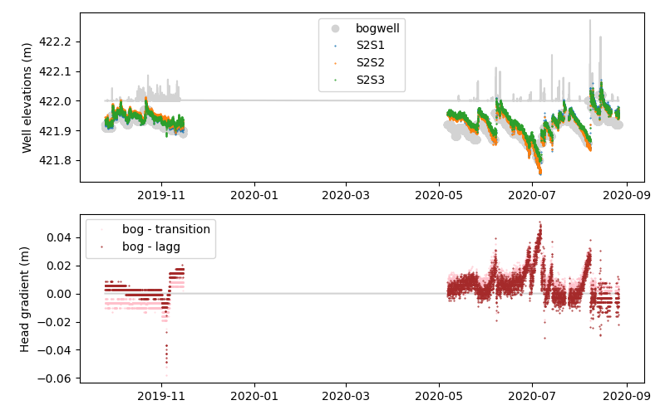

Slide 3
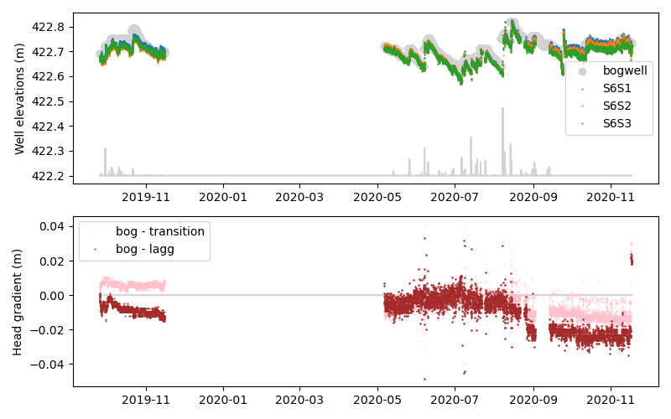

Slide 4
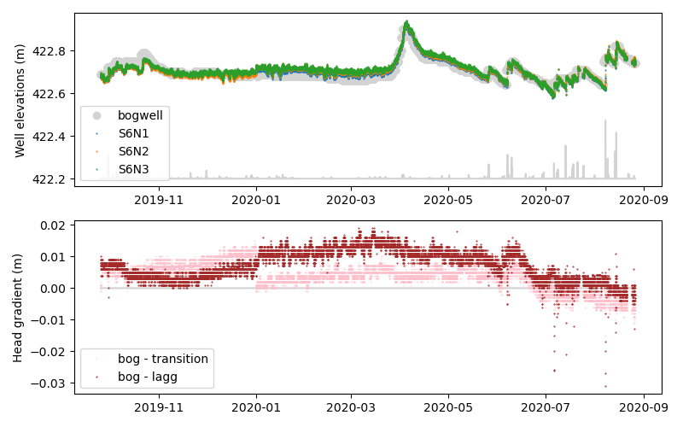

Slide 5
Wetter (i.e., water table higher) conditions leads to “reverse” flow (lagg into bog)... More enrichment of water chemistry based on richer chemistry in the lagg.
If we can extrapolate that high water table → inflow gradient into the bog
Then spring melt actually becomes an very important nutrient “renewal” process into the bog

Slide 6




Slide 7



Slide 8




Slide 9


