Slide 1
Meeting – June 25
Jon Earle

Slide 2
Campus Mesh Tests
Last week, I finished setting up my campus mesh and began testing.
The first tests consisted of sending packets across various routes and intervals, gathering data on delivery rate and latency.
My initial plan was to get delivery rate and latency metrics across two different routes (Goldberg to Dalplex, LSC to CHEB) at 5-second and 1-minute intervals.
It took quite a few attempts to get this test consistently working between the Goldberg to Dalplex. Unfortunately, did not work between the LSC and CHEB.
It could be interesting to use this data to see how Meshtastic simulations compared to real-world results, and how MeshCore performs with the same test.

Slide 3
Meshtastic Delivery Rate + Latency Test Results
Route: Goldberg to Dalplex
Interval | Avg DR (%) | Avg Latency (s) | ACK Received | Bidirectional %
1 minute | 51.6666667 | 8.187308351 | 28 | 90.32258065
5 second | 26 | 15.02221553 | 53 | 67.94871795
As more messages are sent throughout the mesh, delivery rate decreases and latency increases.
Latency is surprisingly high for both tests. This could be because of the LONG_FAST modem preset.
Unfortunately, for the time and effort put into these tests, these tests did not yield statistically significant results. Prioritizing other tests likely would have been more productive.

Slide 4
Mesh-wide Retransmission Test
The next test conducted was to determine how busy nodes are transmitting and retransmitting messages within a given time frame.
Procedure:
Walk around campus, gathering initial local_stats telemetry data, including:
Uptime seconds
% of time since boot taken up transmitting (airUtilTx)
Number of packets transmitted since boot
Number of packets received since boot
Number of duplicate packets
Number of packets relayed for other nodes
Send 1 packet every 5 seconds 100 times from the Goldberg to the Dalplex.
Walk around campus and gather the telemetry data again.

Slide 5
Mesh-wide Retransmission Test Results
timestamp | latitude | longitude | nodeId | uptimeSeconds | channelUtilization | airUtilTx | numPacketsTx | numPacketsRx | numPacketsRxBad | numRxDupe | numTxRelay | numOnlineNodes | numTotalNodes
1782308803.6791291 | 44.6374710331165 | -63.5875248258794 | !6c73daa0 | 61 | 7.8933334 | 0.06255556 | 3 | 7 | 2 | 3 | 1 | 9 | 47
1782309202.331554 | 44.6369664633251 | -63.5891976671482 | !dadfb0cc | 61 | 19.748333 | 0.12286111 | 6 | 14 | 1 | 7 | 5 | 62 | 62
1782310165.334353 | 44.6347432599171 | -63.5917649968432 | !dadfb8d4 | 61 | 10.715 | 0.05611111 | 2 | 5 | 3 | 1 | 1 | 23 | 66
1782310732.606525 | 44.6362052985069 | -63.5940921770574 | !dadfb008 | 122 | 7.621667 | 0.06408334 | 2 | 8 | 4 | 2 | 1 | 2 | 79
1782312597.389235 | 44.6391960574960 | -63.5828730326646 | !dadfb03c | 61 | N/A | 0.028055554 | 1 | N/A | N/A | N/A | N/A | 41 | 41
1782315554.031728 | 44.6374710331165 | -63.5875248258794 | !6c73daa0 | 6844 | 2.0033333 | 5.9859166 | 447 | 665 | 156 | 400 | 64 | 18 | 51
1782316035.450979 | 44.6369664633251 | -63.5891976671482 | !dadfb0cc | 6902 | 4.14 | 5.2986665 | 409 | 1036 | 132 | 406 | 399 | 70 | 70
1782316761.518246 | 44.6347432599171 | -63.5917649968432 | !dadfb8d4 | 6662 | 2.0033333 | 1.7945001 | 155 | 812 | 70 | 267 | 133 | 24 | 66
1782317435.696922 | 44.6362052985069 | -63.5940921770574 | !dadfb008 | 6784 | 7.5516663 | 4.1583333 | 386 | 832 | 95 | 261 | 385 | 24 | 79
1782318815.515288 | 44.6391960574960 | -63.5828730326646 | !dadfb03c | 6242 | N/A | 0.028833333 | 3 | N/A | N/A | N/A | N/A | 41 | 41
 | 44.6374710331165 | -63.5875248258794 | !6c73daa0 | 6783 |  | 5.92336104 | 444 | 658 | 154 | 397 | 63 | 9 | 4
 | 44.6369664633251 | -63.5891976671482 | !dadfb0cc | 6841 |  | 5.17580539 | 403 | 1022 | 131 | 399 | 394 | 8 | 8
 | 44.6347432599171 | -63.5917649968432 | !dadfb8d4 | 6601 |  | 1.73838899 | 153 | 807 | 67 | 266 | 132 | 1 | 0
 | 44.6362052985069 | -63.5940921770574 | !dadfb008 | 6662 |  | 4.09424996 | 384 | 824 | 91 | 259 | 384 | 22 | 0
 | 44.6391960574960 | -63.5828730326646 | !dadfb03c | 6181 |  | 0.000777779 | 2 | N/A | N/A | N/A | N/A | 0 | 0
Note: !dadfb03c (CHEB) did not have the default telemetry settings turned on

Slide 6
Mesh-wide Retransmission Test Results
latitude | longitude | nodeId | uptimeSeconds | airUtilTx | numPacketsTx | numPacketsRx | numPacketsRxBad | numRxDupe | numTxRelay | numOnlineNodes | numTotalNodes
44.6374710331165 | -63.5875248258794 | !6c73daa0 | 6783 | 5.92336104 | 444 | 658 | 154 | 397 | 63 | 9 | 4
44.6369664633251 | -63.5891976671482 | !dadfb0cc | 6841 | 5.17580539 | 403 | 1022 | 131 | 399 | 394 | 8 | 8
44.6347432599171 | -63.5917649968432 | !dadfb8d4 | 6601 | 1.73838899 | 153 | 807 | 67 | 266 | 132 | 1 | 0
44.6362052985069 | -63.5940921770574 | !dadfb008 | 6662 | 4.09424996 | 384 | 824 | 91 | 259 | 384 | 22 | 0
44.6391960574960 | -63.5828730326646 | !dadfb03c | 6181 | 0.000777779 | 2 | N/A | N/A | N/A | N/A | 0 | 0

Slide 7
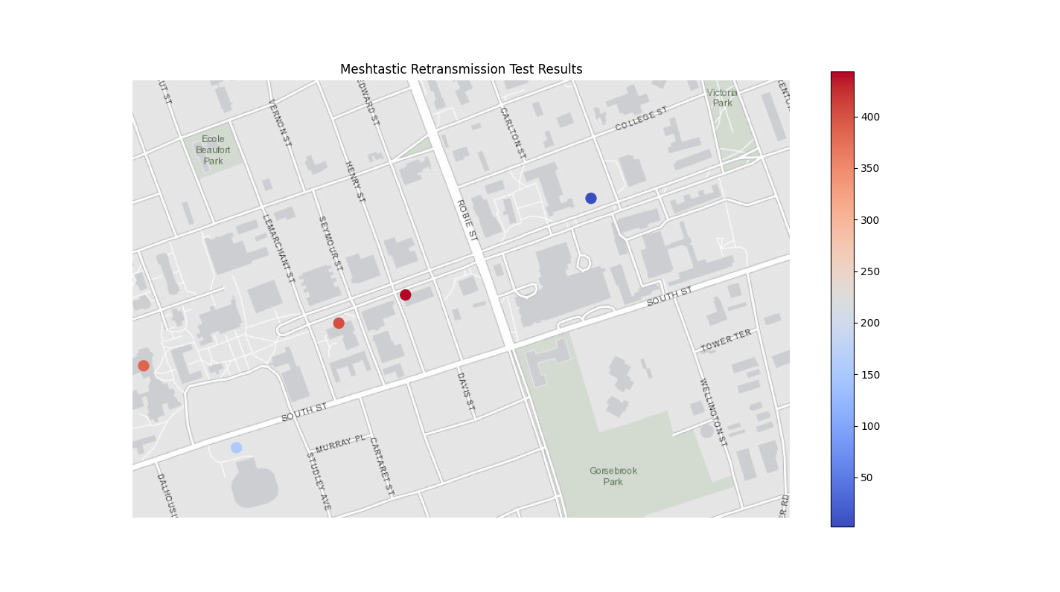

Slide 8
Mesh-wide Retransmission Test
There were some issues with the test:
There is supposed to be another node (!dadfb6c8) in the McCain Arts Building Room 2130 but unfortunately, the doors to the classroom have been locked. Fortunately, the node is still active and is still part of the mesh.
Although I assumed the node in the Collaborative Health Education Building (CHEB) had been recently re-flashed with default settings, I discovered this was not the case only after the test was completed. Because the telemetry module was disabled, data collection was restricted to airUtilTx and packet counts. These metrics remained artificially low because routine background broadcasts were suppressed.
This test could be re-done in the future with these changes for more data and accurate results.
Additionally, this test could be done with custom firmware I have written previously which exposes airUtilTx as milliseconds transferring packets since boot, instead of a percentage of time.

Slide 9
Next Week
Battery Consumption Testing
Observe the overnight power draw on nodes under default conditions.
Mobile Routing Test
Observing how Meshtastic adapts to moving nodes, how broken paths are updated dynamically and how this affects communication performance.
MeshCore
Re-run the previous tests and/or new tests on MeshCore firmware to compare how architectural differences impact results in urban environments.

