Slide 1
Meeting – July 2
Jon Earle

Slide 2
This Week
Link Quality Analysis
MeshMonitor

Slide 3
Link Quality Analysis
This week, I continued my link quality analysis testing, gathering more data on how the link quality decreases as packets are sent at a higher interval.
For each interval, 50 packets are sent between the Dalplex and the Goldberg. The intervals at which I am sending packets are: 5 seconds, 20 seconds, 40 seconds, 1 minute and 5 minutes.
A test for each interval is run at three times of day: morning, afternoon and night.
Although most of the tests are complete, not all tests for every time of day are complete yet. Because I had some initial issues with my scripts, the tests are taking longer than anticipated to complete.

Slide 4
From Data Collected This Morning
METRIC/INTERVAL - Morning | 5sec | 20sec | 40sec | 1min | Average
DR (%) | 74 | 98 | 100 | 100 | N/A
latency | N/A | N/A | N/A | N/A | N/A
avg hops | 1.97297297 | 1.95918367 | 2 | 1.96 | 1.97303916
avg RSSI (outgoing) | -137.64865 | -138.77551 | -138.84 | -139.12 | -138.59604
RSSI SD (outgoing) | 1.90345032 | 1.77089086 | 1.3606721 | 5.50191061 | 2.63423097
avg SNR (outgoing) | -12.797297 | -13.897959 | -14.09 | -14.57 | -13.838814
SNR SD (outgoing) | 1.74487129 | 1.51804971 | 1.10744236 | 3.74371582 | 2.02851979
ACKs received | 13 | 49 | 50 | 50 | N/A
ACKs received (%) | 26 | 98 | 100 | 100 | N/A
avg RSSI (ACK) | -119.3 | -121.35294 | -124.62 | -122.52083 | -121.94844
RSSI SD (ACK) | 13.0558629 | 11.1728663 | 14.5151434 | 15.1825622 | 13.4816087
avg SNR (ACK) | 1.675 | 0.44607843 | -2.45 | -1.1197917 | -0.3621783
SNR SD (ACK) | 9.05691878 | 9.98890806 | 12.9188006 | 12.50319 | 11.1169543

Slide 7
Morning Data cont.
From last week’s testing:
Delivery rate for both the 5 second and 1-minute intervals are up 48% from last week
ACKs received for the 5 second interval are identical to last week but are up 9% for the 1-minute interval.
The delivery rate for the receiver node at the Dalplex has increased drastically, while the number of ACKs being received by the sender node in the Goldberg is relatively similar.
What would cause this? Potentially a previous issue with the script now solved?

Slide 8
MeshMonitor
While running the link quality tests, I focused my attention on other items, most notably, I focused my attention on implementing a community tool called MeshMonitor into the campus mesh.
MeshMonitor is a web app used for the remote monitoring and administration of various kinds of LoRa mesh technology, including both Meshtastic and MeshCore.
Currently, I have MeshMonitor working on my lab desktop, attached to a smaller LILYGO LoRa32 device, which has access to the mesh through the T-Beam set up in Goldberg Room 211.

Slide 9
MeshMonitor cont.
MeshMonitor is a fantastic, highly useful tool, with a variety of features that significantly improve quality of life.
MeshMonitor has a dashboard that visualizes absolutely every metric provided through local telemetry. This includes:
Packets TX/RX/TX relayed
Nodes by hardware model
Radio statistics (% of good, bad, duplicate packets)
Voltage + Battery Life
And more!
There is also a dedicated telemetry dashboard which shows:
Node Status
Hop and distance distribution/heatmap across all nodes in the DB, color coded by SNR

Slide 10
MeshMonitor cont.
MeshMonitor has a dedicated page for administrative commands, allowing the user to remotely change the settings of any device they have access to without using the terminal.
Additionally, MeshMonitor has a security page, where MeshMonitor will scan the node DB for known low-entropy or duplicate keys
The issues causing low-entropy and duplicate keys have been patched.
MeshMonitor supports automation tasks including:
Auto Welcome, Traceroute, send LocalStats
Remote admin scanner
MeshMonitor stores all packet/node data locally in a SQLite DB.

Slide 11
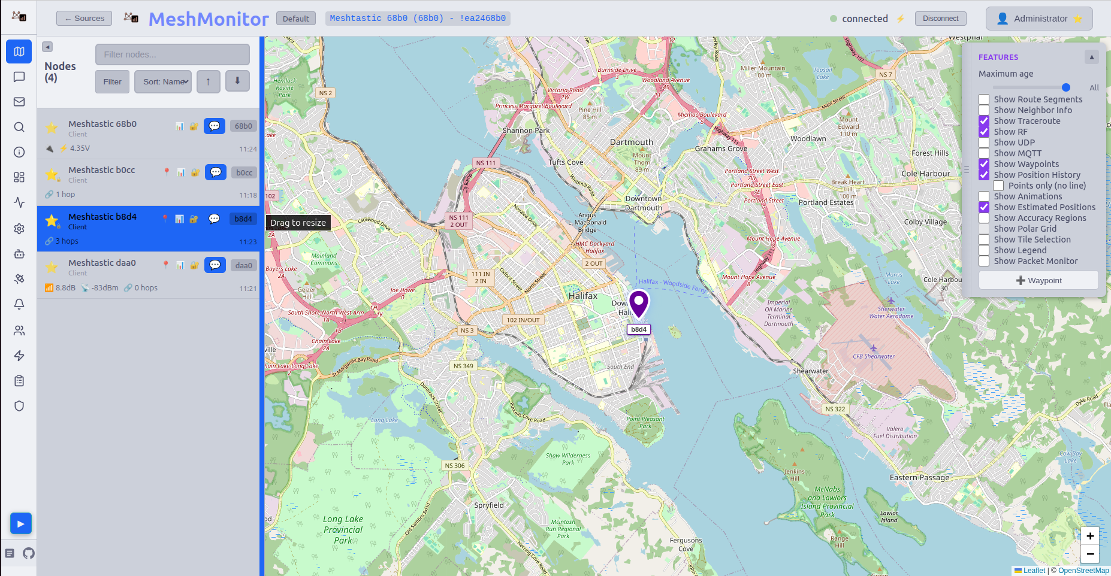

Slide 12
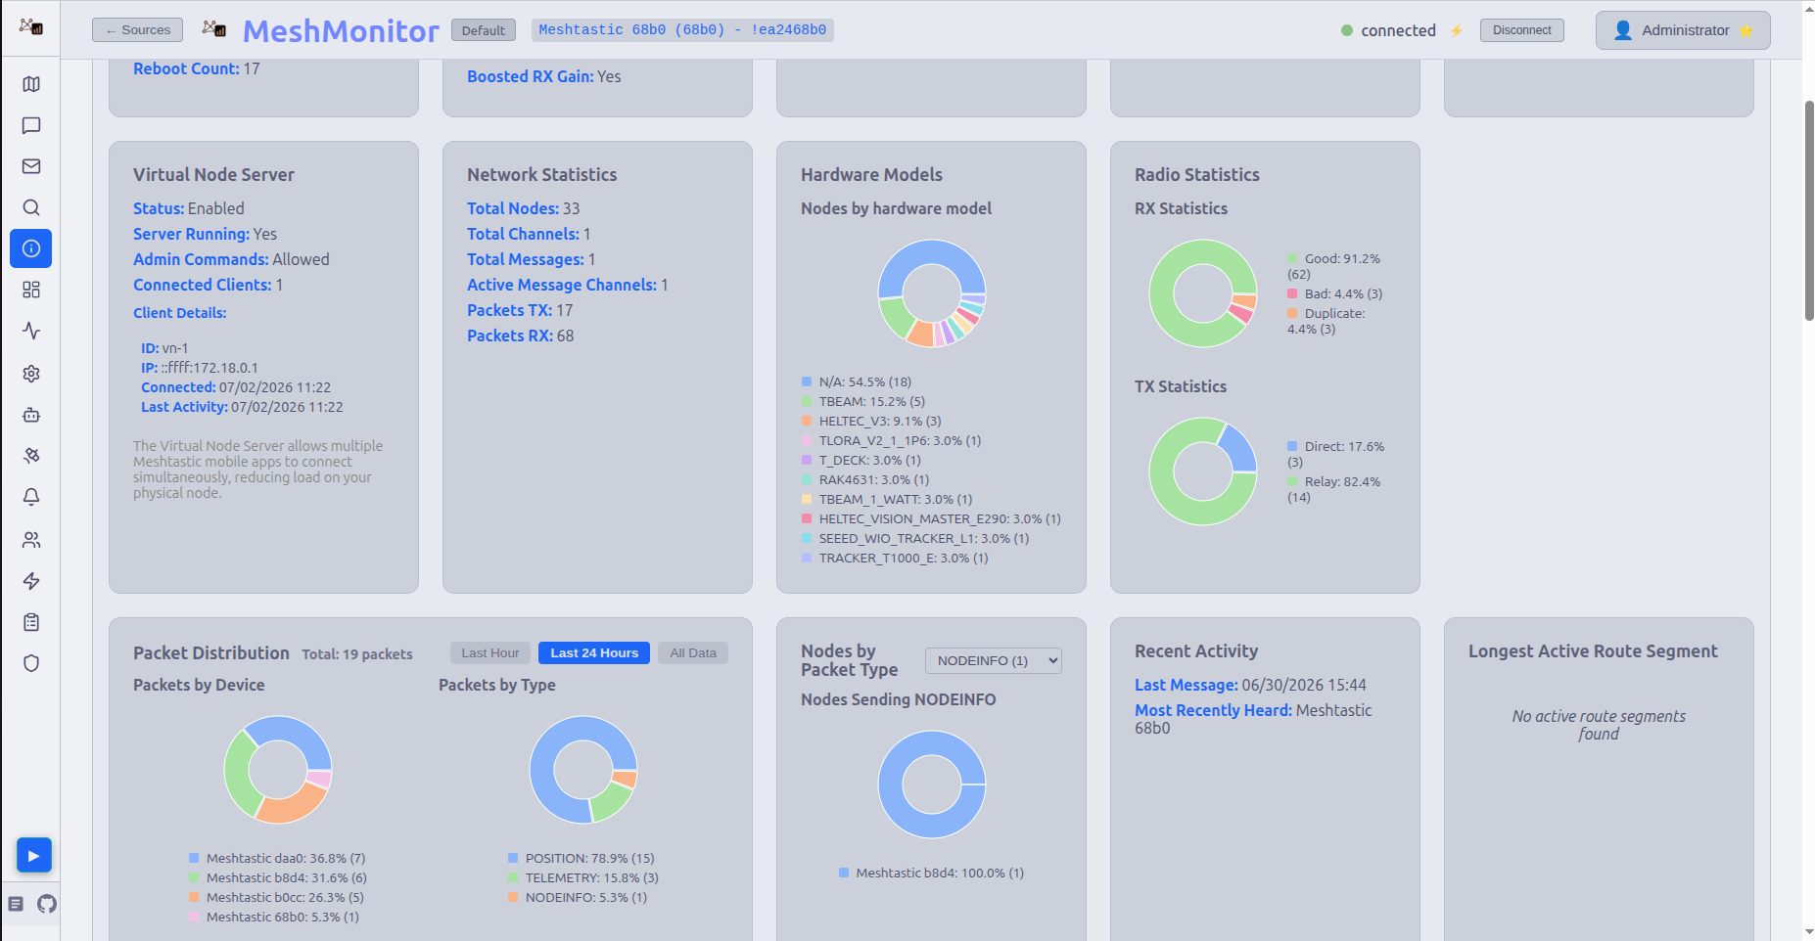

Slide 13
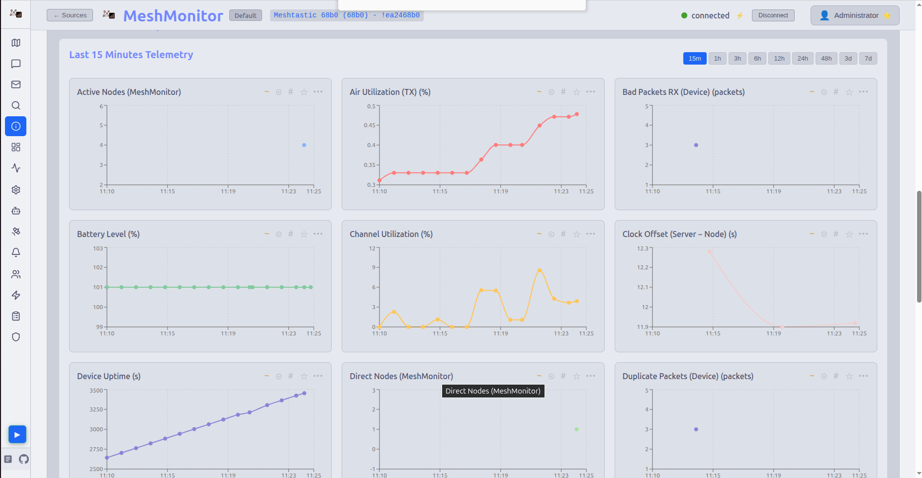

Slide 14
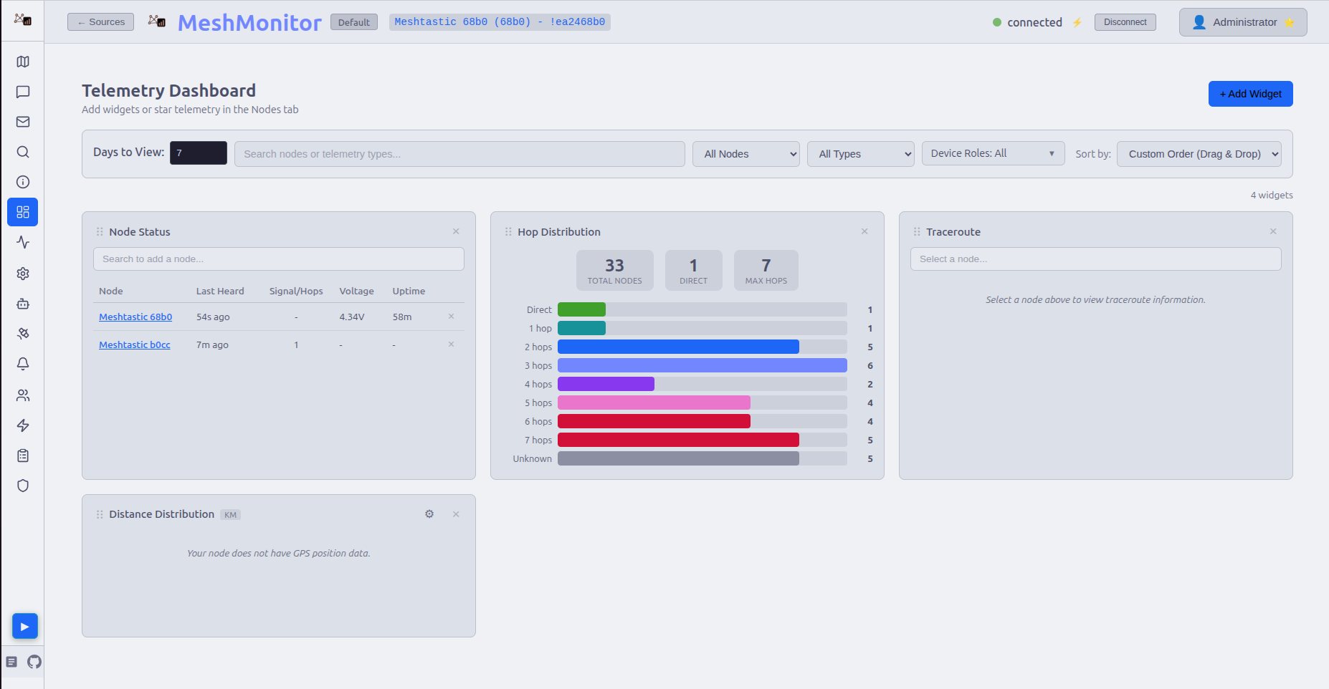

Slide 15
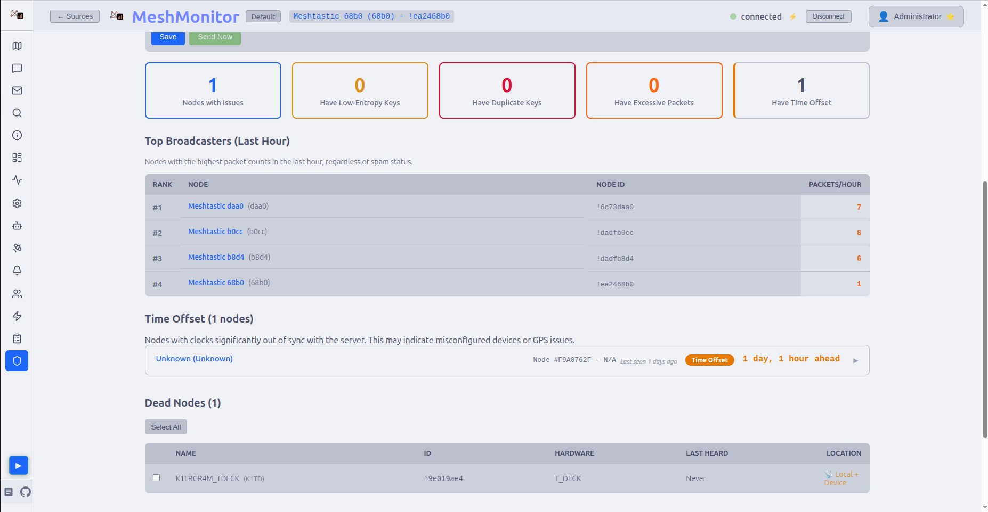

Slide 16
