Slide 1
Project Planning
Jon Earle – USRA 2026

Slide 2
Review: LoRa Radio
Review: LoRa is a wireless radio technology designed for the long-range communication of low-power devices.
A poor wireless connection can result in lost packets or an increased power consumption to compensate for losses.
Because LoRa is used for transmitting weaker signals over long ranges, strong node placement is important for good performance, especially for a city-wide mesh.
Good node placement is outdoors on high places away from buildings and other blockages. A strong line of sight between nodes is always ideal.

Slide 3
Meshtastic vs. MeshCore Node Placement
Both Meshtastic and MeshCore nodes should follow the general guidelines as described previously.
However, MeshCore’s role-based architecture requires more careful network planning.
With MeshCore, receiver nodes should not only be at the highest and clearest locations but should also be near the center of the mesh or surrounded by other nodes to make communication throughout the mesh more efficient.
For both systems, a realistic maximum range between nodes in an urban environment is 2-5km (source). Thus, we should also scatter nodes such that this distance is not exceeded.

Slide 4
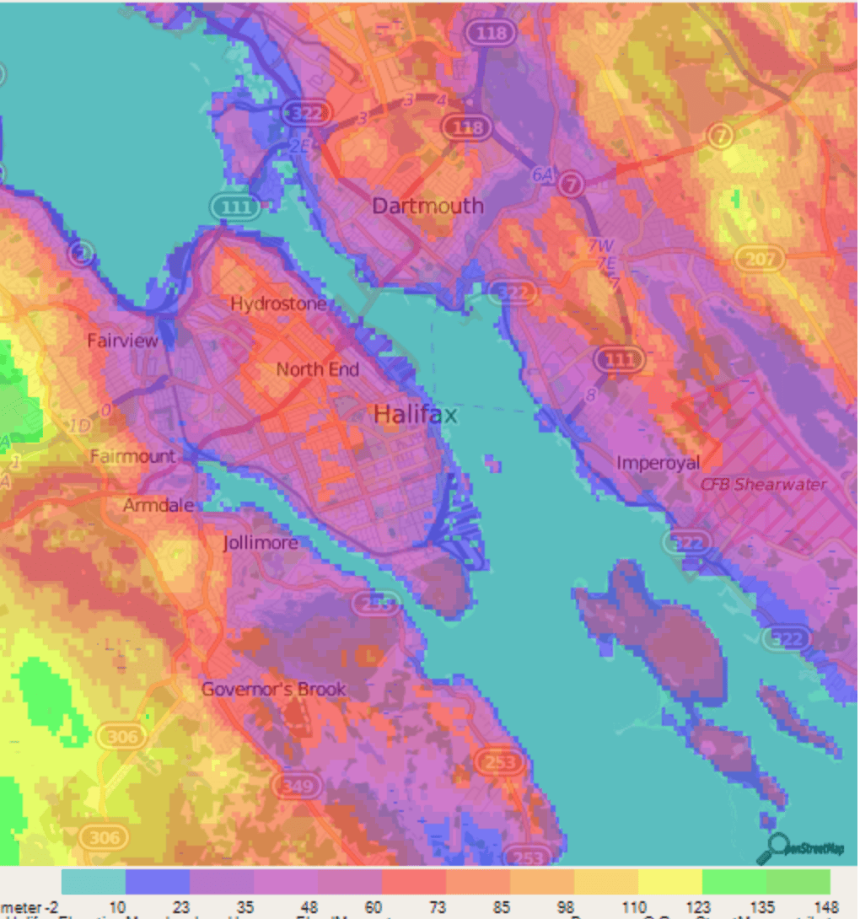
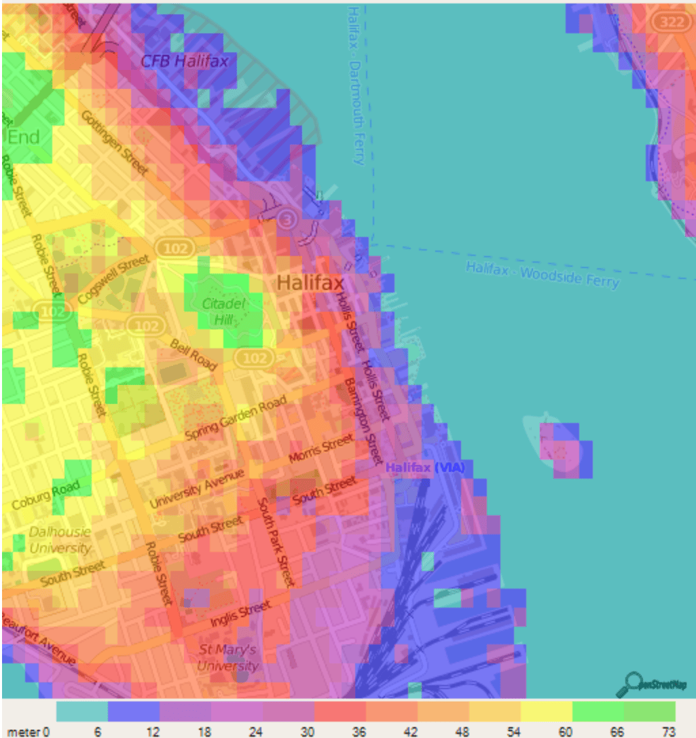
Topographic Map of Halifax Area

Slide 5
Candidate Locations for Nodes (Halifax)
Citadel Hill
One77 Quinpool Road
North End (Robie St.) Water Tower
Fenwick Tower/The Vuse
Goldberg Computer Science Building
Tupper Medical Building
Dingle Tower
The Northwest (apt. building)
Maritime Center
Halifax Forum (somewhere in that area)
Prince of Wales Tower (PPP)
Tupper Medical Building
Saint Mary’s University Observatory
Atlantica Hotel
Merv Sullivan Park
Fort Needham Park
Northwood Home
St. Thomas Aquinas Church

Slide 6
Candidate Locations for Nodes (Outside HFX)
Wyse Tower
The Kevel
Brightwood Golf Course
Horizon Court Apartments
1 Oak Street Apartment
Northbrook Park Apartment
4 Franklyn Court Apartment
Bell Lake Trail
Cowie Hill Apartments
The Waterton Condominiums
HCHC Apartments
The MZM
Icon Bay Developments
…and potentially more?

Slide 7
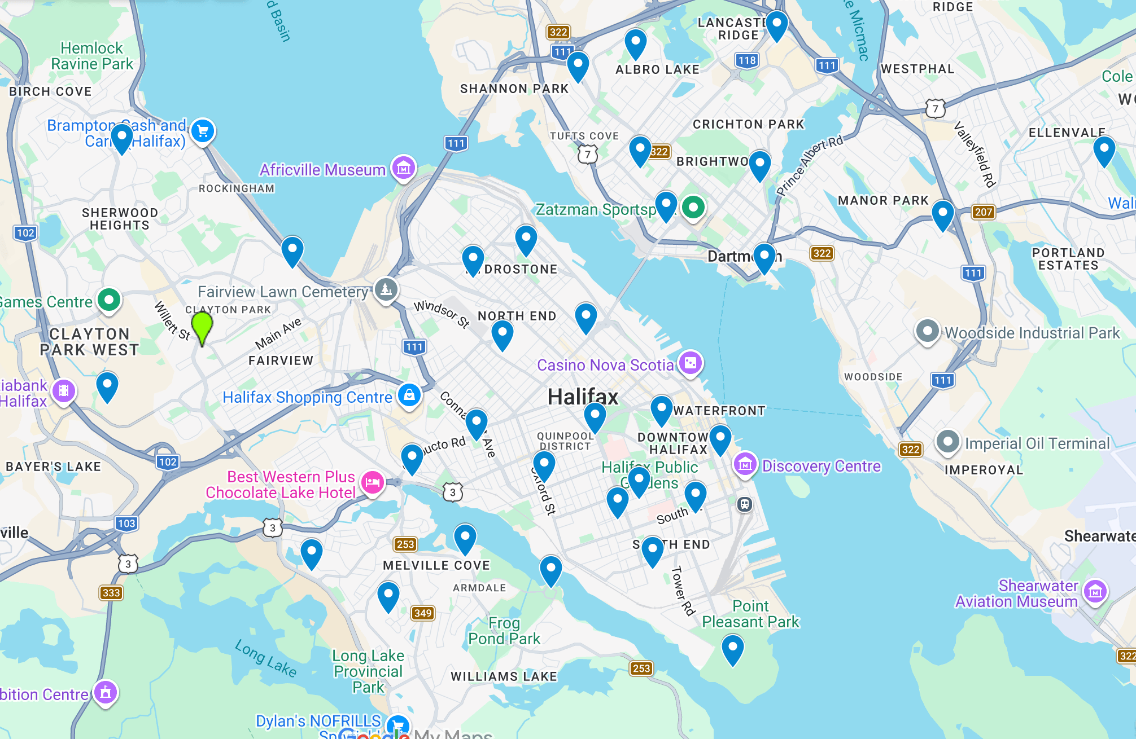
Candidate Locations for Nodes

