Slide 1
Meeting – June 10
Jon Earle

Slide 2
Start of the Week
Last week, I stated the plan was to deploy a small mesh around campus and run tests on them, analyzing signal strength, quality and comparing efficiency between firmwares.
I was going to jump in and assume that under the the same settings, zero-hop communication with Meshtastic and MeshCore are essentially equal. However, I wanted some evidence to back this claim and decided run a simple test for my hypothesis.
The test consisted of biking down University Ave (to Sexton and back), comparing range, RSSI and SNR between the two firmware.

Slide 3
LoRa Settings
All the settings below were applied on both firmware.
Frequency: 906.875 MHz
Bandwidth: 250 kHz
Spreading Factor: 11
Coding Rate: 5 (or 4/5)
Transmit Power: 20 dBm

Slide 4
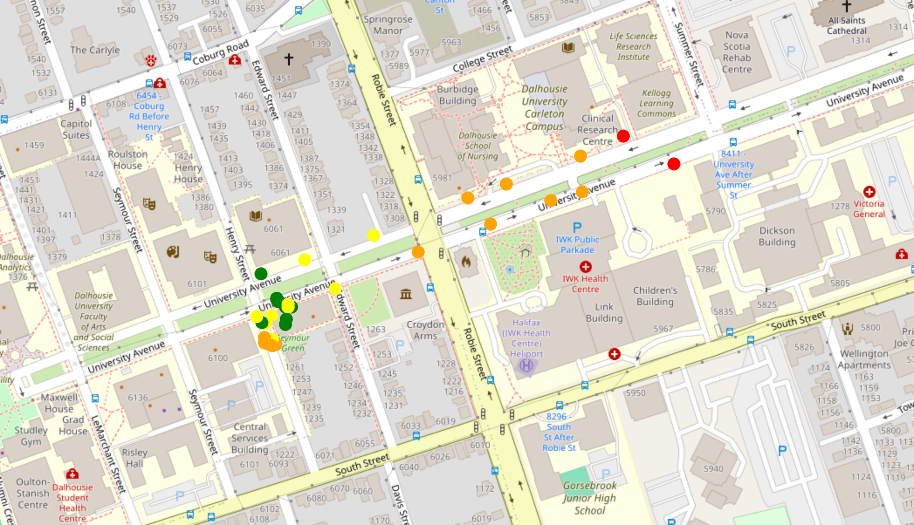
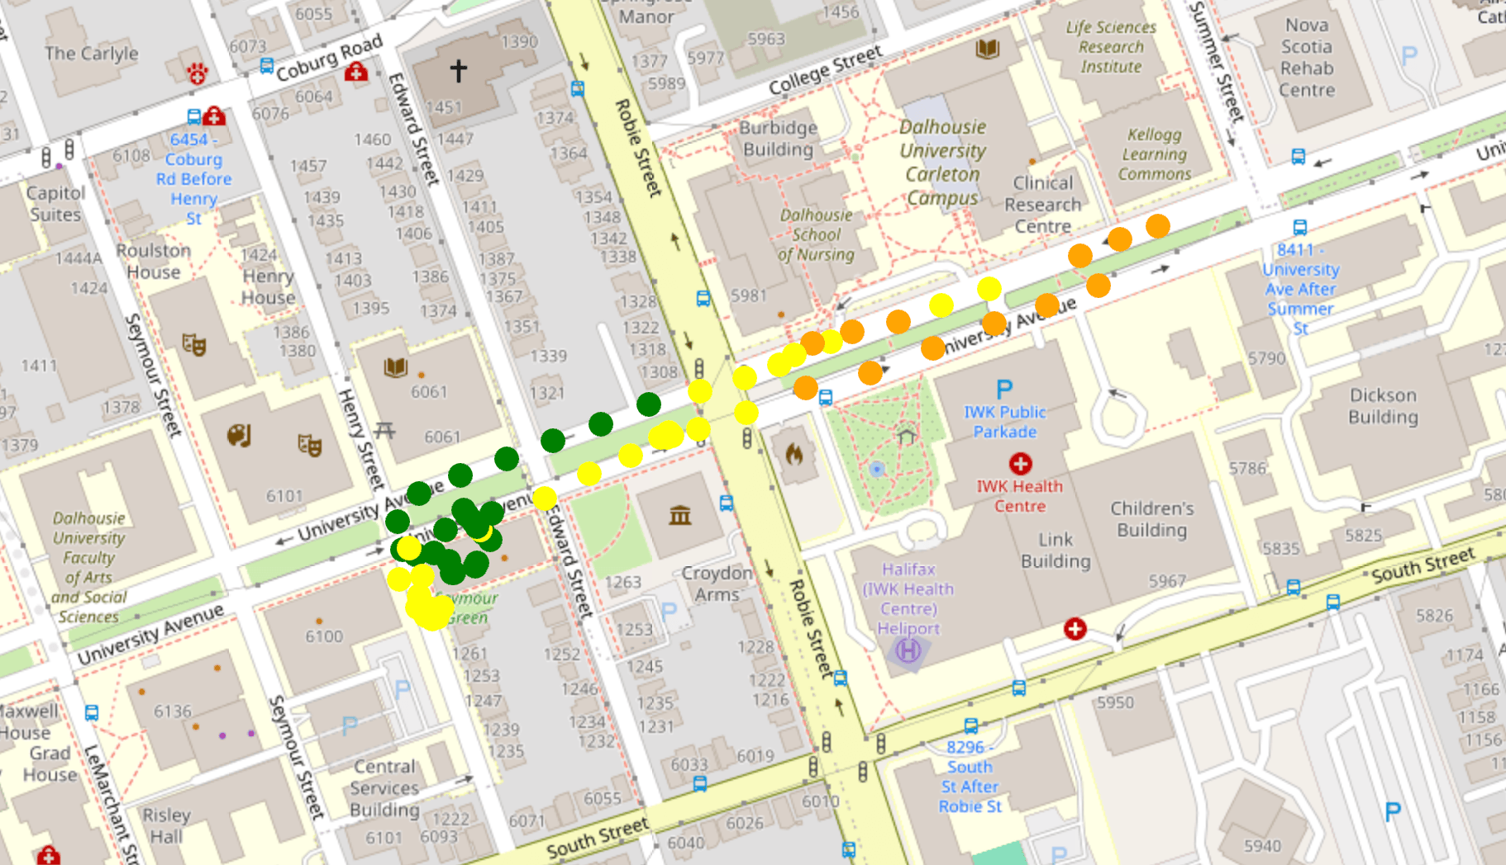
Basic Firmware Comparison Test Results
RSSI
Meshtastic
MeshCore

Slide 5
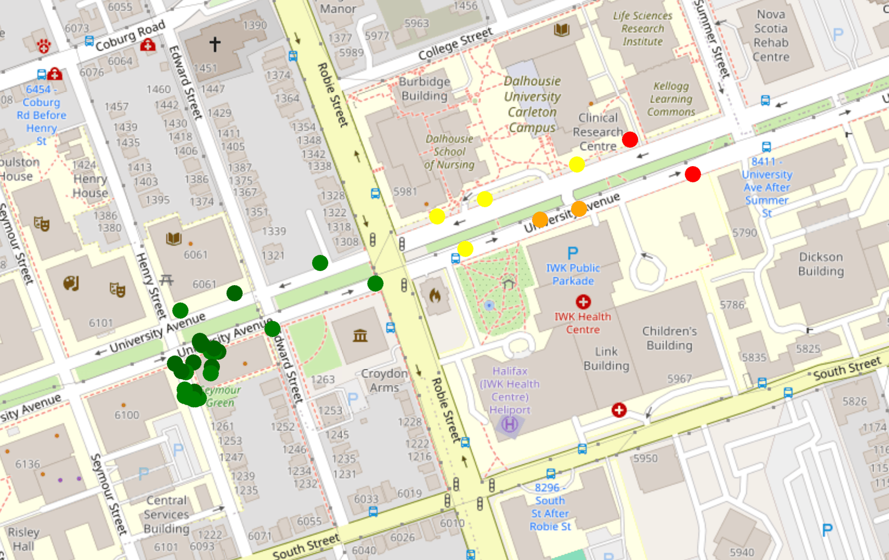
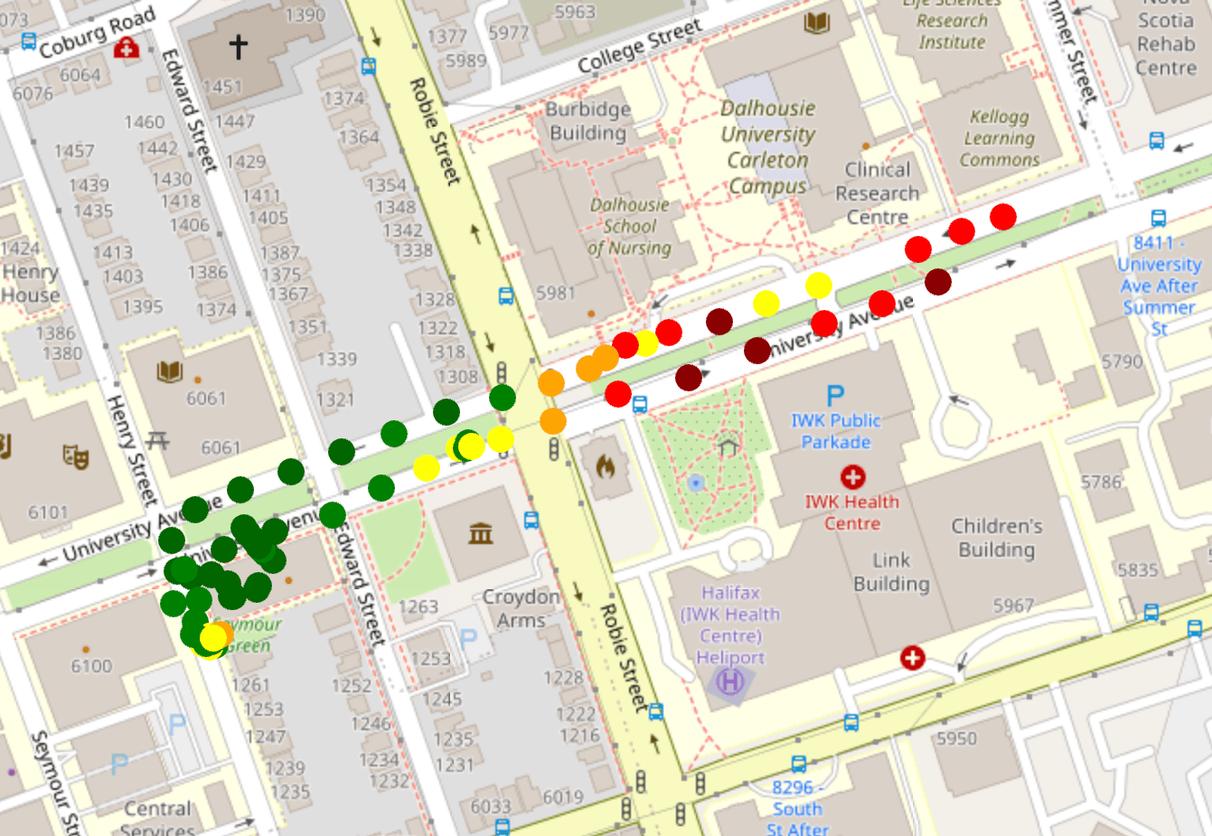
Basic Firmware Comparison Test Results
SNR
Meshtastic
MeshCore

Slide 6
Results
Comparing the two firmware, there seems to be very little difference in all metrics, including range, RSSI and SNR.
I believe the tests show prove enough to say that the two firmware perform similarly enough that further tests can be done under the assumption that they are equal under the same LoRa settings.
The bigger takeaway, however, the range of this test compared to the previous bike tests. In these tests, I switched the sender node to the T3 LoRa32 V1.6.1, which has a much smaller default antenna.
I believe that this significant decrease in sensitivity can be attributed to the change in antenna.

Slide 7
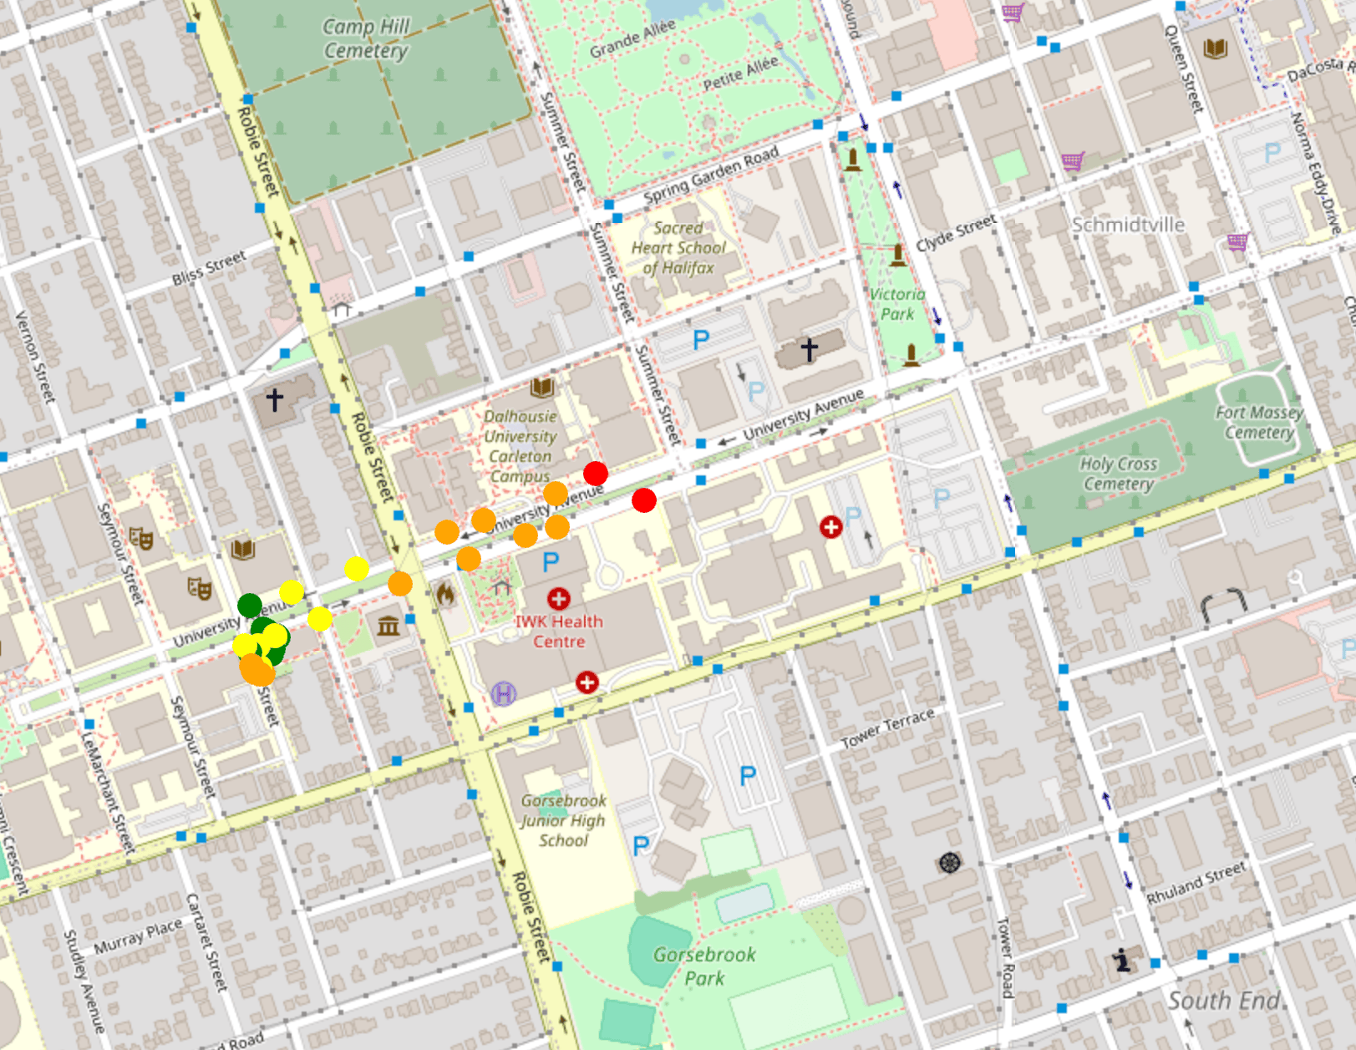
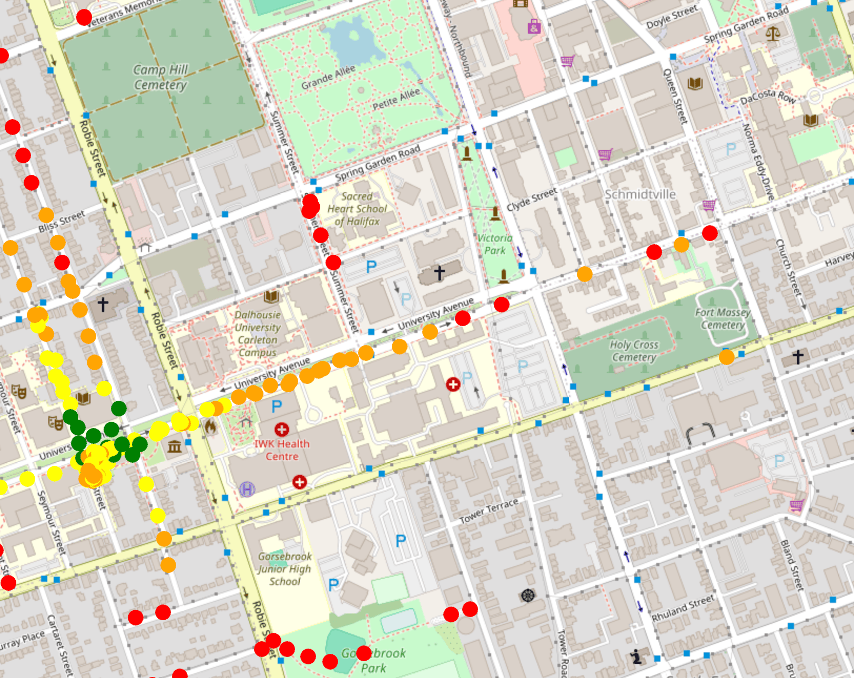
Range Comparison
Small Antenna - T3 LoRa32 V1.6.1
Large Antenna - T-Beam V1.1

