Slide 1
Meeting – July 9

Slide 2
Overview
Link Quality Analysis
Leveraging MeshMonitor to observe mesh behavior in real-time
Dynamic node testing

Slide 3
Link Quality Analysis
Earlier this week, I continued the link quality analysis, running the same tests as before except at a different time of day.
Additionally, I made sure to include both sender and receiver timestamps to calculate end-to end latency.
The results for the afternoon tests were, for the most part, similar to those from the morning.
Some notable observations include:
The delivery rate 20 and 40 second intervals was lower on the afternoon test, but maintained the same increasing trend
The 5 second interval had high latency, with packets being received in a different order than they were sent and a large variance in latency values.

Slide 4
AFTERNOON | 5sec | 20sec | 40sec | 1min | total
DR (%) | 78 | 86 | 90 | 98 | 88.5
latency | 65.9918098 | 6.23665905 | 6.61673935 | 6.21463817 | 6.35601219 | 21.2649616
latency SD | 44.0988802 | 0.81603368 | 1.75006418 | 0.84907817 | 1.22359576 | 32.1789572
avg hops | 1.8974359 | 1.97674419 | 1.95652174 | 2 | 1.95767546
avg RSSI (dBm, outgoing) | -138.17949 | -138.60465 | -138.8913 | -137.4898 | -138.29131
RSSI SD (outgoing) | 1.76026007 | 1.77468354 | 2.19320426 | 1.20972533 | 1.83004444
avg SNR (dB, outgoing) | -14.121795 | -13.976744 | -14.440217 | -12.877551 | -13.854077
SNR SD (outgoing) | 1.70223517 | 1.67688589 | 2.05763131 | 1.16046243 | 1.76647379
ACKs received | 17 | 43 | 46 | 49 | 155
ACKs received (%) | 34 | 86 | 92 | 98 | 77.5
avg RSSI (dBm, ACK) | -118 | -121.37209 | -118.77778 | -120.7551 | -120.1
RSSI SD (ACK) | 7.85281266 | 10.9870557 | 10.3218411 | 11.7287585 | 10.7838744
avg SNR (dB, ACK) | 2.96153846 | 0.98837209 | 2.77777778 | 1.10714286 | 1.735
SNR SD (ACK) | 6.73597784 | 9.50907359 | 8.93381953 | 10.2525403 | 9.34473212
Cells highlighted in orange have extreme, unusual values. The average for these do not take these into account, unless also highlighted in orange.

Slide 5
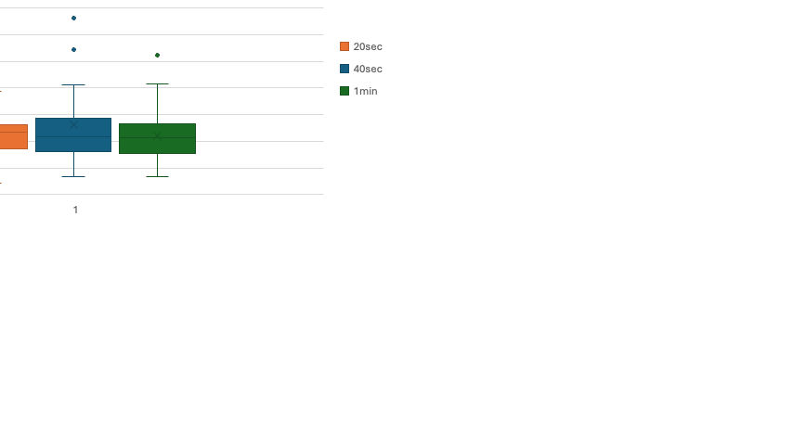

Slide 7
Leveraging MeshMonitor
While MeshMonitor is a fantastic tool for remotely monitoring, tweaking and updating LoRa mesh nodes, it lacked one function I was looking for: to observe how often all nodes were transmitting and receiving packets.
MeshMonitor by default exposes this data for the local node, but not for other remote nodes.
However, MeshMonitor does have a tool which automates local_stats telemetry request from certain nodes at a given interval.
Using this tool, I was able to create a live Grafana dashboard to monitor in real-time which nodes are transmitting the most, relaying and receiving the most packets

Slide 8
Dashboard Snapshot
Link:

Slide 9
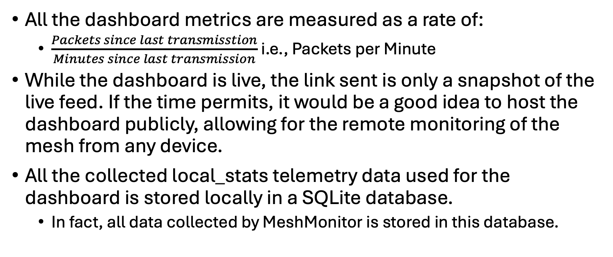
Meshtastic Dashboard
All the dashboard metrics are measured as a rate of:
$\frac{Packets since last transmisstion}{Minutes since last transmission}$ i.e., Packets per Minute
While the dashboard is live, the link sent is only a snapshot of the live feed. If the time permits, it would be a good idea to host the dashboard publicly, allowing for the remote monitoring of the mesh from any device.
All the collected local_stats telemetry data used for the dashboard is stored locally in a SQLite database.
In fact, all data collected by MeshMonitor is stored in this database.

