Slide 1
Week 1 Readings
Jon Earle

Slide 2
Overview

Slide 3
What is Mesh and LoRa?
Mesh: A network where nodes connect directly to as many other nodes as possible to efficiently send data to and from clients.
Mesh networks are decentralized, meaning it generally does not rely on one central router.
LoRa is a wireless radio technology designed for the long-range communication of low-power devices. Thus, it is commonly used in IoT and mesh communication, where power is a serious constraint.
LoRa sacrifices speed for distance and reliability.
LoRa is also resistant to noise (because of Chirp Spread Spectrum) and is good at detecting weak signals. However, it is vulnerable to blockage and works best with a clear line-of-sight.
Notes:
A mesh network is effectively a decentralized network where nodes connect to as many other nodes as possible to efficiently send data
LoRa is a wireless radio technology which is designed for long range communication and low power consumption
It is for this reason that LoRa is good for IoT devices

Slide 4
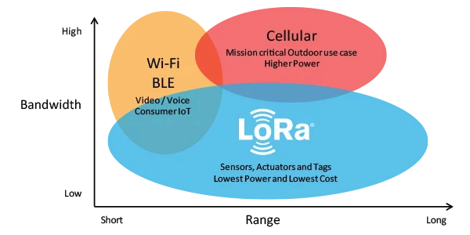
Bandwidth: The maximum rate at which data can be transmitted within a given time frame.

Slide 5
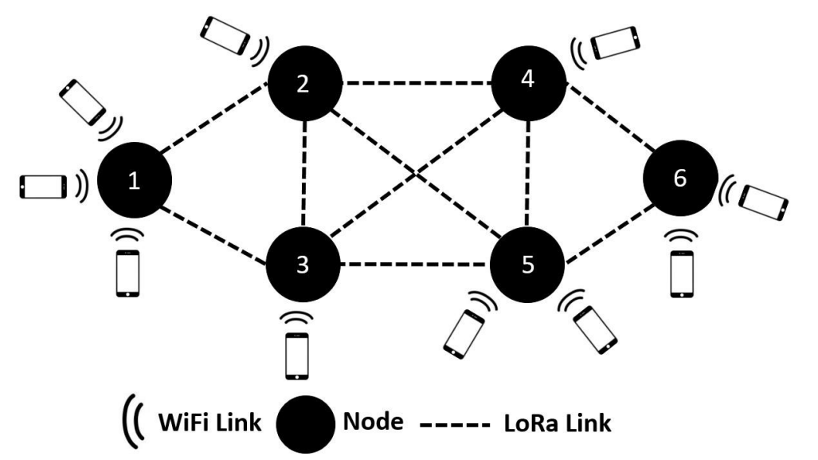
Note: The link between the smartphone/computer does not have to be Wi-Fi but can also be Bluetooth or serial.

Slide 6
Why Mesh Communication?
Programs like Meshtastic and MeshCore use LoRa to create a mesh network, allowing for simple, long-range communication without the use of cellular or Wi-Fi.
Unlike traditional HAM radio, LoRa does not require certification to use.
Thus, LoRa mesh communications are highly appealing in the event of an emergency, where all cellular and Wi-Fi communication fails.
The most prominent emergency would be a natural disaster. In Halifax, the most likely emergency would be a hurricane.
The LoRa frequency band varies based on location. Here, it is 915 MHz.
Hobbyists enjoy using LoRa mesh communication when hiking, camping or any other ’off-grid’ activity, to communicate with friends or family, near or far, without the need to become radio certified.
Notes:
Programs like Meshtastic and meshcore use LoRa to create a mesh network. This established long range communication between devices without the use of WiFi or Cellular data
Hobbyists love LoRa mesh technology because it does not require any certification
One of the most appealing use cases for LoRa meshes is a failsafe for WiFi and cellular in the case of an emergency, likfe natural disaster
It is also good for communication with others while ’off-grid’

Slide 7
LoRa Mesh Networking Ecosystems
The two main LoRa mesh networking ecosystems are Meshtastic and MeshCore.
Meshtastic is an older, open-source mesh, which uses a flood-based routing (managed flooding) algorithm to communicate. Meshtastic has a much larger community outreach because of its age.
MeshCore is a newer mesh which uses a role-based, multi-hop routing design to optimize mesh performance when a specific use case is known. MeshCore has a smaller, but rapidly growing community.
Although Meshtastic vs. MeshCore is a popular debate in the mesh community, the best program depends on the use case.
Notes:
The two main LoRa mesh ecosystems are Meshtastic and MeshCore
The two ecosystems do effectively the same thing, but they differ in architecture
Meshtastic uses a flood routing system to communicate, while MeshCore uses a more robust role-based multi-hop routing design. I will explain these more later
Each has its advantages depending on the use case

Slide 8
Meshtastic
Meshtastic is an open-source communication system that allows low-power devices to communicate long distances without the use of Wi-Fi or a cellular network, by taking advantage of LoRa radio.
Meshtastic is accessible and easy to use. Anyone can buy a node, flash the firmware onto the device with little restriction and begin communication with other nodes via web or mobile.
Meshtastic is supported by a wide variety of devices, including most ESP32, nRF52 and Raspberry Pi Devices. A list of supported devices can be found on the Meshtastic documentation.
Notes:
- Everything here we went over
- Because Meshtastic is older, it generally has a larger community and thus more support for different devices

Slide 9
Meshtastic cont.
The Meshtastic algorithm is a ‘managed flooding’ design.
See next slide
Flood routing is a routing method where if a node hears a new packet, it will automatically rebroadcast it until the maximum hop count is reached or the node has already seen the packet.
Max hops is 3 by default, absolute max is 7
Thus, every node is both a sender and receiver. For the most part, every node is equal.
Nodes that are further away tend to have higher priority to flood first, while closer nodes will refrain from flooding.
Notes:
Again, Meshtastic uses ‘managed flooding’
Managed flooding is a routing method where if a node hears a packet, it will automatically rebroadcast it either until:
The max hop count has been reached
The node has already been seen by the packet
With flooding, every node is both a sender and receiver. Every node is (in Meshtastic, almost) equal
It is also important note that Meshtastic prioritizes nodes that are further away bu making nodes with lower signal-to-noise ratio rebroadcast first to extend range.

Slide 10
Meshtastic cont.
What makes Meshtastic a managed flooding design is that it uses flood routing, but if another nearby node has already rebroadcasted the current packet, it will not rebroadcast it.
Increases simplicity, reduces unnecessary traffic.
The only exception to the managed flooding design is with direct messaging.
If direct messaging is detected, the nodes involved in the previous transmission/response will be marked as next-hop.
Although Meshtastic nodes do have roles, they mostly change sleep behavior and relay behavior. All nodes still must participate in flooding.
Notes:
The only exception to managed flooding with Meshtastic is with direct messaging.
With DMs, the first message will flood. The receiving node will respond with an ACKnowledgement message, which includes logs showing which nodes relayed the packet. The device will now save the path, marking these nodes as next-hop and removing the need for more flooding.

Slide 11
Meshtastic LoRa Configuration
Meshtastic provides a multitude of LoRa configuration settings to allow the user to fine tune the communication based on the mesh setup and use case.
The most important of these include:
Region (Required)
Modem Preset
Max Hops
Transmit Power
Bandwidth
Spread Factor
Coding Rate
All nodes must share the same configuration settings to communicate.
Notes:
Meshtastic provides plenty of LoRa configuration settings to fine tune performance
It is important to make sure that the region and modem presets between nodes are the same or else communication will not work

Slide 12
MeshCore
MeshCore, just like Meshtastic, is an open-source communication system that uses LoRa to allow low power devices to communicate without the internet.
Although the two have similar functions, Meshtastic and MeshCore differ in their architecture. While Meshtastic uses managed flooding, MeshCore uses a hybrid next-hop routing system.
How does hybrid routing work?
Flood routing is used for the first message between two nodes. When the message arrives successfully, the receiving node send back a path-return packet. This allows the sending node to add this route to its contacts.
For any future communication between the same nodes, the flood will be skipped, and the message will move directly as specified in the saved route. If the route is lost, communication will fall back to flooding.
Notes:
Like I said before, MeshCore is just like Meshtastic in its function, but differs in architecture
Very similarly to Meshtastic, it uses next-hop routing (like Meshtastic DMs) for direct messages and flood routing for group and public messages
The main difference is in the roles. With Meshtastic, EVERY node will rebroadcast messages across the mesh. With MeshCore, not every node will rebroadcast – only repeater nodes will rebroadcast.
This prevents wasted airtime and communication, but makes MeshCore more reliant on infrastructure

Slide 13
MeshCore cont.
Because MeshCore uses a hybrid next-hop routing system, MeshCore requires that nodes have varying roles. MeshCore has three key roles:
Companion
Repeater
Room Server
Companion devices connect to your phone and are used to send and receive messages. Repeater devices’ main purpose is to rebroadcast packets.
The downside with the hybrid routing system is that a learned path must stay stable, meaning that if a repeater is moved, it is highly likely that the route will break.
Notes:
As stated previously, MeshCore requires each device to have a role, those being companions, repeaters and room server
Companion devices connect to your phone and are used to send and receive messages. Repeater devices’ main purpose is to rebroadcast packets.
One downside to next-hop routing and path learning is that is a repeater is moved, the route will break and will have to be relearned. This makes Meshtastic better for communication between people constantly moving around off the grid.

Slide 14
Meshtastic vs. MeshCore
As hop count increases, managed flooding becomes highly airtime intensive. More nodes rebroadcasting results in more redundant transmissions.
Airtime = How long a packet occupies the radio channel throughout transmission.
Because of this, Meshtastic has their hop limit set to 7 at most. MeshCore on the other hand, has a hop limit of 64, thus, allowing longer potential routes.
MeshCore’s learned-path routing requires that repeaters do not move. Thus, Meshtastic is the best form of communication for off-grid, mobile groups (For example, a group of hikers or campers)
Meshtastic also has more supported hardware, documentation and telemetry data.
Meshtastic is versatile and simple, while MeshCore is best for stationary, optimization-focused meshes.
Notes:
As hop count increases, managed flooding becomes highly airtime intensive. More nodes rebroadcasting results in more redundant transmissions
Thus, Meshtastic has its max hops set to 7 while MeshCore is at 64. This allows for longer potential routed
As stated previously, Meshtastic nodes can move around and performance stay the same. MeshCore cannot do this, as moving repeaters will break routes
Additionally, Meshtastic has more supported hardware, docs and telemetry
Meshtastic is simple, versatile and best for mobile, group, off-grid communication. MeshCore is best for stationary meshes focused on optimizing performance

Slide 15
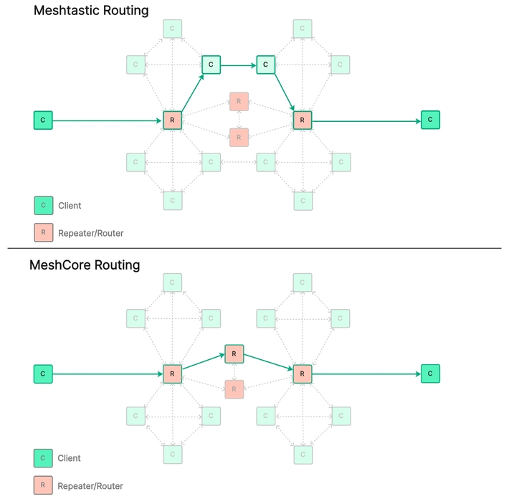

Slide 16
Meshtastic Encryption
Meshtastic is encrypted using AES-256 in CTR mode. However, only the payload is encrypted, not the header/metadata.
Important for flooding: unencrypted headers allow nodes to forward packets they cannot decrypt.
Meshtastic channels are secured using a Pre-Shared Key. Everyone in the channel (including intermediate nodes) are members of the channel and have access to the key.
It is a bad idea to share private info while leaving nodes unattended!
Meshtastic DMs are encrypted using Public Key Cryptography. Only senders and recipients have access to private keys, meaning intermediate nodes do not have access to message contents.
Notes:
Meshtastic and MeshCore encryption is very similar.
The main difference between the two is that Meshtastic uses AES-256 (CTR) while MeshCore uses AES-128. Regardless, both are still very secure
In both systems, channels are securing using a pre-shared key, meaning every node in the channel (including intermediate nodes) have access to the channel key.
Thus, it is a bad idea to share private data in channels while leaving receiver or intermediate nodes unattended
Also in both systems, DMs are encrypted using Public Key Cryptography. Only senders and receivers have private keys, blocking intermediate nodes from access

Slide 17
MeshCore Encryption
There is very little difference between message encryption between Meshtastic and MeshCore.
MeshCore channels are secured using a PSK, where all members of the channel, including intermediate nodes, have access to messages.
MeshCore DMs are also secured with PKC, establishing end-to-end encryption between users.
One difference between the two systems is that MeshCore is AES-128 encrypted (according to the MeshCore website) while Meshtastic is AES-256 encrypted. Both are still extremely secure.
Maybe Meshtastic is more ‘quantum-resistant’ if that is a concern.

Slide 18
Readings

Slide 19
Meshtastic Main Site
The Meshtastic website is, unsurprisingly, the absolute best resource for anything Meshtastic related.
The documentation covers Meshtastic basics, as well as the smallest of details.
Key areas in the documentation include:
Radio settings
Meshtastic Algorithm and Encryption details
Installing and flashing firmware
Device configuration (most importantly and radio, module config)
Compatible hardware
Additional software
Development guides
And more
Notes:
- The Meshtastic site and docs are by far the best Meshtastic resource for anything Meshtastic. This is more or less the only Meshtastic site I frequently refer to

Slide 20
MeshCore Main Site
The MeshCore main site is a good resource for most things MeshCore.
However, the documentation of MeshCore’s website does not go into nearly as much detail as the Meshtastic site.
The website docs are one giant FAQ page, covering anything to do with device compatibility, flashing and troubleshooting. It does not go into detail into MeshCore’s architecture, algorithm, or encryption.
This document by pe1hvh is a complete manual to MeshCore. It is by far the best MeshCore document I have found and is better than the FAQ on the main site.
Notes:
The MeshCore site is good but the docs are not as in depth
There really isn’t documentation but they have a giant FAQ page covering many importqnt details.
I find I have to use 3rd party sources more often with MeshCore. This one is by … my favousite

Slide 21
Meshtastic/MeshCore Web Flasher
The Meshtastic web flasher is the simplest way to flash firmware onto a device.
MeshCore has a very similar, easy-to-use web flasher equivalent to Meshtastic
The Meshtastic website gives step-by-step instruction how to flash the firmware onto the device, giving different instructions depending on what device is being used.
The web flasher is a great alternative to the traditional CLI flasher and makes Meshtastic much more accessible.
Notes:
The web flasher is very self explanatory – it makes flashing firmware onto devices very simple. Both websites are east to use and give instructions with how to flash

Slide 22
Meshtastic/MeshCore GitHub
The Meshtastic GitHub page includes all of their software, including the firmware, website, Apple and Android apps, web flasher, web client, website API, simulator and more.
The MeshCore GitHub includes most their firmware. Notably, MeshCore includes example apps to give a foundation for developers.
Both are essential resources for building custom firmware, specific documentation and flashing software without the web flasher.
Notes:
- The GitHub is also worth noting – very important for questions regarding specific implementation and development

Slide 23
Readings cont.
dev.to – First message in 30 minutes
The best text tutorial to start using Meshtastic.
A simple, easy tutorial with no overcomplication or unnecessary information.
Austin Mesh – Getting Started with MeshCore
The best text tutorial to start using MeshCore.
Like the dev.to tutorial, this tutorial does not beat around the bush, keeping things simple, easy and informative.
Kindlymorrow – What is MeshCore
A fantastic resource explaining the MeshCore architecture and giving a detailed comparison between Meshtastic and MeshCore.
Gives great insight into which ecosystems are thrive depending on the use case
Notes:
These first two articles were my favourite Meshtastic how-tos, specifically the dev.to one. They keep things very simple
The Kindlymorrow what is MeshCore article was super helpful –they explain clearly the architectural differences between Meshtastic and MeshCore and when to use each

Slide 24
Video Resources
How to Set Up Meshtastic (Step-by-Step Guide for Beginners)
Great video for setting up devices and using Meshtastic for the first time.
Web Firmware / Configuration Guide - LILYGO Meshtastic T-Beam V1.1 ESP32 Wireless Module
Best video for showing how to use Meshtastic with the web client.
How to Flash a MeshCore Repeater
Best video for showing how to flash devices with MeshCore. This video shows how to configure a repeater, but setting up a companion is nearly the same.
465 Rutgers University Confirmed: Meshtastic and LoRa are dangerous
More informative video on how to use Meshtastic. Dives into more specifics, including connecting to MQTT servers and integrating sensors nodes into the mesh network. Interesting watch.
Notes:
These videos are good for helping people flash firmware for the first time.
The Meshtastic and LoRa are dangerous video was a great watch. It begun explaining meshes and LoRa at a high level, slowly diving into Meshtastic specifics like how Meshtastic takes advantage of MQTT servers and integrating sensors into the mesh.

Slide 25
Next Steps
First, learn how to flash both Meshtastic and MeshCore firmware onto nodes.
Send messages between both Meshtastic and MeshCore nodes to ensure nodes are working properly.
Create documentation for Meshtastic and MeshCore node setup, communication and troubleshooting
Plan and strategize mesh node placement around Halifax and potentially around the entire HRM
Depending on project scope and inventory

