Slide 1
Weekly Meeting
Jon Earle

Slide 2
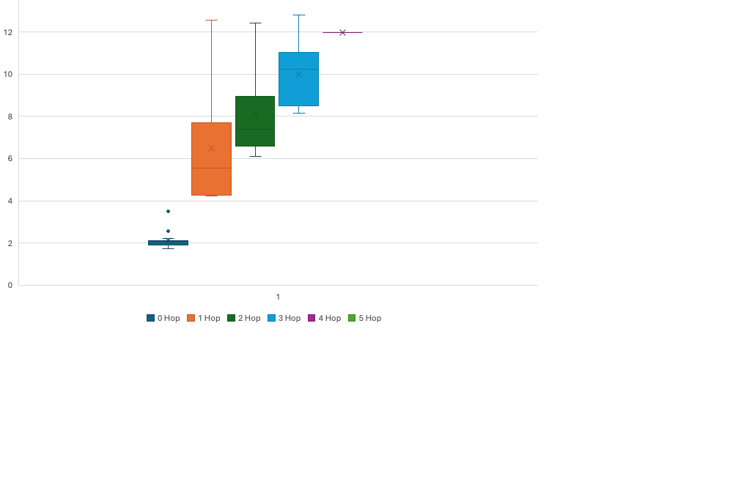
Moving Node Tests
Metrics
Delivery Rate: 73.8%
Average Latency: 6.44 sec
Average Latency by Link: 2.62 sec

Slide 3
Moving Node Tests

Slide 4
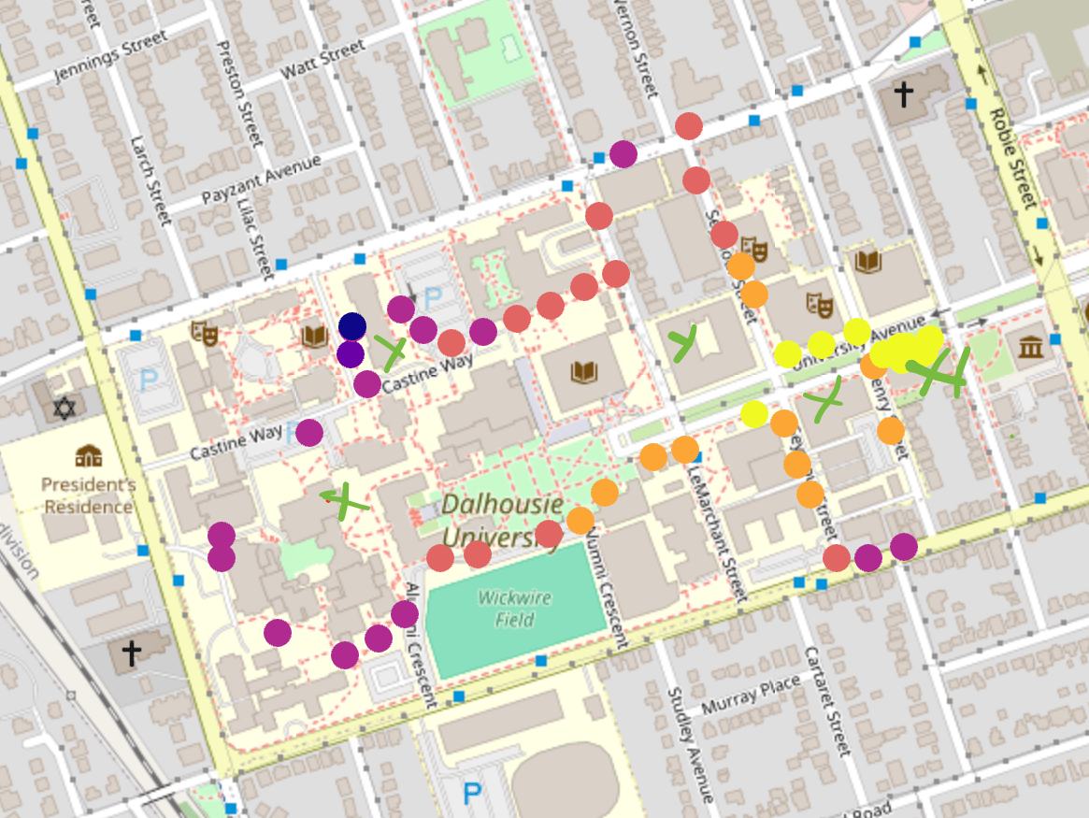
Hops by Location
Legend
0 Hops - Bright Yellow
1 Hop - Orange
2 Hops - Light Red
3 Hops - Magenta
4 Hops - Purple
5 Hops - Dark Blue
Green X = Node
Note: There are two nodes on the Goldberg

Slide 5
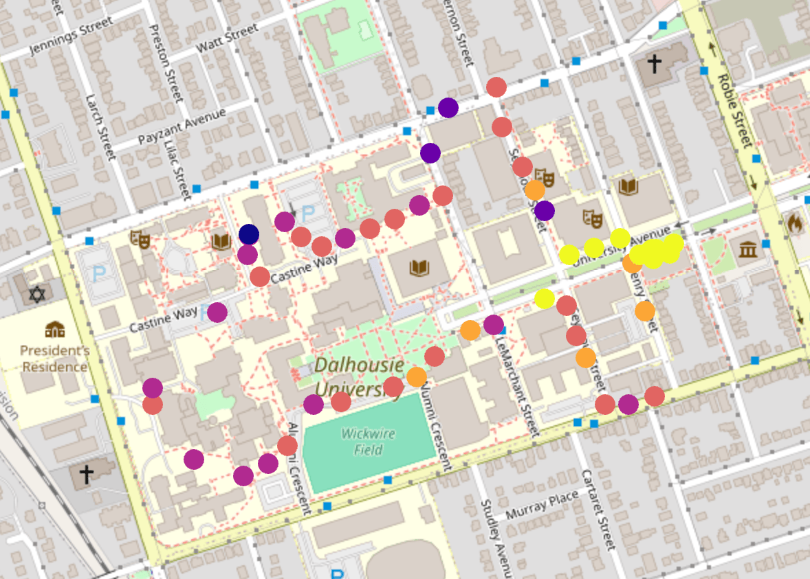
Latency by Location
Legend
Less than 3 seconds - Bright Yellow
3 to 6 seconds - Orange
6 to 9 seconds – Light Red
9 to 12 seconds - Magenta
12 to 15 seconds - Purple
Over 15 seconds - Dark Blue

