Slide 1
Meeting – June 18
Jon Earle

Slide 2
Campus Mesh Deployment
Last week, I began deploying Meshtastic devices around campus, building a LoRa Mesh.
The goal of the mesh is to study the behavior of LoRa mesh networks in an urban environment and compare how different firmware platforms (Meshtastic and MeshCore) perform.
At the beginning of the week, I was focused on finding appropriate locations for devices and mapping connections between nodes, ensuring the mesh is functioning properly
Currently, I am running various tests with Meshtastic, gathering benchmarks on metrics like delivery rate, latency and airtime usage.

Slide 3
Campus Mesh cont.
Currently, there are six nodes scattered around campus, deployed strategically such that:
Nodes are positioned to take advantage of elevation and propagation corridors (streets).
Edge nodes require at least one or two hops to communicate.
Some of the locations I had originally planned could not be used because there was either no access to a window or no nearby power outlet.
For MeshCore, every node will be a receiver node except for the two nodes used in the transmission tests. Those nodes will be Bluetooth companions.

Slide 4
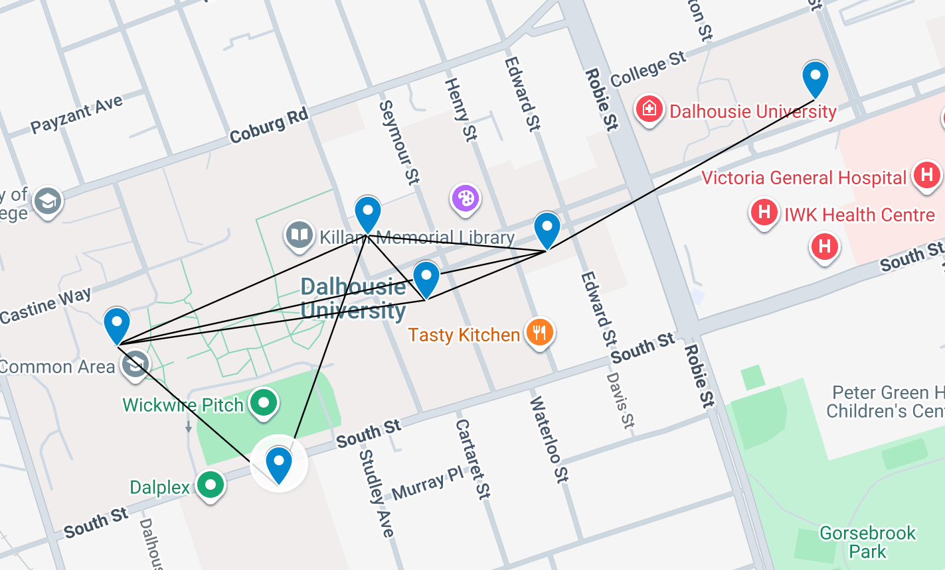
Map of the Campus Mesh

Slide 5
Mapping Neighbors
To determine which nodes were neighbors with other nodes, the plan was to use Meshtastic’s Neighbor Node module to map the mesh. However:
Neighbor Node packets are sent at a minimum interval of four hours to prevent saturation. Attempts to edit the firmware to evade this limit were unsuccessful.
I then left the nodes over the weekend to gather the neighbor data. However, the process only worked for one node.
I then decided to manually go to every node and run a traceroute on every other node in the mesh to add it into the node database and use the resulting information instead.

Slide 6
Tests
For both Meshtastic and MeshCore, I plan on testing delivery rate, latency* and transmission airtime within the mesh with both stationary and moving nodes
End-to-end latency, not strictly network latency. Timestamps taken in Python.
For delivery rate and latency, the test involves periodically sending 1000 messages between two nodes, comparing the two firmware platforms based on how many packets arrive and how long they take to send
This test will be conducted across multiple routes and once with a moving node walking around campus
Routes include: Dalplex to Goldberg, LSC Biology 8th floor to Collaborative Health Education Building

Slide 7
Tests cont.
For transmission airtime testing, MeshCore exposes the metrics directly through the command line. With Meshtastic, airtime is tracked internally. To get around this, I have written custom Meshtastic firmware to expose airtime.
The firmware retains all the default settings but modifies the airUtilTx metric to milliseconds instead of a percentage since boot. Because this is the only change, it is still comparable to default Meshtastic firmware for tests.
Unfortunately, I cannot efficiently gather airtime data for all nodes within the mesh without connecting a computer to every node. Thus, I am currently limited to collecting airtime data from the sender node and one intermediate node.
For the moving tests, I plan on walking around campus with a sender node and place the receiver node at the LSC Biology 8th floor, recording all the previous metrics, as well as the path taken with every message.

Slide 8
Planning for Next Week
Although I had planned to begin testing earlier in the week, deployment and mapping of the mesh took longer than anticipated.
Today, I began testing delivery rate and latency on Meshtastic and plan on testing airtime as well.
Next week, I hope to complete all the tests mentioned previously, while also analyzing node databases to determine how communication ranges within an urban environment
I hope that these tests will provide sufficient data to draw conclusions about how LoRa mesh networks behave within an urban environment and how Meshtastic and MeshCore compare within such an environment.

