Slide 1


A quick guide to DMP
Author: Jone Paesmans
Contact: jone.paesmans@vub.be
Notes:
Hi everybody,
Today I would like to introduce to you what a Data Management Plan, or shortly DMP, is and why it is important.

Slide 2
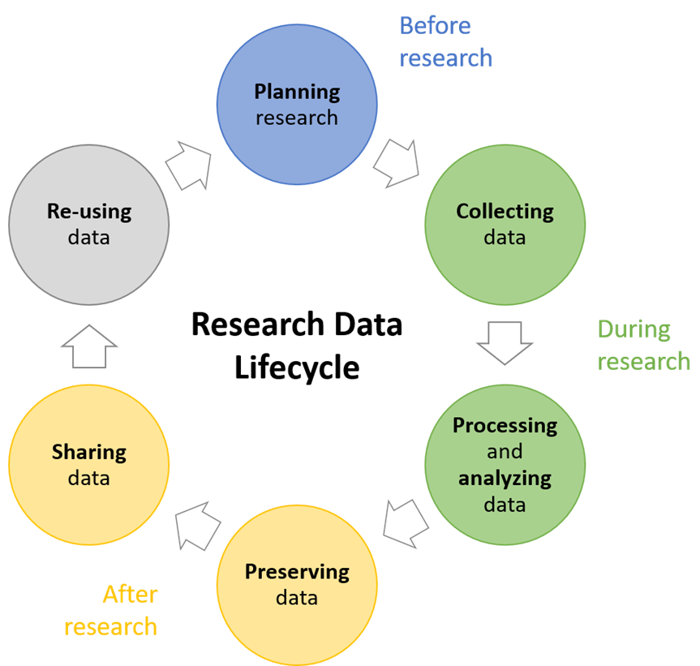
What is a DMP?
Needs to be written before you start your project
“Living” document describing:
Your data and data documentation
Legal & ethical obligations related to your data
Data storage during and after your research project
Data sharing & reuse of your data
Responsibilities & budgets
Notes:
Let’s start with what a DMP is.
A DMP is typically written at the start of a research project. However, it is a living document, meaning that it can be changed during the project because your project might take a turn.
In the DMP you need to:
Describe your data and how you will document your data
In case your data contains legal and ethical obligations, you will need to descrobe them
Think about how you will store your research data during the research project and after the project has finished. Ensure that this corresponds with the policy of VUB.
When your project is finished, you need to share your data so that other can reuse it. This can be done openly, if possible, but in case you are working with sensitive or confidential data, retsricted or closed access is also a possibility.
Finally, you also need to discuss what all these storage locations will cost and who will be responsible for it.

Slide 3
How te create a DMP?
Use the funders template (e.g. FWO, HE)
In case you don’t have a specific funder or they don’t propose a template
Adviced to use Flemish DMP template
Use DMPOnline
Notes:
When you need to create a DMP for a funder, they often provide a specific template that need to be used.
In case you don’t have a specific funder or in case your funder doesn’t propse a specific template, you are advised to use the Flemish DMP template.
In DMPOnline, you can find templates of different funders, but also the Flemish DMP template.

Slide 4
Why is a DMP important?
For funders:
Mandatory requirement for certain funders, e.g. FWO & HE
Demonstrates responsible use of funding
Notes:
For many funders — like FWO and Horizon Europe — a DMP isn’t optional anymore. It’s a mandatory requirement that shows your project takes data management seriously. But it’s not just a box to tick. It’s a way to demonstrate that public or grant money is used responsibly — that the data you produce will be accessible, reusable, and ethically handled.

Slide 5

Why is a DMP important?
For researchers = plannings tool that saves headache later
Saves time later by organizing data handling early in the project
Reduces the risk of data loss, corruption, or privacy breaches
Makes your data easier to find and reuse
Simplifies sharing within teams and with external partners
Designed by Freepik
Notes:
For us as researchers, the DMP is really a planning tool — a way to think ahead before problems appear. If you decide early how you’ll collect, store, and share data, you save yourself a lot of time later on when results need to be published or shared with collaborators.
It helps avoid disasters like data loss or privacy breaches, and it keeps data findable — for yourself, for your colleagues, and even for future reuse. A clear plan also makes team collaboration easier, especially in interdisciplinary or multi-institutional projects.
So, for the funder it’s proof of responsibility, and for the researcher it’s good self-defense — a bit of structure that keeps your data, and your sanity, intact.

Slide 6
Conclusion
A DMP = planning for your data’s full life cycle
Required by funders, useful for researchers
Saves time, prevents loss, increases impact
Good data management = good research
Notes:
So to wrap up — a Data Management Plan really means planning for your data’s full life cycle. From the moment you collect it, through analysis and publication, to long-term preservation and possible reuse.
Funders ask for it because it’s part of responsible, transparent science. But for researchers, it’s more than compliance — it’s a tool that actually makes your work easier and more robust.
By thinking ahead, you save time later, you avoid losing valuable data, and you make your results easier to share and cite. In short, good data management isn’t extra work — it’s what good research looks like.
If you remember one thing from this talk, let it be this: a DMP isn’t paperwork, it’s a habit of thinking ahead.

