Slide 1
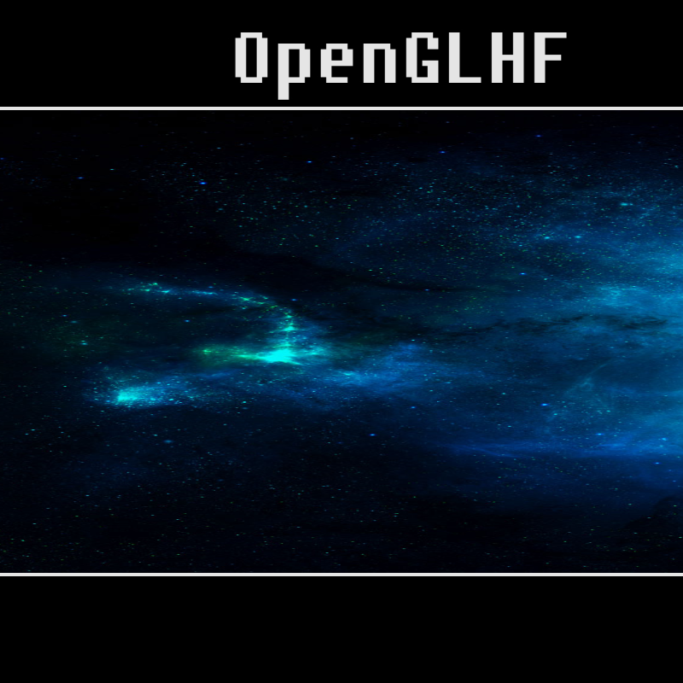
OpenGLHF
GLHF - ”good luck, have fun”
Setting the mood
Introduction
Letterboxed

Slide 2
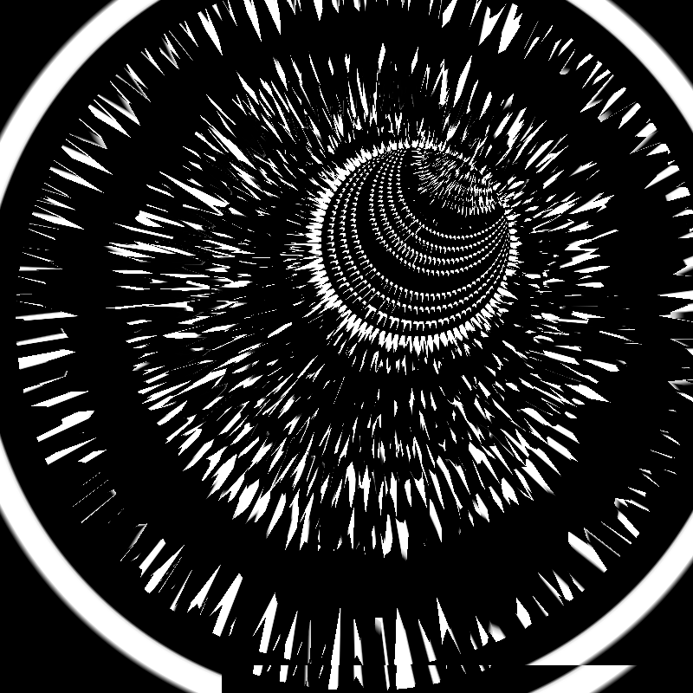
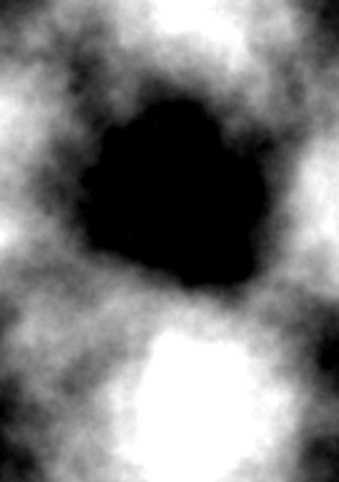
Tunnel
Heightmapped tunnel
Perlin noise
Allows for interesting shapes
360 pixels wide heightmap:

Slide 3
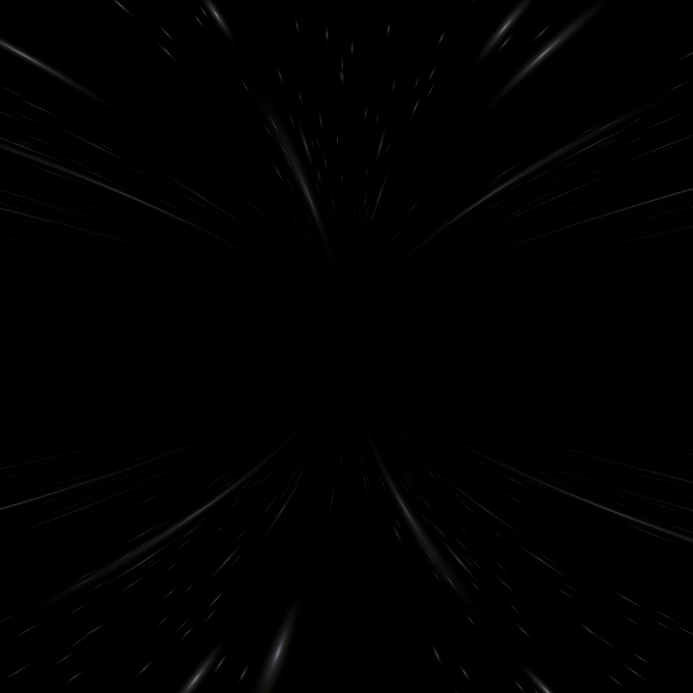
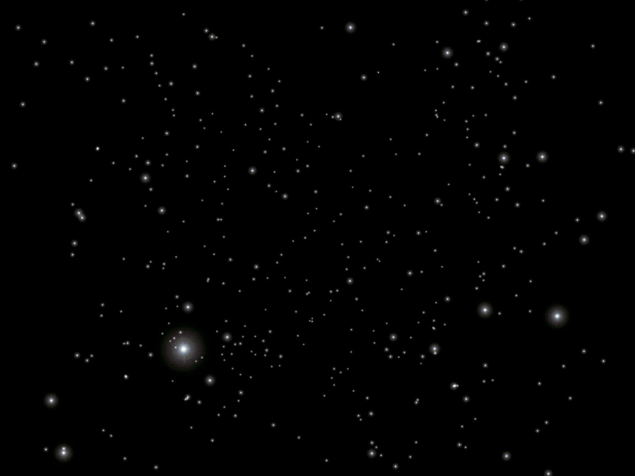
Blackhole
Rectangle covering screen
Written as a shader
2 parts:
  Outward-moving texture
  Darkened center

Slide 4
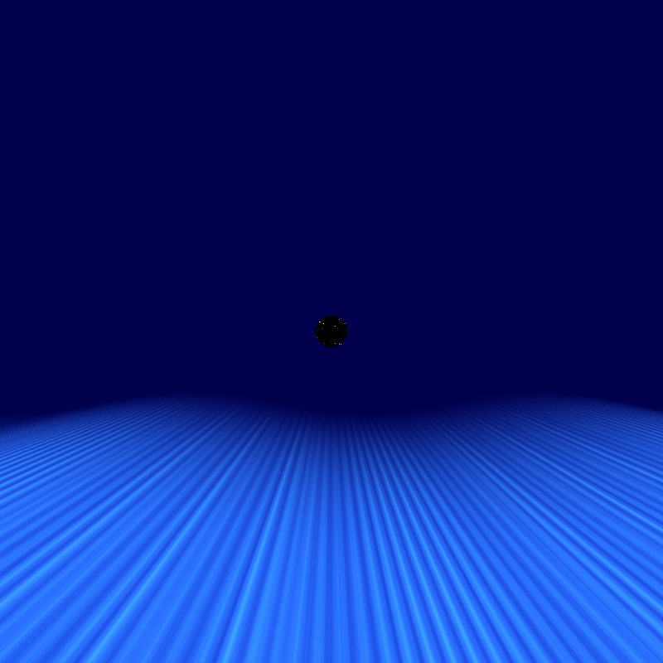
Water
Originally water-like
Now more like neon
Rendered through a shader, fade-in with (something like)
float strength = p.z+ time*30.0;
strength = smoothstep(1.0, 50.0, strength);
gl_FragColor = texture2D(texture, p.xy)*strength + vec4(0.0, 0.0, 0.3, 1);

Slide 5
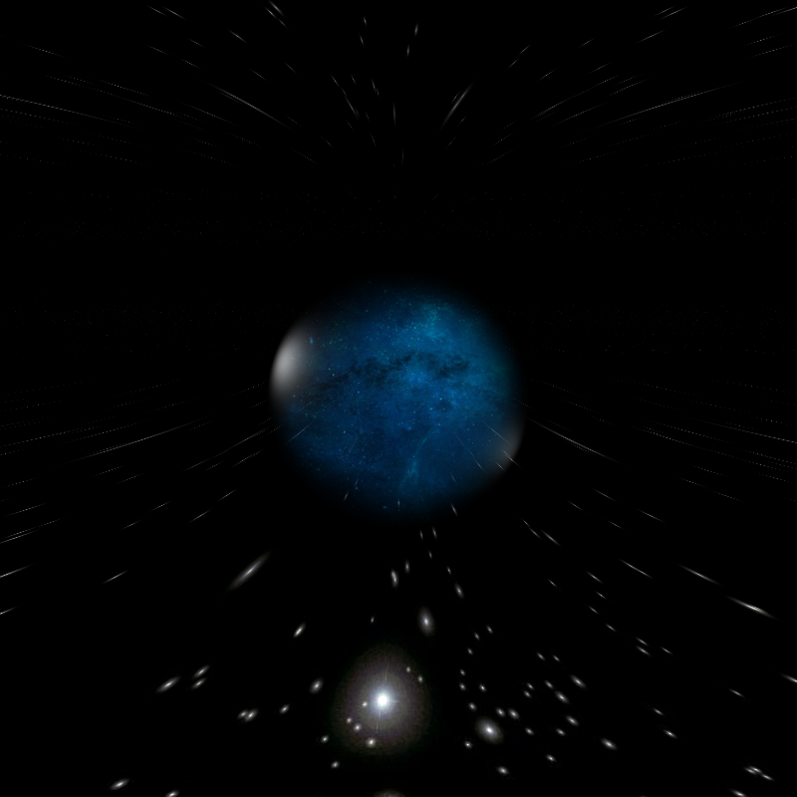
Peephole
Transition between the last parts
Something like
vec4 w = warp();
vec4 meta = <next part>();
vec2 dist = Pos.xy / time;
float d = dot(dist, dist);
float d2 = 1.0 - d;
gl_FragColor = w*d + (meta*d2);

Slide 6
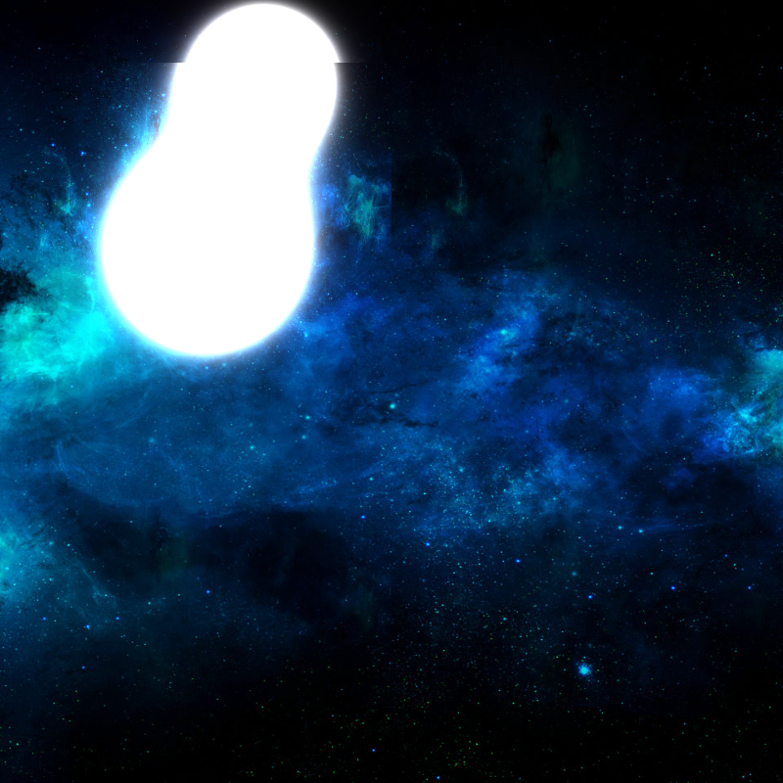
Metablob
Layered background images
Two metablobs
All on the shader:
float r1 =(dot(p-move1,p-move1));
float r2 =(dot(p+move2,p+move2));
float metaball = (1.0/r1+1.0/r2);
float hard = pow(metaball, 6.0)

