Slide 1
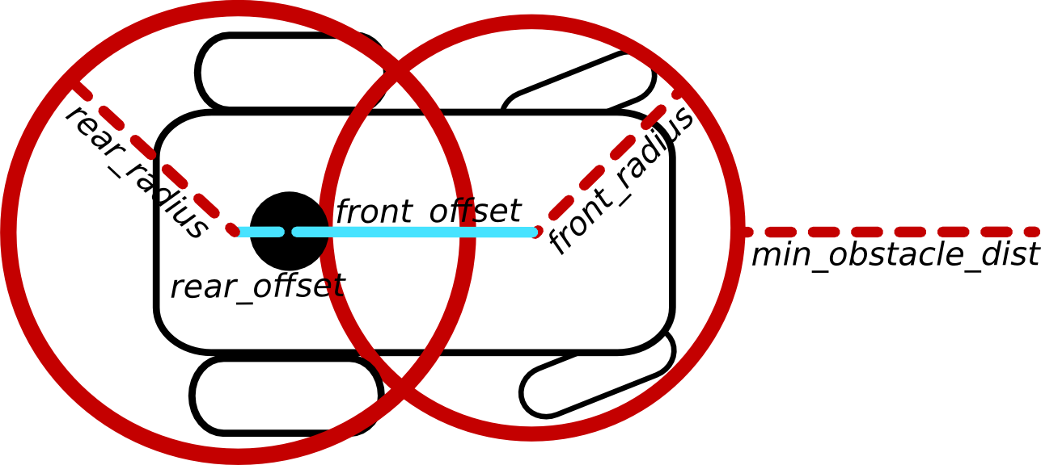
Scale is 2 full boxes = 1 meter
Each small box is ¼ meter

Slide 2
Scale is 2 full boxes = 1 meter; Each small box is ¼ meter

Slide 3
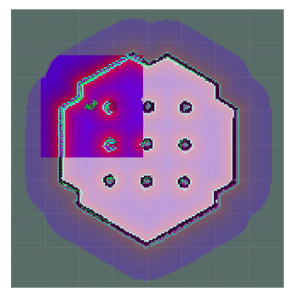
https://uos.github.io/mbf_docs/tutorials/beginner/path_planning/
create_pose(-1.75, 0.74, 0, 0, 0, 0.539, 0.843),
create_pose(-0.36, 1.92, 0, 0, 0, -0.020, 0.999),
create_pose(0.957, 1.60, 0, 0, 0, -0.163, 0.987),
create_pose(1.8741, 0.3830, 0, 0, 0, -0.70, 0.711),
create_pose(1.752, -0.928, 0, 0, 0, -0.856, 0.517),
create_pose(0.418, -2.116, 0, 0, 0, 0.998, 0.0619),
create_pose(-0.775, -1.80, 0, 0, 0, 0.954, 0.300),
create_pose(-1.990, -0.508, 0, 0, 0, -0.112, 0.999)
-0.36,1.92
(2)
0.957, 1.6
(3)
-1.75, 0.74
(1)
1.874, .383
(4)
-1.99, -0.508
(8)
1.752,-0.928
(5)
-0.775, -1.8
(7)
0.418, -2.116
(6)

Slide 4
https://uos.github.io/mbf_docs/tutorials/beginner/path_planning/
create_pose(6.0, 19.0, 0, 0, 0, 0.539, 0.843),
create_pose(13.75, 24.3, 0, 0, 0, -0.020, 0.999),
create_pose(19.3, 22.7, 0, 0, 0, -0.163, 0.987),
create_pose(23.75, 17.3, 0, 0, 0, -0.70, 0.711),
create_pose(23.75, 11, 0, 0, 0, -0.856, 0.517),
create_pose(17.5, 4.9, 0, 0, 0, 0.998, 0.0619),
create_pose(11.25, 6.0, 0, 0, 0, 0.954, 0.300),
create_pose(5.8, 12.8, 0, 0, 0, -0.112, 0.999)
Following the example from the previous page I am going to move to the right and up (15, 15) and make the radius of the circle, 10 meters
5
10
15
20
25
25
13.75,24.3
(2)
19.3, 22.7
(3)
20
6, 19
(1)
23.75, 17.3
(4)
15
5.8, 12.8
(8)
15, 15
23.75,11
(5)
10
11.25, 6
(7)
5
17.5, 4.9
(6)

Slide 5
https://uos.github.io/mbf_docs/tutorials/beginner/path_planning/
create_pose(7.5, 22.0, 0, 0, 0, 0.392, 0.920),
create_pose(15.0,25.0, 0, 0.000, 0.000, 0.000, 1.000),
create_pose(22.5, 22.5, 0, 0.000, 0.000, -0.353, 0.936),
create_pose(25.0, 15.0, 0, 0.000, 0.000, -0.707, 0.707),
create_pose(22.5, 7.5, 0, 0.000, 0.000, -0.918, 0.397),
create_pose(15.0, 5.0, 0, -0.000, 0.000, 1.000, -0.000),
create_pose(7.5, 7.5, 0, 0.000, 0.000, 0.946, 0.323),
create_pose(5.0, 15.0, 0, 0.000, 0.000, 0.697, 0.717)
Following the example from the previous page I am going to move to the right and up (15, 15) and make the radius of the circle, 10 meters
X
5
10
15
20
25
15.0,25.0
(2)
Orientation(0.000, 0.000, 0.000, 1.000) = Angle: 0.000
25
22.5, 22.5
(3)
Orientation(0.000, 0.000, -0.353, 0.936) = Angle: -0.721
Y
7.5, 22
(1)
Orientation(0.000, 0.000, 0.392, 0.920) = Angle: 0.805
20
5.0, 15.0
(8)
Orientation(0.000, 0.000, 0.697, 0.717) = Angle: 1.541
25.0, 15.0
(4)
Orientation(0.000, 0.000, -0.707, 0.707) = Angle: -1.571
15
15, 15
10
7.5, 7.5
(7)
Orientation(0.000, 0.000, 0.946, 0.323) = Angle: 2.483
22.5, 7.5
(5)
Orientation(0.000, 0.000, -0.918, 0.397) = Angle: -2.326
15.0, 5.0
(6)
Orientation(-0.000, 0.000, 1.000, -0.000) = Angle: 3.142
5

Slide 6
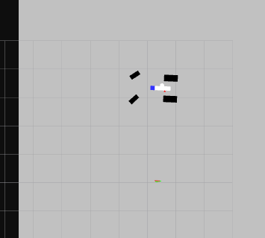
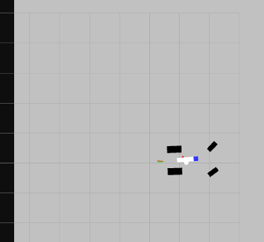
My cutting deck is 40” (101.6 cm/1.02 meters)
4.3 OD
3.1 BL

Slide 7
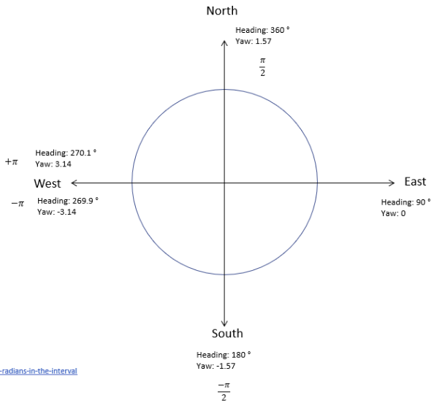
Scale is 2 full boxes = 1 meter; Each small box is ¼ meter
(6, 6+2.14)
3.925
2.355
(6-2.14, 6)
(6+2.14, 6)
(6, 6)
5.495
(6, 6-2.14)
0.785
East | 0.000
NE | 0.785
North | 1.570
NW | 2.355
West | 3.140
SW | 3.925
South | 4.710
SE | 5.495

Slide 8
Scale is 2 full boxes = 1 meter; Each small box is ¼ meter
(6, 6+2.14)
3.925
2.355
(6-2.14, 6)
(6+2.14, 6)
(6, 6)
5.495
(6, 6-2.14)
0.785
East | 0.000
NE | 0.785
North | 1.570
NW | 2.355
West | 3.140
SW | 3.925
South | 4.710
SE | 5.495

Slide 9
Scale is 2 full boxes = 1 meter; Each small box is ¼ meter
(7.5, 14.3)
(10, 15)
create_pose(12.5, 14.3, 0, 0.0, 0.0, 0.8668, 0.4987),
create_pose(12.5, 5.7, 0, 0.0, 0.0, 0.4987, 0.8668),
create_pose(12.5, 14.3, 0, 0.0, 0.0, 0.8668, 0.4987),
create_pose(7.5, 14.3, 0, 0.0, 0.0, 1.0, 0.0),
create_pose(5.0, 10.0, 0, 0.0, 0.0, -0.8668, 0.4987),
create_pose(7.5, 5.7, 0, 0.0, 0.0, -0.4987, 0.8668),
create_pose(12.5, 5.7, 0, 0.0, 0.0, 0.0, 1.0),
create_pose(12.5, 5.7, 0, 0.0, 0.0, 0.4987, 0.8668)point (12.5, 5.7)
[(15.0, 10.0), (12.5, 14.3), (7.5, 14.3), (5.0, 10.0), (7.5, 5.7), (12.5, 5.7)]
0.0 , 9.9 , 0.0 , 0.0 , 0.0 , 0.0 , 1.0 ),
1.2 , 9.9 , 0.0 , 0.0 , 0.0 , 0.0 , 1.0 ),
4.79 , 8.38 , 5.48 , -0.0 , 0.0 , 0.3894 , -0.9211 ),
1 - 7.53 , 5.54 , 5.81 , -0.0 , 0.0 , 0.2342 , -0.9722 ),
2 - 11.41 , 5.26 , 0.33 , 0.0 , 0.0 , 0.1629 , 0.9866 ),
14.32 , 7.85 , 1.13 , 0.0 , 0.0 , 0.5342 , 0.8453 ),
14.49 , 11.74 , 1.93 , 0.0 , 0.0 , 0.8213 , 0.5706 ),
11.82 , 14.57 , 2.73 , 0.0 , 0.0 , 0.9786 , 0.2057 ),
7.93 , 14.63 , 3.53 , -0.0 , 0.0 , 0.9815 , -0.1916 ),
5.07 , 11.93 , 4.03 , -0.0 , 0.0 , 0.9039 , -0.4278 ),
1.63 , 10.12 , 3.23 , -0.0 , 0.0 , 0.9991 , -0.042 ),
1.2 , 10.1 , 3.14 , 0.0 , 0.0 , 1.0 , 0.0008 ),
12 sides
(15.0, 10.0)
(14.3, 12.5)
(12.5, 14.3)
(7.5, 14.3)
(5.7, 12.5)
(5.0, 10.0)
(5.7, 7.5)
(7.5, 5.7)
(10.0, 5.0)
(12.5, 5.7)
(14.3, 7.5)
create_pose(7.5, 14.3, 0, 0.0, 0.0, 1.0, 0.0),
(12.5, 14.3)
(6.5, 13.5)
(13.5, 13.6)
(10, 10)
(5, 10)
(15, 10)
create_pose(5.0, 10.0, 0, 0.0, 0.0, -0.8668, 0.4987),
East | 0.000
NE | 0.785
North | 1.570
NW | 2.355
West | 3.140
SW | 3.925
South | 4.710
SE | 5.495
1
(7.5, 5.7)
2
(12.5, 5.7)
create_pose(7.5, 5.7, 0, 0.0, 0.0, -0.4987, 0.8668),
create_pose(12.5, 5.7, 0, 0.0, 0.0, 0.4987, 0.8668),

Slide 10
19.4 | 10.0
21.8 | 10.0
(20.6, 10.3)
4.19
3.67
3.14
18.4 | 9.0
22.8 | 9.0
(20.6, 7.8)
1.57
2.09
2.62
3.14
3.67
4.19
(18.1, 7.8)
(23.1, 7.8)
East | 0.000
NE | 0.785
North | 1.570
NW | 2.355
West | 3.140
SW | 3.925
South | 4.710
SE | 5.495

Slide 11
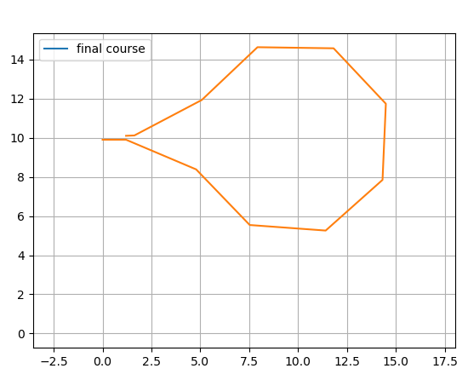
Scale is 2 full boxes = 1 meter; Each small box is ¼ meter
New point 0 Going from 10.0,10.0 at 0 radians generates the new point (15.0, 10.0)
New point 1 Going from 10.0,10.0 at 1.047 radians generates the new point (12.5, 14.3)
New point 2 Going from 10.0,10.0 at 2.094 radians generates the new point (7.5, 14.3)
New point 3 Going from 10.0,10.0 at 3.142 radians generates the new point (5.0, 10.0)
New point 4 Going from 10.0,10.0 at -2.094 radians generates the new point (7.5, 5.7)
New point 5 Going from 10.0,10.0 at -1.047 radians generates the new point (12.5, 5.7)
[(15.0, 10.0), (12.5, 14.3), (7.5, 14.3), (5.0, 10.0), (7.5, 5.7), (12.5, 5.7)]
Generated waypoints
0.0 , 9.9 , 0.0 , 0.0 , 0.0 , 0.0 , 1.0 ),
1.2 , 9.9 , 0.0 , 0.0 , 0.0 , 0.0 , 1.0 ),
4.79 , 8.38 , 5.48 , -0.0 , 0.0 , 0.3894 , -0.9211 ),
7.53 , 5.54 , 5.81 , -0.0 , 0.0 , 0.2342 , -0.9722 ),
11.41 , 5.26 , 0.33 , 0.0 , 0.0 , 0.1629 , 0.9866 ),
14.32 , 7.85 , 1.13 , 0.0 , 0.0 , 0.5342 , 0.8453 ),
14.49 , 11.74 , 1.93 , 0.0 , 0.0 , 0.8213 , 0.5706 ),
11.82 , 14.57 , 2.73 , 0.0 , 0.0 , 0.9786 , 0.2057 ),
7.93 , 14.63 , 3.53 , -0.0 , 0.0 , 0.9815 , -0.1916 ),
5.07 , 11.93 , 4.03 , -0.0 , 0.0 , 0.9039 , -0.4278 ),
1.63 , 10.12 , 3.23 , -0.0 , 0.0 , 0.9991 , -0.042 ),
1.2 , 10.1 , 3.14 , 0.0 , 0.0 , 1.0 , 0.0008 ),
East | 0.000
NE | 0.785
North | 1.570
NW | 2.355
West | 3.140
SW | 3.925
South | 4.710
SE | 5.495

