Slide 1
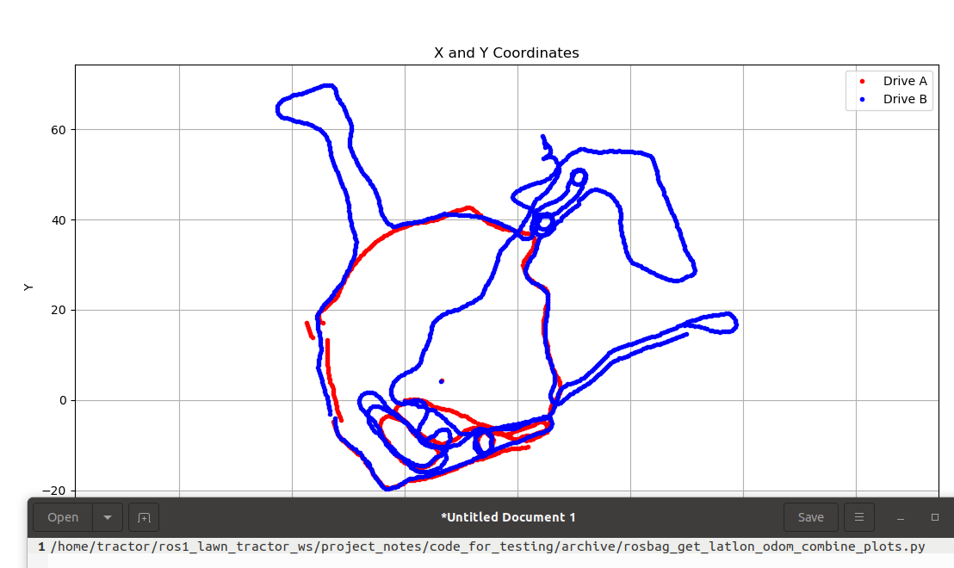
Site 4 – Northwest Corner
Site 3 – North and front yard
Site 1 - Main
Site 2 – South side of house

Slide 2
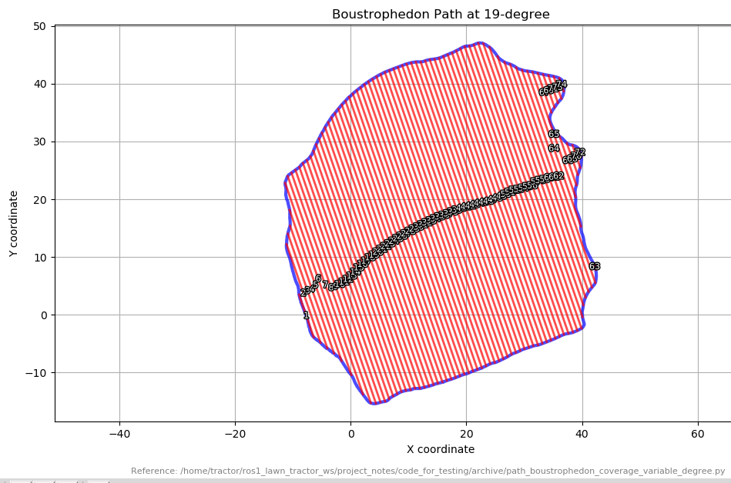

Slide 3
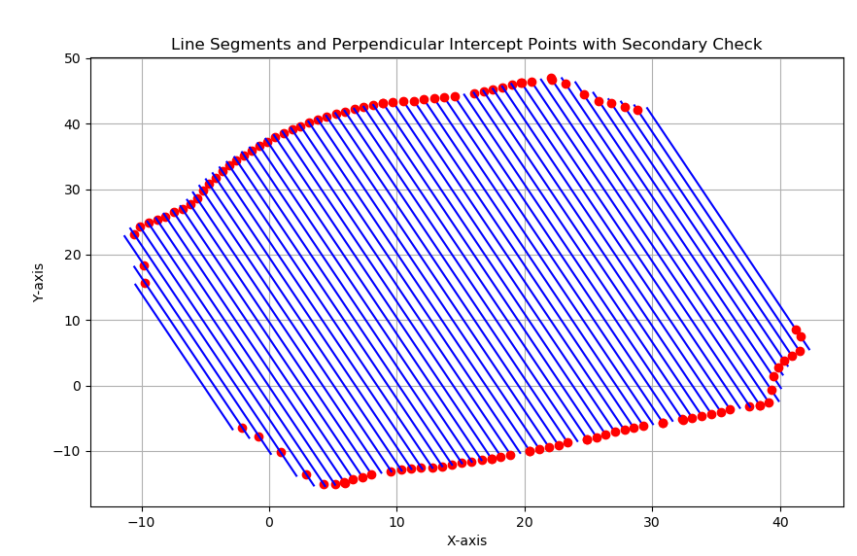

Slide 4
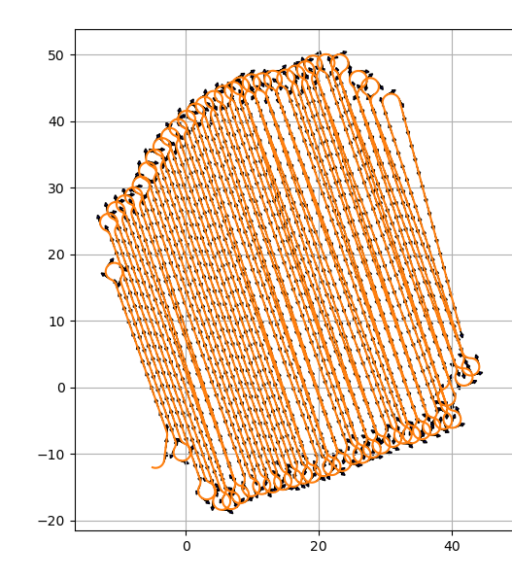
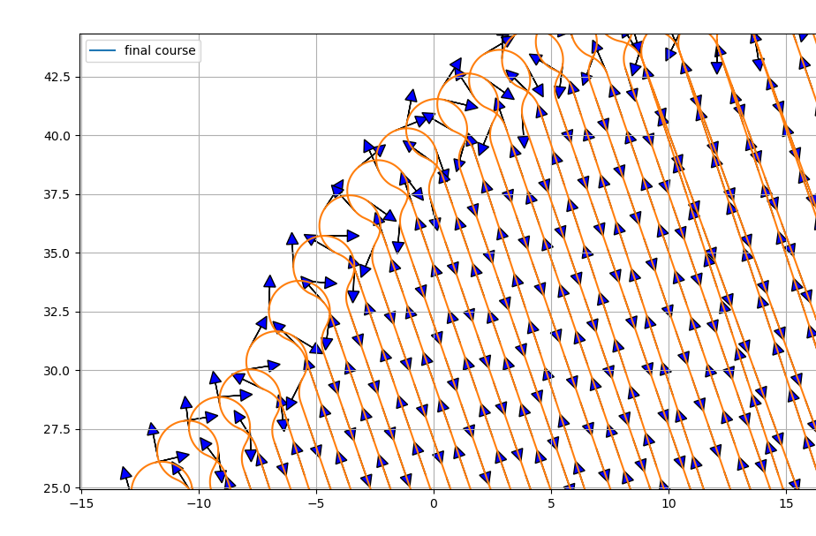

Slide 5
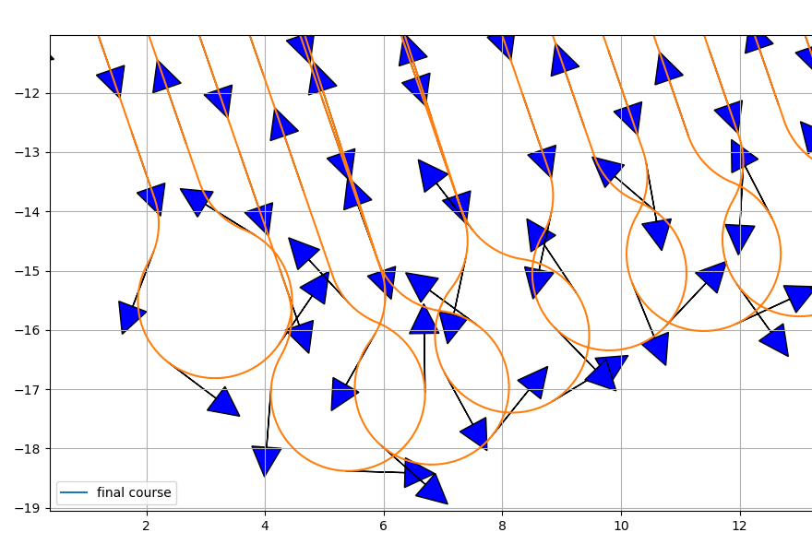

Slide 6
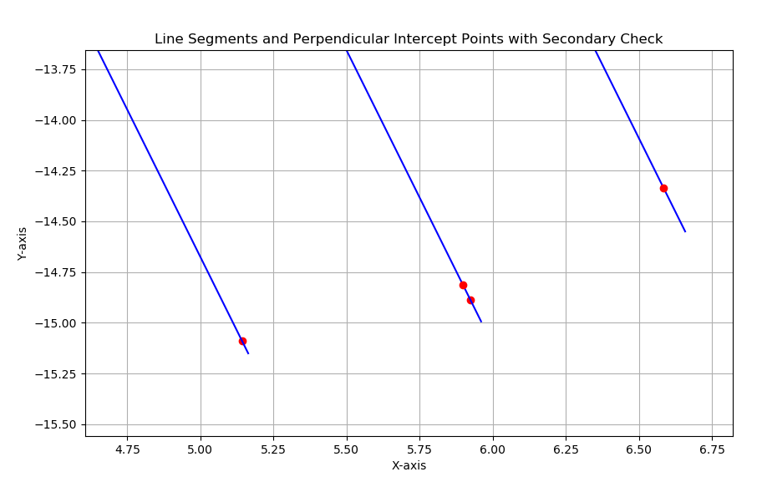
9
Line 9
8
6.585 | -14.337
Corrected – Point 18
7
Corrected – Point 17
Current – Point 18
Line 8
6.658 | -14.550
Line 6
5.898 | -14.812
Line 7
5.14 | -15.09
5.924 | -14.889
When the next line segment is shorter than the current segment
- The stopping point should be Line 9 intersection point
- The go to point should be the bottom of Line 9
5.96 | -14.994
5.16 | -15.14
Current – Point 17

Slide 7
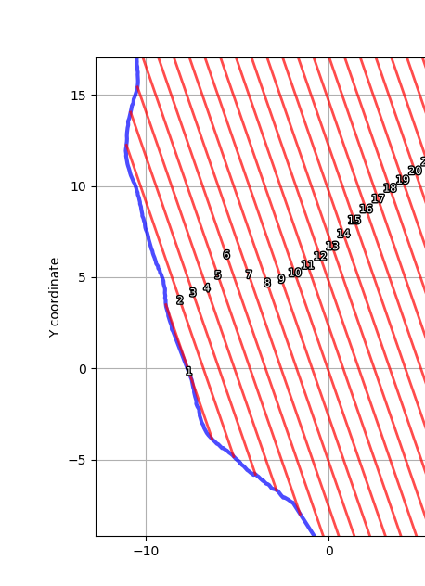
x1, y1 = -6.373268939109791, -3.8884440636760638 # Replace with your x1, y1
x2, y2 = -8.914302735073203, 3.4912539271027665 # Replace with your x2, y2
angle_of_travel = math.atan2(y2 - y1, x2 - x1)
print("LINESTRING 1 The angle of travel in radians is:", angle_of_travel)
# what is the intersecting point of the point x2, y2 and the line segment (x3, y3), (x4, y4)
x3, y3 = -5.195466293158876, -4.837644520732015
x4, y4 = -11.07529003323793, 12.238603544022125
angle_of_travel = math.atan2(y4 - y3, x4 - x3)
print("LINESTRING 2 The angle of travel in radians is:", angle_of_travel)
x5, y5 = -4.011300363905062, -5.805325294373941,
x6, y6 = -10.84625596421566, 14.044827108479351

Slide 8
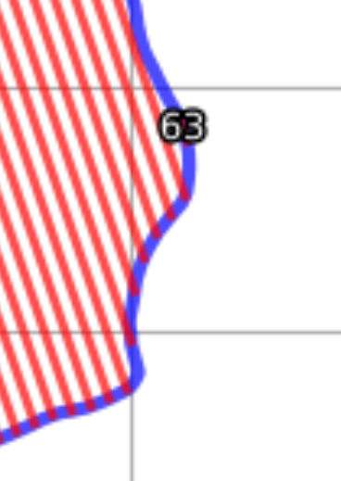
If the line segment you are running (A) is longer than the next line segment (B) then you want to stop running the current line segment at the point you are equal to the next line segment (C). The intersect point is on line segment A.
B
C
A

Slide 9
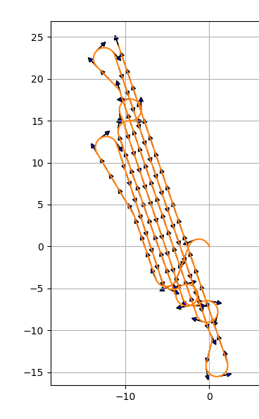
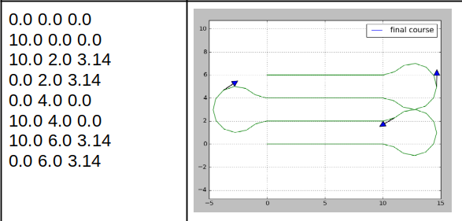
This was the input file:
0.00 0.00 1.90
-6.37 -3.89 1.90
-8.91 3.49 1.81
-11.08 12.24 5.04
-5.20 -4.84 5.60
-4.01 -5.81 1.90
-10.85 14.04 1.30
-10.47 15.42 5.04
-2.86 -6.68 5.50
-1.56 -7.98 1.90
-10.56 18.15 1.73
-11.31 22.82 5.04
0.14 -10.44 5.25
2.14 -13.79 1.90
-10.87 24.00 1.90
From: python3 ~/ros1_lawn_tractor_ws/project_notes/code_for_testing/path_planner_stable/path_planning_waypoint_generator.py
This is what I think I need to go towards.

Slide 10
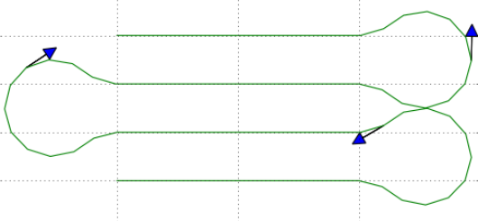

Slide 11
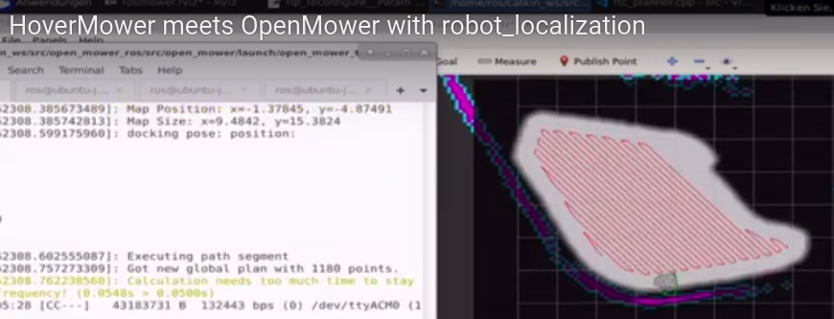
Note in this path they just ran a straight line from one line segment to the next.

Slide 12
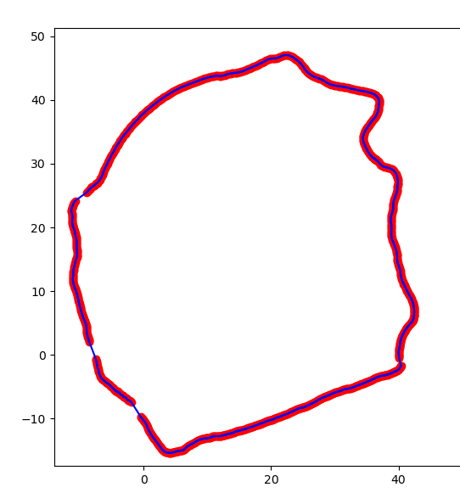

Slide 13
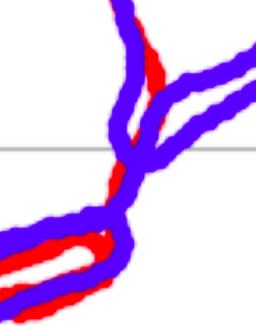
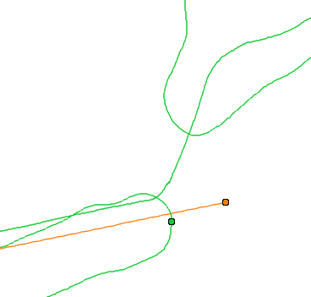
This will be the first spot to head toward
1174.8
First turn, use blue, but then switch to red.
1214.589 (blue)

Slide 14
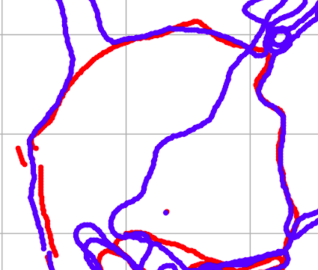
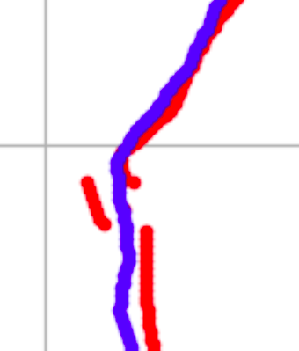
switch from red to blue
switch to red

Slide 15
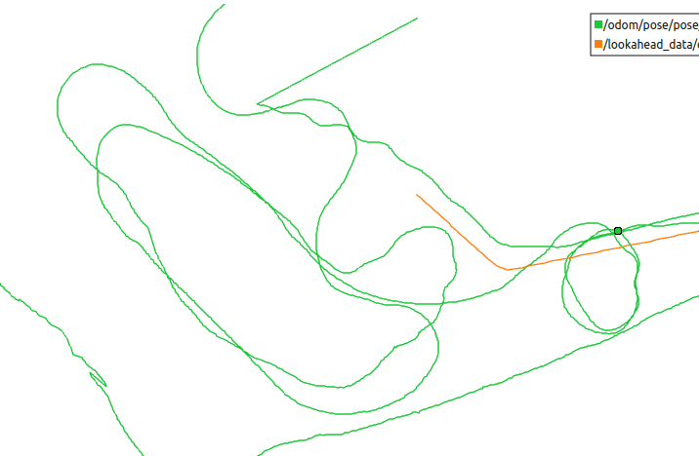
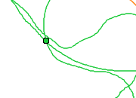
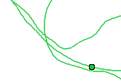
Obstacle 1
1237.810 (start) to 1286.956 (end)
Obstacle 2
1308.20 (start) to 1502.40 (end)

Slide 16
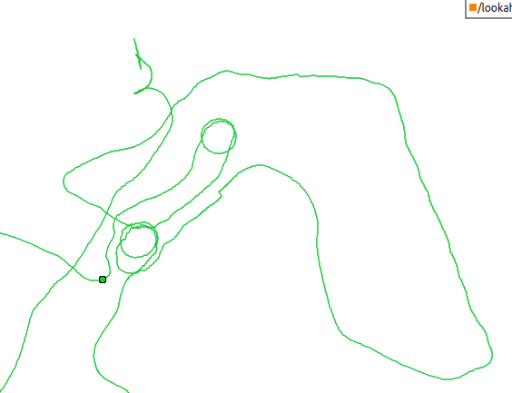
North and front yard (end)
845.080
North and front yard (start)
515.475

Slide 17
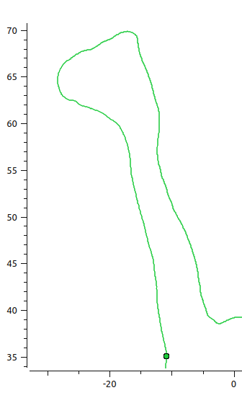
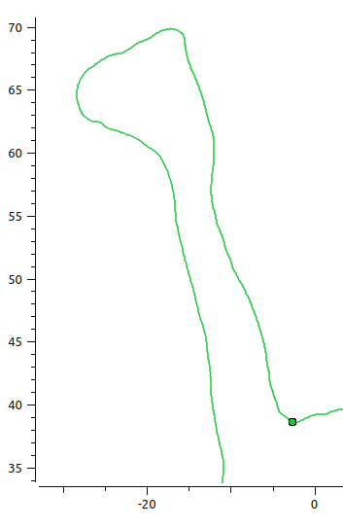
Northwest Corner (end)
1043.328
Northwest Corner (start)
896.225

Slide 18
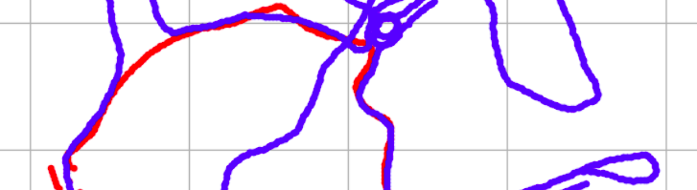

Slide 19
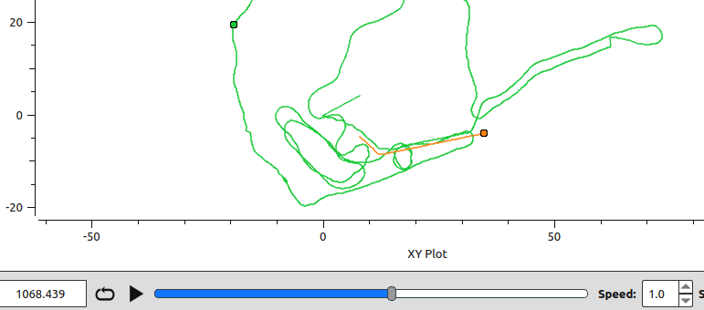

Slide 20
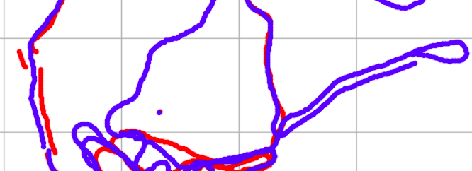
Path 1 – West segment 1 (start)
1067.99
Path 1 – West segment 1 (end)
1101.526
West segment – use blue (step 3)
1104.00

Slide 21
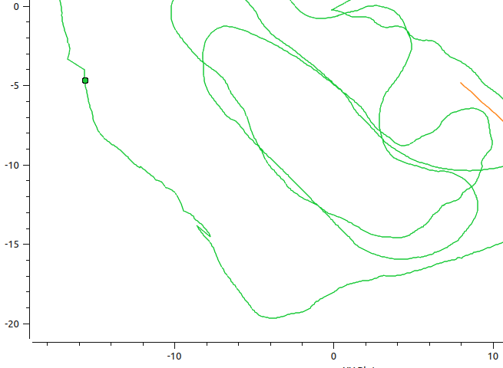
Path 1 – West segment 1 (end)
1101.526
Path 1 - West segment 2 (start)
1104.00
Path 1 - West segment 2 (end)
1119.00
Path 1 - West segment 3 (start)
1119.00

Slide 22
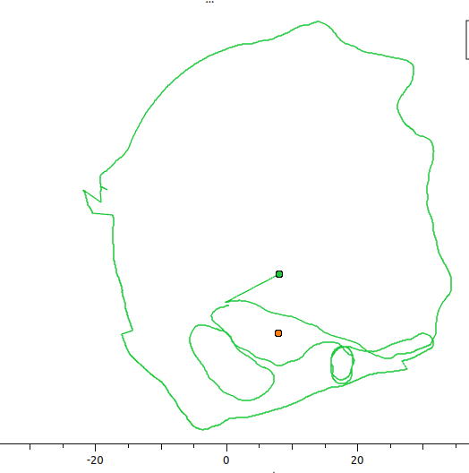
Update
collins_dr_62_A_from_rosbag_run1.csv
- Add header columns
- Find the last spot of the previous run

Slide 23
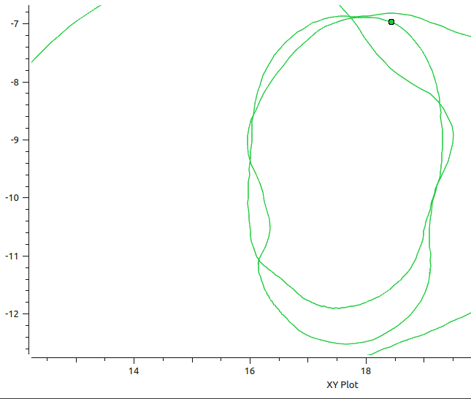
17.6
-6.8
-12.2 (diameter of 5.4) (center: 17.6, -9.5)

Slide 24
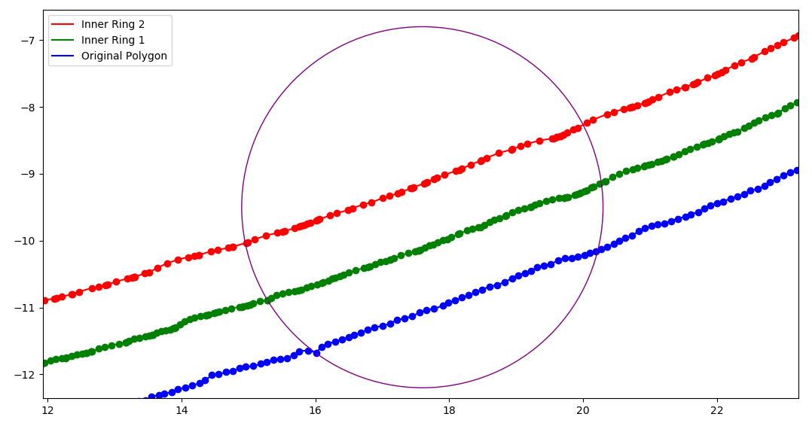
17.547, 6.794
- Open the .csv file with the path
- Search for intersection points with the obstacle
- Find the intersection points on both ends of the circle
- Plan the arc of the circle that connects the intersection points following the shortest distance
20.0, -8.257
20.305, -9.169
20.248,-10.149
14.92, -10.0
15.273, -10.88
15.959, -11.60
17.79, -12.2

Slide 25
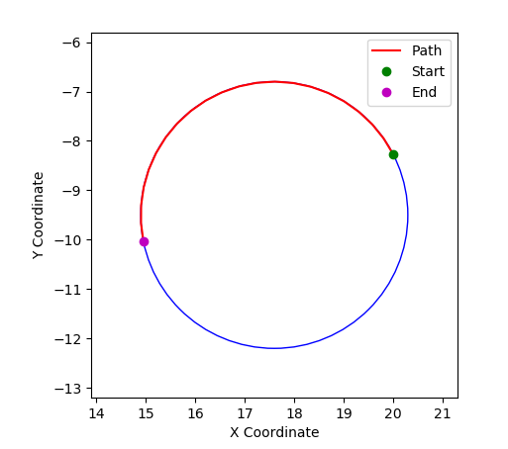
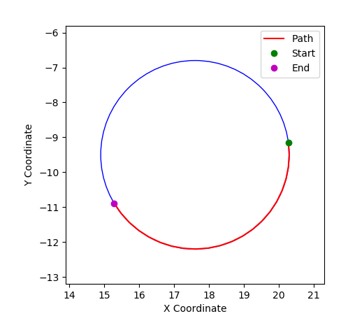
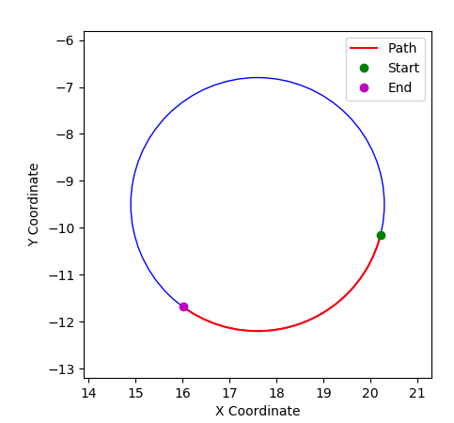

Slide 26
Psuedo Code for Path Planning with Obstacles
/code_for_testing/archive/obstacle_handling/test_straight_line_check.py
open the .csv file
set the obstacle size
calculate the circle segments
loop 1 – iterate the .csv file for each path segment
  loop 2 – compare each circle segment to the path segment
    Determine if a segment intersects. Use ‘do_segments_intersect(seg1_start, seg1_end, seg2_start, seg2_end):’ from ‘archive/obstacle_handling/test_straight_line_check.py’
    Determine if the first intersect from outside the obstacle and moving to the inside or are you running the path from inside the obstacle to the outside. I need to know this because I will need to trim the original path. You may want to visualize the results and capture input from the user. I’m going to assume the first intersect is outside and the next intersect is inside, until this does not work.
    Calculate which direction is shortest around the obstacle and create a path to travel; Plot it for visualization.
    Replace the original intersecting path with the calculated new path
      Take the points up until the first intersection and append them to the new path
      Take the calculated path and append them
      Skip over the unneeded segments
      Take the points up until the second intersection and append them to the new path
    I need to confirm the rows that should be eliminated; Do a simple read and print for row 1291, 1348 – confirmed
    Do I want to take
      1291 – 1, 1348 + 1
      3216 – 1, 3291 + 1
      4767 – 1, 4809 + 1

Slide 27
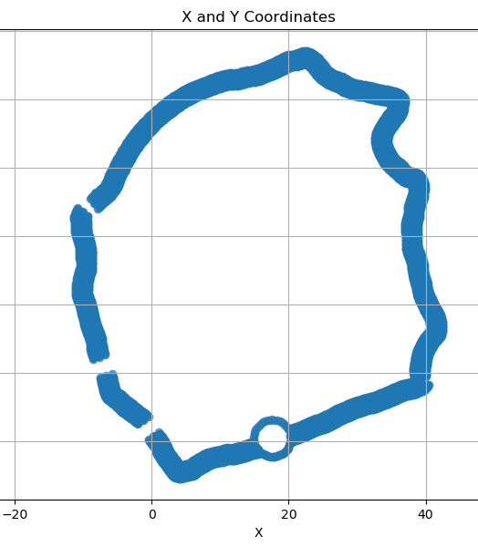
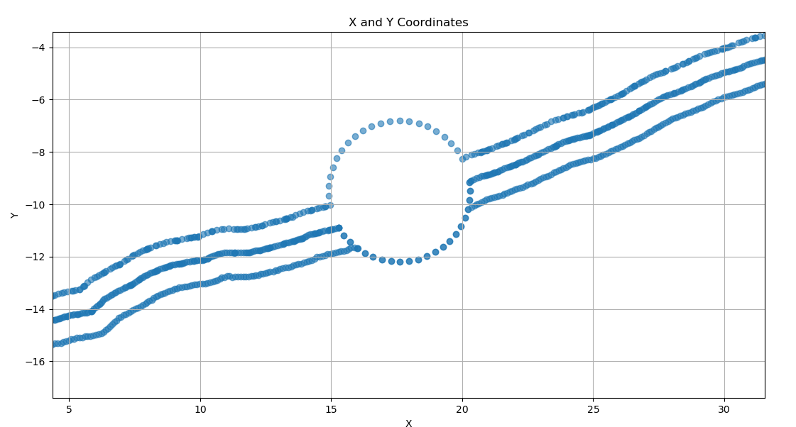
15’ obstacle

Slide 28
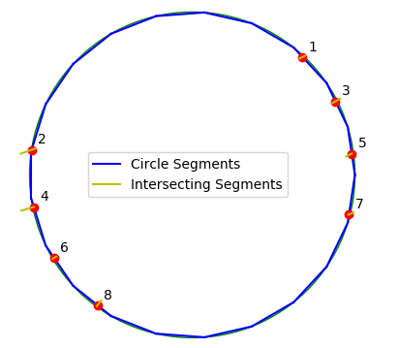
0 to 1031
Beginning 0 to 1031 Begin
Circle (0) 1031 to (1)1068 Loop a
Temp (1) 1068 to (2) 2537 Loop a
Circle (2) 2537 to (3) 2595 Loop b
Temp (3) 2595 to (4) 4463 Loop b
Circle (4) 4463 to (5) 4538 Loop c
Temp (5) 4538 to (6) 6015 Loop c
Circle (6) 6015 to (7) 6056 End
End (7) 6056 to end End
() - ‘I’ index
How do I complete the ‘end’?
circle_arc_df 1 (0, 1)
1068 to 2537
1068 to 2537
circle_arc_df 2 (2, 3)
2595 to 4463
circle_arc_df 2 (4, 5)
4538 to 6015
2595 to 4463
circle_arc_df 4 (6, 7)
4538 to 6015
6056 to end
xy_file_name rows that intersected with the circle: [1031, 1068, 2537, 2595, 4463, 4538, 6015, 6056]
0 1 2 3 4 5 6 7
1 0 1068 2537 (14.933875073983838, -9.085531433256849) (19.97641527142415, -8.281316268910585)
3 1 2595 4463 (14.97012281243527, -10.031980848604402) (20.247204353386163, -9.149723771641119)
5 2 4538 6015 (15.307216305396427, -10.876582335577533) (20.20108302910253, -10.156271221377008)

Slide 29
Next steps
Define the inner polygon – maybe based on the starting point
  Where did I define the starting point
    start_point_x, start_point_y are defined in the paths_locations.csv file
    Where is it used?
      ‘ring_path = create_inner_rings(gps_data, num_inner_rings, path_size, start_point, xy_file_name)’ in path_ll2xy_2inner_rings_v4.py
      More specifically ‘def reorder_ring(ring, start_point):’ which looks for the closest point and reorders the ring
Create the Boustrophedon path based on the inner polygon
  Innermost ring written to file: /home/tractor/ros1_lawn_tractor_ws/project_notes/paths/Collins_Dr_62/Site_01_innermost_ring.csv
  Reviewing ‘path_boustrophedon_coverage_variable_degree.py’
    This creates the line segments, but two things need to occur after the line segments are created.
      The disconnected line segments need to be excluded
      The intersection points have to be defined to allow for Dubins ‘keyhole’ u-turns to be calculated
      The continuous Dubins path has to be created
Join the outer path and the Boustrophedon path
Improve the Boustrophedon process so it does not require as much ‘hand work’

Slide 30
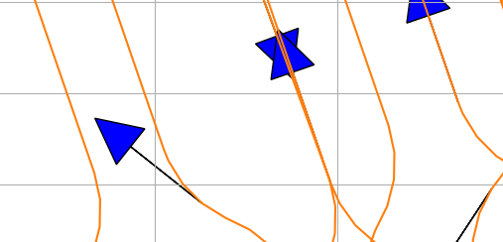
You can see three of these rows are equal, but one is wider. That means the correct point is to the left of where the line segments are coming together.

Slide 31
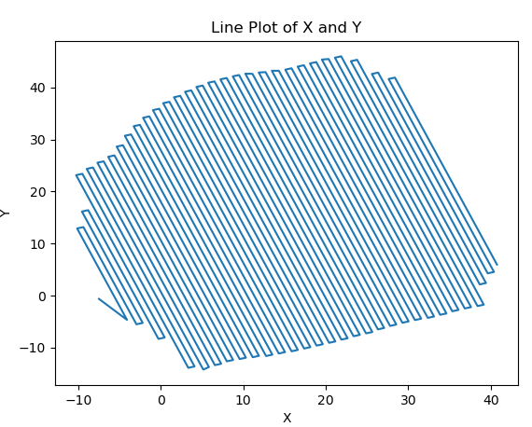
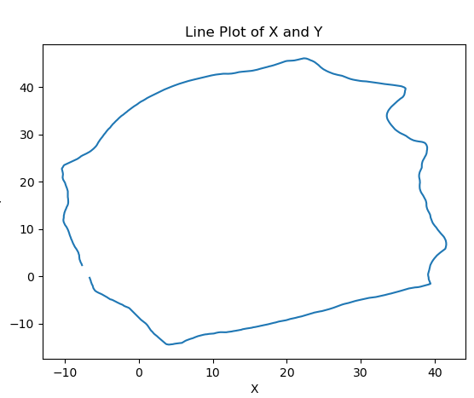
This is interesting.
When I plot /paths/Collins_Dr_62/Site_01_boustrophen_inner_ring.txt I get the following
'/home/tractor/ros1_lawn_tractor_ws/project_notes/paths/Collins_Dr_62/Site_01_innermost_ring.csv'
Plotting program: /code_for_testing/archive/boustrophedon/path_test_plot_inner_ring.py
I thought I was only going to get the outer bound
Where was ‘Site_01_boustrophen_inner_ring.txt ‘ created?
Site_01_innermost_ring.csv'

Slide 32
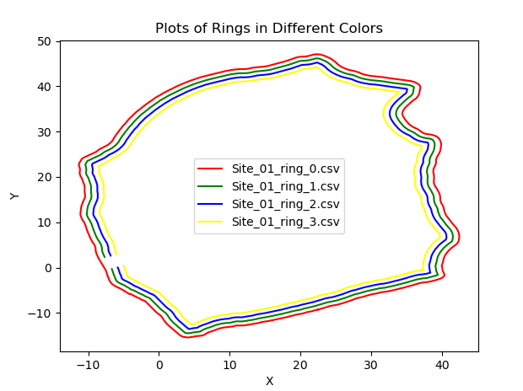
I adjusted ~/code_for_testing/archive/path_polygon_rings/path_ll2xy_2inner_rings_v4.py to save each polygon as a separate file so I can confirm I’m working with the correct one.
From the program ~/code_for_testing/archive/boustrophedon/path_test_plot_multiple_rings.py
Now I need to use #3, rerun creating the boustrophedon path, add the outer perimeter and plot it to see how the u-turns line up

Slide 33
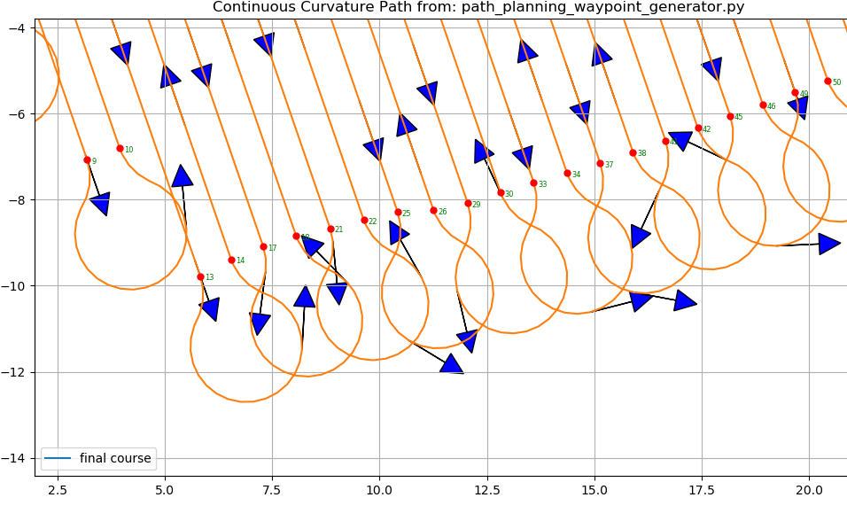
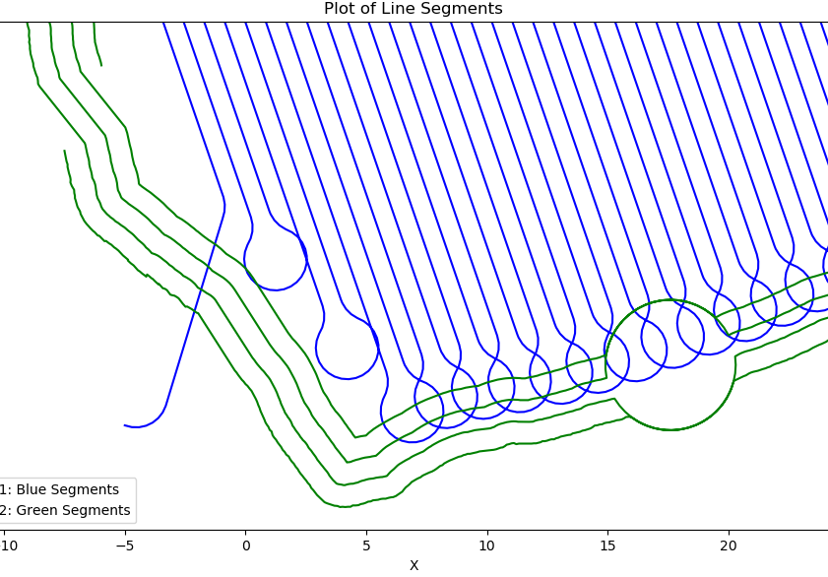
Starting with segment 33,34 to 49,50 they need to be moved up (i.e. higher on the y axis)
I need to copy from 32 to 35 and make line segment 32, 34 and segment 34, 35 ‘shorter’ on the y axis

Slide 34
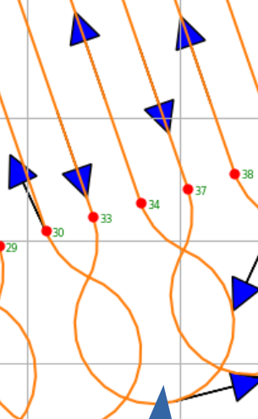
Problem definition
I have two line segments in x, y format:
Point 32 0.397 30.713
Point 33 13.587 -7.595
Point 34 14.364 -7.380
Point 35 0.781 32.068
The second line segment needs to be made shorter by 1.5. If the slope of the line was straight up and down it would be easy. I would keep x the same and add 1.5 to the y coordinate, but the slope of the line is not straight up and down. Can you help me calculate a new x, y coordinate for the second line segment and provide the python code so I can replicate it in my environment?
Because this is a path, the points are 32 to 33 to 34 to 35, but in explaining it mathematically I want points 32 and 35 to remain constant.

Slide 35
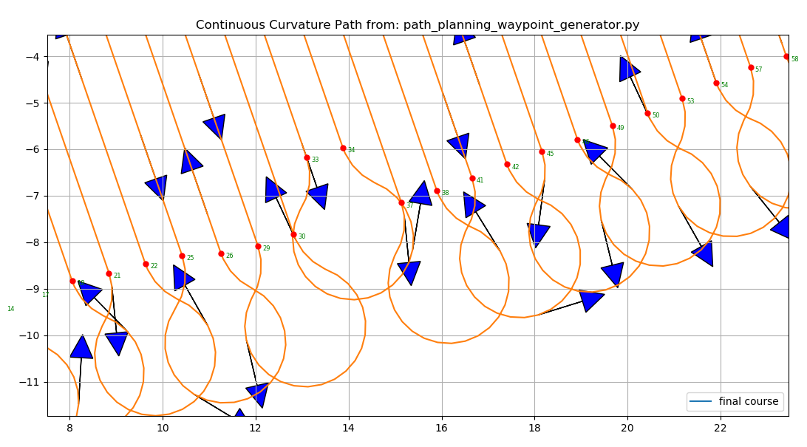
Points 33, 34 were moved up successfully. Now I need to move 37, 38

Slide 36
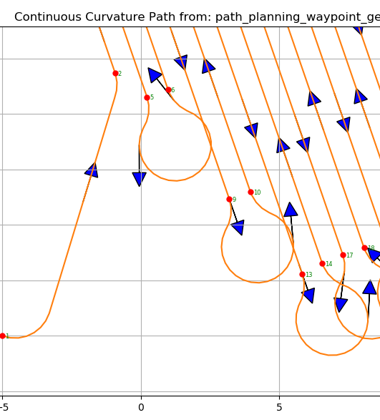
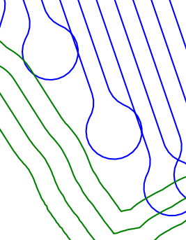
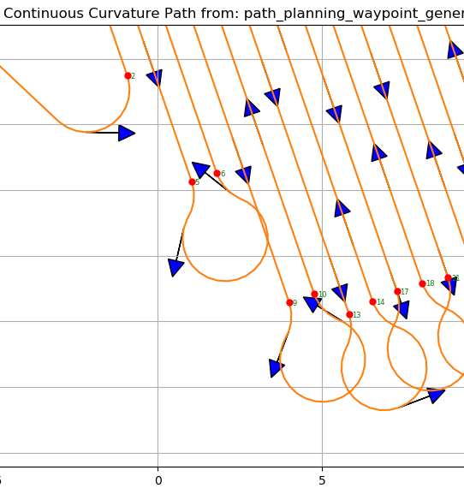
For 5,6 and 9,10 the logic worked to add 2.5 meters by using a negative value for ‘length_to_shorten’

Slide 37
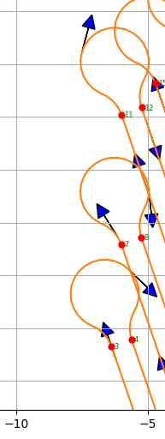
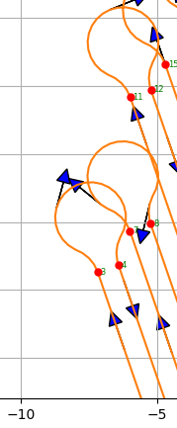
For 3, 4 and 7, 8 test logic to add 2.5 meters by using a negative value for ‘length_to_shorten’ and confirming the start and stop values are correct
3,4 uses 2, 3, 4, 5
7, 8 uses 6, 7, 8, 9
So we need a new ‘end’ for 2, 3 and a new start for 4, 5

Slide 38


Site_01

Slide 39


Site_01

Slide 40


Ready to test Site_01

Slide 41



Creating Path for Site04
Play rosbags for the time stamps
  Open Plotjuggler $ rosrun plotjuggler plotjuggler
  Right 897; Left - 1043
  ~/bagfiles/Collins_Dr_62_Site_01_run1_2023-11-01-14-02-20.bag
Play the rosbag for the red path and get the time stamps (~/bagfiles/Collins_Dr_62_Site_01_run2_2023-11-01-14-51-56.bag)
  Right – 281; Left – 295
Open 'rosbag_latlon_to_json_and_csv.py'

Slide 42

Site_04
This is producible, but it is not a continuous path starting from the inside to the outside. How do I make a path from this so I can test it?
What created ‘Site_01_4_outer_paths.txt’ because it is the similar path for Site_01?
For reference:
I adjusted ~/code_for_testing/archive/path_polygon_rings/path_ll2xy_2inner_rings_v4.py to save each polygon as a separate file so I can confirm I’m working with the correct one.
From the program ~/code_for_testing/archive/boustrophedon/path_test_plot_multiple_rings.py
I created this using the x, y coordinates from the /odom topic, but if I want to be flexible you should use lat, lon data (e.g. you want to change the starting point or reference origin in the future.)

Slide 43
How to create Site_04.csv
How do I get a lat, lon file for Site_04?
/archive/rosbag_get_latlon_odom.py function:
  Script that reads the lat, lon data from the /fix topic and x, y positions from /odom/pose/pose/position topic in a ROS bag file, between a starting and ending point in seconds, converts those positions to x, y coordinates and then plots them using pyplot.
  This program does not appear to write the output to a .csv file
It appears I ran ‘/rosbag_latlon_to_json_and_csv.py’ and then manually updated ‘collins_dr_62_A_from_rosbag_run1.csv’ with attributes about the data. Site_04 is referenced in the #1 file, but not the #2 file. Subsequently I must have copied data out of ‘collins_dr_62_A_from_rosbag_run1.csv’ and ‘collins_dr_62_A_from_rosbag_run2.csv’ to hand build the Site_01 file.
This is what Site_01 looks like:

Slide 44
Building Site_04.csv
Run ‘/rosbag_latlon_to_json_and_csv.py’ and then manually updated ‘collins_dr_62_A_from_rosbag_run1.csv’ with attributes about the data. Do the same for the #2 file.
Reference Site_04 in the #1 file,
Review #2 file for the points that will close the ‘peninsula’ portrayed in the data from #1.
Put each set of points into clockwise sequnce
Copied data out of ‘collins_dr_62_A_from_rosbag_run1.csv’ and ‘collins_dr_62_A_from_rosbag_run2.csv’ to create Site_04 file.
Run ~ /path_polygon_rings/path_helper_to_visualize_first_xy_point.py to visualize the points, sort points or clip points as needed to make a complete polygon
Open ~/path_polygon_rings/path_ll2xy_2inner_rings_v4.py
  location_name = 'Collins_Dr_62_Site_04'
  xy_file_adjusted_for_obstacles = '/home/tractor/ros1_lawn_tractor_ws/project_notes/paths/Collins_Dr_62/Site_01_ring_adjusted_for_obstacles.csv' # for obstacle calculations
  If there is an obstacle, update obstacle data:
    circle_center = (17.6, -9.5)
    radius = 5.4 / 2
    num_circle_points = 21
  output_file_path = '/home/tractor/ros1_lawn_tractor_ws/project_notes/paths/Collins_Dr_62/Site_01_ring_0.csv'
  output_file_path = f'/home/tractor/ros1_lawn_tractor_ws/project_notes/paths/Collins_Dr_62/Site_01_ring_{i}.csv'
  lookahead=2.5
  speed=0.75
The ‘input_path.txt’ file will be created. You can now run this in simulation and then make corrections as needed.
If you are happy with the path in simulation move and rename the input_path.txt into the folder “ready for testing’; Double check the speed is 0.75 m/s.
Open ‘Path Planning - Boustrophedon path creation notes.odt’ for instructions on creating stripes for the coverage map
I then then take Site_01.csv and build a list of line segments based on the Boustrophen coverage map from the polygon. The line segments are in an (x1, y1), (x2, y2) format; For my 19 degree lines at the initial site the (x1, y1) will have the lowest y axis value (i.e. are at the bottom of the property when portrayed on an x, y graph). The script that produces it is: ~/code_for_testing/archive/path_boustrophedon_coverage_variable_degree.py; At this point the intersection points are not calculated that will connect these lines.
Run script that calculates intersection points ~/code_for_testing/archive/dubins/plotIntersectingPointsV8.py Manually review the graph. Update the script to delete the beginning and ending line segments that will be handled by outer perimeter runs. (i.e. The lines that are short or have multi-paths, disconnected line segments.

Slide 45


These are corner turns that may be a problem in the field test. You might be able to avoid issues by extending the lookahead distance for the problematic corners or trimming the waypoints to smooth the curve.

