Slide 1
SECURE FILE INTAKE / CUSTOMER ARCHITECTURE
Secure document intake on Azure
A customer walkthrough of the user journey, architecture, and security boundaries
Verify the sender.
Scan twice before release.
Retrieve securely, then delete.
No WAF or Application Gateway. Consumption-based compute and private file storage.
SHERIFF / PUBLIC HEALTH / CORRECTIONS
01
Notes:
Customer architecture overview. Malware scanning reduces risk; it is not a guarantee or a compliance certification.

Slide 2
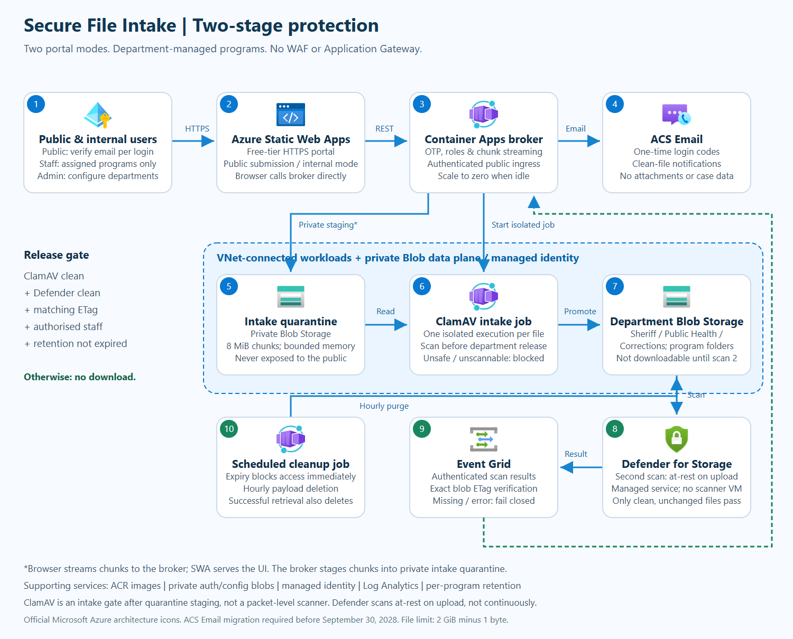
SECURE FILE INTAKE / CUSTOMER ARCHITECTURE
Architecture at a glance
Official Azure service icons | Full end-to-end diagram
1 Verify email and authorise
2 Stage into private quarantine
3 ClamAV intake scan
4 Defender at-rest scan
5 Notify and retrieve
6 Delete on retrieval or expiry
The full-resolution PNG and HTML are supplied separately for detailed inspection.
SHERIFF / PUBLIC HEALTH / CORRECTIONS
02
Notes:
Use the supplied full-resolution architecture PNG/HTML to inspect small labels. The following slides expand each part of this diagram.

Slide 3



SECURE FILE INTAKE / CUSTOMER ARCHITECTURE
A safer way to receive documents
Two portal modes. One controlled file lifecycle.
Public submission
Internal workspace
Short-lived storage
Email-verified users submit to the right department and program.
Assigned staff retrieve files. Department admins configure programs.
Files disappear after retrieval or the program's retention period.
SHERIFF / PUBLIC HEALTH / CORRECTIONS
03
Notes:
This is the updated secure file intake architecture. It gives the public a simple submission portal and gives departmental staff a separate, authorised workspace. Every file follows a controlled lifecycle, from email-verified submission, through two malware checks, to retrieval or automatic deletion.

Slide 4


SECURE FILE INTAKE / CUSTOMER ARCHITECTURE
1 | Verify every sign-in
Email one-time codes replace public passwords.
Request a code
Verify the mailbox
Enforce permissions
Anyone can register with an email address.
Single-use, eight-digit code. Ten-minute expiry. Limited attempts.
The API checks the session and department/program access.
SHERIFF / PUBLIC HEALTH / CORRECTIONS
04
Notes:
A public user starts by entering an email address. The service sends a one-time code, and the first verified login registers that email. Every subsequent login needs a fresh code. Codes expire after ten minutes and allow only five attempts. The browser keeps its session in memory. Staff privileges are assigned explicitly; knowing an email address never grants departmental access.

Slide 5
SECURE FILE INTAKE / CUSTOMER ARCHITECTURE
2 | Let each department manage its programs
Sheriff. Public Health. Corrections.
Department admins
Program recipients
Submission context
Create programs and delegate departmental administration.
Configure who is notified and who may retrieve each program's files.
Program, case/permit reference, notes, and a retention deadline.
SHERIFF / PUBLIC HEALTH / CORRECTIONS
05
Notes:
Each of the three departments can define its own programs, categories, or services. Administrators set the notification list and retention period for each program. Public users choose a department and program, enter a permit, identification, or case reference, add details, and select their file. The retention policy is captured with that submission.

Slide 6

SECURE FILE INTAKE / CUSTOMER ARCHITECTURE
3 | Upload reliably, then pass the intake gate
8 MiB chunks. Independent retries. Isolated ClamAV execution.
Chunk broker
Private Blob path
ClamAV job
Streams chunks into private quarantine with bounded memory.
Storage has no public endpoint access or shared account keys.
Scans the complete quarantined file before department release.
SHERIFF / PUBLIC HEALTH / CORRECTIONS
06
Notes:
The browser splits the file into eight mebibyte chunks and retries failed chunks independently. The broker streams those chunks into private intake quarantine. It does not load the whole file into memory. A separate, isolated ClamAV job scans the complete upload before any department copy is released. This is intake scanning after quarantine staging, not packet-level inspection. The accepted file limit is two gibibytes minus one byte, so the scanner can inspect every accepted file.

Slide 7


SECURE FILE INTAKE / CUSTOMER ARCHITECTURE
4 | Require a second clean result at rest
Defender result + exact blob ETag = release decision.
Department copy
Microsoft Defender
Trusted scan event
Clean ClamAV output is saved under the selected program.
Scans the stored department copy when it is created.
Authenticated callback; matching ETag; no result means no download.
SHERIFF / PUBLIC HEALTH / CORRECTIONS
07
Notes:
After ClamAV reports clean, the job creates a program-specific copy in the selected department's storage container. Microsoft Defender for Storage scans this file at rest when it is uploaded. Event Grid delivers an authenticated result to the broker. The result must match the exact version of the blob, identified by its ETag. Until both checks are clean, retrieval is blocked. Malicious files are rejected; errors, missing results, and changed files never bypass the gate.

Slide 8
SECURE FILE INTAKE / CUSTOMER ARCHITECTURE
5 | Notify, retrieve, then remove
The notification contains a portal link, never the document.
Notify recipients
Authorised download
Delete stored payload
Email after both checks pass. No attachments or case details.
The API checks program access, scan status, ETag, and expiry.
Completed server response deletes it; interrupted transfers can retry.
SHERIFF / PUBLIC HEALTH / CORRECTIONS
08
Notes:
Once both scans pass, the configured recipients receive an email linking to the internal portal. The message contains no file attachment or sensitive case details. Staff sign in, see only their assigned submissions, and stream a download. The API rechecks authorisation, the malware result, the blob ETag, and retention expiry. A completed server response deletes the stored payload. An interrupted transfer retains it for retry. Server completion cannot prove that a recipient saved a durable copy.

Slide 9

SECURE FILE INTAKE / CUSTOMER ARCHITECTURE
6 | Enforce retention without always-on compute
Expiry is an access rule, not just a cleanup schedule.
Hourly cleanup job
Private service identity
Operational visibility
Removes expired payloads, including abandoned submissions.
Managed identity for storage, registry, job control, and email.
Monitor pending scans, failed jobs, and Defender scan-cap alerts.
SHERIFF / PUBLIC HEALTH / CORRECTIONS
09
Notes:
Retention is enforced at the API immediately, even between cleanup runs. An hourly Container Apps job removes expired payloads and retries pending notifications. Managed identity handles Azure access without storage keys in application code. Log Analytics supports troubleshooting. Operations should monitor failed jobs, pending scans, and the Defender scan budget. This design adds no WAF or Application Gateway.

Slide 10
SECURE FILE INTAKE / CUSTOMER ARCHITECTURE
Low fixed cost. Explicit security boundaries.
Pay for work performed; never release a file to save scan cost.
Reuse the existing estate
Scale to zero
Budget the required scan
SWA Free, LRS storage, Basic registry, and private endpoint.
Broker idles at zero; scan and cleanup jobs are short-lived.
Defender is billed by scan volume. Cap exhaustion blocks release.
SHERIFF / PUBLIC HEALTH / CORRECTIONS
10
Notes:
The solution reuses the existing Azure resources and keeps fixed costs low. Static Web Apps stays on the free tier, the broker scales to zero, and compute jobs run only when needed. Defender scanning is a new usage-based cost required by the document. We scan department copies rather than duplicate quarantine data, and a configurable cap controls exposure. If the cap is reached, files remain blocked. Finally, the email integration needs a migration plan before the announced ACS Email retirement in September twenty twenty-eight.

Slide 11
SECURE FILE INTAKE / CUSTOMER ARCHITECTURE
Operating decisions and boundaries
Keep the security controls explicit as the customer scales
Accepted size: 2 GiB minus 1 byte; encrypted or unscannable files stay blocked.
At expiry, access stops immediately; hourly physical cleanup may lag up to one hour.
A completed server response triggers deletion; it cannot prove the user saved a local copy.
Department isolation is application-enforced using a shared managed identity.
Budget Defender scan volume; reaching its cap blocks release rather than bypassing scans.
Plan replacement of ACS Email before September 30, 2028.
SHERIFF / PUBLIC HEALTH / CORRECTIONS
11
Notes:
Production decisions: review staff MFA, identity separation, records retention, monitoring, scan budget and email lifecycle. Soft delete and versioning must be disabled for the documented physical deletion semantics. Sources and detailed controls are in the accompanying architecture HTML and repository deployment guide.

