Slide 1
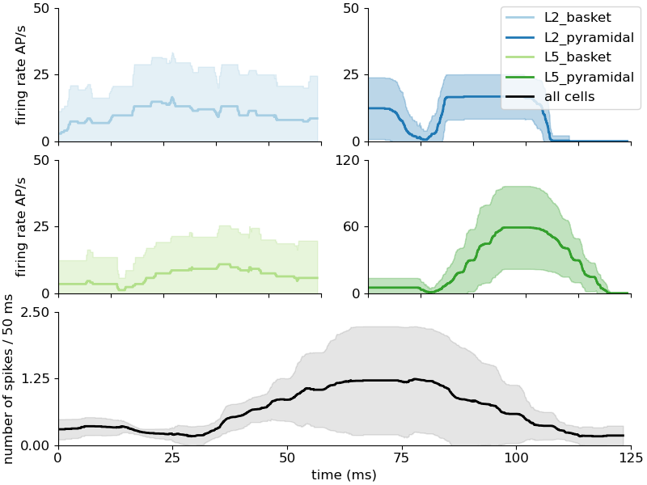
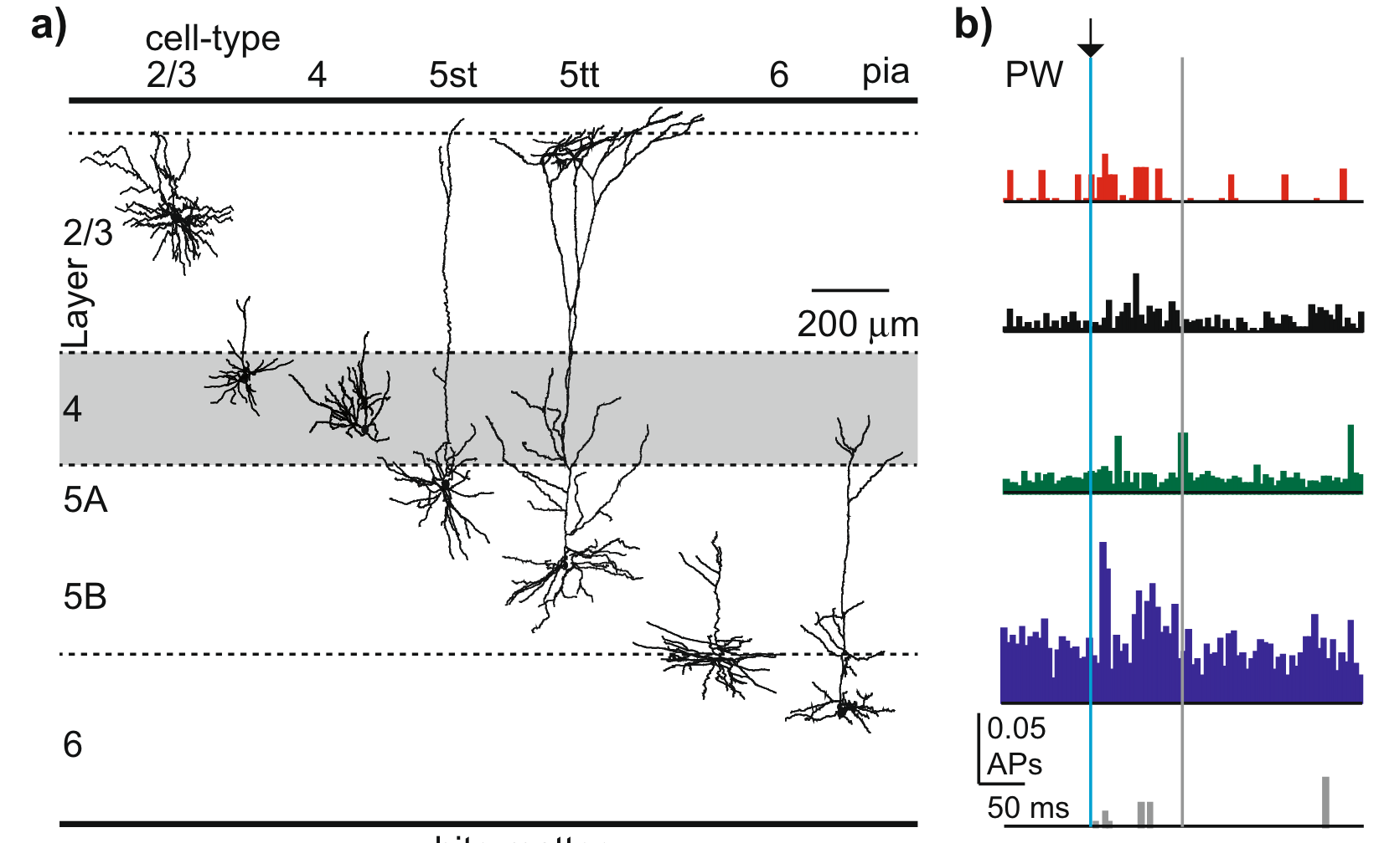
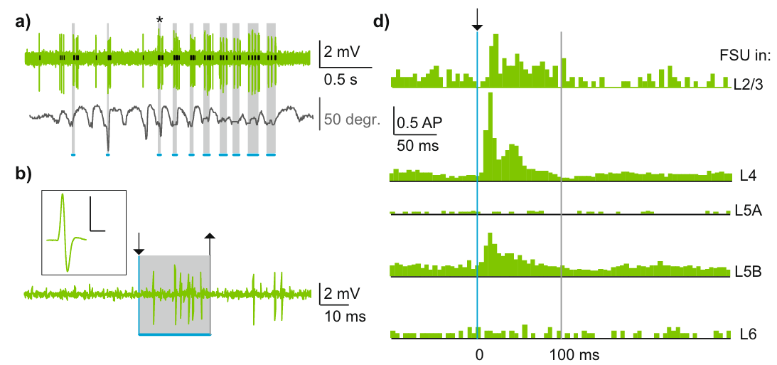
Suprathreshold Dipole tuning –reasonable firing rates?
De Kock et al., 2021 -> passive whisker flick
Mainly triggers L5 ET spiking (and stim can be decoded
from bursts)
several studies suggest that L5 neurons in rodents respond most
strongly to inputs (Quiquempoix, 2015; Snyder & Smith, 2015)

Slide 2
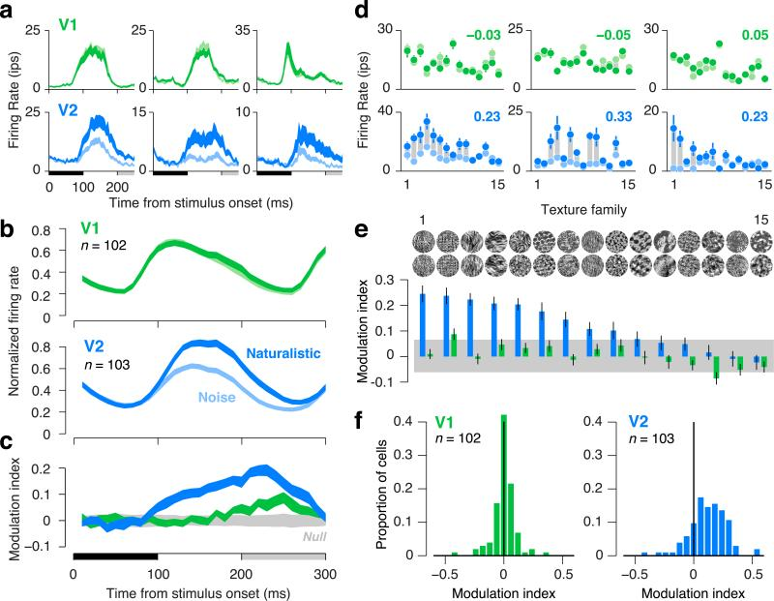
Suprathreshold Dipole tuning – reasonable firing rates?
Freeman et al., 2013 (Primate V1 V2, single cell recordings)

Slide 3
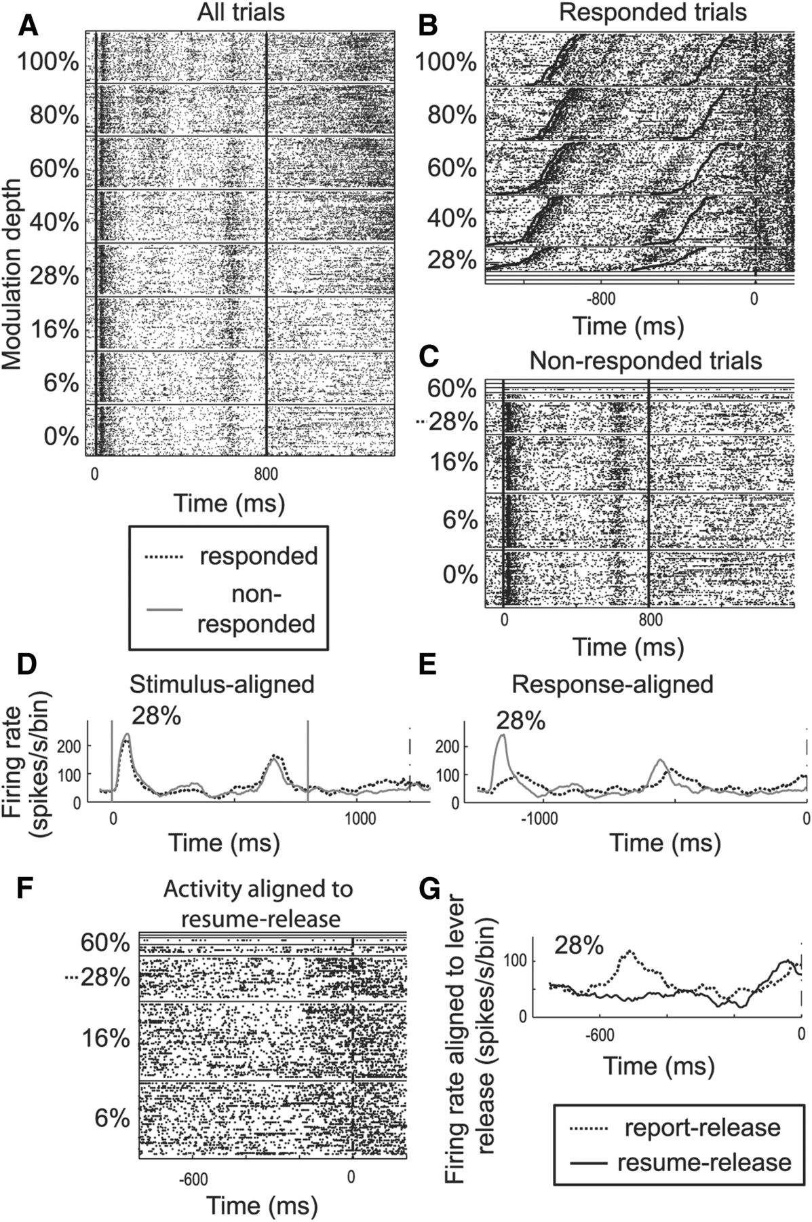
Suprathreshold Dipole tuning – reasonable firing rates?
Niwa et al., 2013 (Primate A1, MUA – does not distinguish between cell types)

Slide 4
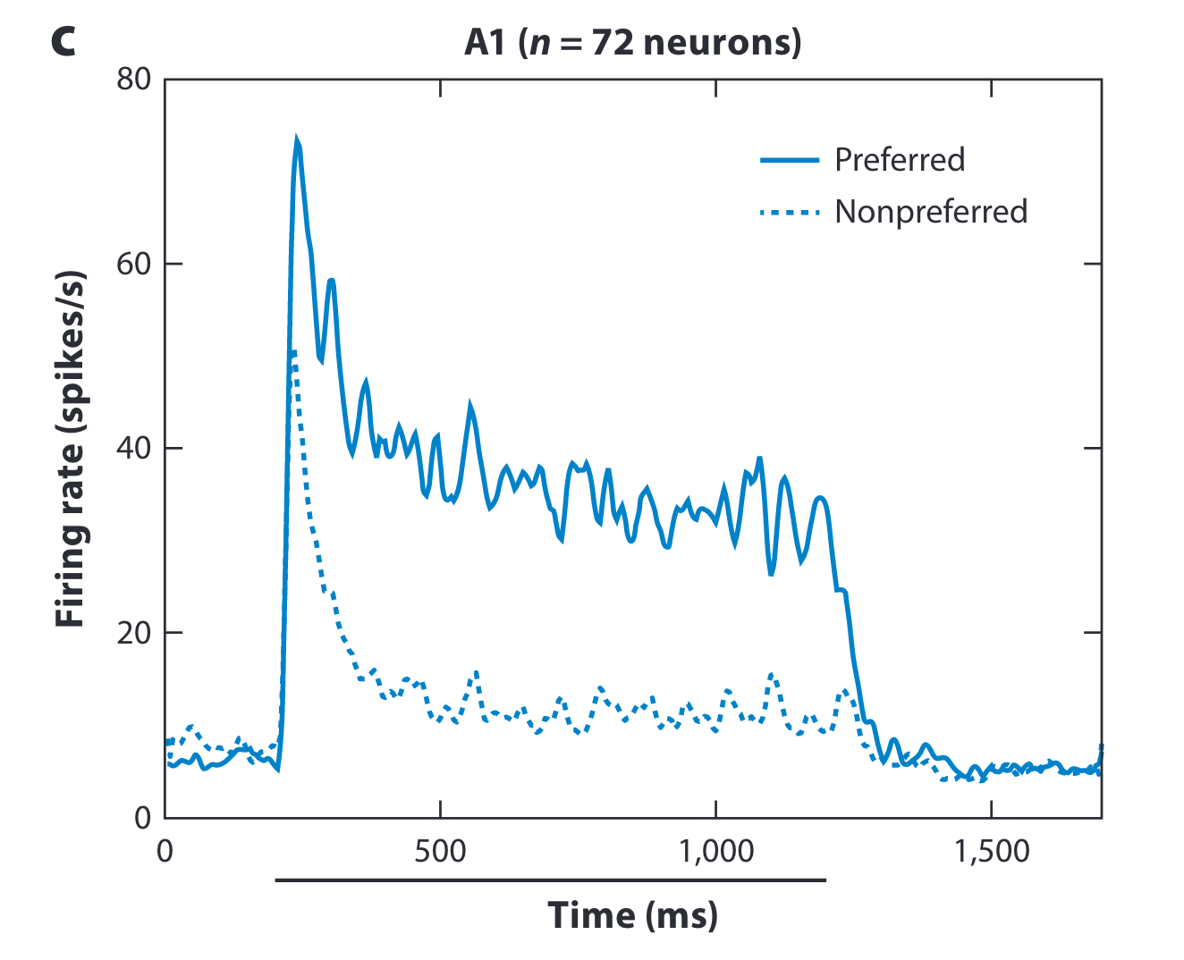
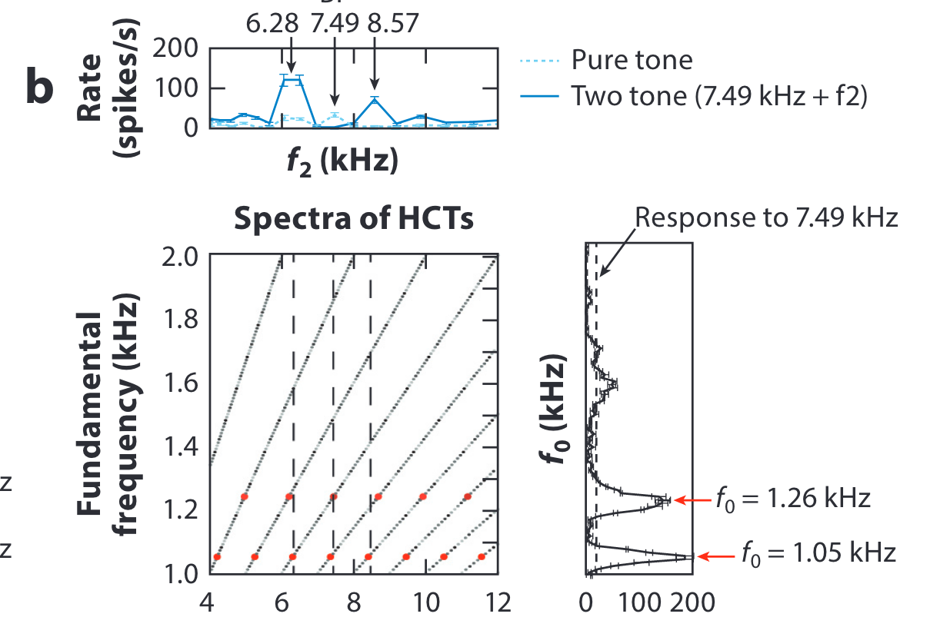
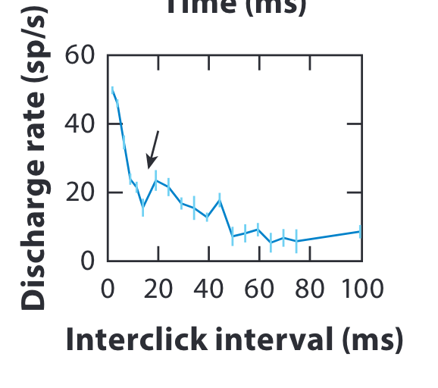
Suprathreshold Dipole tuning – reasonable firing rates?
cat
macaque
Wang 2018 (cat A1 40-80 spikes per second; macaque 20-40 spikes per second in response to click train)

Slide 5
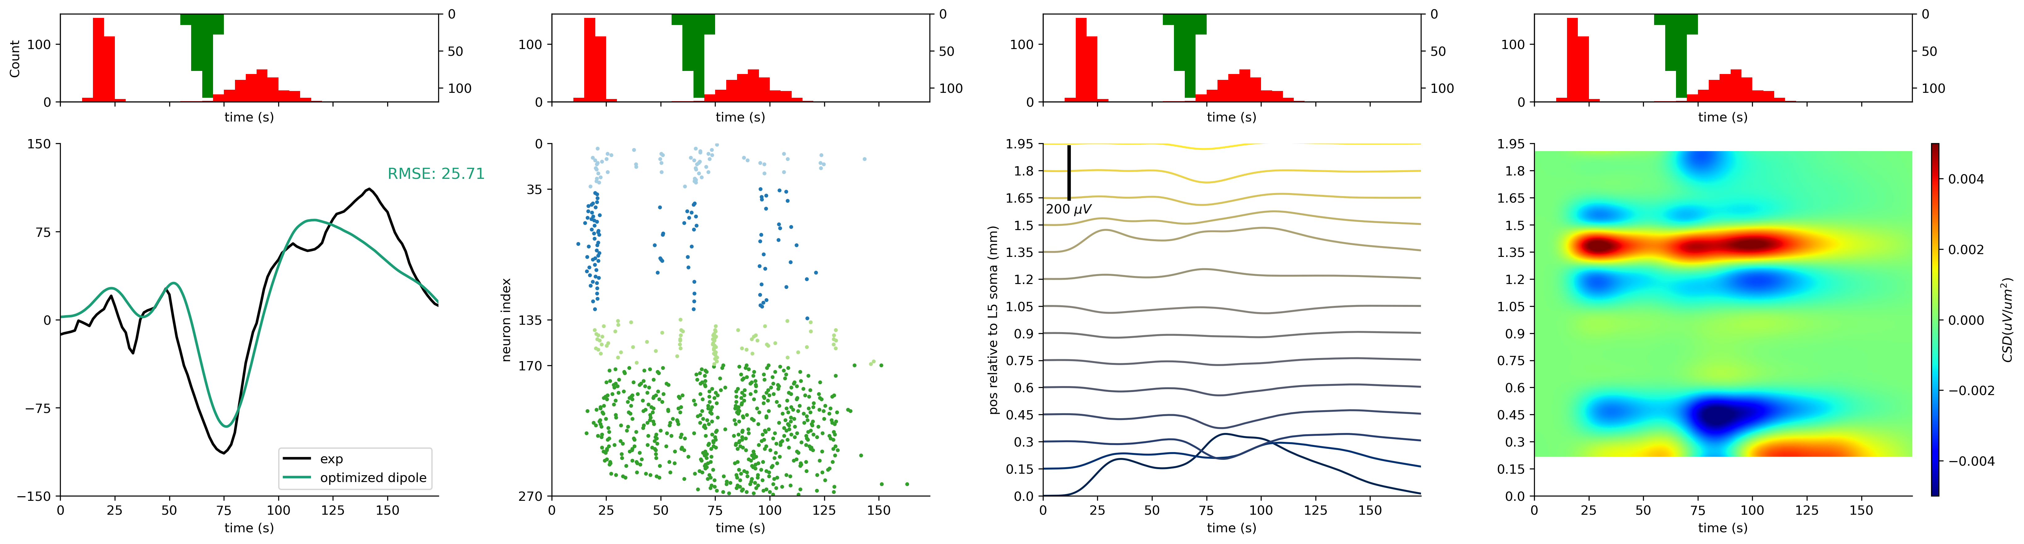
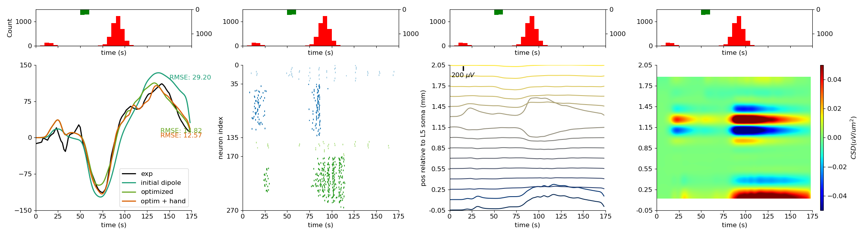

Slide 6
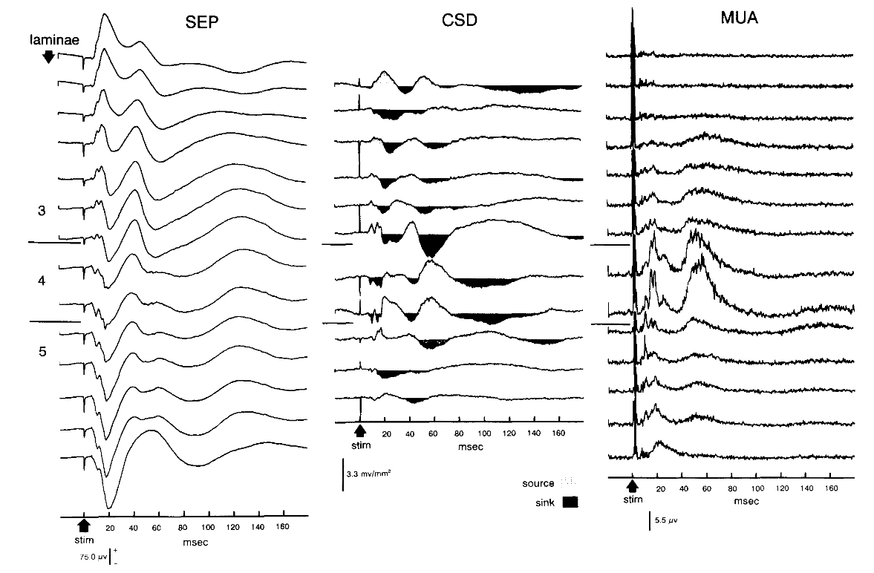
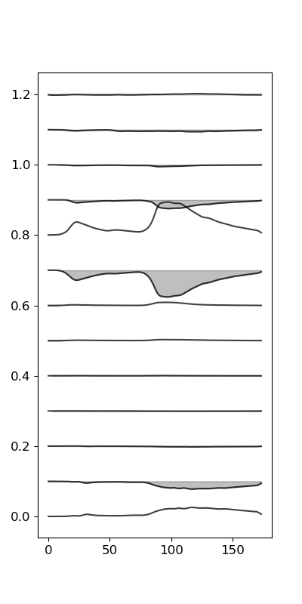
Suprathreshold Dipole tuning - CSD
Reproduced LFP:
first bump supra,
second bump infra
but upward and downward
deflections not as prominent
as in data
distal drive: down in L2/3
up in L5
second proximal response
by L5 and L2/3
Peterson, Schroeder, Arezzo, 1995

Slide 7
Suprathreshold Dipole tuning - CSD
Reproduced CSD:
sink-source profile between
L2/3 and L4
two sinks in supra though
simulation is later than data
generally more driven by supra
upward deflection in response
to second prox driven by both
L2/3 and L5
Peterson, Schroeder, Arezzo, 1995

Slide 8
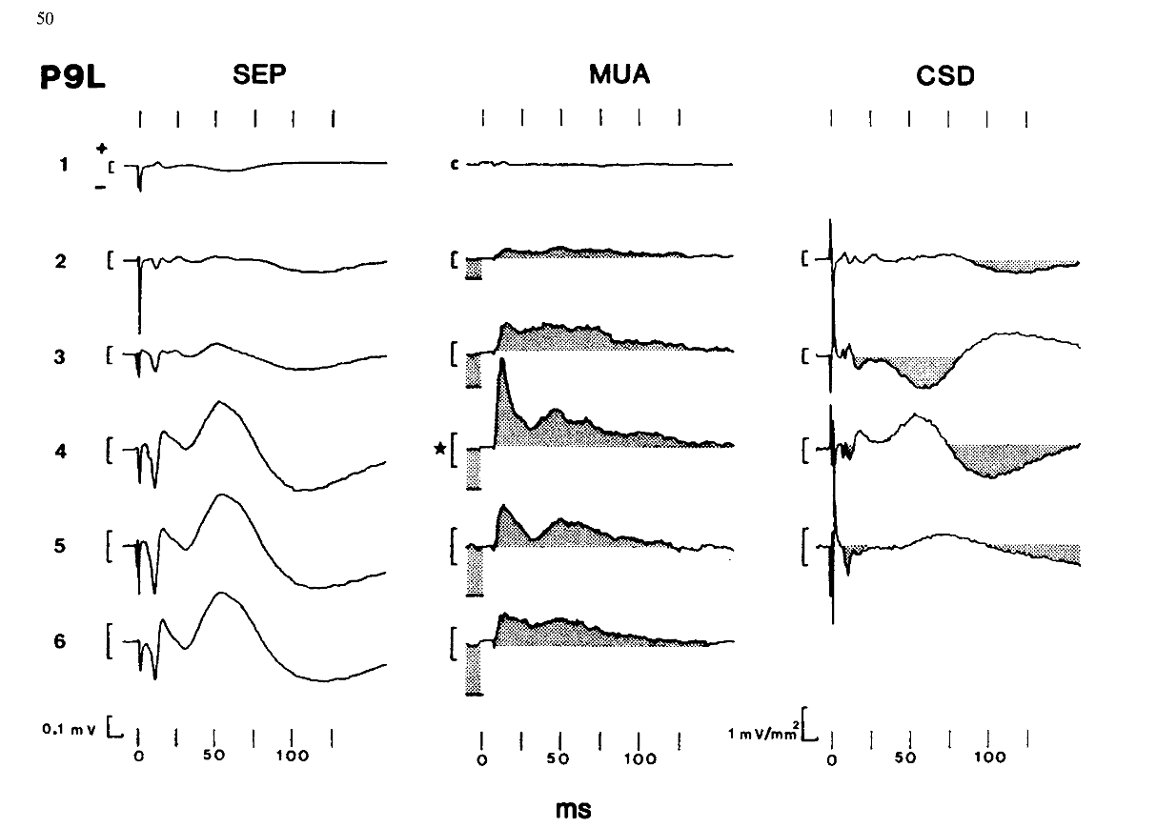
Suprathreshold Dipole tuning - CSD
Kulics and Cauller, 1986 – second proximal driven by L5? Report more contribution from L5

Slide 9
Current Suprathreshold with Jones 2009 and Darcy’s settings
New model has better
dipole fit
Comment Nick in lab meeting: L5 is quiet ?

Slide 10
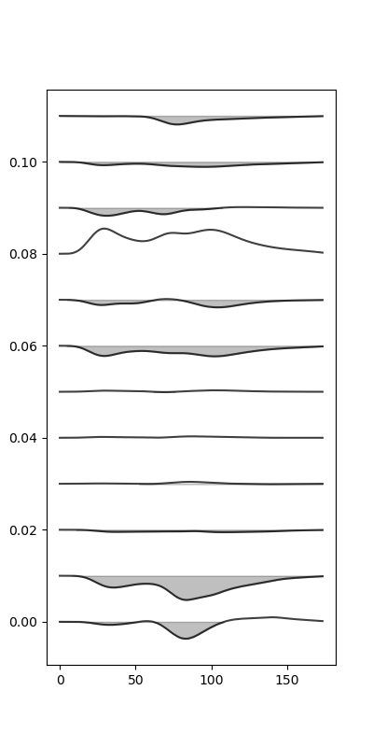
Current Suprathreshold with Jones 2009 and Darcy’s settings
CSD and LFP somewhat similar to new model,
except for sink in L5 (not so much in new model or data)

Slide 11
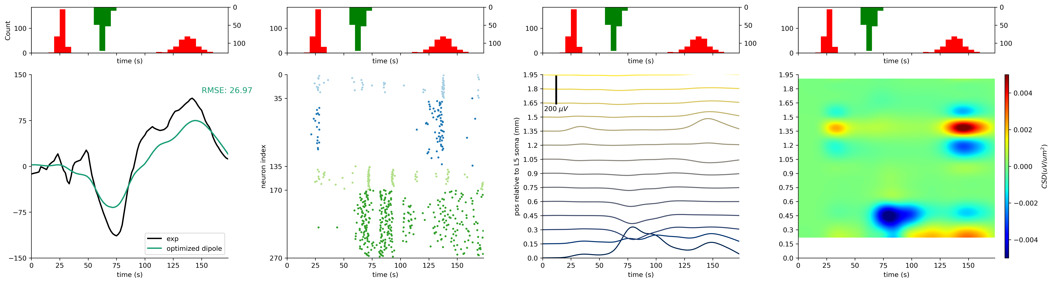
Jones 2009 base model

Slide 12
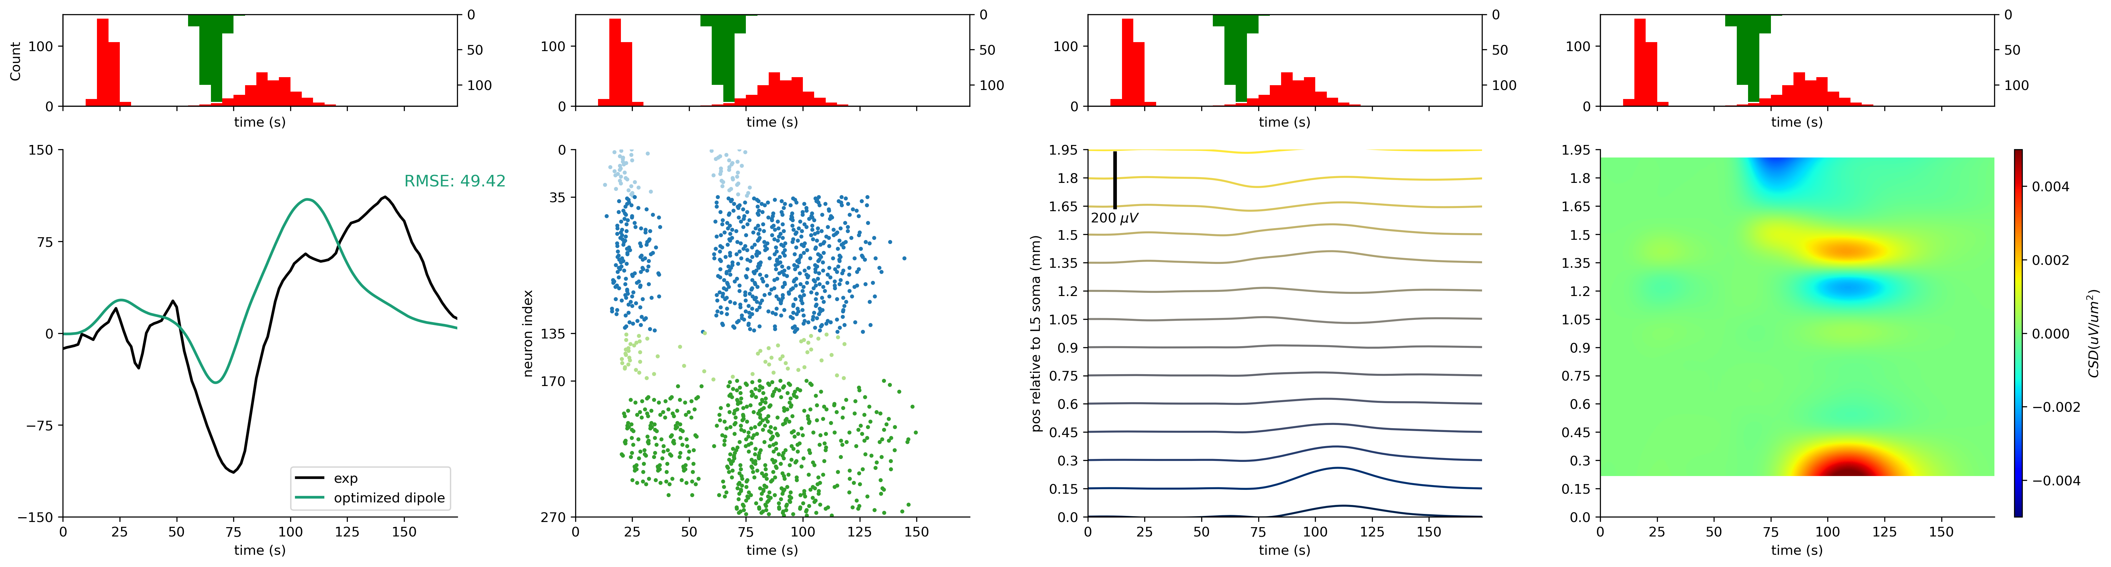
Neymotin 2020 settings

