Slide 1
Addressing customer churn in the European market
Presenter: Edmund Alyn Jones
Dramatically Richer Analysis, LLC

Slide 2
Factors that affect odds of leaving

Slide 3
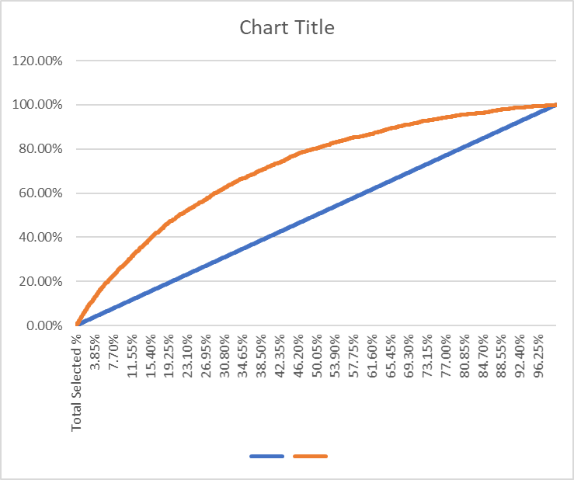
Cap Curve
The Model we’ve created is out performing a random sampling to determine the likelihood of a client leaving the bank.
But what does this mean exactly?

Slide 4





Slide 5
…who should we be reaching out to with a more catered experience?
The model has helped us identify who is most likely to leave and therefore when we send correspondence, we can be certain to target the “at-risk” individuals in our upcoming campaigns.
So the big question is …

