Slide 1
Contact Information
Meredith Doellman
Office: 290E Galvin Life Sciences Center
Email: mdoellma@nd.edu
Office hours:
3:00-5:00pm Thursday, Jordan Cafe
Appointment by email
No office hours during fall break ☺

Slide 2
Learning Outcomes
Familiarize yourself with common data file formats
Implement regular expressions to manipulate these data files
Practice using a dictionary in python

Slide 3
Today’s Class
Choose your own adventure!
Optional resources available (use either/both/none):
Annotated list of functions
Detailed pseudocode
Work through Exercise 8 in pairs
Fork from mdoellma/Intro_Biocomp_ND_318_Tutorial8

Slide 4
For After Break
Monday (10/23)
Read Kelly et al. 2014
Posted on Sakai
Quiz at the beginning of lecture!
Friday (10/27)
Exercise 8: String manipulation with regex
Work through the exercise together
One member of each team submits a pull request
Due by start of next tutorial

Slide 5
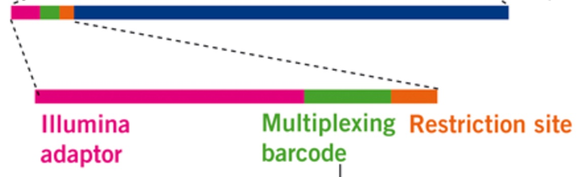


RADseq Sequence Structure
Adaptor structure
green barcode unique to individual
Sequencing primer sits on pink adaptor
Resulting data sequence

Slide 6
Raw Sequence Data (fastq format)
Info from sequencer (header)
Sequence we care about
@FCC638CACXX:5:1101:1207:1875#ATCNCGATC/1
NATCCAGACAATTCGCAAACATGTGTGGGTCAGCTGGGTTTACGTAAACCATCGTTAGATCGGAAGAGCACACGTCTGAACTCCAGTCACATCACGATCT
+
BP\cceeegcegghiihiiiiiihfhhiihiiiiiihigghiiiiiihifghiighigggggeeecddccccccc^bcccccccbcccY]_bbcccc_W`
Another header (don’t worry about this)
Quality score for each bp (don’t worry about this!)

Slide 7
Challenge #2 Goal
> v14.osb.014
CGCTGCTTGCTAAATATGCATGCTACCACTTTGCAATGGGGTGCTGTCGTACTCTTCCGATTTTGGAAGAGAATTGCATTTCGTGCA
> V10.F.016
TACTGCCTGAGGGTTATAATCCCTAAGTGCGGCCAAAGGCCGCCTACGCAGAAAGGTGTTCAGCCCCCCTTCTTTCGCAACACAGAA
> V10.F.013
ACGTCGATGACACACCAAATCCGACGGCGAATAATCCCAAAATACTCGGAGTAACATTCGACAGCCTGCTCTCCGTCTCTGCGCACG
> V10.F.035
AGGAGCGACACGCGCTCGTAGGCATAATGCAACAATTGCAACAATTTGTGCTTTAGATCGGAAGAGCACACGTCTGAACTCCAGTCA

Slide 8
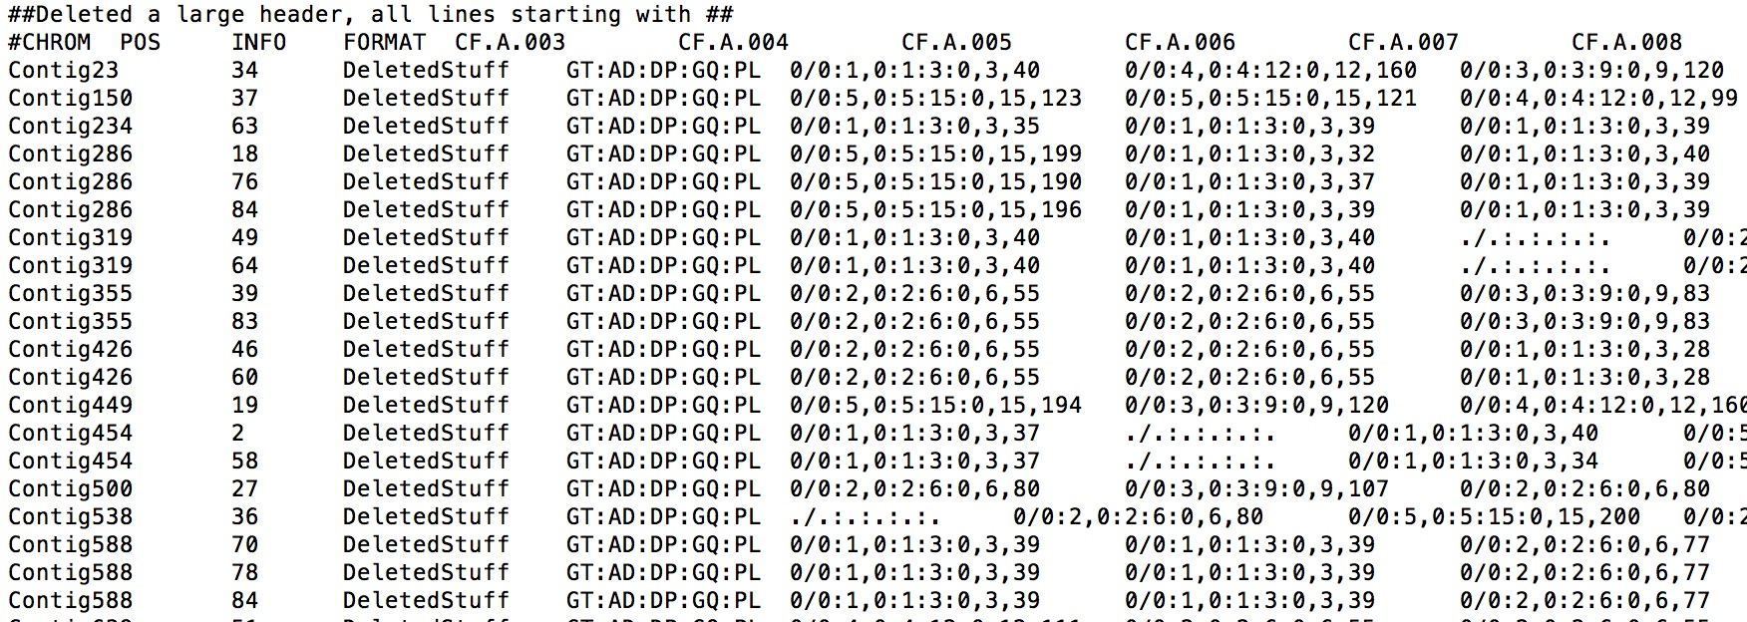
SNP Data (VCF format)
Sample names we care about (line starts with #)
Header (usually many more lines starting with ##)
SNP positions
0/0:7,0:7:21:0,21,194
Per sample SNP data

Slide 9
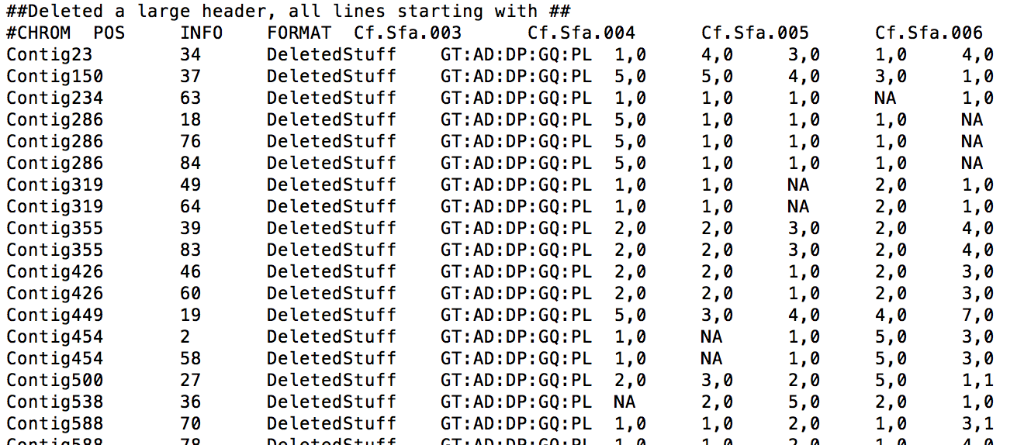
Challenge #1 Goal

Slide 10
Dictionaries in Python
dictionary = {}
for line in file:
line = line.strip()
cols = line.split()
if cols[0] in dictionary:
print("Duplicate: " + cols[1])
break
else:
dictionary[cols[0]] = cols[1]
dictionary[key]

