Slide 1
Food Perish Prevention System
Using IoT and Sensor-based Automation
Jones A 720421104024
Biju K 720421104009
Muthu Kumar A 720421104036
Jayasurya M 720421104020
Guide: Dr. N Sudha Robert Benny (Asst)

Slide 2
Abstract
Purpose :
The main purpose of this project is to monitor and control the temperature and humidity of perishable goods such as meat, fruits, vegetables, bakery items, and cooked foods during transportation and storage.
Objective:
To ensure the quality of food is maintained, minimize spoilage, and reduce manual intervention using IoT-based temperature and humidity monitoring.
Outcome:
A system that automatically adjusts the temperature and humidity based on the food type and sends alerts to the driver when it crosses the threshold.

Slide 3
Problem Statement
Problem:
Perishable food items such as meat, vegetables, cooked food, and bakery items require specific temperature and humidity during transportation.
Without proper monitoring and control, food spoilage increases, resulting in heavy losses to the food processing industry.
Challenge:
To develop an automated system that can monitor and control temperature and humidity based on food type.
Minimize spoilage and ensure product quality.

Slide 4
Proposed Solution
Our Solution:
Use of sensors to measure inner, outer, and food temperature.
Humidity sensors to monitor humidity level inside the container.
Automatically control cooling (compressor) and heating (heater) based on food type.
Send alerts to the driver if conditions exceed the threshold.
Store temperature & humidity data in the cloud for future analysis.

Slide 5
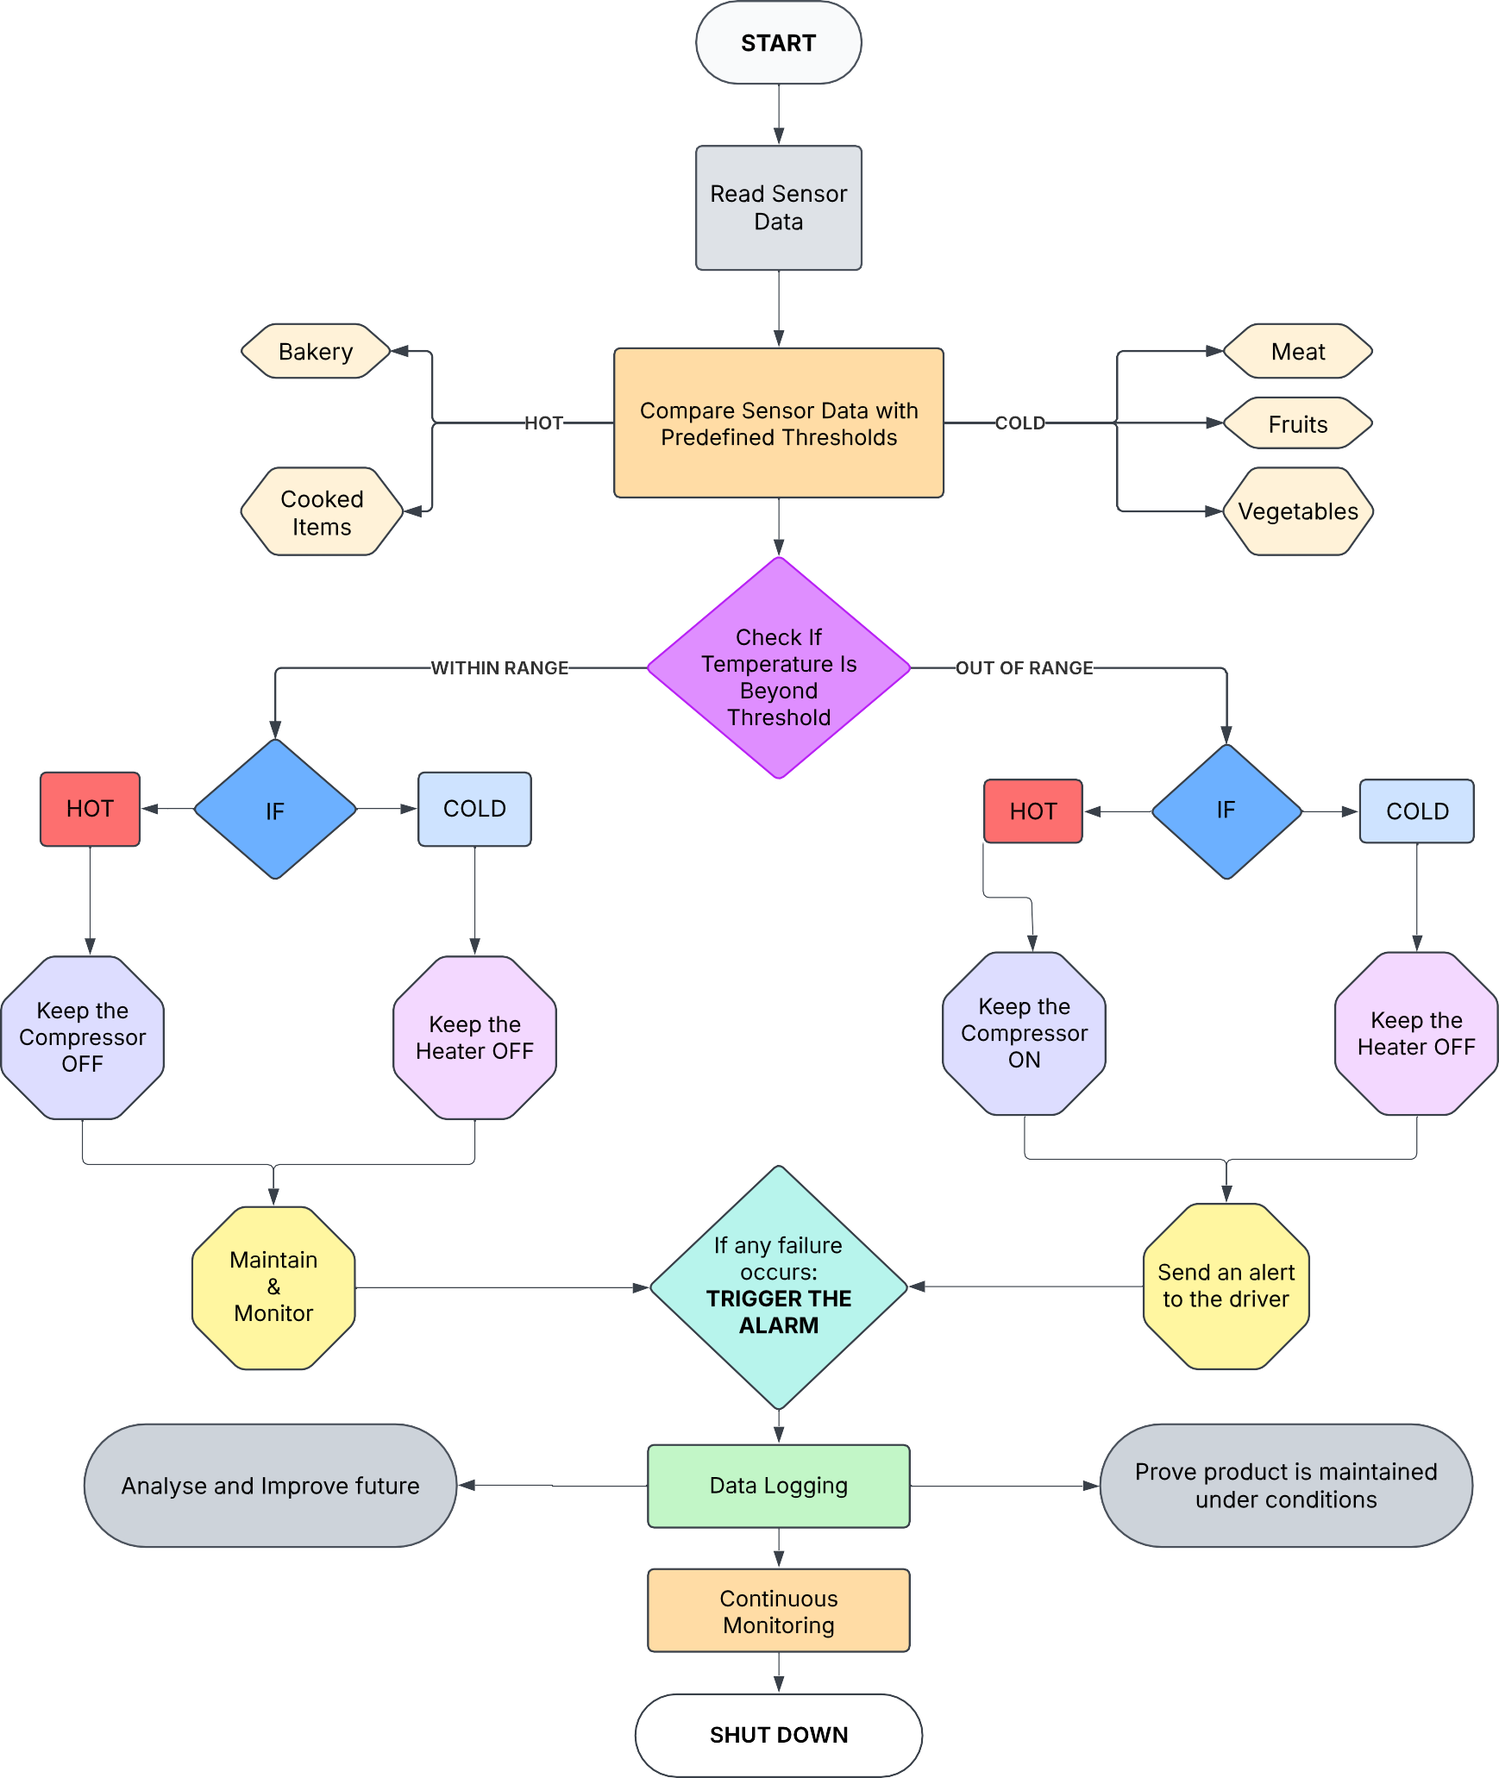
Flowchart(Workflow)

Slide 6
Explanation
Start Process – The system starts when the truck engine is turned on.
Read Sensor Data – Sensors collect temperature and humidity readings.
Compare Sensor Data with Predefined Thresholds – The system checks if the food type requires hot or cold storage.
Check if Temperature is Beyond Threshold – Determines if the temperature is within the required range.
If Temperature is Too High:
For hot food: Keep the compressor OFF.
For cold food: Turn the compressor ON.
If Temperature is Too Low:
For hot food: Turn the heater ON.
For cold food: Keep the heater OFF.

Slide 7
Monitor & Handle the System – The system continuously monitors temperature and humidity.
Trigger an Alarm – If conditions go out of range, the system activates an alert.
Send an Alert to the Driver – Notifies the driver if intervention is needed.
Maintain & Monitor – Ensures optimal conditions for food safety.
Data Logging – Records temperature and humidity for future analysis.
Analyze & Improve Future Performance – Uses collected data for better control in future transportation.
Continuous Monitoring – Ensures product quality throughout transportation.
Shutdown – The system stops operation after delivery.

Slide 8
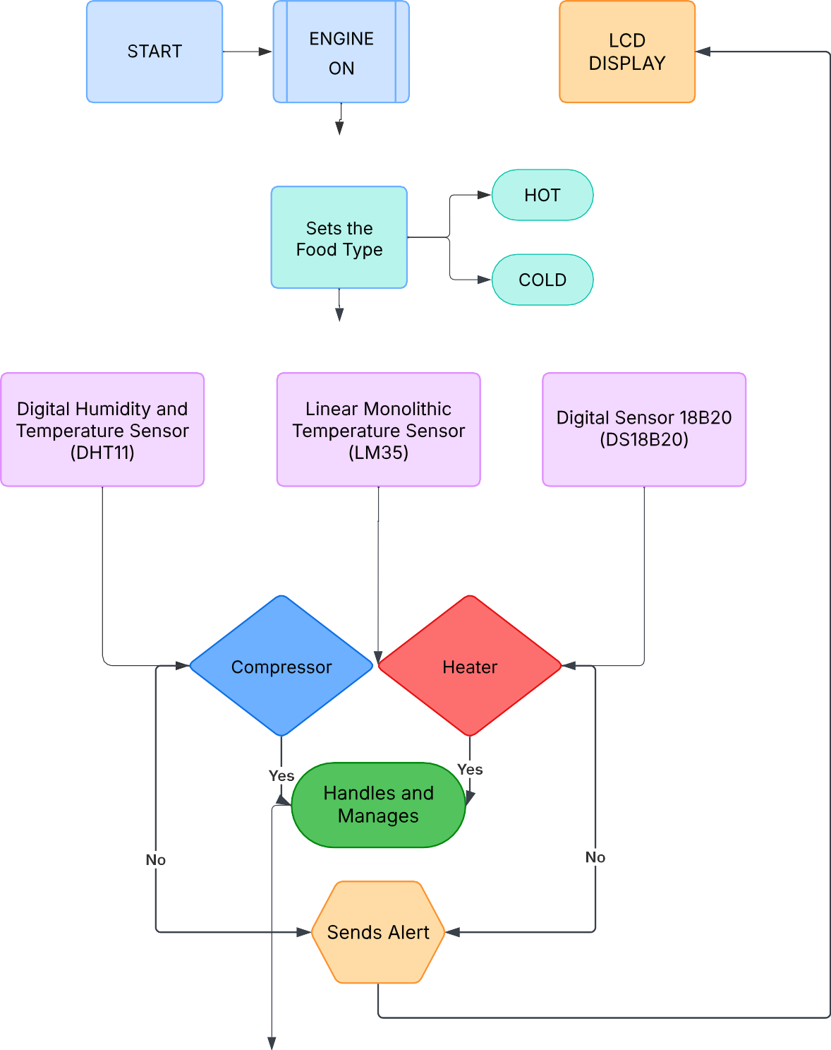
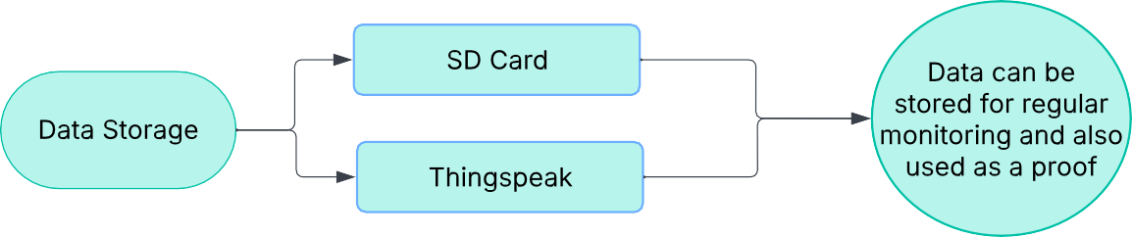
Flowchart(Hardware)

Slide 9
Based on type
If Food is Cold (Meat, Fruits, Vegetables):
When the temperature exceeds the threshold, the compressor turns ON.
Humidity is controlled accordingly.
Alerts are sent to the driver if temperature crosses the range.
Data is stored in the cloud.
If Food is Hot (Cooked Food, Bakery):
When the temperature drops below the threshold, the heater turns ON.
Humidity is controlled accordingly.
Alerts are sent to the driver if the temperature falls.
Data is stored in the cloud.

Slide 10
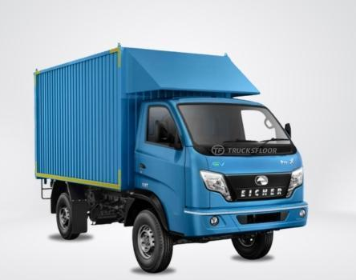
Prototype Application for Indian Trucks (3.5 Ton Load Capacity)
This system is designed for light commercial vehicles (LCVs) on Indian roads, typically used for distributing perishable food products.
The vehicle is divided into four insulated compartments, each functioning independently to store a different type of food (e.g., vegetables, dairy, meat, bakery) based on its optimal temperature requirements.
Each compartment is equipped with dedicated sensors, cooling/heating elements, and control logic, allowing it to maintain specific conditions independently regardless of external environment or other compartments.

Slide 11
Prototype
DHT11 Sensor: Measures temperature and humidity inside the container.
LM35 Sensor: Measures outer temperature.
DS18B20 Sensor: Measures direct food temperature.
Relay Module: Controls the compressor and heater.
Compressor Unit: Provides cooling when the temperature rises.
Heater Unit: Provides heating when transporting hot food.
LCD Display: Shows real-time temperature and humidity.
Wifi Module (ESP8266): Sends temperature/humidity data to the cloud.
Cloud Storage (ThingSpeak): Stores temperature and humidity data.

Slide 12
Intelligent Temperature-Controlled Container Prototype
This prototype is designed to maintain optimal temperature for perishable goods during transportation using heating and cooling systems.
It integrates multiple sensors (DS18B20, LM35, DHT11) for precise temperature and humidity monitoring.
The cooling system uses a Peltier module paired with a 12V CPU cooling fan, while heating is managed by a 12V 40W cartridge heater.
An Arduino Uno controls the sensors and relays, while a ESP01 module sends real-time data to ThingSpeak for remote monitoring.
User inputs for mode and food type selection are facilitated through six push buttons and displayed on a 16x2 LCD with I2C interface.
This scalable solution supports multi-compartment setups in commercial vehicles, ensuring customized temperature control for different food categories.

Slide 13
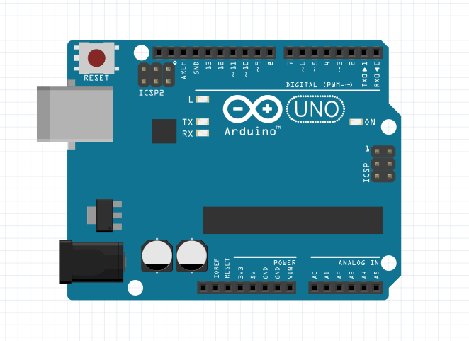
Key Components Used
Arduino UNO R3:
Acts as the brain of the system, processes sensor data, and controls devices.
Also has Analog pins, so its easy to implement analog pins

Slide 14
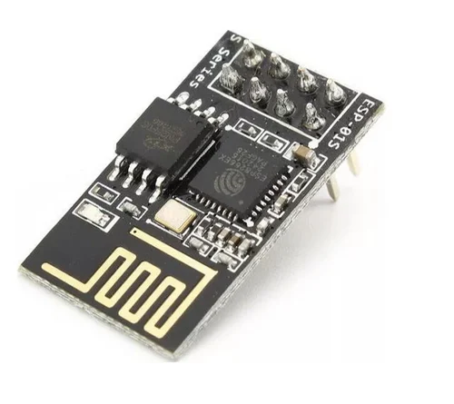
Key Components Used
ESP01 (Wifi Module)
Handles Wi-Fi connectivity and uploads sensor data to ThingSpeak for cloud-based monitoring.

Slide 15
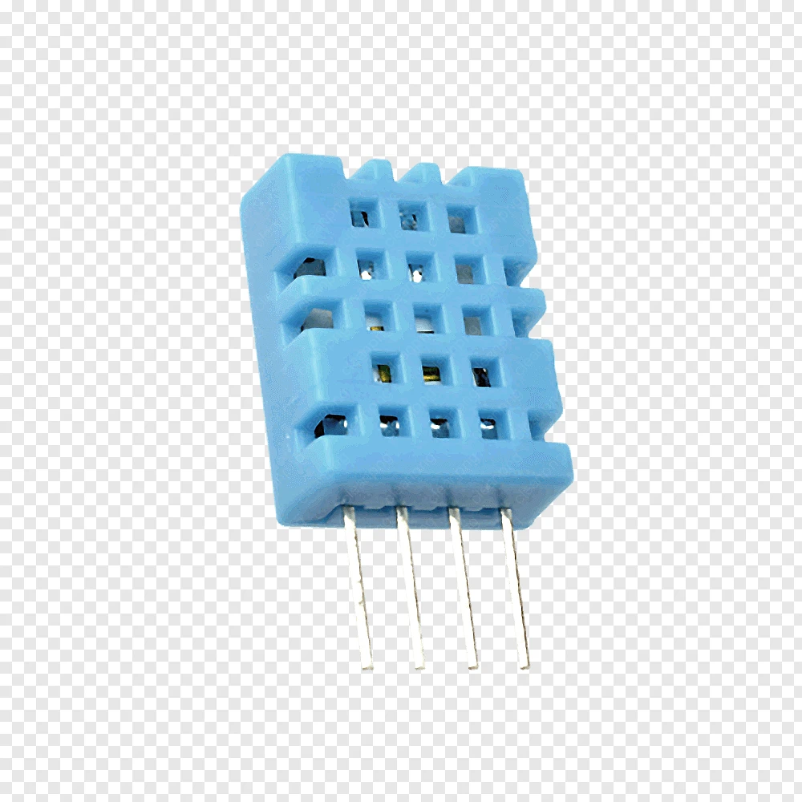
Sensors
DHT11(Digital Humidity and Temp Sensor)
Measures ambient temperature and humidity.
Provides data for environmental tracking and alerts.
Helps ensure proper storage conditions for food.

Slide 16
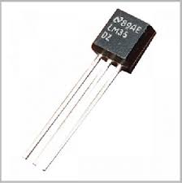
Sensors
LM35(Linear Monolithic 35)
Analog sensor that outputs voltage proportional to temperature.
Used for general internal temperature monitoring.
Provides fast and low-power readings.

Slide 17
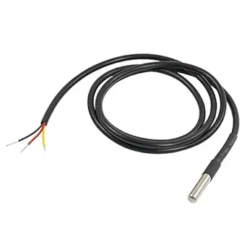
Sensors
DS18b20(Waterproof Sensor)
Digital temperature sensor with high accuracy.
Waterproof and suitable for extreme cold/hot zones.
Used to control heating/cooling thresholds precisely.

Slide 18
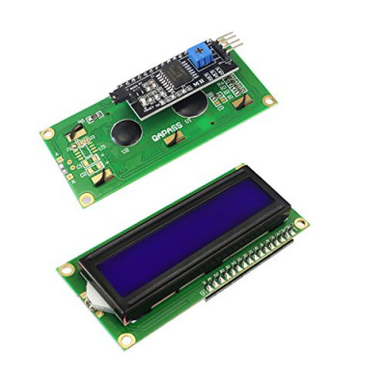
Other Components
16x2 I2C LCD Display
Displays real-time temperature, humidity, and system status.
Uses I2C protocol to reduce the number of wires.
Helps the user interact easily with the system.

Slide 19
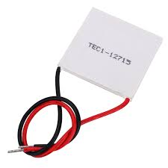
Other Components
Peltier Module (TEC1-12706)
Thermoelectric device that cools when current flows through.
Used to actively cool compartments with perishable goods.
Works with a fan and heatsink for efficiency.

Slide 20
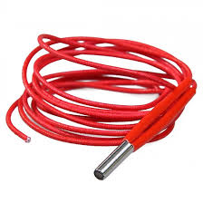
Other Components
12v40w Cartridge Heater
High-power resistive heater used to warm up container compartments.
Controlled via relay to switch heating on/off based on temperature.
Ensures perishable goods remain above minimum threshold.

Slide 21
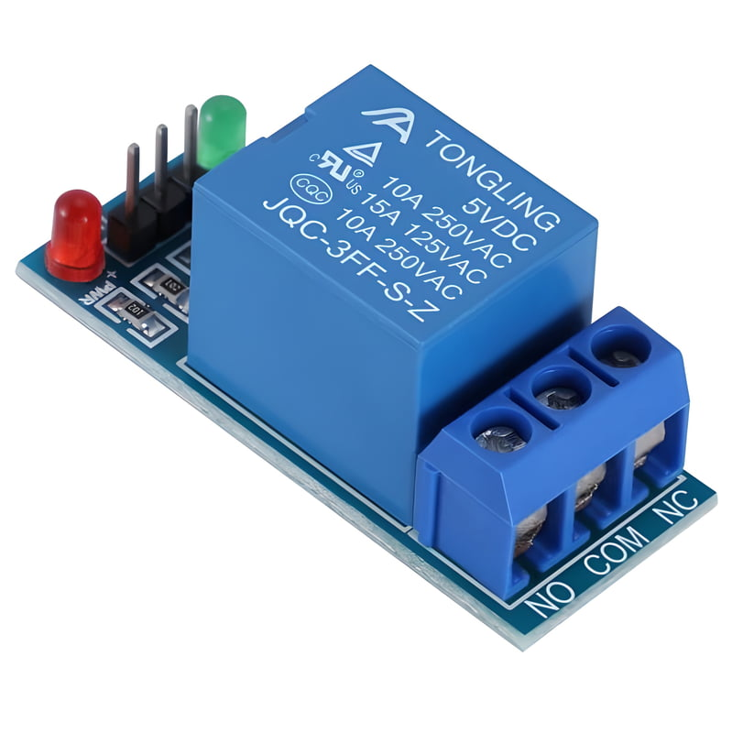
Other Components
Relay Module (x2)
Used to switch high-current devices like heater and Peltier safely.
Provides electrical isolation between control and power circuits.
Activated by Arduino digital output pins.

Slide 22
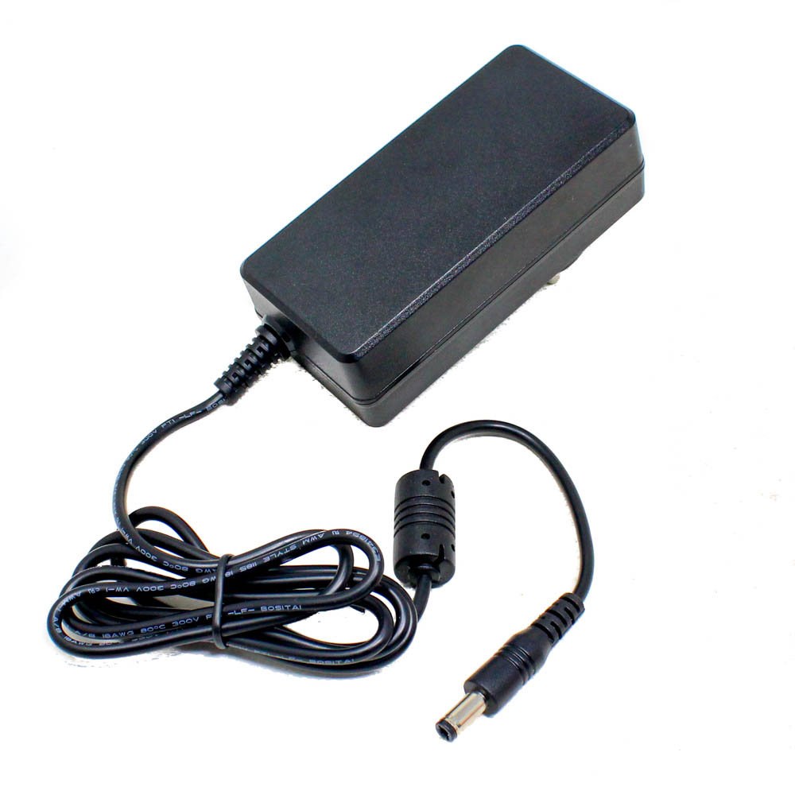
Other Components
12V 3A Adapter
Provides sufficient current to run the heater, Peltier, and fan.
Powers high-load components with stable voltage.
Shared across relays and thermal elements for unified supply.

Slide 23
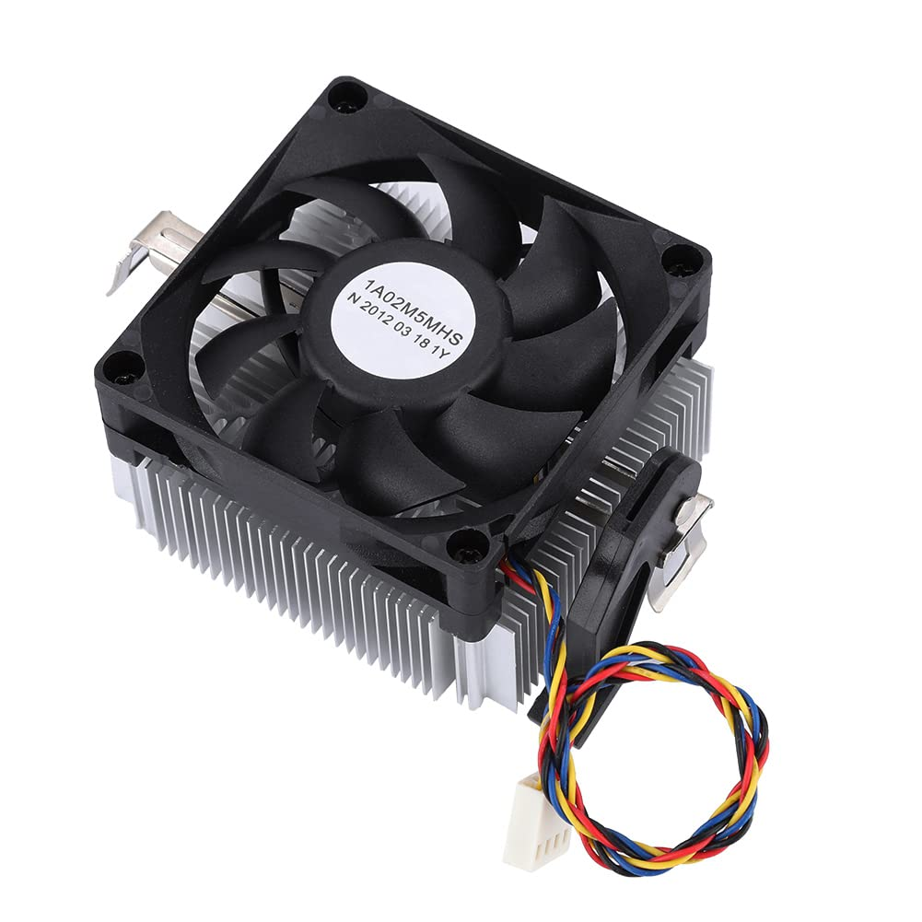
Other Components
CPU Cooling Fan(12v)
Cools the hot side of the Peltier module to maintain efficiency.
Prevents overheating and enhances thermal regulation.Powered directly from 12V power supply.
They ensure continuous airflow, preventing overheating and maintaining optimal thermal performance inside the container.

Slide 24
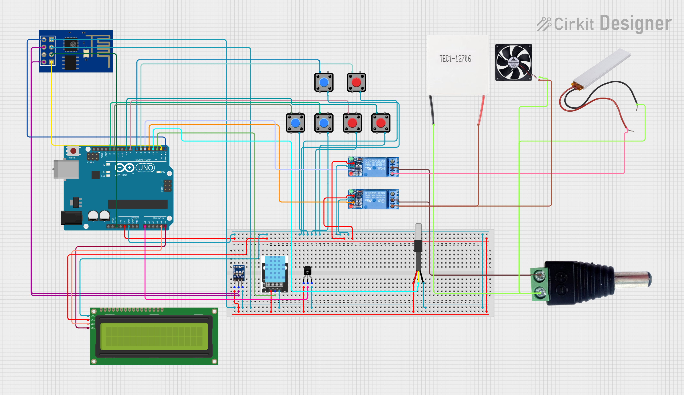

Slide 25
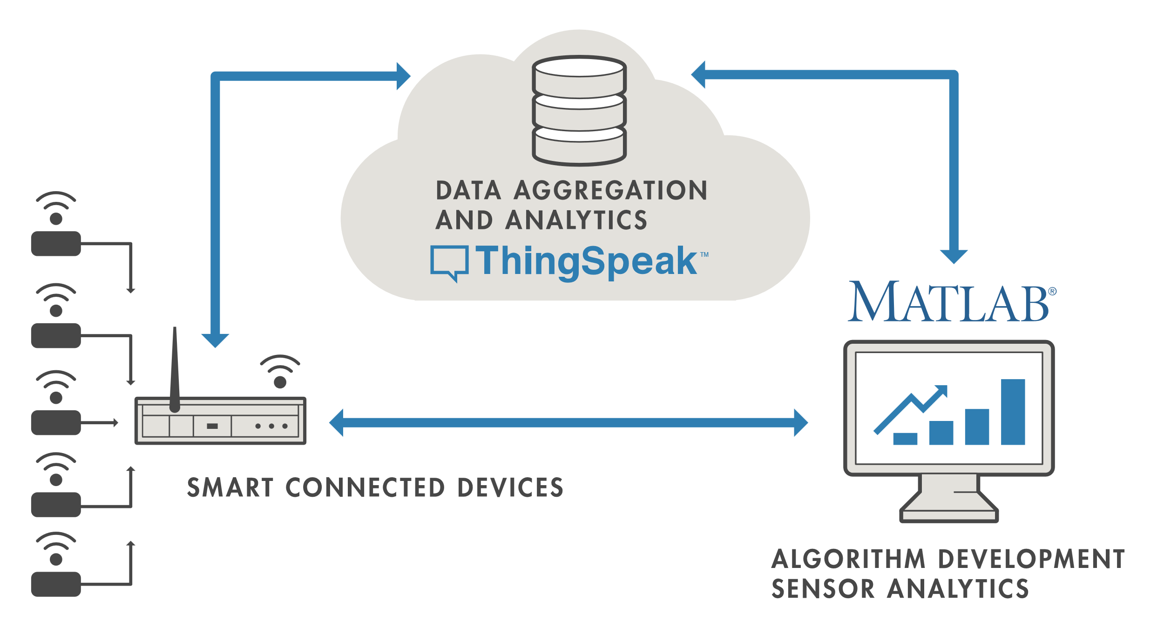
Uploading data in Cloud
What is ThingSpeak?
ThingSpeak is a cloud-based IoT data platform.
It allows devices (like Arduino, ESP8266) to upload sensor data online.
Supports: Real-time data logging, visualization with charts, basic data analysis
Data is sent via HTTP GET requests using a Write API Key.
Ideal for remote monitoring projects (e.g., temperature, humidity).

Slide 26
How Data is Saved on ThingSpeak
Data is stored in Channels which include:
Field1 to Field8: Store individual sensor values.
Entry ID: Automatically assigned number for each upload.
Timestamp: Records the exact time data was received.
Example request: https://api.thingspeak.com/update?api_key=XXXX&field1=25.5&field2=60
Data can be viewed in graphs or downloaded (CSV).Supports private/public access, API keys, and data sharing.

Slide 27
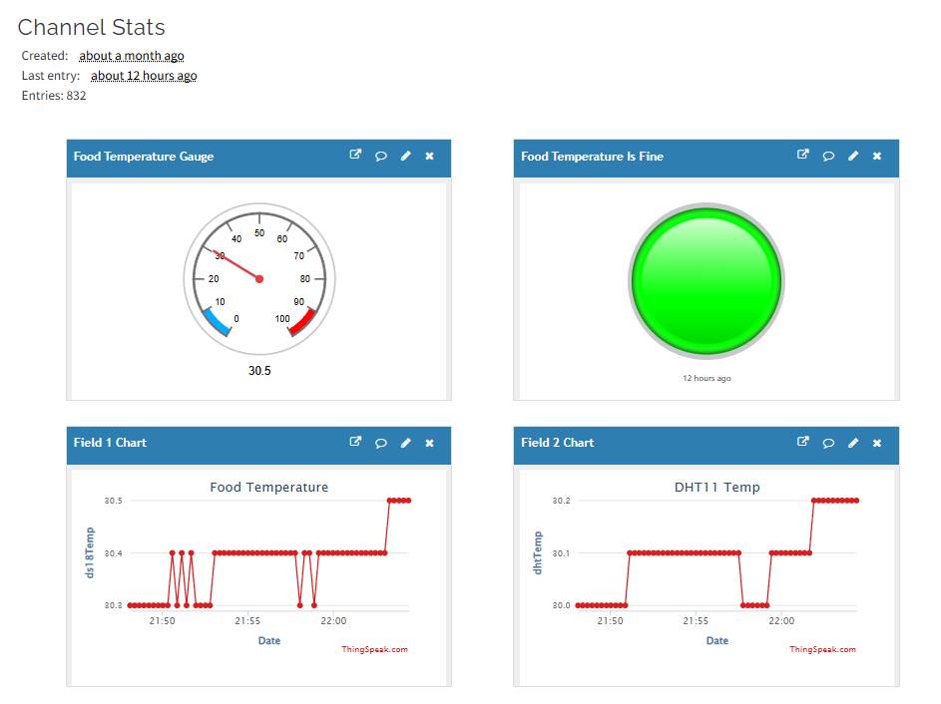

Slide 28
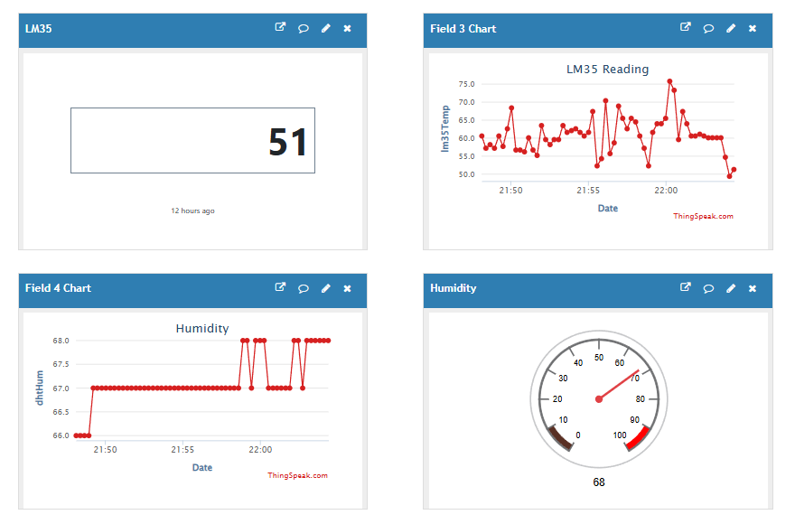

Slide 29
Final Product Enhancements & Scalability
Components to Upgrade for Final Product:
Replace Arduino Uno with a more robust microcontroller like STM32 or ESP32 for higher processing power and integrated Wi-Fi.
Use industrial-grade temperature sensors with higher accuracy and durability (e.g., PT100 RTD sensors).
Swap Peltier modules with compressor-based refrigeration units for more efficient and powerful cooling.
Replace cartridge heater with sealed, high-efficiency electric heating elements suitable for larger volumes.
Upgrade LCD with a touchscreen display or integrate with smartphone apps for better User-Interface
Use a reliable CAN bus or industrial communication protocol for multi-compartment management in large vehicles.

Slide 30
Why this system is better than Normal Refrigeration Containers?
Energy Efficiency: The system adjusts temperature only when needed, reducing power consumption.
Cost-Effective: Lower energy usage leads to significant cost savings compared to full-container refrigeration.
Real-Time Monitoring: Sensors continuously track temperature and humidity, ensuring optimal conditions.
Food Safety: Maintains precise temperature control, preventing spoilage and ensuring quality.
Data Logging: Stores temperature data for regulatory compliance and future analysis.
Eco-Friendly: Reduces carbon footprint by minimizing unnecessary cooling operations.
Smart Alerts: Sends notifications to the driver in case of temperature deviations or system failures.

Slide 31
References
Papers: Development of an Arduino-based Field Heat Regulator for Fruit Storage and Transportation, IAES International Journal of Robotics and Automation (IJRA), Vol. 13, No. 3, September 2024.
Datasheets:
DHT11 Sensor Datasheet
LM35 Sensor Datasheet
DS18B20 Sensor Datasheet
Arduino Libraries:
DHT Sensor Library (Adafruit)
One-Wire Library for DS18B20
Relay LibraryIoT
Reference Link:
Project Files

Slide 32
Thank You

