Slide 1
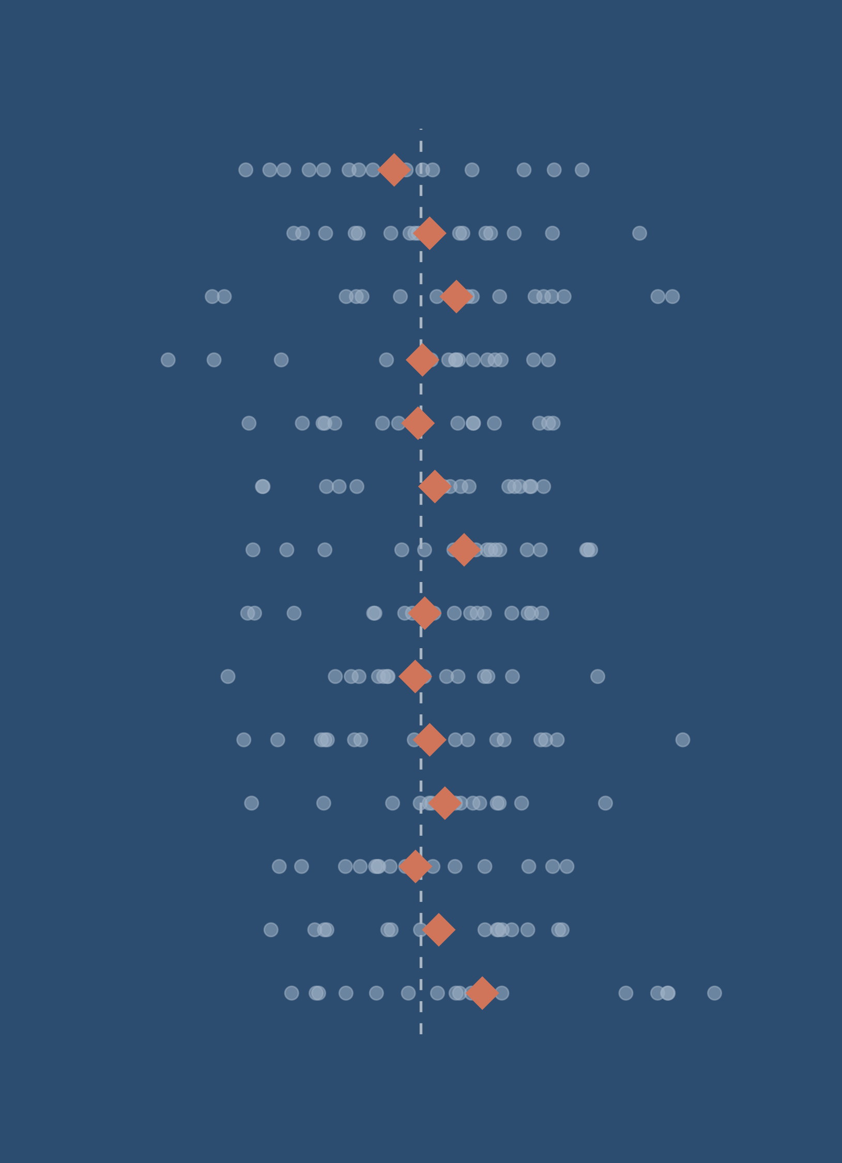
From biological variation to statistical uncertainty
Summary statistics, distributions and probability
Notes:
Timing: 1 min.
This lecture is the bridge from describing and visualising data (lectures 04-06) to statistical inference (randomisation tests next). Guiding question: why do two samples from the same population tell different stories?
One running example throughout: a hypothetical light-trap survey of one moth species. All numbers are simulated (seeds in lecture_figures/summary_statistics/generate_figures.R).
Cover graphic: 14 samples of 16 moths from one population; diamonds are sample means.

Slide 2
Summary statistics, distributions and probability
Explain why a sample can misrepresent a population
Choose summaries of location, spread and shape to fit the data and the question
Describe what normal and Poisson distributions represent
Distinguish variation among individuals (SD) from uncertainty in an estimate (SEM, CI)
Explain why larger samples are more precise but no less biased
Notes:
Timing: 1 min.
Objectives map onto the four sections: 1 samples; 2 describing; 3 probability; 4 uncertainty (objectives 4 and 5).
Practical afterwards: book chapter 11, sections 11.4, 11.6, 11.8-11.9.

Slide 3
Samples and populations
01
Notes:
Transition. We almost never measure the whole population.

Slide 4
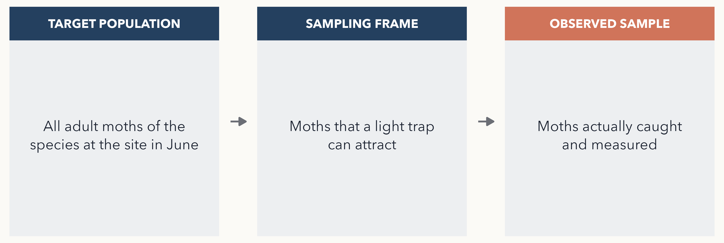
Which moths does our sample represent?
Ask: does every moth have the same chance of ending up in the sample?
Notes:
Timing: 2.5 min.
Question: what is the typical forewing length of adult moths of this species at the site in June? The target population is all of them. The sampling frame is the moths a light trap can attract. The observed sample is the moths actually caught and measured.
Each step can let some moths in more easily than others: some individuals fly less, are less attracted to light, or fly mostly on nights we did not trap. That is selection bias, and it is a different problem from chance variation between samples.
Also: measuring the same moth twice does not give two independent observations.
Links to book section 11.2 (populations, samples and bias).

Slide 5
Which sample better estimates the mean forewing length in June?
n = 40, trapped on a range of nights through June
n = 400, trapped on warm, dry nights only
Notes:
Timing: 2 min. Vote, then discuss.
Answer: probably A, but it depends, and that is the point. B has ten times the data, but if body size affects flight activity on warm nights, B is systematically biased, and more data only make it more precisely wrong. A larger n reduces random error; it does not fix the way the sample was chosen.
Ask: what would you need to know to decide? (Whether size affects flight or attraction to light; whether early and late June moths differ.)

Slide 6
Describing a distribution
02
Notes:
Transition. Location, spread and shape.

Slide 7
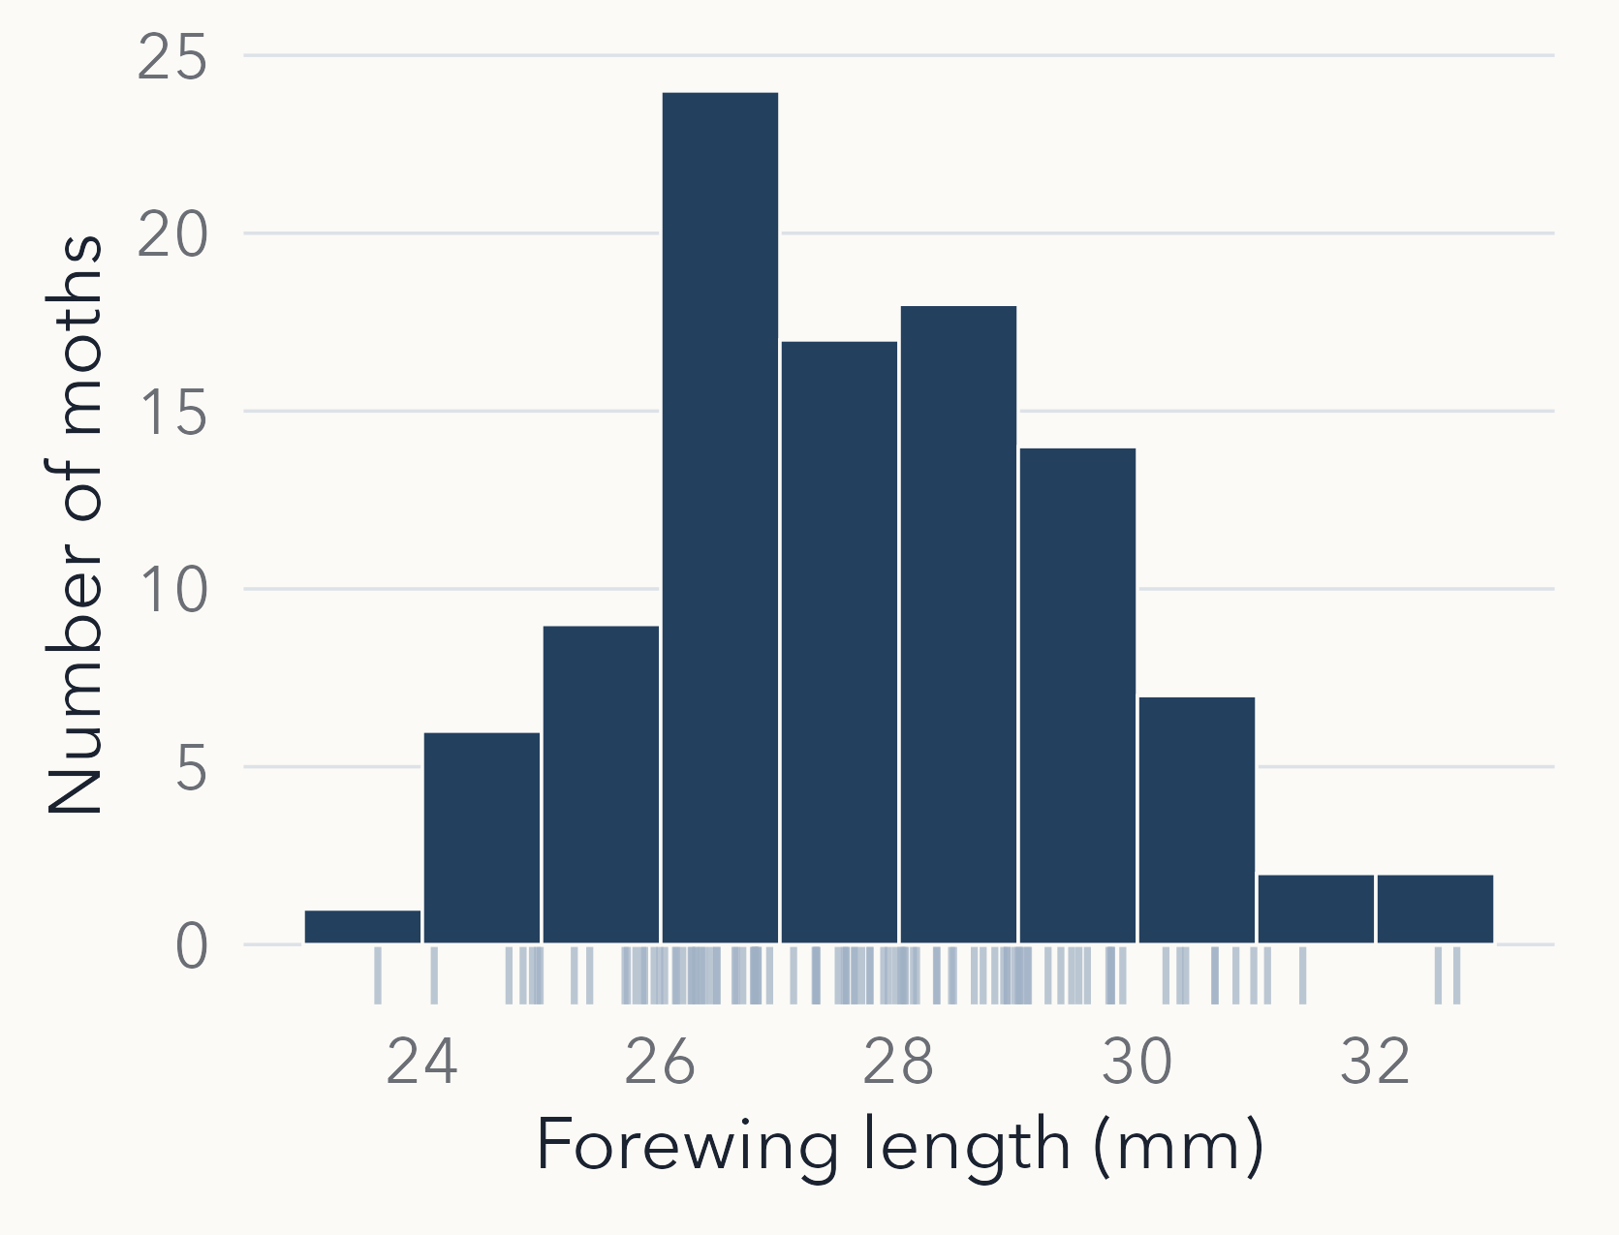
Look before you summarise
Location: where is the centre?
Spread: how much do moths differ?
Shape: symmetrical, skewed, more than one peak?
Unusual values: errors, or real biology?
Notes:
Timing: 2 min.
Simulated forewing lengths of 100 moths (sample mean 27.8 mm, SD 1.8 mm). Ask the class to read the four features off the histogram before giving any formula. The tick marks under the bars are the individual moths.
Callback to lecture 06 (Anscombe): very different data can share the same summary numbers, so look first.

Slide 8
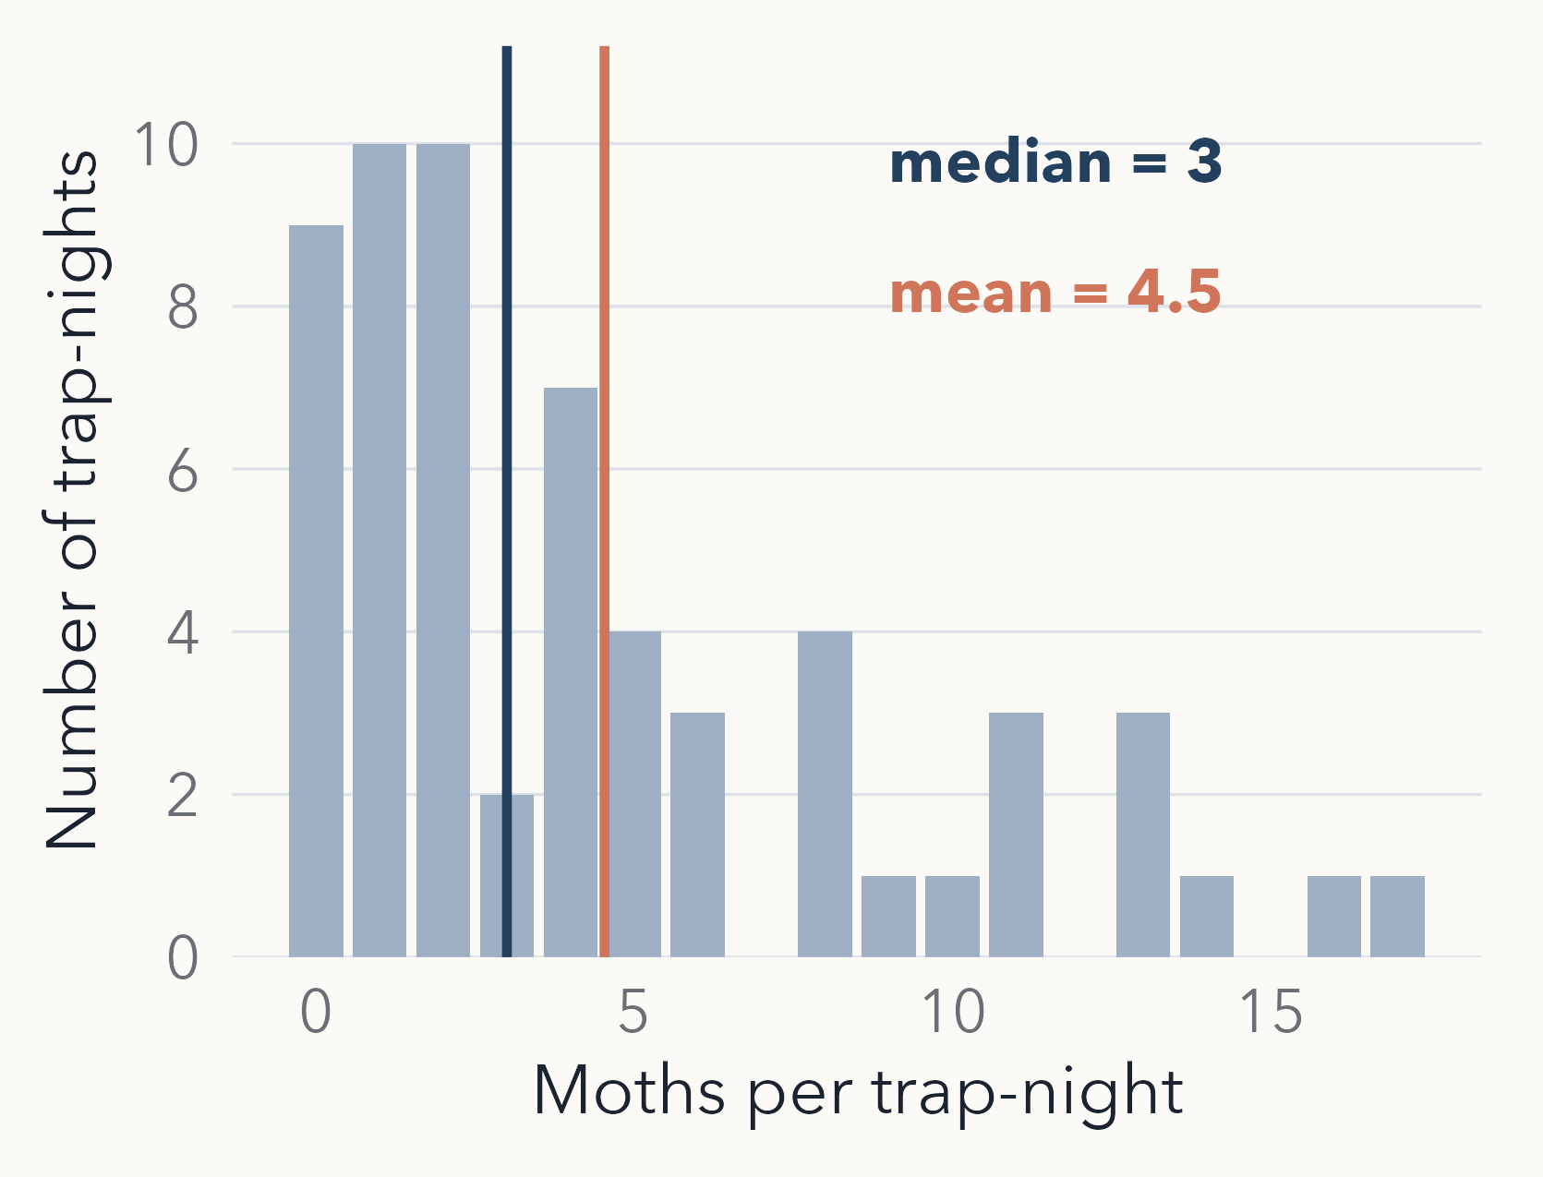
Mean or median? It depends on the shape
Trap counts are right-skewed: a long tail of busy nights
The mean, mean(x), uses every value and is pulled towards the tail: 4.5 moths
The median, median(x), is the middle value: 3 moths
Both are valid: the mean estimates the expected catch, the median a typical night
Notes:
Timing: 2.5 min.
Simulated counts of moths on 60 trap-nights (negative binomial, mean 4.5; the realised mean is 4.5 and the median 3). Name the shape: right (positive) skew, the tail is on the right.
Neither statistic is 'better'. If you want the total catch over a season, the mean is what you need (mean x number of nights). If you want to describe a typical night, the median is more representative.
Misconception to head off: the mean is not 'wrong' for skewed or count data.

Slide 9
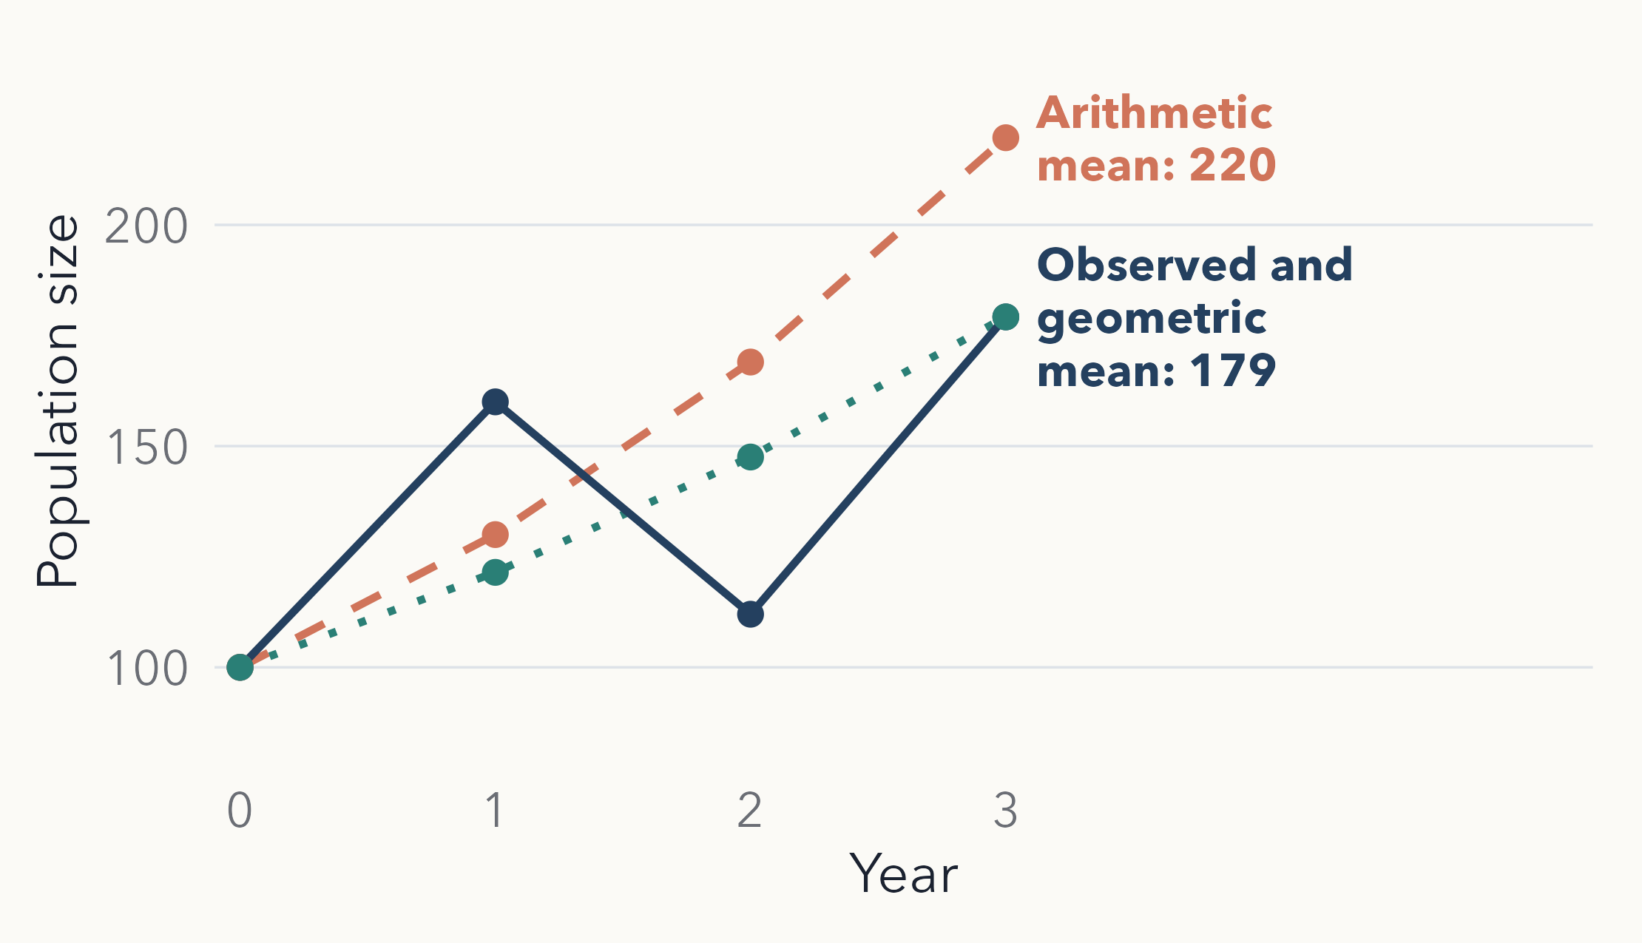
Average growth with the geometric mean
TAKEAWAY
Rates of 1.6, 0.7 and 1.6 average 1.3, which predicts 220, not 179
The geometric mean, 1.21, is right: exp(mean(log(x)))
Notes:
Timing: 2.5 min.
A population of 100 grows by a factor of 1.6, then 0.7 (a bad year), then 1.6, ending at 179. The arithmetic mean rate, 1.3, overshoots: 100 x 1.3^3 = 220. The geometric mean, (1.6 x 0.7 x 1.6)^(1/3) = 1.215, gives 100 x 1.215^3 = 179.
Rule: use the arithmetic mean when quantities add up (mass, length); the geometric mean when they multiply (growth rates, ratios). Equivalent R: exp(mean(log(x))).
Harmonic mean (from the old deck, now optional): the right average for rates over a fixed distance or amount, e.g. average speed over equal distances, 1 / mean(1 / x).

Slide 10
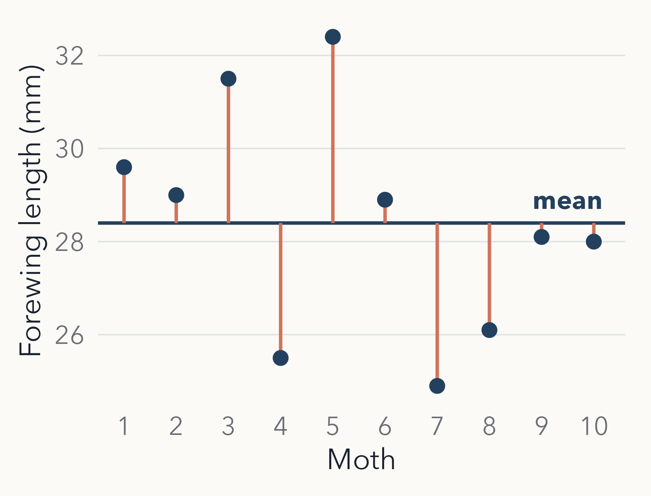
Variance and SD: spread around the mean
Each moth's deviation from the mean (orange lines)
Square, add up and divide by n − 1: the variance, var(x) = 5.98 mm²
Why n − 1? Deviations from the sample mean are a little too small, so dividing by n underestimates
SD = √variance, back in mm: sd(x) = 2.45 mm
Notes:
Timing: 2.5 min.
Ten simulated moths (mean 28.4 mm). Squaring stops positive and negative deviations cancelling and weights big deviations more.
n - 1: the sample mean is, by construction, the value that minimises the sum of squared deviations from these ten points, so deviations from it are on average smaller than deviations from the true population mean. Dividing by n - 1 instead of n makes the variance unbiased (Bessel's correction); the SD, its square root, is still very slightly biased low, which we ignore. With n = 1 there is no information about spread at all, and n - 1 = 0 says so.
Variance is in squared units (mm squared); the SD is back in mm, so it is the one we report.
Students need variance again in ANOVA.

Slide 11
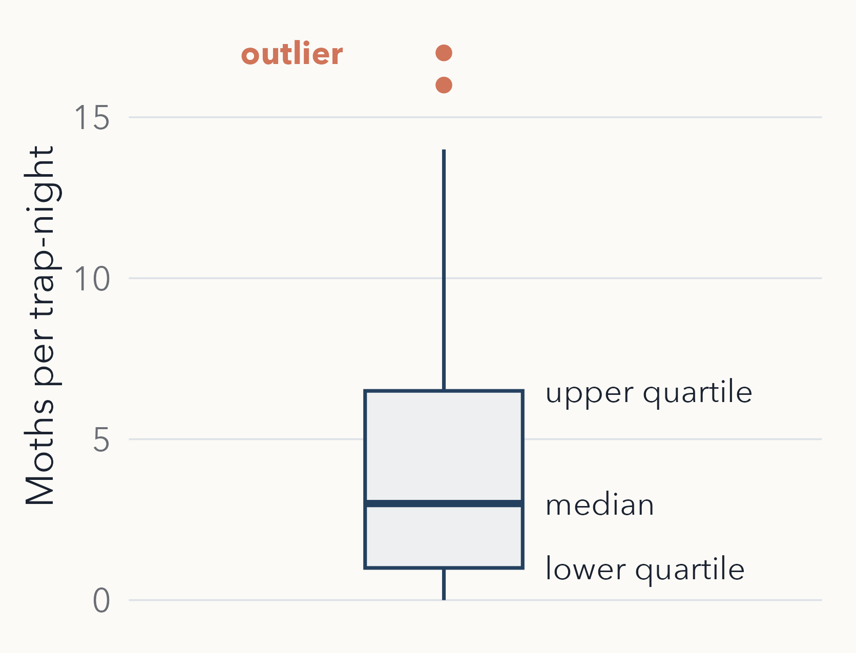
Box plots: median, quartiles, outliers
The box holds the middle 50% of nights; its length is the IQR, IQR(x) = 5.5
The line is the median (3 moths)
Whiskers reach the furthest values within 1.5 × IQR of the box
Points beyond are flagged as possible outliers: check them, don't just delete them
Notes:
Timing: 2 min.
Same 60 trap-nights as the mean/median slide. summary(x) gives: min 0, lower quartile 1, median 3, mean 4.5, upper quartile 6.5, max 17. IQR = 6.5 - 1 = 5.5. Upper whisker limit = 6.5 + 1.5 x 5.5 = 14.75, so 16 and 17 are drawn as points.
Choosing a summary: roughly symmetric data, mean and SD; strongly skewed data or outliers, median and IQR (and show the distribution); counts, the mean is still the expected count, add median and quartiles where useful. Always give n and units.
An 'outlier' may be a recording error or a genuinely busy night: biology first.
The whiskers stop at 14, so this box plot does not show the maximum (17). Base R's boxplot() and fivenum() use Tukey's hinges and give an upper hinge of 7 here, not 6.5; students redoing this in base R may see a slightly different box.
Book 11.7 compares normal and Poisson samples with box plots.

Slide 12
Probability and distributions
03
Notes:
Transition. From describing what we saw to describing what could happen.

Slide 13
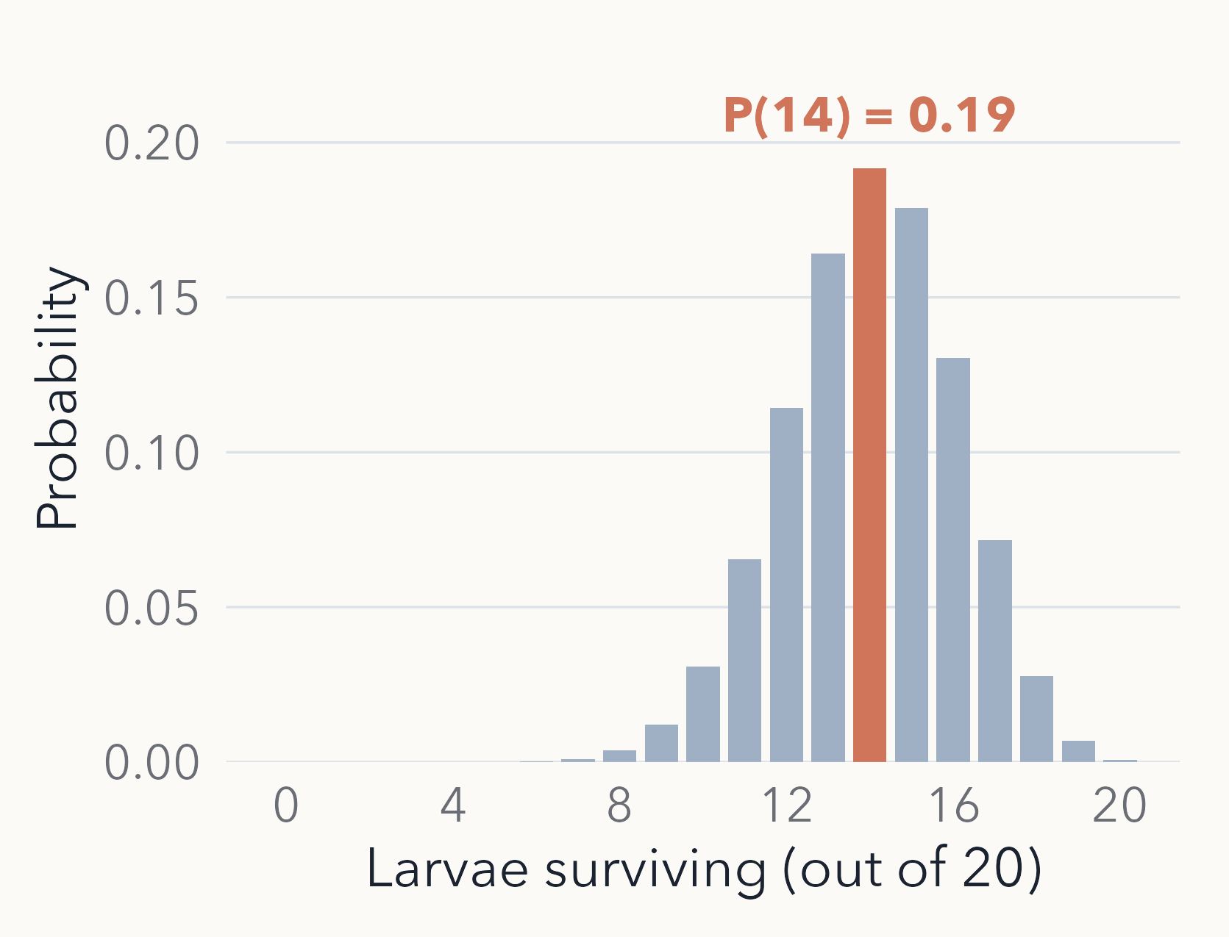
Probability describes what could happen
Each larva survives with probability 0.7 (0 = never, 1 = always)
Out of 20, we expect 0.7 × 20 = 14 to survive
The realised number varies: exactly 14 has probability 0.19; 12 to 16 has 0.78
This set of outcomes and their probabilities is a probability distribution
Notes:
Timing: 2 min.
Probability as a long-run proportion: if we watched very many larvae, 70% would survive. Assumes each larva survives independently with the same probability.
The figure is the binomial distribution for 20 trials and p = 0.7 (name it; it returns in the GLM lectures). The expected value, 14, is the most likely single outcome but still happens less than one time in five.
Book 11.3.1 (probability). Odds and log-odds (11.3.2) are a preview for logistic regression later; not needed today.

Slide 14
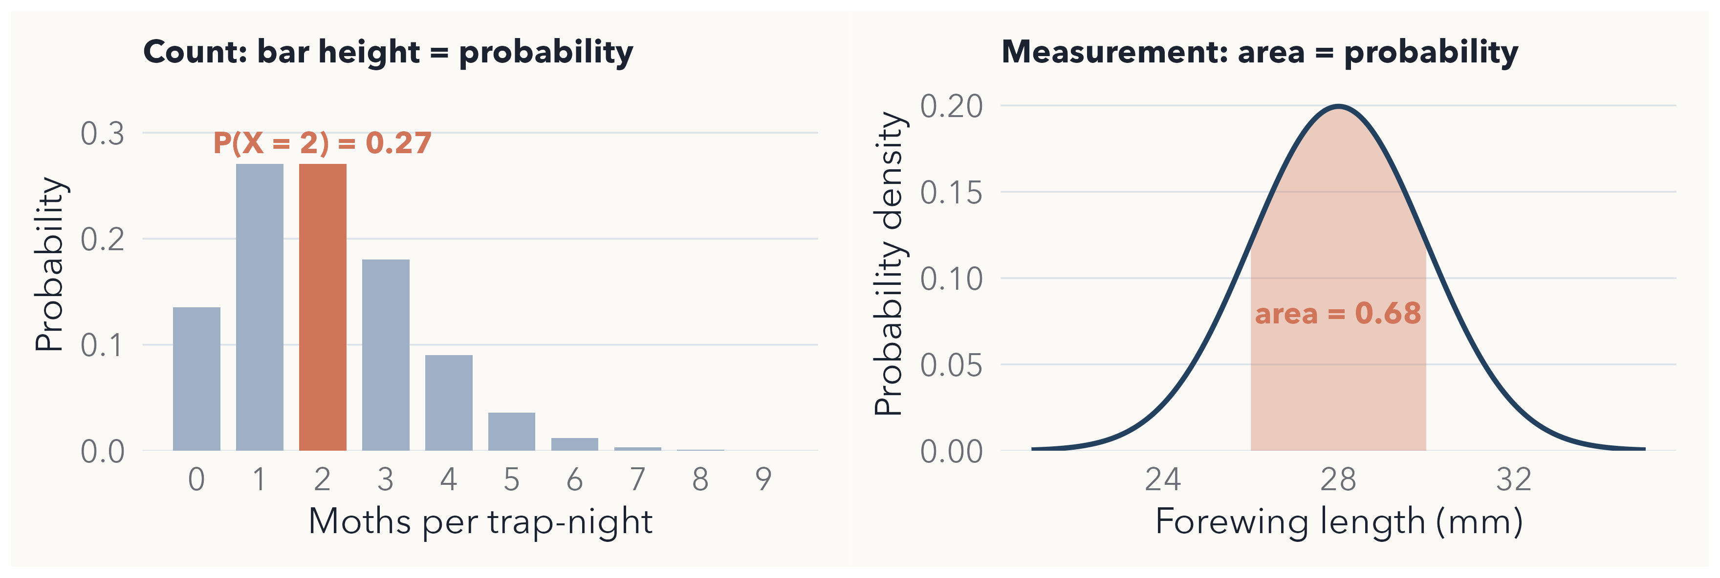
Probability for counts, density for lengths
For a measurement, probability = area under the curve; one exact value has probability 0.
Notes:
Timing: 2.5 min.
Left: Poisson with lambda = 2. Each bar is the probability of exactly that count, e.g. P(X = 2) = 0.27, and the bars add up to 1.
Right: normal with mean 28 mm and SD 2 mm. The height of the curve is a probability density, not a probability (it can even exceed 1 for very narrow distributions). The probability that a moth's forewing is between 26 and 30 mm is the shaded area, 0.68.
Book 11.3.4 (probability density).

Slide 15
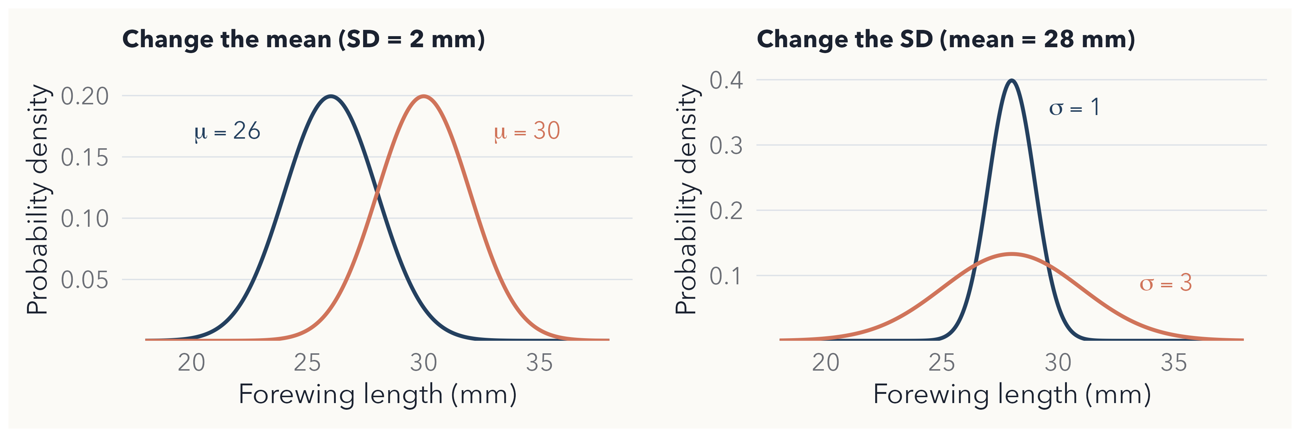
The normal distribution: μ and σ
Normal model: about 68% of values within ±1 σ, 95% within about ±2 σ. Simulate: rnorm(n, mean, sd)
Notes:
Timing: 2.5 min.
mu (the population mean) moves the curve; sigma (the population SD) widens or narrows it. Greek letters for population parameters; x-bar and s for the sample statistics that estimate them.
The 68-95 rule describes the normal model, not all data: for the skewed trap counts, mean +/- 2 SD = 4.5 +/- 9 runs below zero, which is impossible for counts. That does not make the mean or SD wrong; it means a symmetric interval is a poor description of skewed data.
Later linear models assume normally distributed residuals, not normally distributed raw data.
Practical: book 11.4, rnorm().

Slide 16
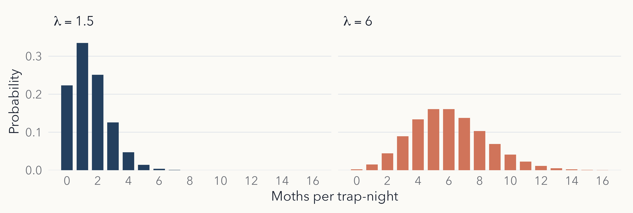
The Poisson distribution: λ for counts
Mean = variance = λ; real counts are often more variable (overdispersion). Simulate: rpois(n, lambda)
Notes:
Timing: 2.5 min.
Counts per unit of effort, here moths per trap-night. Small lambda: strongly right-skewed with many zeros; larger lambda: more symmetric.
In a Poisson model the variance equals the mean. Real ecological counts are often more variable than that (overdispersion), for example because moths arrive in groups or nights differ in weather. Name the term; it returns in the GLM lectures.
Practical: book 11.6, rpois().

Slide 17
Which is the most sensible starting model for moths caught per trap-night?
Normal, mean 4.5
Poisson, λ = 4.5
Binomial, p = 0.7
Uniform, 0 to 20
Notes:
Timing: 2 min.
Answer: B. Counts are whole numbers from 0 upwards, which is what the Poisson describes. A normal model allows negative and fractional counts; a binomial needs a fixed number of trials; a uniform says 0 and 20 moths are equally likely.
Follow-up: our simulated counts had mean 4.5 but variance about 20 (SD 4.5), far more than a Poisson's variance of 4.5. So Poisson is a starting point to check, not a final answer.

Slide 18
From variation to uncertainty
04
Notes:
Transition. The most important idea today: estimates vary from sample to sample.

Slide 19
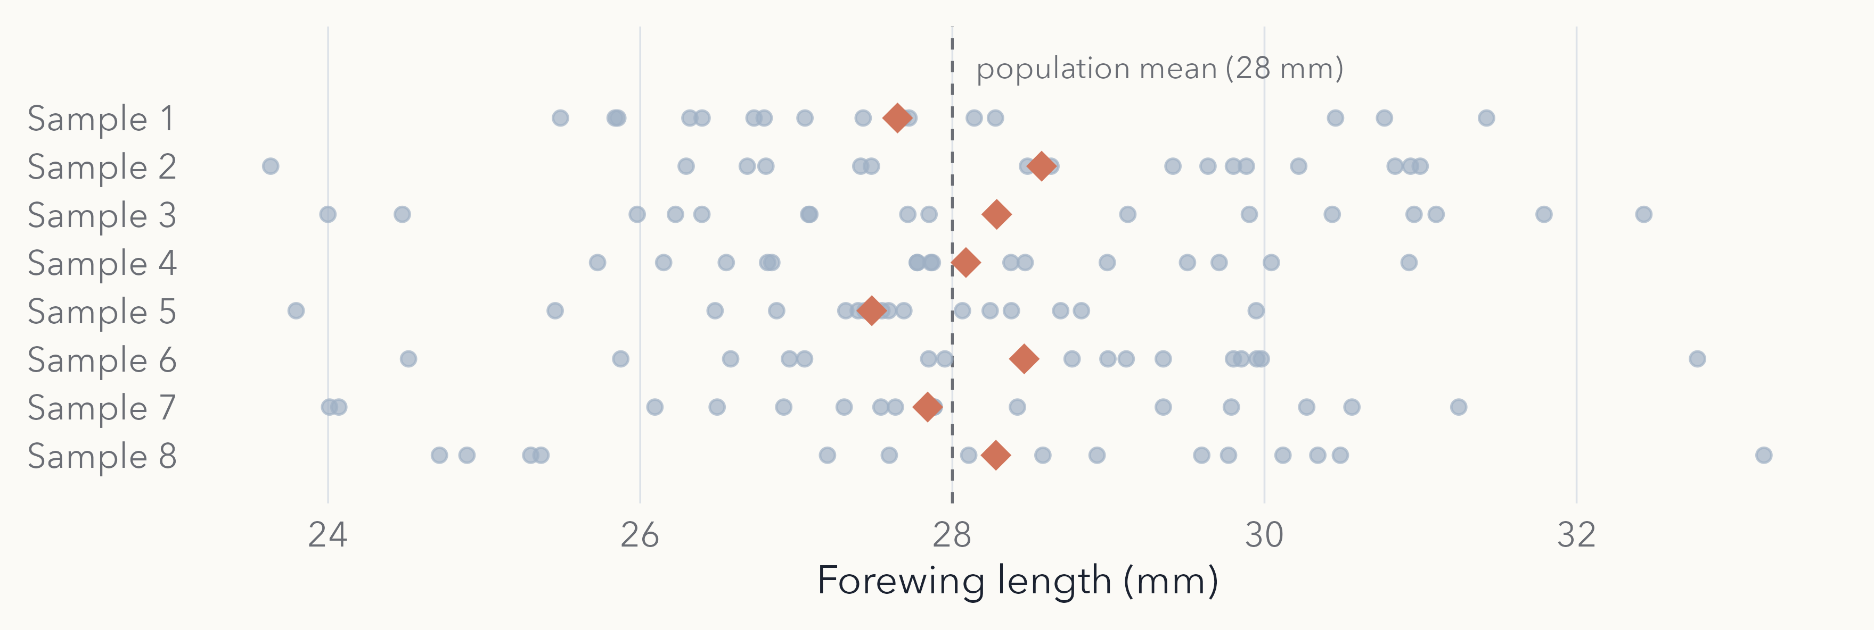
Each sample gives a different mean
Eight samples of 16 moths from one population (mean 28 mm, SD 2 mm). Diamonds are the sample means: 27.5 to 28.6 mm.
Notes:
Timing: 1.5 min.
Nothing about the population changed between rows; only which moths we happened to catch. Each sample mean is an estimate of the population mean (28 mm), and each one misses by a bit.
Ask: if you had only one row, how would you know how far off you might be? That is what the next three slides answer.

Slide 20
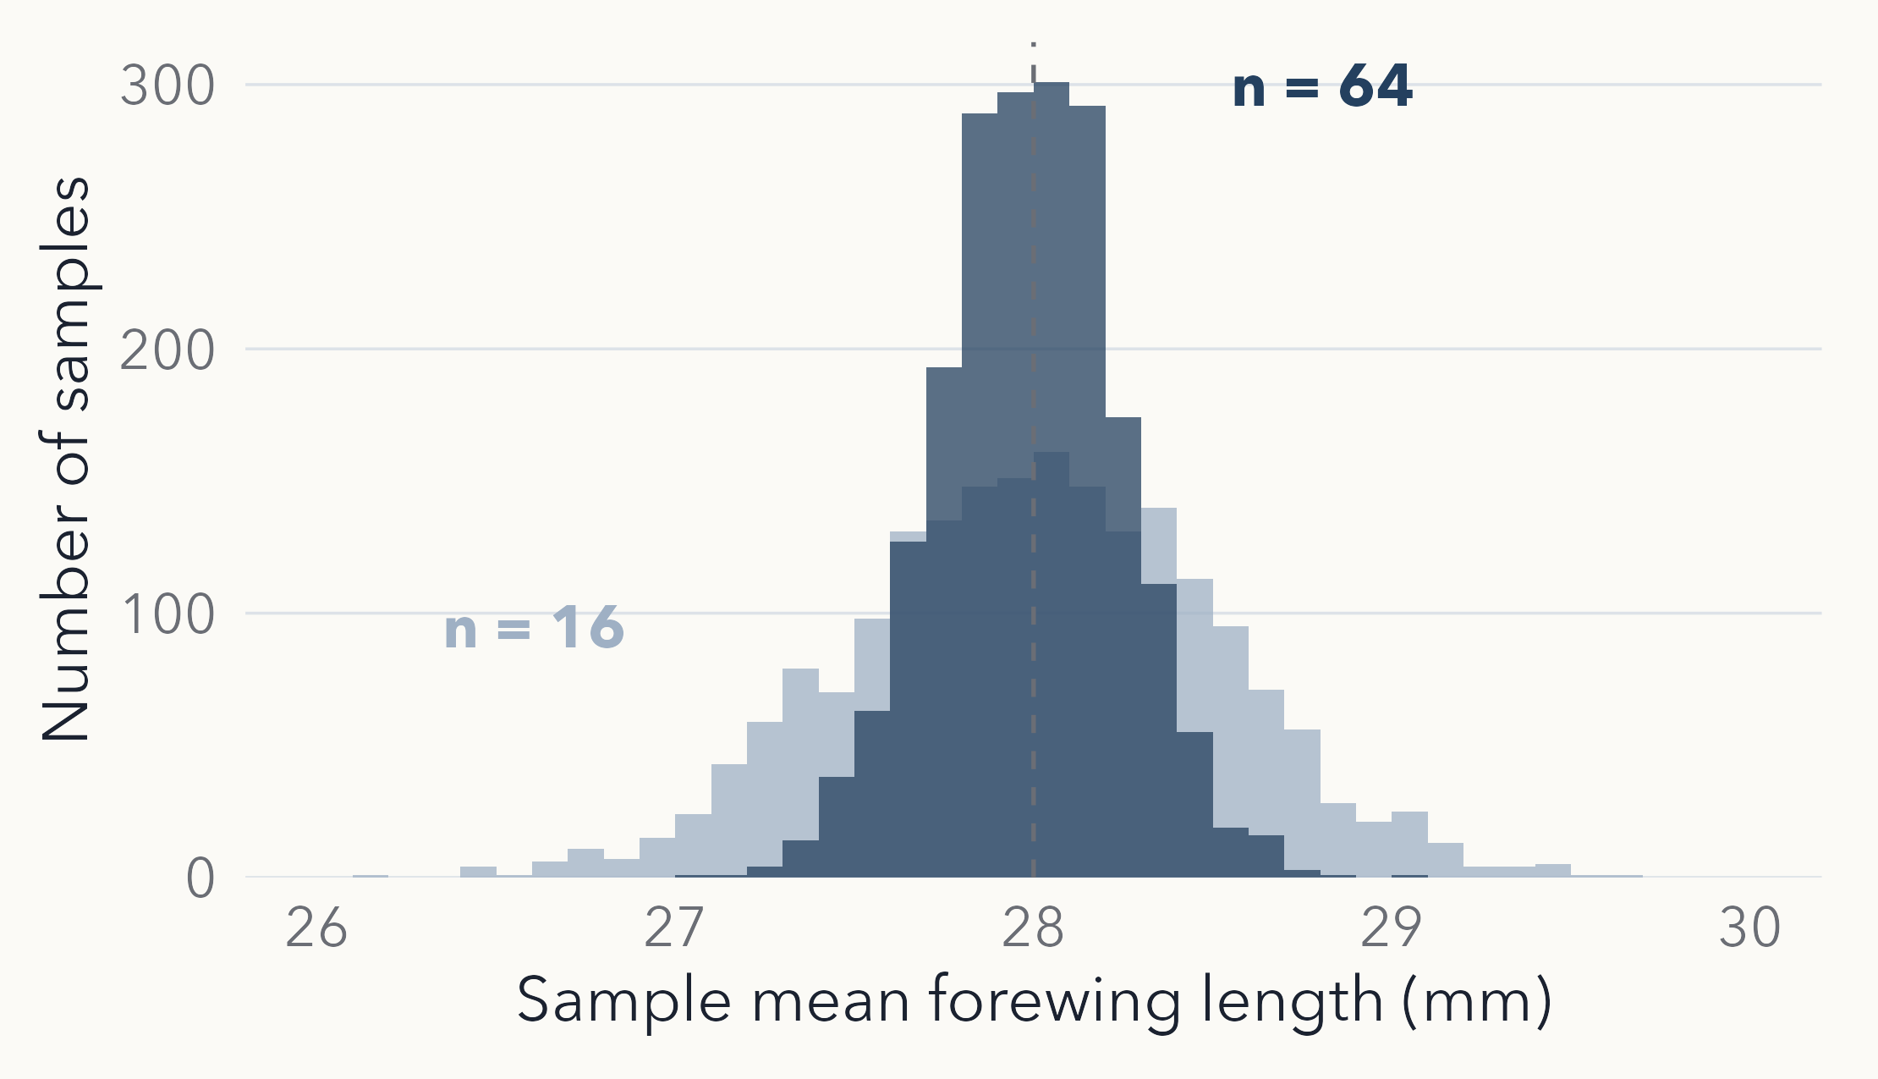
Larger samples give more precise means
TAKEAWAY
Both sets of means centre on 28 mm
Spread shrinks with √n: four times the moths halves it
Law of large numbers: as n grows, means approach 28 mm
Notes:
Timing: 3 min.
Each bar counts how many of 2,000 simulated samples had a mean in that range: this is the sampling distribution of the mean. SD of the 2,000 means: 0.51 mm for n = 16, 0.25 mm for n = 64.
Two separate ideas. Law of large numbers: as n grows, the sample mean gets closer to the population mean. How fast: the spread of sample means shrinks with the square root of n, so four times the moths halves it (this is the SEM, next slide).
But only for random error: the biased warm-night sample from section 1 would centre on the wrong value however large n became.
Practical: the virtual-dice exercise (book 11.8-11.9) shows the same thing with proportions of sixes. (The shape becoming normal is the central limit theorem; not needed today.)

Slide 21
SD and SEM answer different questions
SD: SPREAD OF THE MOTHS
SEM: UNCERTAINTY IN THE MEAN
How much do individual moths differ?
About 2 mm, whatever the sample size
Use it to describe data: mean ± SD
How much would the sample mean vary between samples?
SEM = SD / √n: 0.5 mm for n = 16, 0.25 mm for n = 64
In R: sd(x) / sqrt(length(x))
Notes:
Timing: 2.5 min.
The SEM formula predicts exactly what we simulated: 2 / sqrt(16) = 0.5 and 2 / sqrt(64) = 0.25 (simulated 0.51 and 0.25).
The SD estimates a fixed property of the population and does not shrink with n. The SEM shrinks as n grows.
Common error: error bars showing SEM make data look less variable than they are; always say which you plotted.
The simple formula assumes independent observations; repeated measures on the same moth or clustered sampling break it.

Slide 22
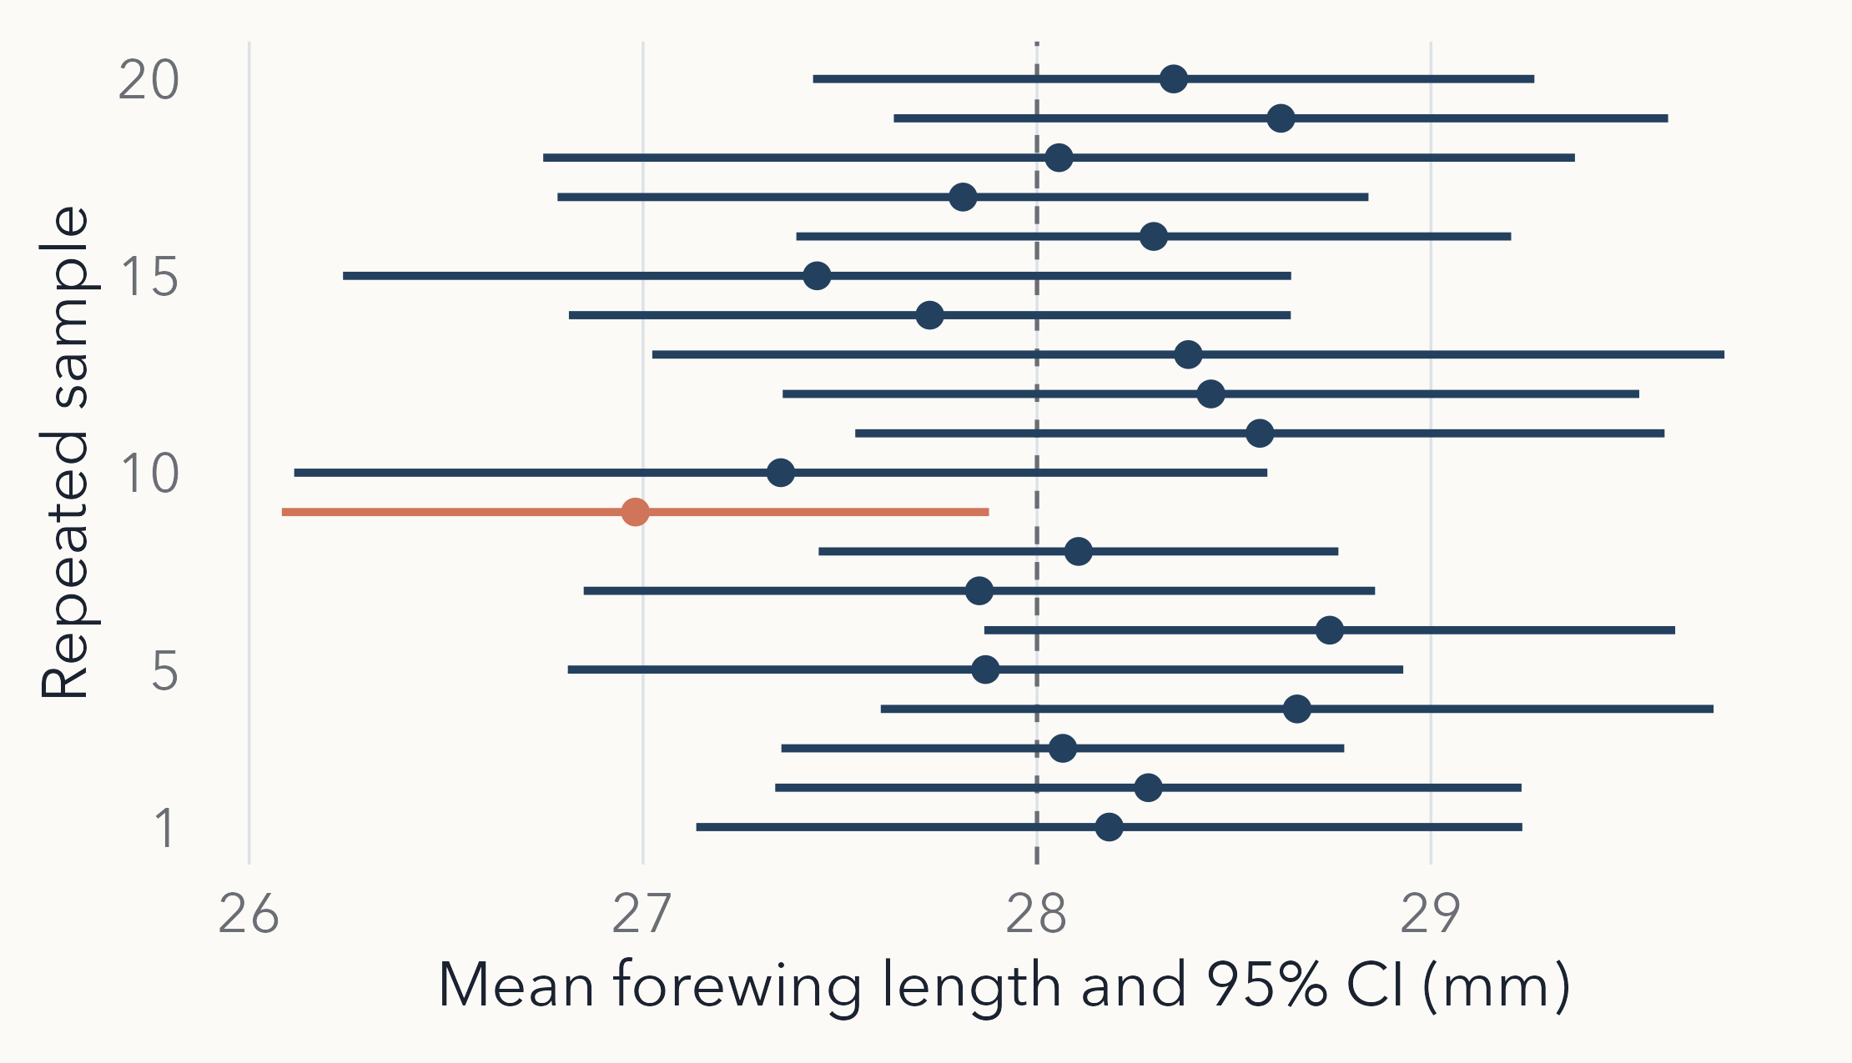
A 95% confidence interval for the mean
TAKEAWAY
About 95% of intervals contain the true mean (here 19 of 20)
Roughly mean ± 2 × SEM: t.test(x)$conf.int
Notes:
Timing: 3 min.
Twenty samples of 16 moths, each with its 95% CI from t.test(). One (orange) misses 28 mm. Seed chosen so the display shows the expected 1 in 20; real repetitions vary.
The 95% describes the procedure: in the long run, 95% of intervals built this way contain the true mean. Avoid saying 'there is a 95% probability that this particular interval contains the mean'.
For n = 16 the multiplier is 2.13 (t with 15 df), not 1.96; widths vary because each sample has its own SD.
Overlapping CIs do not by themselves mean 'no difference'; comparing groups comes with t-tests. This is the definition of a CI used from here on (lecture 02 points forward to it).

Slide 23
Which summary or model would you use?
4 MIN · PAIRS
For each study, first say what the population is.
A Forewing lengths of 50 moths: describe how variable they are
B Moths per trap-night on 30 nights: describe a typical night
C Survival of 40 larvae: how precisely have we estimated survival?
Notes:
Timing: 3 min (pairs 2 min, then a quick class check).
A: all moths of the species at the site; if roughly symmetric, mean and SD (show the histogram); remember trap bias.
B: nights in the season at that site; counts are skewed, so median and quartiles for a typical night, the mean for the expected catch; Poisson is a candidate model, check for overdispersion.
C: larvae in the population; report survivors out of 40 and the proportion; precision needs an SE or CI for a proportion, which comes later with binomial GLMs. Are the larvae independent (same clutch?)
No single correct summary independent of the question.

Slide 24
Key points
Samples vary by chance; more data cannot fix bias
Fit summaries to the shape and the question
Normal (μ, σ) and Poisson (λ) describe possible outcomes
SD describes moths; SEM and CIs describe uncertainty in the mean
Practical: book chapter 11
11.4 Normal, rnorm()
11.6 Poisson, rpois()
11.8–11.9 Law of large numbers, virtual dice
Notes:
Timing: 1 min.
Practical priorities (about 60 min): normal distribution 11.4; Poisson 11.6; virtual dice 11.8-11.9. Comparing two normals (11.5), normal vs Poisson (11.7) and coin flipping are extras if time allows.
Next lecture series: randomisation tests use exactly this idea of how much a statistic varies between samples.

