Slide 1
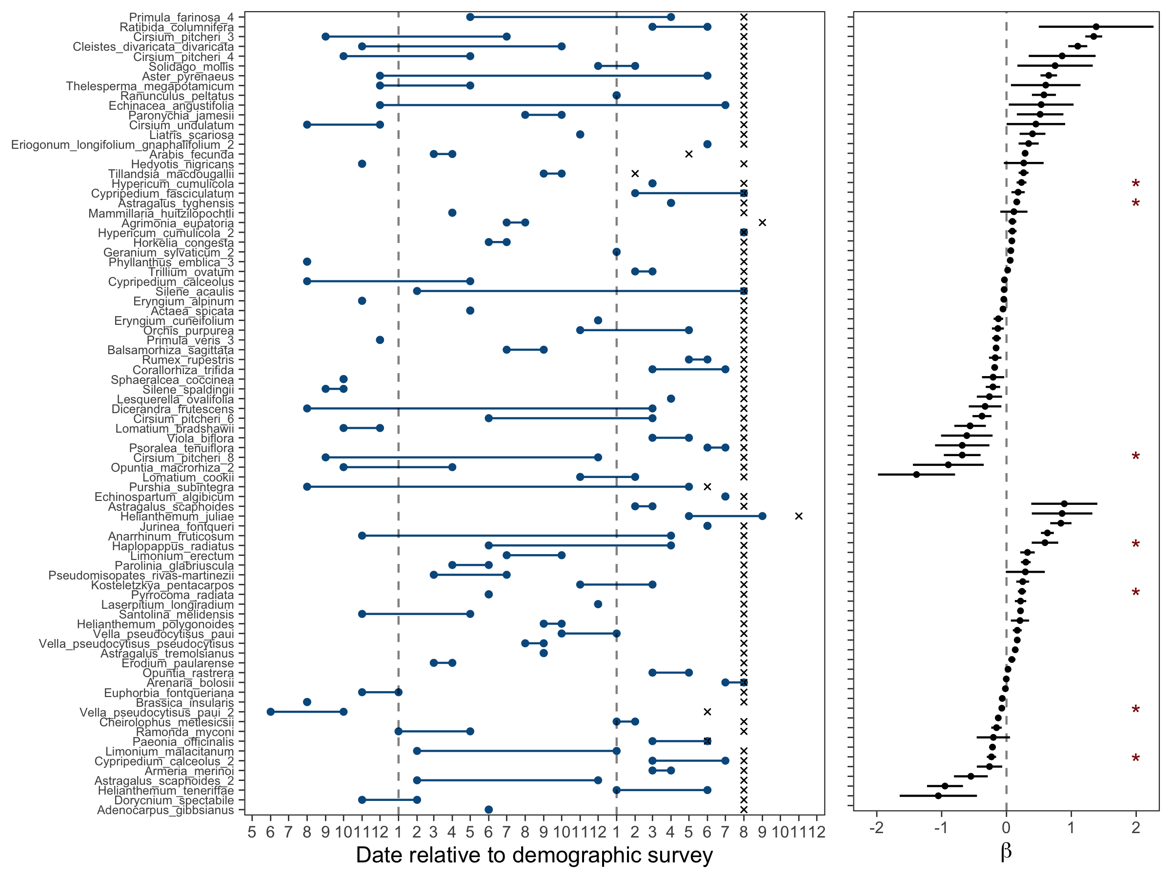
window
open
window
close
demographic
survey
Temperate ecoregions
Desert / Mediterranean

