Slide 1
ConnectTel Customer Churn Prediction
Jones Oteri

Slide 2
Project Objective
Leveraging Machine Learning to Reduce Customer Attrition

Slide 3
Problem Definition
The Challenge of Customer Churn
Customer churn is the loss of customers to competitors.
It leads to revenue loss, hinders growth, and threatens sustainability.
Existing retention strategies lack precision and effectiveness.

Slide 4
How Will the Company Benefit?
By accurately forecasting customer churn, ConnectTel can:
Reduce Customer Attrition: Implement targeted retention initiatives to prevent churn.
Enhance Customer Loyalty: Retain valuable customers and improve overall satisfaction.
Maintain a Competitive Edge: Stay ahead in the highly dynamic and competitive
telecommunications industry.

Slide 5
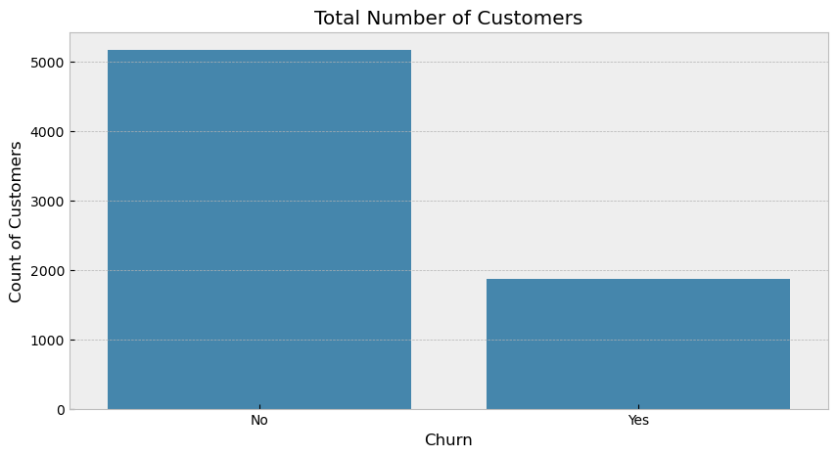
Exploratory Data Analysis (EDA)
Visualize Relationships between Customers and Churn
The YES of a value (1,869) represent customers who have churned (i.e., discontinued their service).
The NO of a value (5,174) represent customers who have not churned (i.e., continued their service)

Slide 6
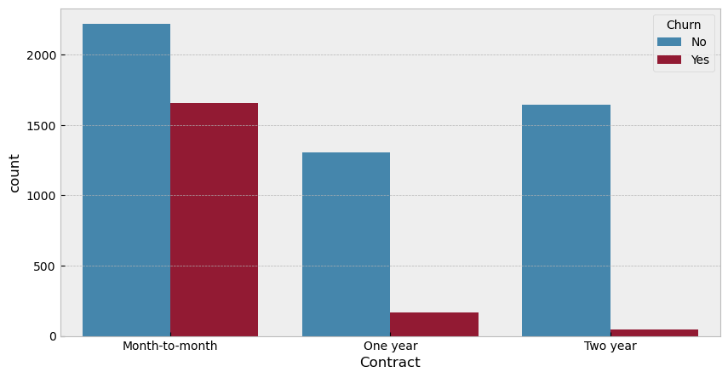
Exploratory Data Analysis (EDA)
Visualize Relationships between Churn and Contract

Slide 7
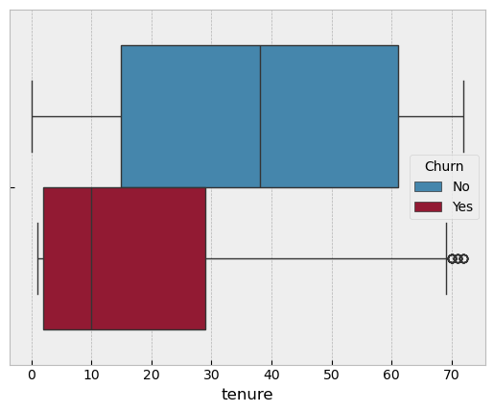
Exploratory Data Analysis (EDA)
Visualize Relationships between Churn and Tenure

Slide 8
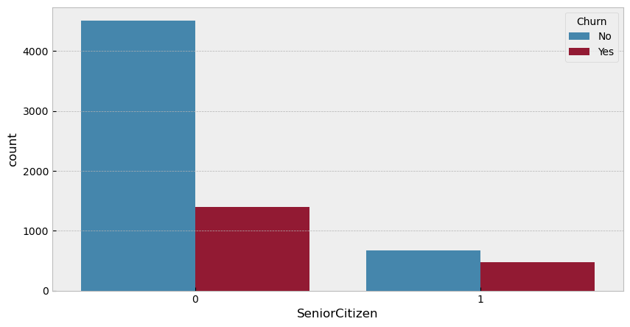
Exploratory Data Analysis (EDA)
Visualize Relationships between Churn and Senior Citizen
Senior Citizen” has two categories:
0 (non-senior citizens)
1 (senior citizens).

Slide 9
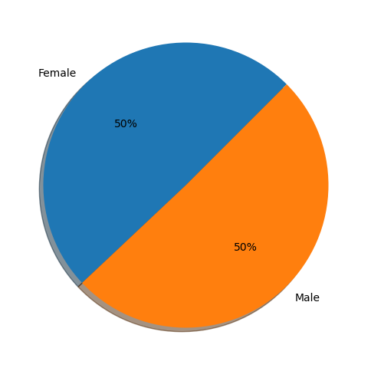
Univariate Analysis For Gender

Slide 10
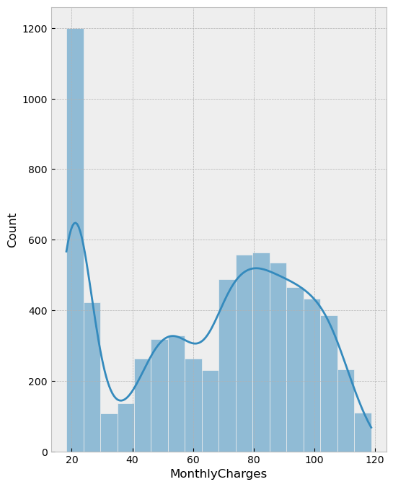
Univariate Analysis
A histogram plot for the Monthly charges.

Slide 11
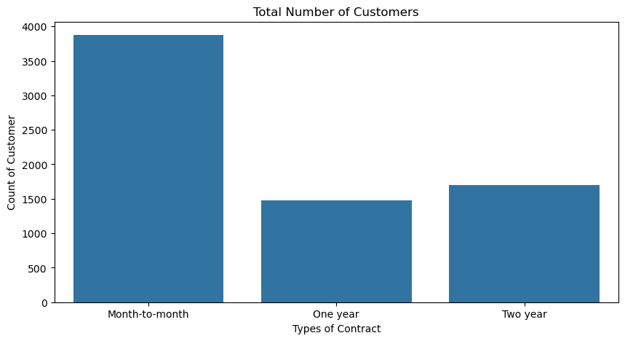
Univariate Analysis
A bar plot visualizing the types of Contract

Slide 12
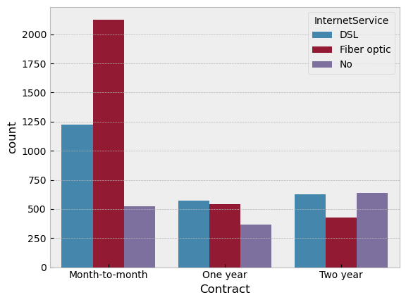
Bivariate Analysis
Visualize Relationships between Contract and Internet Service.

Slide 13
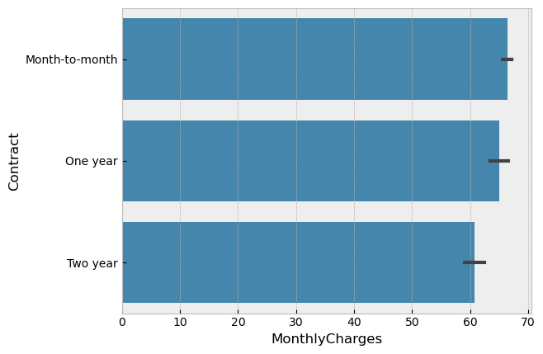
Bivariate Analysis
Visualize Relationships between Contract and Monthly Charges.

Slide 14
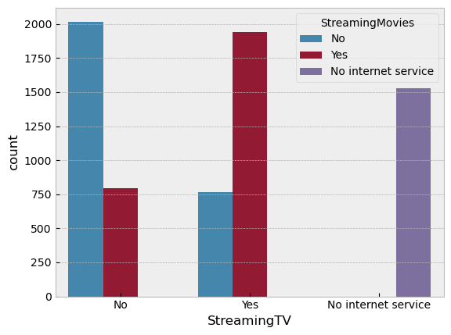
Bivariate Analysis
Visualize Relationships between Streaming TV and Streaming Movies
The blue bars represent the count of people who do not have Streaming TV.
The red bars represent the count of people who have Streaming Movies.
The purple bars represent the count of people who have no internet service.

Slide 15
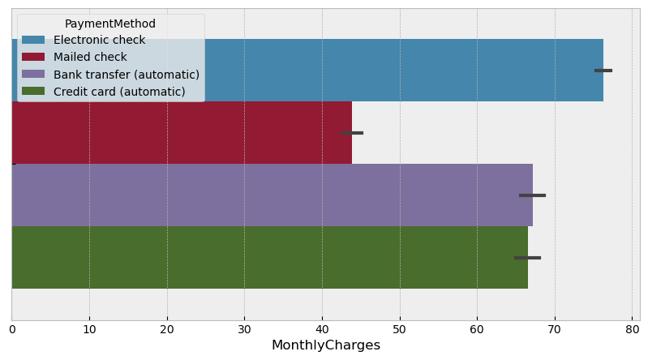
Bivariate Analysis
Visualize Relationships between Payment Method and Monthly Charges.

Slide 16
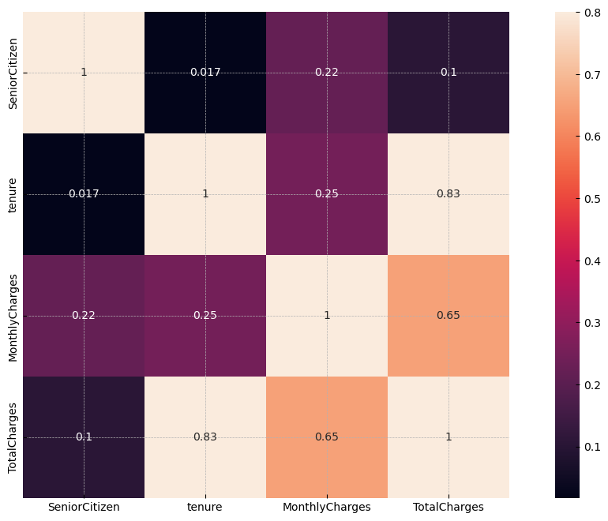
Multivariate Analysis
Correlations between:
Tenure vs Total Charges
Tenure vs Monthly Charges
Monthly Charges vs Total Charges

Slide 17
Feature Engineering
Preparing the Data for Modelling
Encode categorical variables (e.g., Gender, Phone service etc) into numerical values.
Create new features from existing ones (e.g., average monthly charges).
Address missing values and outliers as needed.

Slide 18
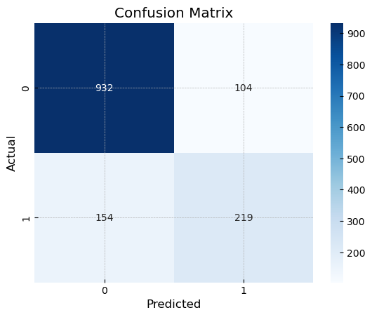
Model Selection, Training, and Validation
Building the Churn Prediction Model
Logistic regression
Accuracy: 81.69 %
Precision: 67.8 %
Recall: 58.71 %
F1-score: 62.93 %
AUC-ROC: 74.34 %

Slide 19
Model Selection, Training, and Validation
Building the Churn Prediction Model
Random Forest Classifier
Accuracy: 79.49 %
Precision: 65.33 %
Recall: 47.99 %
F1-score: 55.33 %
AUC-ROC: 69.41 %

Slide 20
Model Selection, Training, and Validation
Building the Churn Prediction Model
KNeighborsClassifier
Accuracy: 78.85 %
Precision: 63.44 %
Recall: 47.45 %
F1-score: 54.29 %
AUC-ROC: 68.8 %

Slide 21
Model Evaluation
LOGISTIC REGRESSION MODEL
Accuracy:
The Logistic Regression Model predicts correctly the outcome for approximately 81.69% of customers compare to Random Forest Classifier and KNeighborsClassifier.
Precision:
A precision of 67.8% suggests that the model predicts a positive outcome
Recall:
A recall of 58.71% indicates that the model identifies approximately 58.71% of the actual positive customers.
F1-score:
A value of 62.93% suggests a reasonable balance between precision and recall.
AUC-ROC:
An AUC-ROC of 74.34% indicates that the model performs reasonably well

Slide 22
Model Evaluation
Confusion Matrix
True Positives (TP):
There are 219 true positives (correctly predicted positive cases).
True Negatives (TN):
There are 932 true negatives (correctly predicted negative cases).
False Positives (FP):
There are 104 false positives.
False Negatives (FN):
There are 154 false negatives.

Slide 23
Conclusion
I think the business should be more focus on minimizing the false Negative compared to the true positive.
Reasons:
Missing a customer who is likely to churn (false negative) can result in revenue loss. ConnectTel would need to detect potential churners early to prevent them from leaving.
It can result to customer dissatisfaction.
It can also result to brand reputation impact.

Slide 24

Thank you for your attention

