Slide 1
Mind-Body Practice on Gene Expression
Sara Jones
AS.410.671.82.FA17
Final Project, 12/10/17

Slide 2
Outline
Background
Dataset
Outliers
Feature Selection
Gene Expression
Clustering
Classification
Conclusions
References

Slide 3
BACKGROUND
Dusek et al. hypothesized that consistent, long-term practice of relaxation response (such as deep breathing, meditation), can result in characteristic changes in gene expression, especially with genes that elicit the stress response.
They assessed the transcriptional profile of whole blood collected from long-term practitioners of daily RR practice in comparison to controls. Controls then took part in a 8-week RR practice with training/education. Whole blood was collected before and after this 8-week RR practice.
For this analysis, controls were treated as two groups: no RR practice and 8-week RR practice. These groups, along with the long-term RR practice group, were compared.

Slide 4
DATASET: GDS3416
Platform: GPL570
Type: Expression profiling by array
Organism: Human
Sample type: RNA from whole blood
Series published: 7/5/2008
Genes: 54,675
Samples: 72
3 groups:
1. No relaxation response practice n=23
2. 8 weeks of relaxation response practice n=24
3. Long-term daily relaxation response practice n=25

Slide 5
OUTLIERS
Four methods used:
Correlation plot – heat map
Cluster dendogram
CV vs. Mean
Average correlation

Slide 6
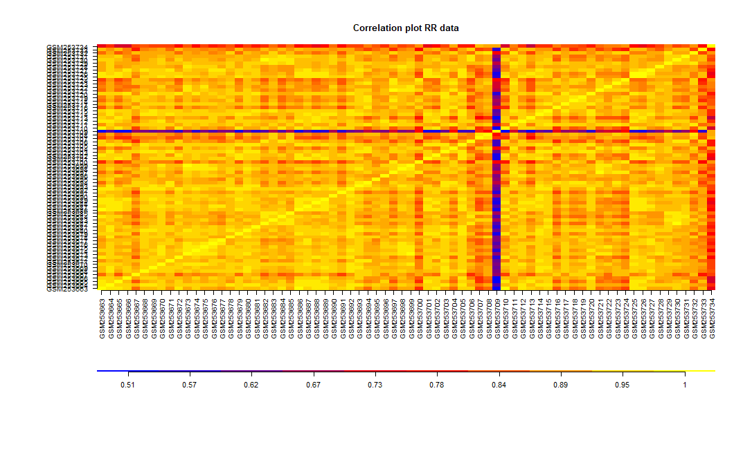
Outliers – Correlation plot
Potential outlier: GSM253709

Slide 7
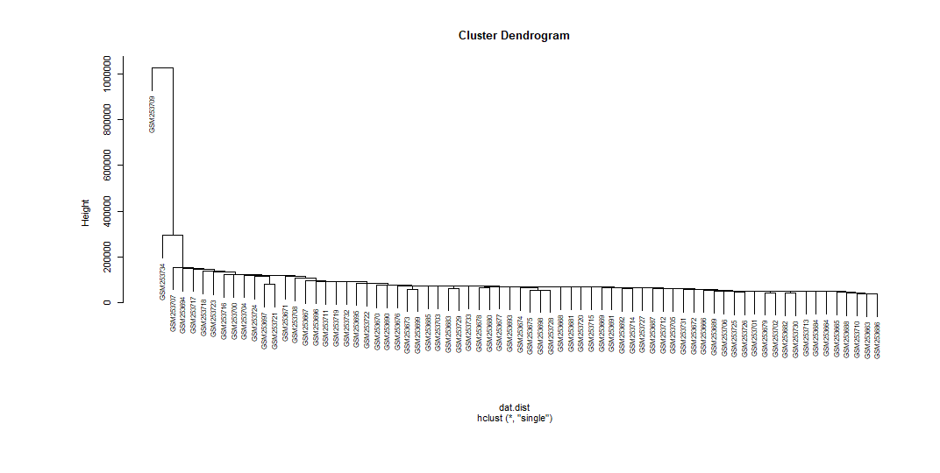
Outliers – Cluster Dendogram
Potential outlier: GSM253709
Potential outlier: GSM253734

Slide 8
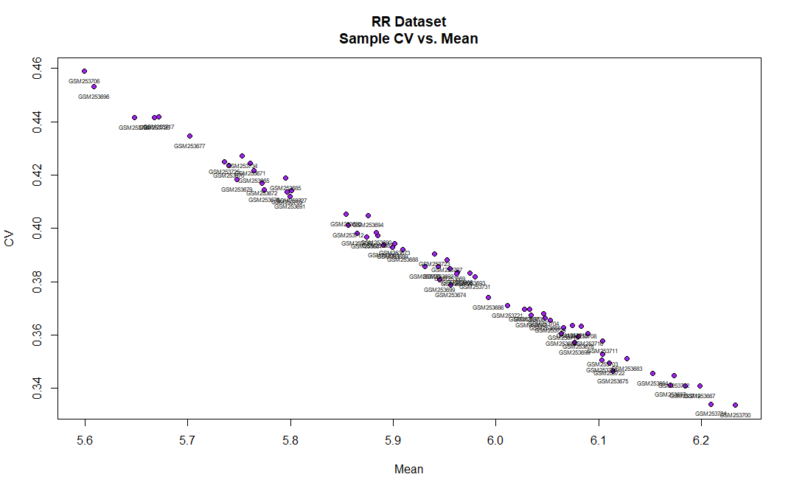
Outliers – CV vs. Mean

Slide 9
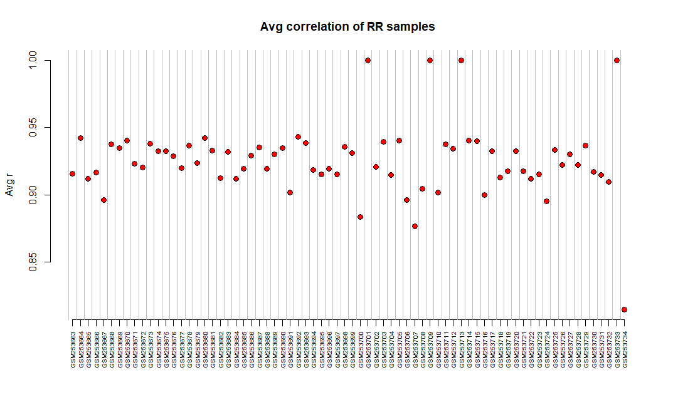
Outliers – Average correlation
Potential outlier: GSM253734

Slide 10
Outliers - Summary
Correlation plot – GSM253709
Cluster dendogram – GSM253709 and GSM253734
CV vs. Mean – Nothing stood out as a potential outlier
Average correlation – GSM253734
Removed GSM253709 and GSM253734 since 2/4 methods suggest they are outliers.
New sample size = 70
1. No relaxation response practice n=23
2. 8 weeks of relaxation response practice n=23
3. Long-term daily relaxation response practice n=24

Slide 11
Filtering Genes with Low Expression
Genes were removed if the average gene expression < 50
54625 genes → 32215 genes
22410 genes removed

Slide 12
Feature selection - Methods
One-factor ANOVA used on the log₂ transformation of the data
Genes retained if the p-value < 0.05
P-values not adjusted
Significance (p<0.05) lost with Holm’s and Bonferroni
Number of genes retained: 482
Genes with p-value < 0.01: 69
Genes with p-value < 0.001: 3

Slide 13
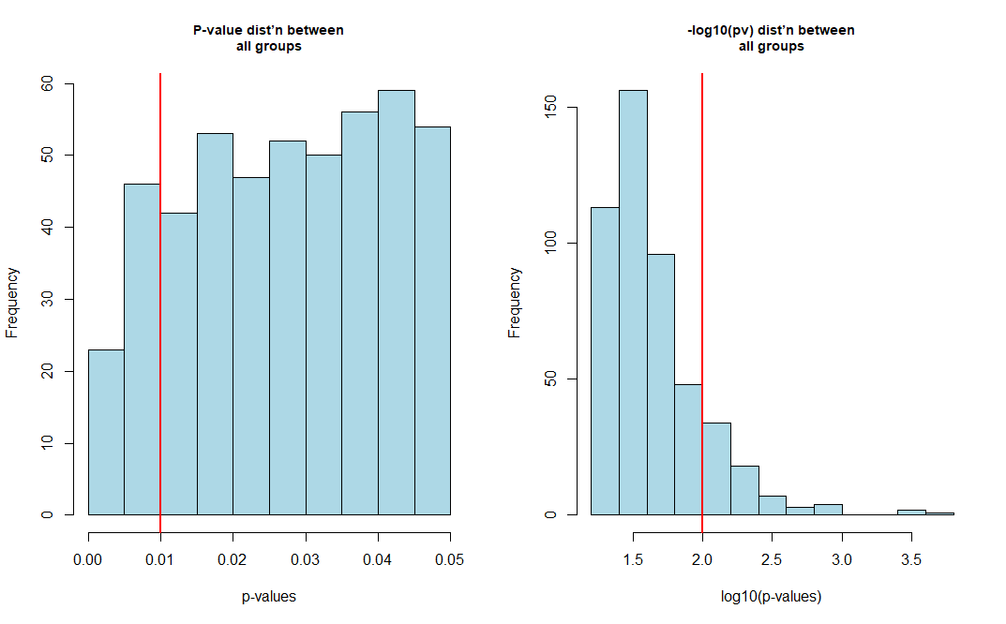
Feature selection: P-value dist’n

Slide 14
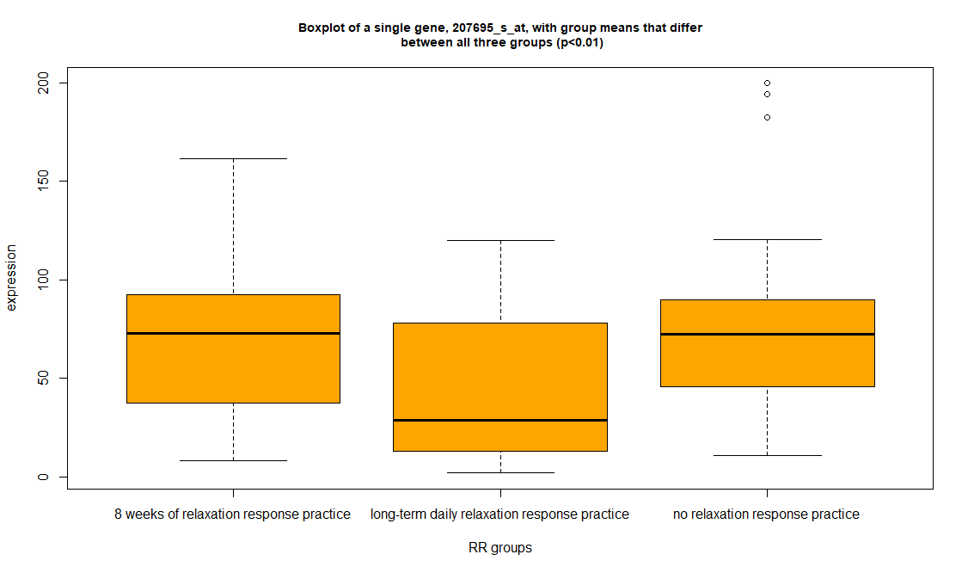
Feature selection: Box plot
Long-term is lower than both No and Short-term RR practice for this specific gene.

Slide 15
Gene Expression
To select the top 5 discriminant genes (positive and negative direction), the long term and naïve groups were compared using the Student’s t-test on log2 transformation of the data.
Assumed that greatest difference in gene expression would be better observed between the two groups.
The top 5 discriminant genes (positive direction) were selected with the following thresholds:
p-value < 0.01 and linear fold > 1.5
The top 5 discriminant genes (negative direction) were selected with the following thresholds:
p-value < 0.05 and linear fold < 0.5
Only 3 discriminant genes with the above thresholds

Slide 16
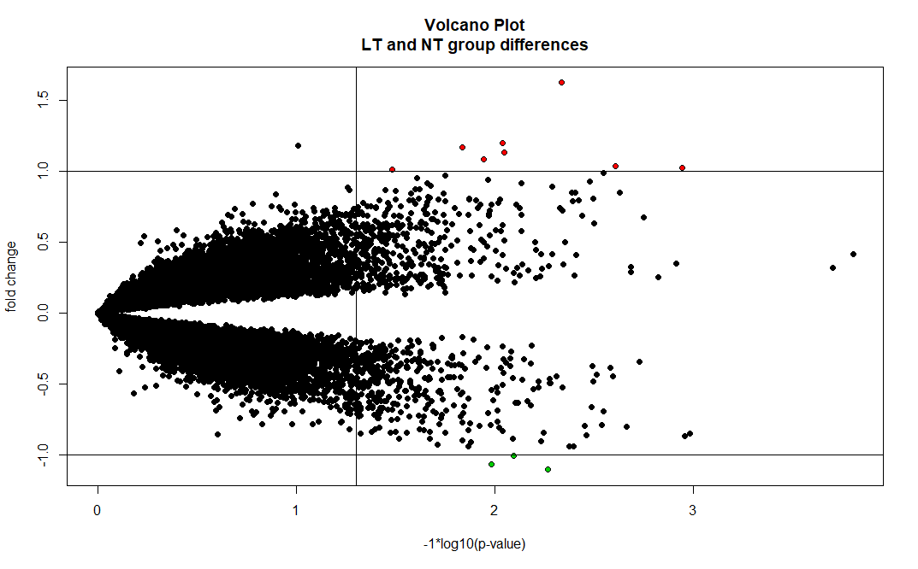
Gene Expression: Volcano Plot

Slide 17
Gene expression: Positive Expression
Probeset | Gene symbol | Gene name | GO Biological process | GO Molecular Function
223758_s_at | GTF2H2 | General transcription factor IIH subunit | DNA repair, response to stress, etc.. | Transcription factor activity, etc…
207509_s_at | LAIR2 | Leukocyte associated immunoglobulin like receptor 2 | Regulation of immune response | Protein binding
207695_s_at | IGSF1 | Immunoglobulin superfamily member 1 | Regulation of transcription | Receptor activity, etc…
218719_s_at | GINS3 | GINS complex subunit 3 | DNA replication | Protein binding, etc...
210584_s_at | POLDIP3 | DNA polymerase delta interacting protein 3 | Regulation of translation, etc… | RNA binding, etc…

Slide 18
Gene Expression: Negative Expression
Probeset | Gene symbol | Gene name | GO Biological process | GO Molecular Function
202222_s_at | DES | Desmin | Muscle contraction, regulation of heart contraction, etc… | Protein binding, structural constituent of cytoskeleton, etc…
217611_at | ERICH1 | Glutamate rich 1 | NA | NA
232499_at | ITPKB | inositol-trisphosphate 3-kinase B | T-cell differentiation, cellular signaling, etc… | Transferase activity, kinase activity,etc…

Slide 19
Clustering
Used subset of genes with p<0.05: n=482
Two methods:
Hierarchical clustering with Manhattan distance metric and median linkage method
K-means clustering with k=3
Neither method clustered samples into distinct groups by class.

Slide 20
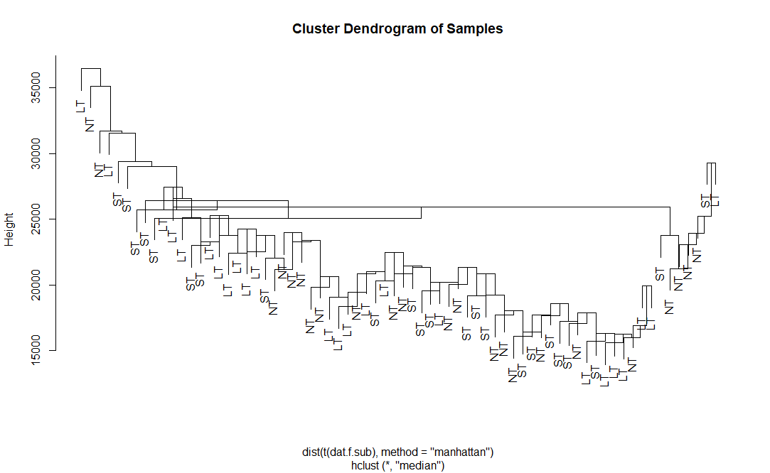
Clustering: Hierarchical

Slide 21
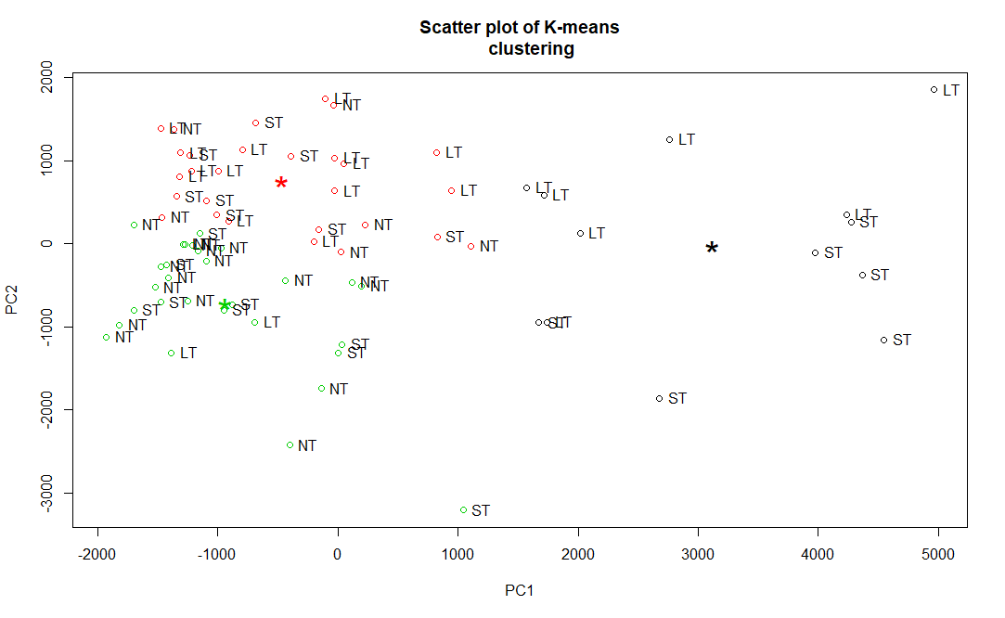
Clustering: K-means

Slide 22
Classification
Two supervised methods used on subset of genes with p<0.05: n=482:
1. Discriminant analysis
Training set: 15 no RR, 15 eight-week RR, 15 long-term RR
Test set: 8 no RR, 8 eight-week RR, 15 long-term RR
2. Support vector machine
Mismatches occurred with discriminant analysis but not with support vector machine. Better grouping observed with support vector machine as shown in plots.

Slide 23
Classification: Confusion matrix -DA
 | 8 week RR | Long-term RR | No RR
8 week RR | 7 | 1 | 1
Long-term RR | 1 | 6 | 3
No RR | 0 | 2 | 4
Mismatches observed with test data using the discriminant analysis method.

Slide 24
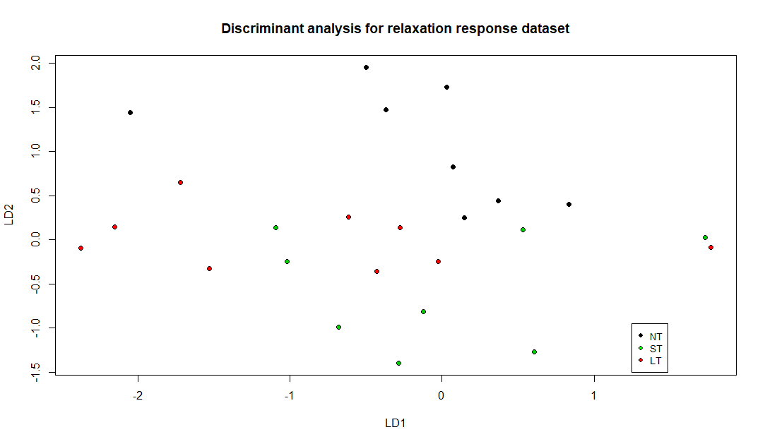
Classification: Discriminant Analysis

Slide 25
Classification: Confusion matrix-SVM
 | 8 week RR | Long-term RR | No RR
8 week RR | 23 | 0 | 0
Long-term RR | 0 | 24 | 0
No RR | 0 | 0 | 23
No mismatches observed using support vector machine method.

Slide 26
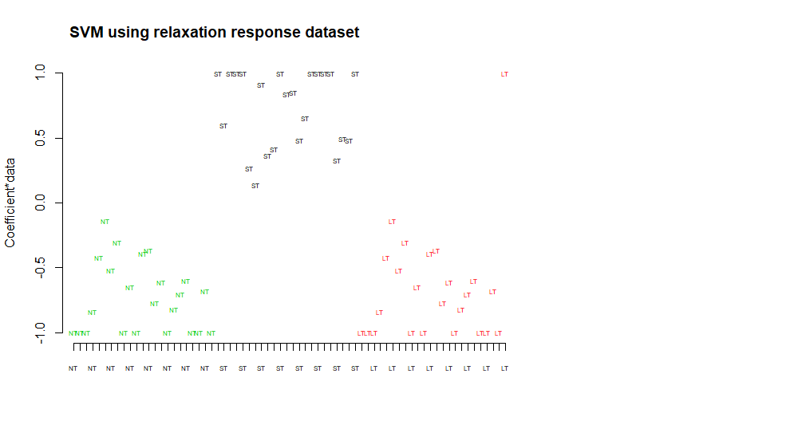
Classification: Support Vector Machine

Slide 27
Conclusions
According to Dusek et al., gene ontology and gene set enrichment analyses revealed significant alterations among long-term and short-term RR practitioners in
cellular metabolism
oxidation phosphorylation
generation of reactive oxygen species
response to oxidative stress
These changes seem to indicate that daily RR practice can counteract cellular damage related to chronic psychological stress.

Slide 28
Conclusions
From my analysis, around 482 genes were differentially expressed (p<0.05) among the three groups.
When comparing the long-term and no RR practice groups, one of the top 10 discriminant genes, GTF2H2, was upregulated in long-term practitioners.
This may suggest that long-term practitioners exhibit enhanced DNA damage repair activity when responding to stress, and as result less overall cellular damage.
Clustering methods of the significant genes did not reveal any obvious clusters of the groups.
Classification methods, particularly SVM, classified the samples into the right groups.
This seems to indicate that there are distinct characteristics among the groups, even between the no RR and 8-week RR groups.

Slide 29
References
Dusek JA, Otu HH, Wohlhueter AL, Bhasin M et al. Genomic counter-stress changes induced by the relaxation response. PLoS One 2008 Jul 2;3(7):e2576. PMID: 18596974

