Slide 1
Code-switching sentiment analysis
Sergey Sokolov
10-14 December 2018

Slide 2
NLPCC 2018 Competition: Shared task 1
Given: short texts in Chinese/English
Find: Find sentiments of the text out of possible:
Happiness
Sadness
Anger
Fear
Surprise
Each record can have zero or multiple sentiments (multitask classification)

Slide 3
Dataset
Pre-tokenized messages from Weibo selected to have English component as well
Total: 2200 records = 6000 train + 728 dev + 1202 test
Each record: pre-tokenized text
Each label: 5 sentiments (T/F)

Slide 4
Classic approach
Embedding
Encoder
Output

Slide 5
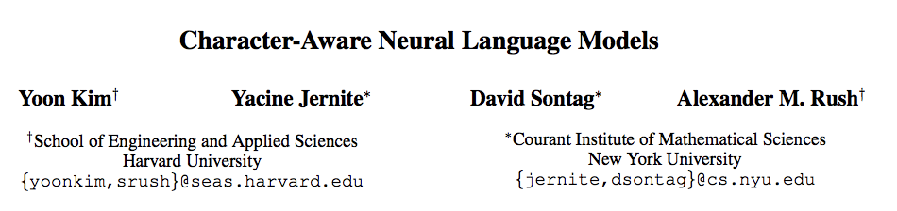
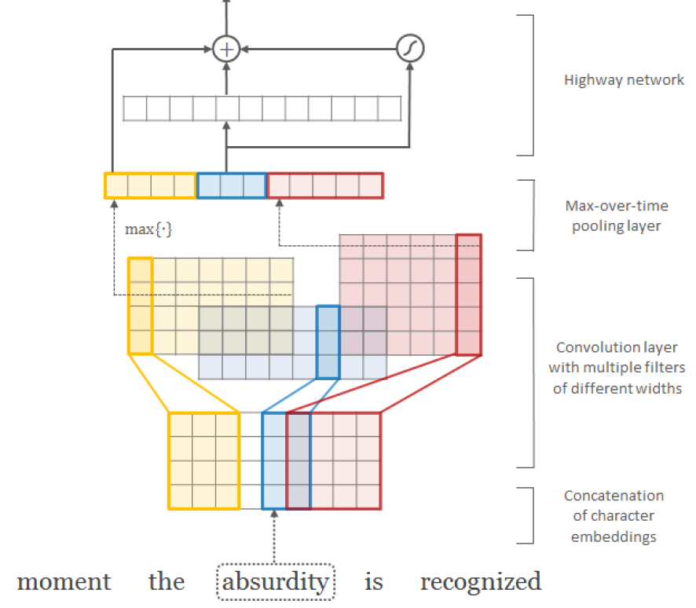
Convolutional encoder

Slide 6
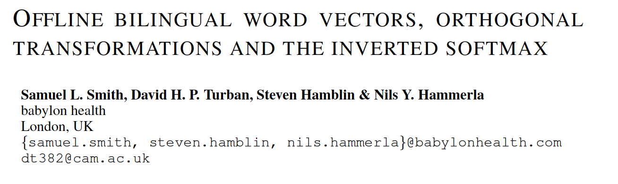
How to deal with bilingual text?
Train embedding “online” from 2 monolingual sources with a small bilingual corpus acting like regularizer
Do “offline” embedding matrix alignment
Alignment matrices on github

Slide 7
Let’s look into the code

Slide 8
Can we beat baseline?
Team | Happiness | Sadness | Anger | Fear | Surprise | Marco-F1
DeepIntell | 0.734 | 0.616 | 0.543 | 0.264 | 0.418 | 0.515
DUTIR_938 | 0.715 | 0.521 | 0.541 | 0.166 | 0.396 | 0.468
Shining | 0.710 | 0.652 | 0.540 | 0.292 | 0.139 | 0.467
lxzlx624 | 0.734 | 0.637 | 0.570 | 0.204 | 0.164 | 0.462
xiamx-rali | 0.624 | 0.494 | 0.457 | 0.200 | 0.366 | 0.428
zzuhhjx | 0.692 | 0.428 | 0.406 | 0.186 | 0.376 | 0.418
Team_1 | 0.594 | 0.510 | 0.440 | 0.143 | 0.310 | 0.399
CASIA-ED | 0.596 | 0.417 | 0.510 | 0.130 | 0.337 | 0.398
cmos_nlp | 0.632 | 0.414 | 0.352 | 0.161 | 0.265 | 0.365
Yang_NEU | 0.568 | 0.432 | 0.351 | 0.207 | 0.255 | 0.363
rax | 0.576 | 0.421 | 0.392 | 0.103 | 0.306 | 0.360
NLP@WUST | 0.630 | 0.374 | 0.287 | 0.146 | 0.354 | 0.358
scau_geek | 0.615 | 0.480 | 0.398 | 0.000 | 0.230 | 0.345
Baseline | 0.587 | 0.500 | 0.390 | 0.108 | 0.128 | 0.342
Lab1010 | 0.385 | 0.458 | 0.271 | 0.061 | 0.063 | 0.248
The Dream Team of NLP | 0.480 | 0.350 | 0.160 | 0.062 | 0.137 | 0.238
GDUFSLEC | 0.491 | 0.131 | 0.190 | 0.045 | 0.299 | 0.231
CSUNLP | 0.441 | 0.354 | 0.033 | 0.093 | 0.149 | 0.214
CQUT_301_1 | 0.246 | 0.161 | 0.093 | 0.053 | 0.049 | 0.121
BISTU_IIPI | 0.456 | 0.007 | 0.018 | 0.000 | 0.000 | 0.096
Competition results:
19 effective submissions
Best Macro-F1: 0.515
Baseline: 0.342
My result:
varies between 0.39 and 0.41 (7-8th place)

Slide 9
Ideas for possible improvements

Slide 10
Better tokenization
Given text is pre-tokenized, but there are still some noise
Use gluonnlp.data.JiebaTokenizer()
Or nltk.parse.corenlp.CoreNLPParser()
Much slower
Can parse emojis in code points to some extend

Slide 11
Different model
Reuse encoder from pretrained language model and fine tune it for your dataset
Code example, Tutorial
Use self-attentive models
Tutorial

Slide 12
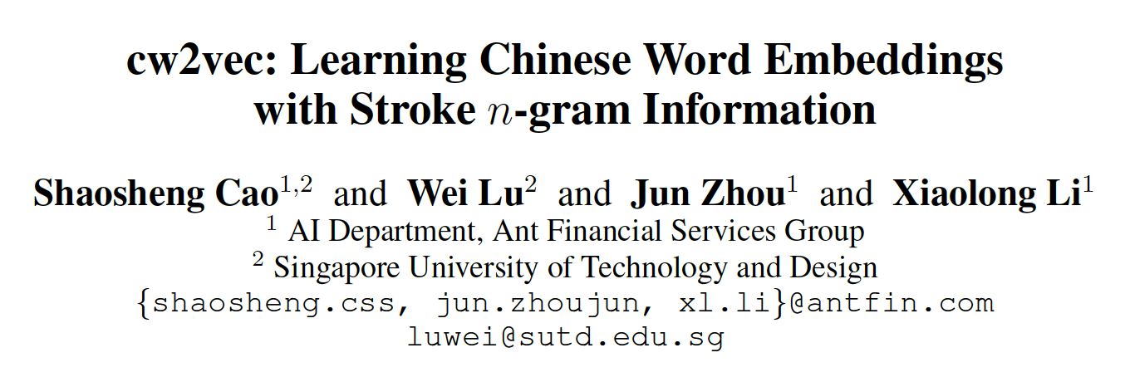
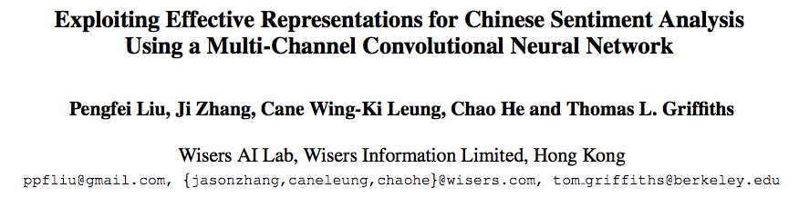
More effective data representation
Using character embedding doesn’t add as much value for Chinese language as for European languages
Possible sources:
Character radicals
Character components
Character stroke n-grams
Pinyin

Slide 13
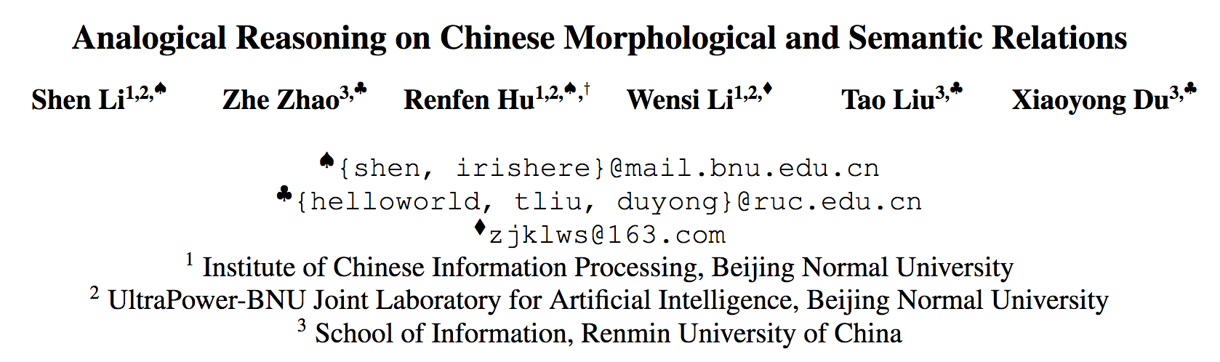
Better Chinese embedding
The best embedding is domain specific
100+ embeddings for different domains
Better Chinese-English alignment matrix
Another source of alignment: automatic translation
Use analogical reasoning for morphological and semantic relations

Slide 14
Train embedding vs. pre-trained embedding
Pro: Using pre-trained embedding saves computational resources
Con: Training embedding from scratch for specific domains can significantly decrease OOV words ratio
Con: Need a lot of text
Another approach: use pre-trained word embeddings and fine-tune
Train your word embedding with GluonNLP

