Slide 1
Multihost Training with MXNet
Sergey Sokolov
10-14 December 2018

Slide 2
Agenda
Introduction
Distributed Training on DLAMI – 60 min
Distributed training with SageMaker – 30 min

Slide 3
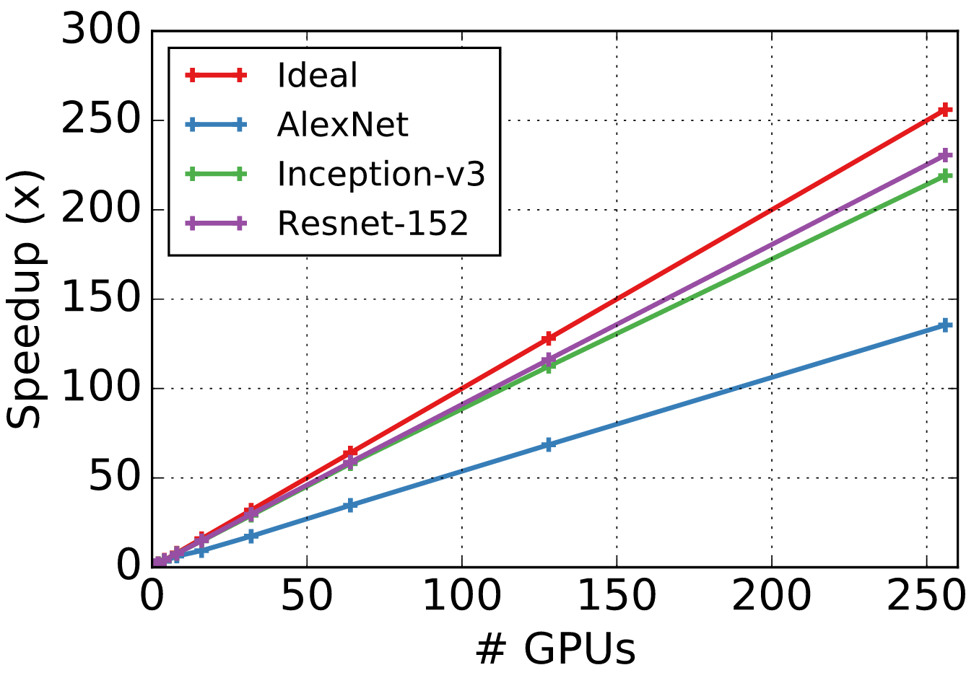
Why distribute?

Slide 4
Distributed Training with MXNet

Slide 5

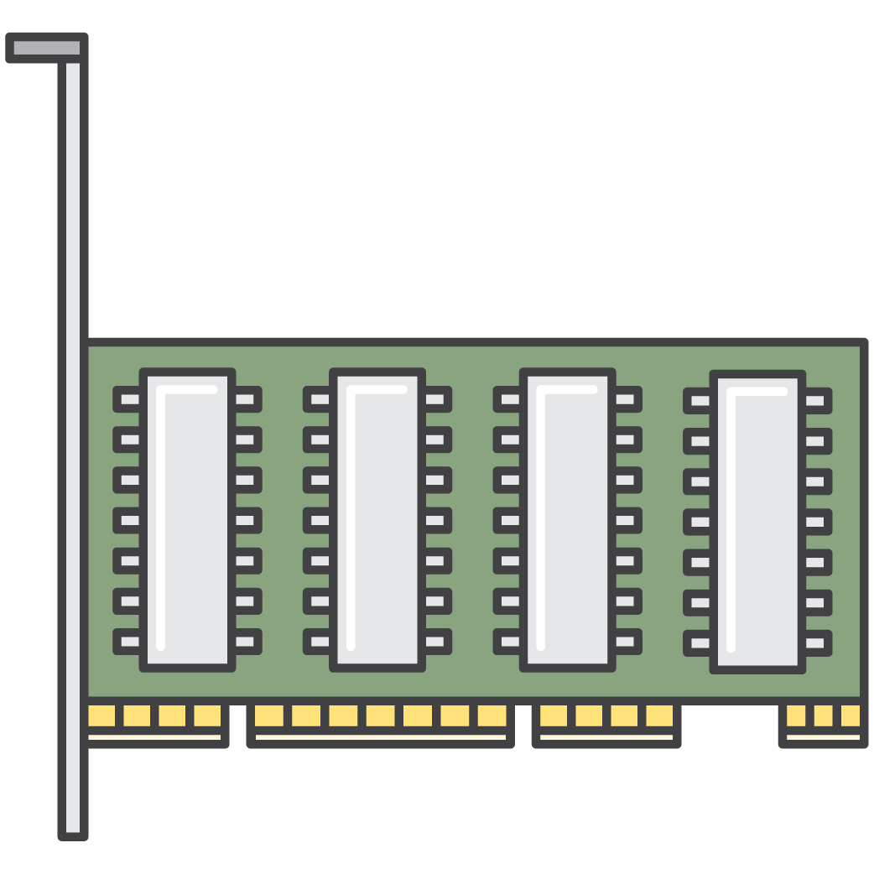

The kvstore
dist_sync
dist_device_sync
dist_async

Slide 6



MainComponents of an MXNet Cluster
scheduler
worker(s)
server(s)

Slide 7
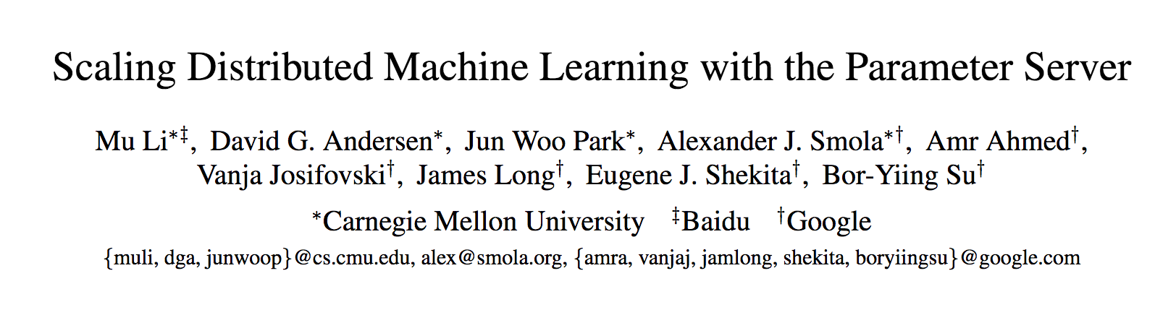
Main resource
https://www.cs.cmu.edu/~muli/file/parameter_server_osdi14.pdf

Slide 8
Our Test Cluster
2 Physical Hosts
Each worker 4 gpus
1x scheduler
2x worker(s)
2x server(s)

Slide 9
Start a scheduler – 1 per cluster
import os
os.environ.update({
"DMLC_ROLE": "scheduler", # Could be "scheduler", "worker" or "server"
"DMLC_PS_ROOT_URI": "127.0.0.1", # IP address of a scheduler
"DMLC_PS_ROOT_PORT": "9000", # Port of a scheduler
"DMLC_NUM_SERVER": “2", # Number of servers in cluster
"DMLC_NUM_WORKER": “2", # Number of workers in cluster
"PS_VERBOSE": "2" # Debug mode
})
import mxnet as mx

Slide 10
Start a parameter server to store parameters – 1 or many
import os
os.environ.update({
"DMLC_ROLE": "server", # Could be "scheduler", "worker" or "server"
"DMLC_PS_ROOT_URI": "127.0.0.1", # IP address of a scheduler
"DMLC_PS_ROOT_PORT": "9000", # Port of a scheduler
"DMLC_NUM_SERVER": “2", # Number of servers in cluster
"DMLC_NUM_WORKER": “2", # Number of workers in cluster
"PS_VERBOSE": "2" # Debug mode
})
import mxnet as mx

Slide 11
Start a worker to do forward/backward pass – 1 or many
import os
os.environ.update({
"DMLC_ROLE": "worker",
"DMLC_PS_ROOT_URI": "127.0.0.1",
"DMLC_PS_ROOT_PORT": "9000",
"DMLC_NUM_SERVER": “2",
"DMLC_NUM_WORKER": “2",
"PS_VERBOSE": "2"
})
…
kv_store = mx.kv.create('dist_device_sync‘)
…
Trainer(…, kvstore = kv_store)

Slide 12

Server: ADD_NODE( role=server )
1x scheduler (1)
Hey scheduler, I’m server, I’m up, my rank is ? please add me to the cluster
1x worker (?)
1x server (?)

Slide 13
Scheduler: Confirm ADD_NODE( role=server )
I'm confirming that I got:
“Hey scheduler, I’m server, I’m up, my rank is ? please add me to the cluster”
1x scheduler (1)
Hey scheduler, I’m server, I’m up, my rank is ? please add me to the cluster
1x worker (?)
1x server (?)

Slide 14
Worker: ADD_NODE( role=worker)
1x scheduler (1)
Hey scheduler, I’m worker, I’m up, my rank is ? please add me to the cluster
1x worker (?)
1x server (?)

Slide 15
Scheduler: ASSIGN_RANK( rank=8, node=server)
Assigning rank 8 to the server
1x scheduler (1)
1x worker (?)
1x server (?)

Slide 16
Scheduler: ASSIGN_RANK( rank=9, node=worker)
Assigning rank 9 to the worker
1x scheduler (1)
1x worker (?)
1x server (?)

Slide 17
Scheduler: ADD_NODE( rank=9, node=worker)
Hey, worker, you are now part of the cluster with rank 9
1x scheduler (1)
1x worker (?)
1x server (?)

Slide 18
Scheduler: ADD_NODE( rank=8, node=server)
Hey, server, you are now part of the cluster with rank 8
1x scheduler (1)
1x worker (?)
1x server (?)

Slide 19
Scheduler: CONNECTED( 1 worker, 1 server )
1x scheduler (1)
1x worker (?)
1x server (?)

Slide 20
Server: CONNECTED( 1 scheduler, 1 worker )
1x scheduler (1)
Finally I’m connected and have rank 8
1x worker (?)
1x server (8)

Slide 21

Worker: CONNECTED( 1 scheduler, 1 server )
1x scheduler (1)
Finally I’m connected and have rank 9
1x worker (9)
1x server (8)

Slide 22
Scheduler, Worker, Server: BARRIER_REACHED( barrier_group = 7)
I have reached barrier
1x scheduler (1)
I have reached barrier
I have reached barrier
1x worker (9)
1x server (8)

Slide 23
Scheduler: BARRIER_COUNT( barrier_group = 7 ) = 3
3 nodes have reached barrier, looks like all gang is here
1x scheduler (1)
1x worker (9)
1x server (8)

Slide 24
Scheduler: BARRIER_REMOVED( barrier_group = 0 )
Hey server and worker, you are free to go, barrier has been removed.
1x scheduler (1)
1x worker (9)
1x server (8)

Slide 25
Scheduler: BARRIER_COUNT( barrier_group = 7 ) = 1
I will wait you all in the next barrier
1x scheduler (1)
1x worker (9)
1x server (8)

Slide 26
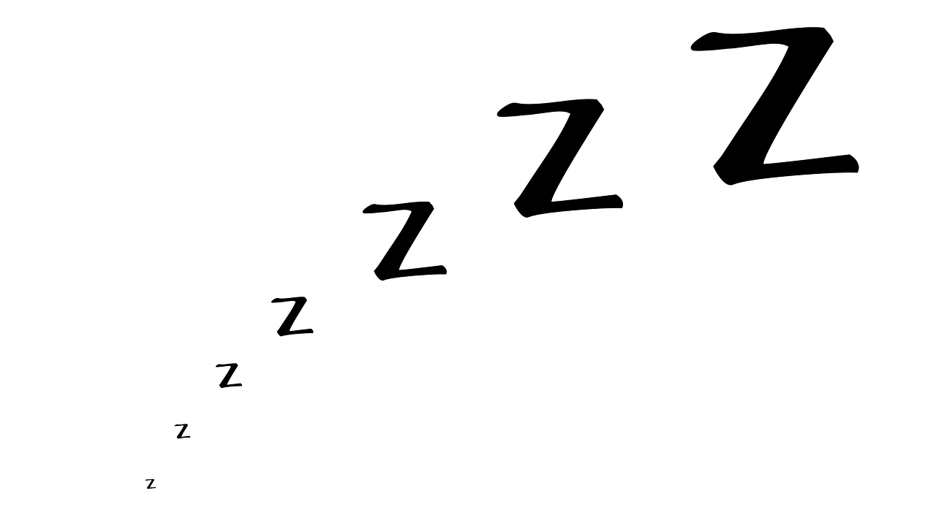
Scheduler: SLEEP()
1x scheduler (1)
1x worker (9)
1x server (8)

Slide 27
Helper file
python ~/mxnet/tools/launch.py -n 2 -s 2 -H hosts \
--sync-dst-dir /home/ubuntu/cifar10_dist \
--launcher ssh \
"python /home/ubuntu/cifar10_dist/cifar10_dist.py“
-n - number of workers that must be launched
-s - number of parameter servers that must be launched.
--sync-dst-dir - destination location where the contents of the current directory will be rsync'd
--launcher ssh -use ssh to login on each machine in the cluster and launch processes.
"python /home/ubuntu/dist/dist.py" - command that will get executed in each of the launched processes.
-H specifies the list of hosts in the cluster to be used for distributed training.

