Slide 1


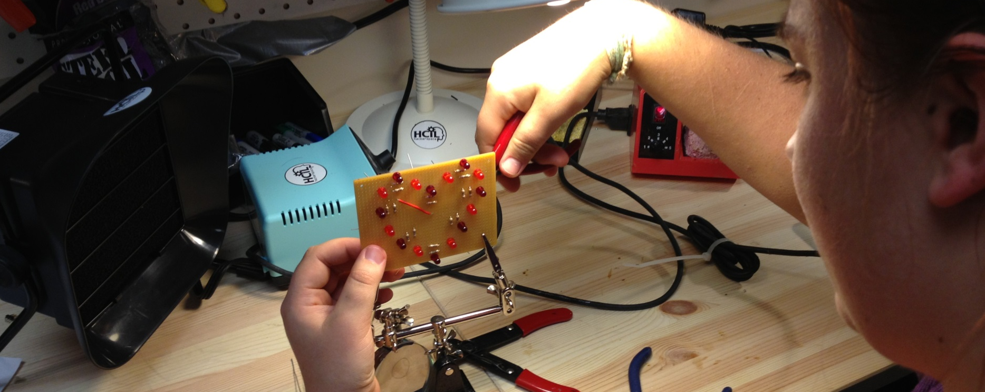
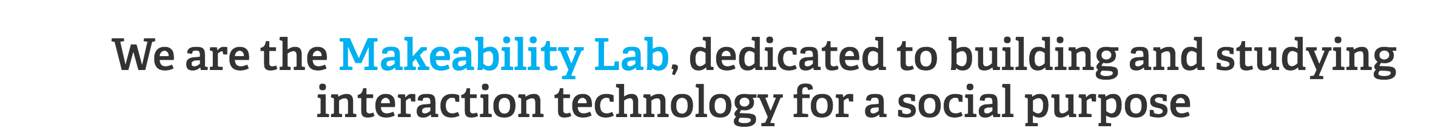





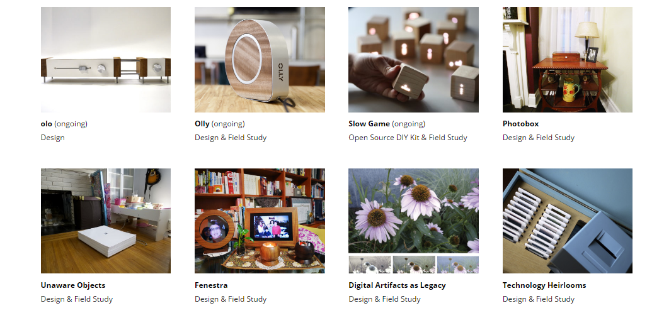
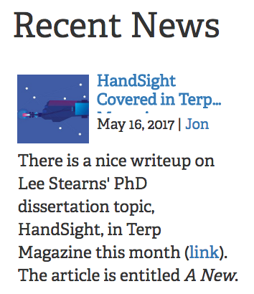
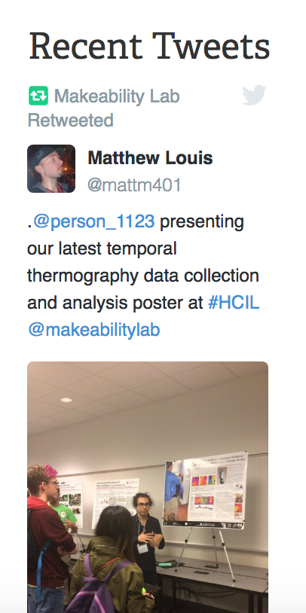
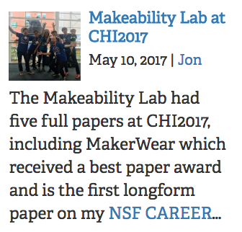
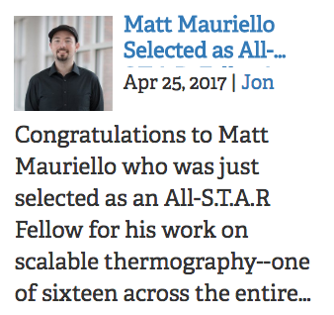
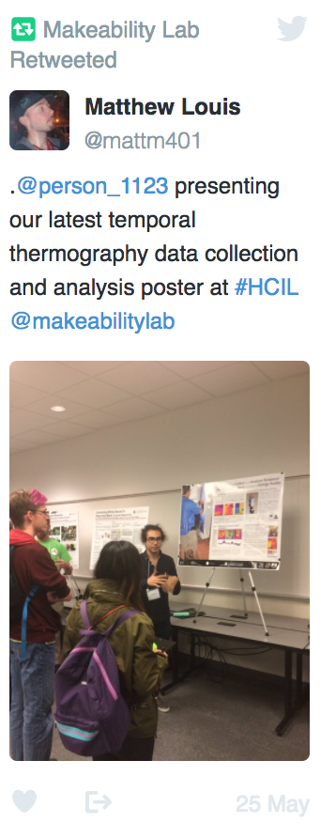
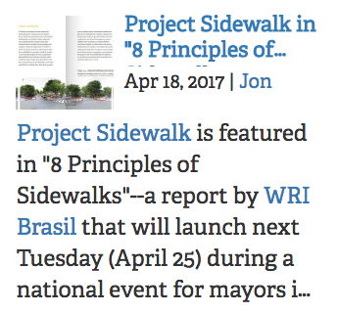
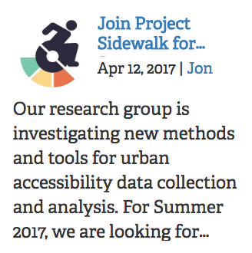
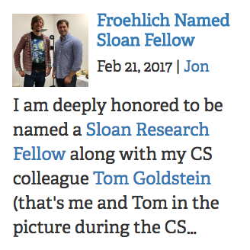

ML
makeability lab
home projects publications talks people hcil
Recent Projects
Project 1 (2017)
Sustainability, fabrication, health
Project 1 (2017)
Sustainability, fabrication, health
Project 1 (2017)
Sustainability, fabrication, health
Project 1 (2017)
Sustainability, fabrication, health

Slide 2
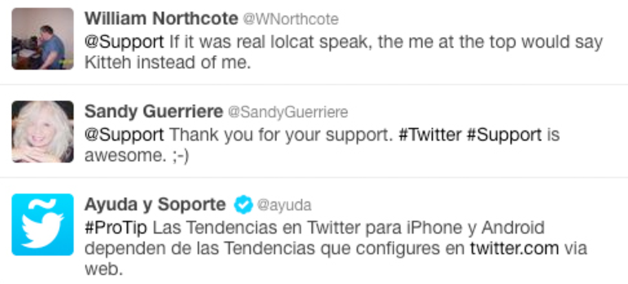
ML
makeability lab
home projects publications talks people hcil
Recent Projects
Project 1 (2017)
Sustainability, fabrication, health
Project 1 (2017)
Sustainability, fabrication, health
Project 1 (2017)
Sustainability, fabrication, health
Project 1 (2017)
Sustainability, fabrication, health

