Slide 1


Slide 2
@jon_fuller
practicing apprentice
not MongoDB expert (sorry)
not SQL/RDBMS expert (not sorry)
Notes:
This’ll go a lot better if we have a conversation rather than me up here talking the whole time.

Slide 3
Huh?
Notes:
Just to get a feel…
who has heard of NoSQL?
who has used any NoSQL datastore?
who has used MongoDB?

Slide 4
Let’s Be Clear

Slide 5



Us vs. Them
Notes:
In interest of full disclosure, and interest of me saying something that comes across wrong
This is NOT an us vs them proposition
The point is, we need to be deliberate about the choices we make about persistence instead of always just assuming RDBMS like we have for the last however many years.
Today I’ll be focusing on alternative strategies, but I’d like to be clear that I’m not trying to paint the picture of we’re awesome, they’re not

Slide 6
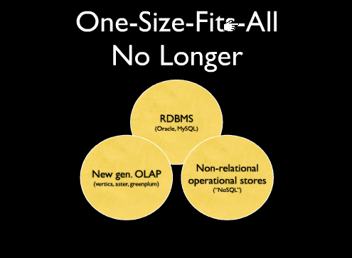
One-Size-Fits-All
No Longer
Notes:
The general idea is that
RDBMS fits sometimes.
OLAP fits sometimes.
Document stores fit sometimes.
Key/Value stores fit sometimes.

Slide 7
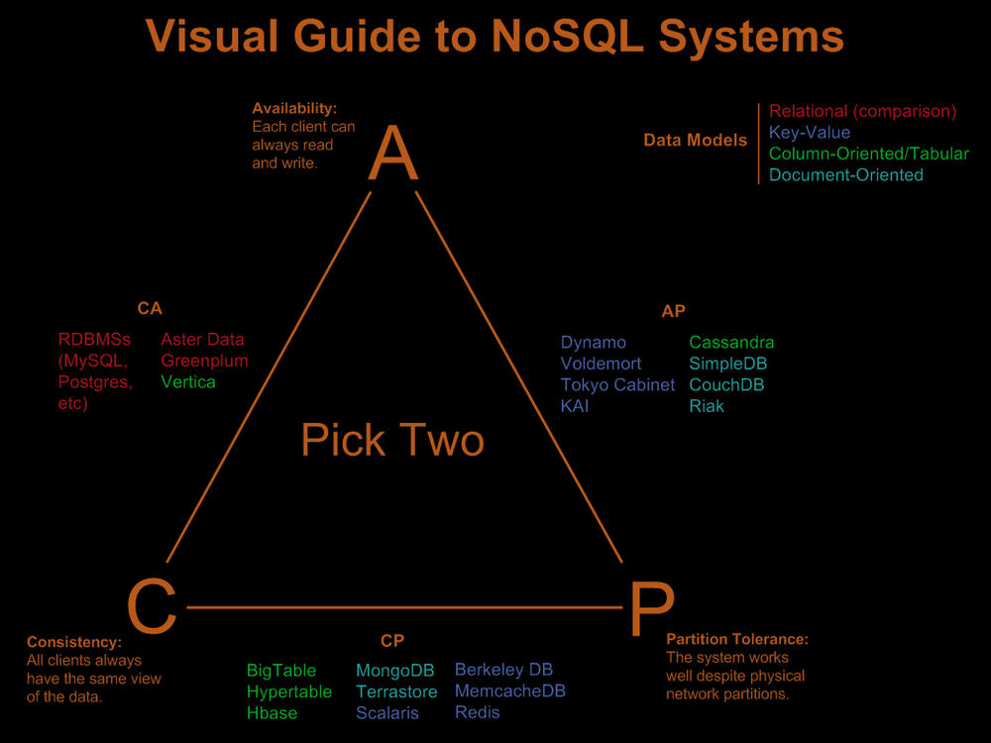
Notes:
cap theorem
says you get to pick two (sort of like the golden triangle of quality/budget/scope triangle of software systems)
you can see mongo lives down in the bottom CP, which means it aims at being consistent, and handles physical network partitions well

Slide 8
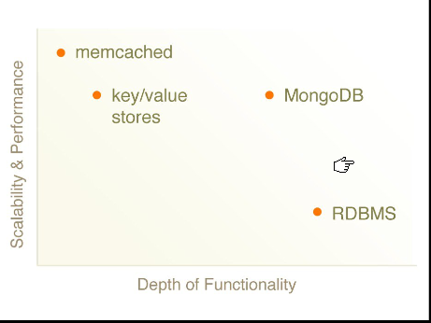
Notes:
here’s just a simple diagram showing where on the scale mongo fits with features and performance.
you can do some crazy things with RDBMS, but at the sacrifice of scalability and performance (unless you like to pay $$$$)
key value stores and memcached give you a really simple model to work against, but that’s basically it as far as your programming model. the good thing is they can scale horizontally very easily since it’s just a ‘hashtable’
mongo attempts to bridge that gap by providing webscale/cloudscalability out of the box, but also allowing a richer programming model.

Slide 9
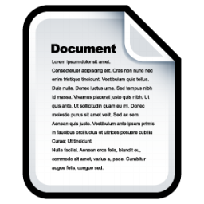
Document DB
first_name: ‘Jon’
last_name: ‘Fuller’
address:
line_1: ‘659 Danforth’
line_2: ‘Apt 234’
zip: 46032

Slide 10
NoSQL
Notes:
Meaning we don’t use SQL like we always do with RDBMS… we’ll see later how we do query though

Slide 11
NoSchema
Notes:
Take a deep breath and take the plunge… it’ll all be okay.
It’ll all boil down to “semi-structured” data

Slide 12
No Joins!
(sort of)
Notes:
Since all the data for a given item is likely contained within a given document…most joins will be eliminated.

Slide 13
Client
Notes:
And since we don’t have joins, sharding becomes a whole lot easier, because all the data will be local on a given box. Allowing us to scale horizontally with commodity hardware.

Slide 14
New Models
Natural DDD Anyone?
Notes:
And the cool side effect all of this has on our software, is that we’re going to come up with new and interesting models and architectures

Slide 15

New Models
Notes:
It all starts with an idea
Awesome
Change the world
Mobile, Web, Kindle, Desktop

Slide 16

Paperless
Notes:
I HATE papers
I HATE filing paper
I HATE it when it stacks up on my table
Get RID of it!
So I’m gonna make this app, and it’s going to have to store data.
I start going into analysis paralysis, DB? ORM? NH/FNH? Subsonic? SQL Server/MySQL? Ugh.

Slide 18

JSON
{
first_name: ‘Jon’,
last_name: ‘Fuller’,
address: {
line_1: ‘659 Danforth’,
line_2: ‘Apt 234’,
zip: 46032}
}
Notes:
Our documents are structured-data. They are represented in our applications like JSON.
BSON

Slide 19
Table:RDBMS::Collection:MongoDB
(sort of)
Notes:
But it’s even a little more structured than just a bunch of documents floating around
We’ve got these things called collections.
They are kind of like tables, but not really.
They hold a set of related data.
Collections, however, hold documents, so they aren’t flat like tables.

Slide 20




Collections
Birds
Notes:
Here’s where part of the schema free comes into play.
There are no mechanical constraints in the database to tell you to not store cheeseburgers next to your birds.
But if you think about it… do you let your database tell you that now?
No, you’d never think about storing cheeseburgers in your birds table.

Slide 21
Static:Dynamic::RDBMS:MongoDB
(typing)
Notes:
Still structured, but no mechanical constraints
To me, it feels a lot like getting over that initial fear in Ruby.

Slide 22
db.papers.save({
date:’5/22/2010’,
tags:[‘paystub’],
views:0,
original_filename:’paystub.pdf’,
content: <BINARY>});
Notes:
So we’ve got some UI going (or something, and finally are ready to jam some papers into the database.
A couple important things here.
The first…
Papers is the name of the collection.
The first time you use it, it is created.
The thing we’re saving is a JSON document.
Note that tags is an array.
And content is just a byte array.
The database creates an _id key… it’s special
One important thing to note. most of these little snippets we see are what you’d enter at the mongo shell. the ideas translate to your programming language of choice… usually.

Slide 23
db.papers.save({
date:’5/22/2010’,
tags:[‘paystub’],
views:0,
original_filename:’paystub.pdf’,
content: <BINARY>});
Notes:
Anyone that has ever done a system dealing with content from files has been faced with this question:
Include the contents
Include a pointer to the file on a network share.
Both have their drawbacks and advantages.

Slide 24
GridFS
Notes:
A filesystem in the database.
Basically you get buckets to put things in, rather than directories.
It’ll chunk your files into pieces and store them inside the database.
It makes it super easy to push and pull files from your DB.
Most languages give you drivers that mimic the file io libraries of your platform.

Slide 25
db.papers.save({
date:’5/22/2010’,
tags:[],
views:0,
original_filename:’paystub.pdf’,
grid_fs_name: <SHA1 of file>});
Notes:
So, we’ll back up, and change the content to be a SHA1 of the file for uniqueness, and we’ll store the file itself in GridFS.

Slide 26
New Models
Notes:
So now we’ve got our app and we can put data into it… it might be useful to get data out of it?

Slide 27
Query
db.papers.find();
Notes:
This is sort of like select *

Slide 28
Query
db.papers.find();
db.papers.find({date:’5/22/2010’});

Slide 29
Query
db.papers.find();
db.papers.find({date:’5/22/2010’});
db.papers.find({tags:’paystub’});
Notes:
Even though tags is an array, it looks to see if paystub is in the tags array
This could be REALLY expensive
What if I’ve been using this thing for 10 years, have 1000 documents and 200 tags?
Ah, Index

Slide 30
Index
db.papers.ensureIndex({tags:1});
db.papers.find({tags:’paystub’});
Notes:
Since Mongo speaks JSON, it can index into your documents easily.
The one turns it on
A zero would remove the index
Now we can query and it’ll be nice and fast

Slide 31
Query
db.papers.find(
{tags: {$all:[‘paystub’, ‘jon’]}});
Notes:
This is really useful because it makes sure ALL the things in the given array are present in the target array.
So this would give me all of jon’s paystubs

Slide 32
Query
db.papers.find(
{tags: {$all:[‘paystub’, ‘jon’]}});
db.papers.find(
{tags: {$in:[‘paystub’, ‘jon’]}});
Notes:
$in is kind of the converse. If any of the items in the target array are in the given array, it’ll match.
So this will give me all of jon’s things, and all of the paystubs.

Slide 33
New Models
Notes:
So now we can get data in and out
It might be useful to be able to change information?

Slide 34
Update
db.papers.update(
{_id:<ID>, {$inc: {views:1}}});
Notes:
Mongo provides several atomic functions.
$inc here is one of them
We could do the whole
Get
Update
Save
routine, but that causes network traffic and the ability to get out of sync, if we’re using an ORM.
This makes for a fast, succinct operation.
However, if we’re using sprocs, we can get similar functionality already in a relational system

Slide 35
Update
db.papers.update(
{_id:<ID>, {$push: {tags:’jon’}}});
Notes:
A couple more examples…
This lets us push a value into an array

Slide 36
Update
db.papers.update(
{_id:<ID>, {$pull: {tags:’paystub’}}});
Notes:
And pull a value from an array

Slide 37
Notes:
We’re done
It’s awesome
We changed the world
Just like twitter and facebook. people can now be paperless on the toilet… wait… bad idea
Either way EVERYONE is using your app!

Slide 38

Notes:
And along comes the fail whale

Slide 39
Shard
Shard
Shard
Client
Notes:
Sort of like a machine index in addition to other indexes.
The client doesn’t know the difference, but the data is distributed horizontally across machines, with potentially commodity hardware.

Slide 40
Notes:
So now we’re back to happy with our app, and all is sane again, and we’re making money (or at least changing the world and NOT filing papers anymore)

Slide 41
Notes:
we’ll pause here and try to answer any questions or catch up on anything I might’ve forgotten to mention.
since we’ve got a little bit of time left over, I’ll try to give you a heads up on a few more pretty cool things about mongo.

Slide 42




Available Platforms
Notes:
in x86 and x64, for each.
and the cool thing is, it’s not ridiculous to get running on any of these either. you unzip the package, and run the executable
dead simple, no lengthy, troublesome installations and possible missing required components/dependencies that you need to track down

Slide 43
Map/Reduce
function(){
this.tags.forEach(
function(tag){
emit(tag, {count: 1}); })
}
function(key, values){
var total = 0;
for ( var i=0; i<values.length; i++ ) {
total += values[i].count;
}
return {count: total};
}
Notes:
mongodb has a full javascript interpreter on the backend (spidermonkey), so it natively understands javascript.
with map/reduce, you can give it two javascript functions, and handles the rest (machine balancing, etc.)
this example counts the number of times each tag is used
map: loops over each tag, and returns the tag, and it’s count
the reduce, gets a key, and some values. this function can be called many times over. so the key will be any given tag, and it’s values will be just a bunch of ones (the first time around)
but the next time around,after we’ve given it a value back of something like 10, the next time it might be adding some ones, and a 10 together.

Slide 44
C#
NoRM
http://github.com/atheken/NoRM/
mongodb-csharp
http://github.com/samus/mongodb-csharp
Notes:
norm
gives you strong typing of your documents, and full linq support
mongodb-csharp

Slide 45
mongodb.org
try.mongodb.org
github.com/jonfuller/paperless
github.com/jonfuller/presentations
Comments/Questions/Feedback
(please!!)
Notes:
Resources:
Fail whale: http://upload.wikimedia.org/wikipedia/en/d/de/Failwhale.png
Cheeseburger: http://www.iconarchive.com/icons/aha-soft/food/256/burger-icon.png
Light: http://www.flickr.com/photos/mr_beaver/3486761520/
Document: http://icons2.iconarchive.com/icons/deleket/sleek-xp-basic/256/Document-icon.png
MongoDB Logo: http://www.mongodb.org/download/attachments/132305/logo-mongodb-ondark.png
Red and Black Birds: http://www.inspiredm.com/2009/04/12/the-social-bird-icon-set-the-first-inspired-release/
Twitter Bird: http://www.truerwords.net/6118/enclosure/twitterific.png
Neo vs Smith: http://www.users.sbg.ac.at/~0020358/img/Neo_vs_Smith.jpg
Feature diagram: http://media.tumblr.com/tumblr_kwc24gHxBz1qappj8.png
One Size Fits All - http://media.tumblr.com/tumblr_kwc23k4MNm1qappj8.png
CAP diagram - http://blog.nahurst.com/visual-guide-to-nosql-systems#

