Slide 1
dealing with dependencies
taking your architecture to rehab

Slide 2
me
I Am:
@jon_fuller
practicing apprentice
SEP
I Am Not:
expert
all-knowing
Notes:
you very well may ask questions I don’t know answers to… so if someone else has the answer, please chime in.
PLEASE interrupt me at any time during the presentation/conversation to ask a question or otherwise.

Slide 3
simplicity
Notes:
our focus here is going to be about managing all the complexity that comes into your system because of dependencies. it makes your systems tough to manage and inflexible.
we’ll try to see how it can be much simpler than how you’re wiring everything together now.
simplicity can mean a lot of things…

Slide 4
flexible

Slide 5
maintainable

Slide 6
testable

Slide 7
agile

Slide 8
low coupling
Notes:
I’m hoping, for my sake, not for yours I wouldn’t want to wish you harm that these things are important to you, and that you want to help figure out how to achieve them in your system.

Slide 9
acronym overload
DIP
IoC
OMG!
DI
WTF?
Notes:
We see these acronyms thrown all around when we’re talking about this topics, often interchangeably. Throughout the rest of the talk, hopefully we’ll figure out what they mean, and that they are distinct.

Slide 10
Single Responsibility Open-Closed Liskov Substitution Interface Segregation Dependency Inversion
DIP

Slide 11

DIP
Thou Shall Invert Dependencies
Notes:
Uncle Bob wrote an excellent paper on the DIP. It’s definitely worth a read, it’s up at objectmentor.com… or if you can’t find it, let me know and I’ll help you out. What does invert dependencies really mean. Anyone?

Slide 12
Security
Handler
Uses
Login
Service
DIP
Notes:
I’m not gonna use formal UML here, because I’m not that smart. That being said, the shape and direction of the arrows don’t really have significance other than the direction I feel the “dependency” is flowing. However, if you take a look at Uncle Bob’s Paper, you can see real UML if you’re a fan of that. I however, am not. Discuss diagram.

Slide 13
Security
Handler
Uses
Login
Service
Active Directory
Exchange
DIP
Notes:
So this is great until you realize your security handler now depends on exchange working in order to work.
How do you test this?
What if the guy working on the AD service isn’t done yet?
What if we ordered the Exchange server, but it isn’t here yet?

Slide 14

HIGH LEVEL MODULES SHOULD NOT DEPEND UPON LOW LEVEL MODULES . BOTH SHOULD DEPEND UPON ABSTRACTIONS.
Security
Handler
Uses
ILogin
Service
Login Service
Is A
DIP
Notes:
We introduced the ILoginService abstraction upon which both the security handler depends on (with a uses relationship) and the login service depends on (with an imlementation/inheritance) relationship.
They each now only depend on the abstraction, and neither directly on one another. The dependency has been inverted, and the concrete dependency has been broken.
Now, if Dean, working on the LoginService is on vacation while I’m trying to write the Security Handler, I can still get completed, since I know longer care about his implementation, only about the interface.

Slide 15
X
Y
90˚
DIP
Notes:
Orthogonality.
With this inverted dependency in place we get the benefit of orthogonality.
Now since we only depend on abstractions, rather than concretions we can change these to modules independently.
Concerns of one module don’t project onto the concerns of the other.
Changes to one won’t affect another.
However, if the semantics or interface changes, then, obviously, we’ll have some work to do.

Slide 16
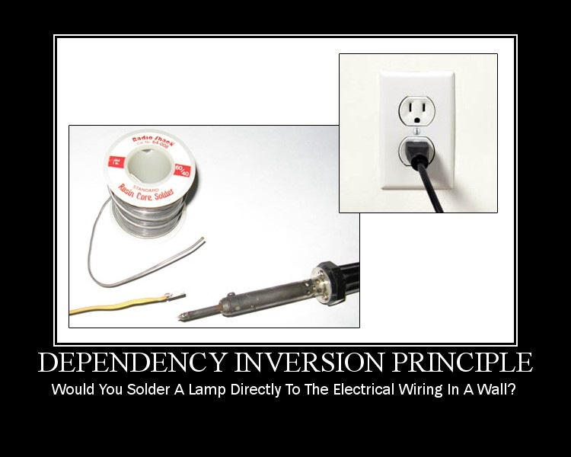
DIP
Notes:
So we’ve broken our concrete dependencies (or at least we know how).
We need to somehow wire our implementations together.
http://www.lostechies.com/cfs-filesystemfile.ashx/__key/CommunityServer.Blogs.Components.WeblogFiles/derickbailey/DependencyInversionPrinciple_5F00_0278F9E2.jpg

Slide 17
service location & factories
DI
Notes:
I think the first natural place to go is service location.
You shove everything behind a global object/static gateway and pull our your dependencies.

Slide 18
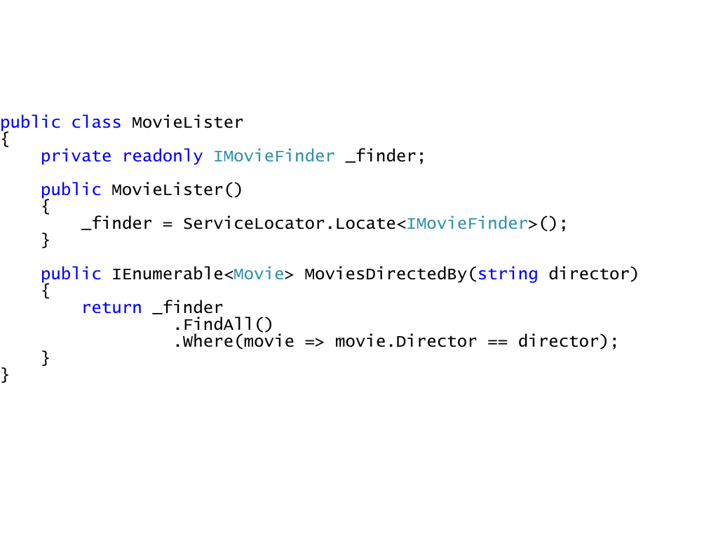
DI
Notes:
At this point, we’ve basically traded dependencies. We got rid of ImdbMovieFinder dependency but picked up the ServiceLocator one.
That being said, this is probably the lesser of two evils. It’s slightly more flexible.
We’ve still got a bit of a smell though… the dependencies aren’t explicit.
You can’t tell what this class needs, unless you look inside of it, at the implementation. Imagine using a library, and having to look at the source code to figure out what you need to register in your service locator to make it work?
The idea is to make your implicit dependencies explicit, by declaring them, somehow.
Also, depending on the implementation of your service locator, it may be difficult to reconfigure at deployment or runtime which finder gets used.
That being said, this works pretty well, is easy to understand and is better than hard-coding all your dependencies.
Let’s see a better way…

Slide 19
dependency injection
DI
Notes:
Dependency injection is the act of injecting your dependencies (whether they’ve been inverted or not) into the consuming class of the service or dependency.
We saw a minute ago how the consumer was pulling dependencies in. We’re going to flip that upside down, and pass them into the consumer.

Slide 20
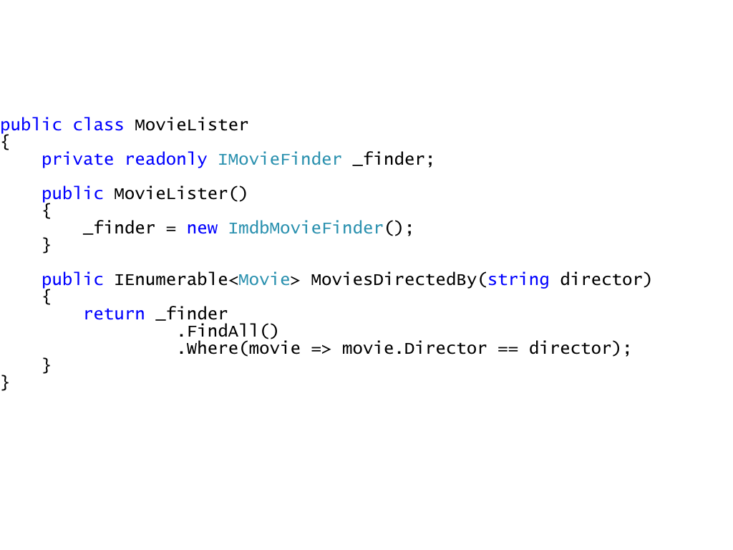
DI
Notes:
no injection

Slide 21
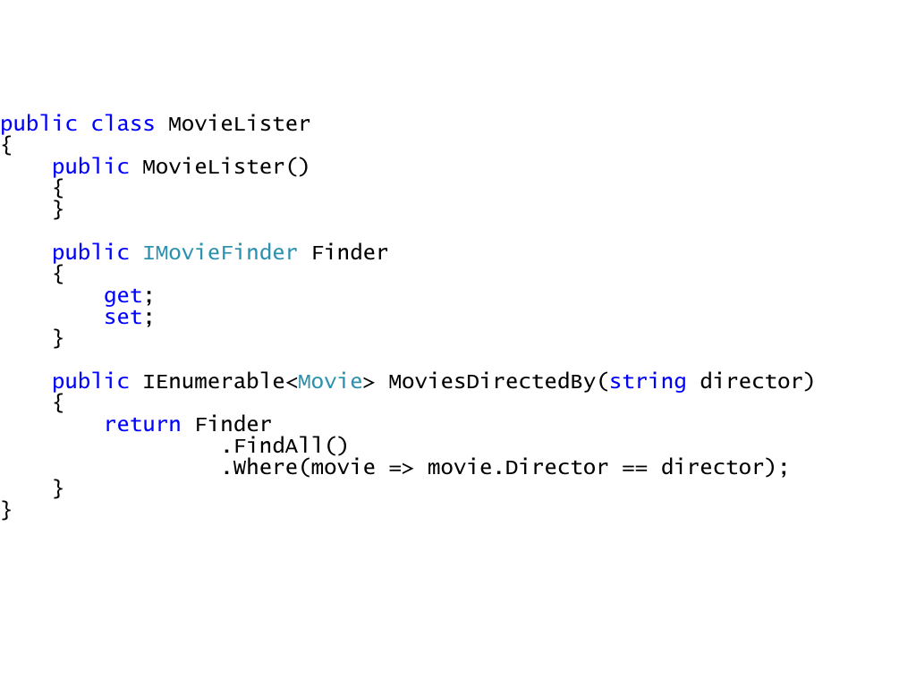
DI
Notes:
property injection
Java guys like to do it this way

Slide 22
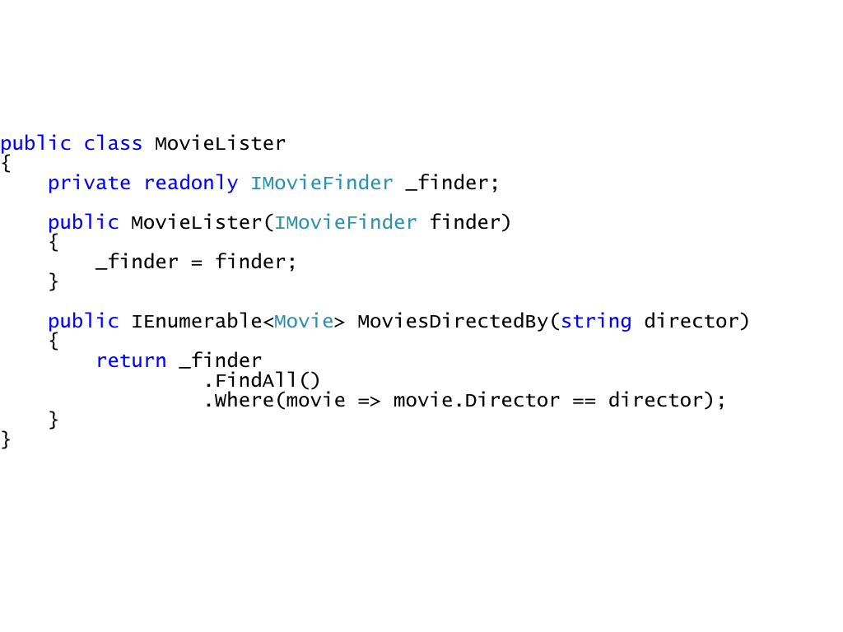
DI
Notes:
constructor injection
.NET guys (myself included) like to do it this way.
You can see now, how the dependencies are explicitly stated up front, when the class gets created.

Slide 23
poor man’s DI
DI
Notes:
Poor Man’s DI is:
Easy to understand
Low barrier to entry way to start doing DI.

Slide 24
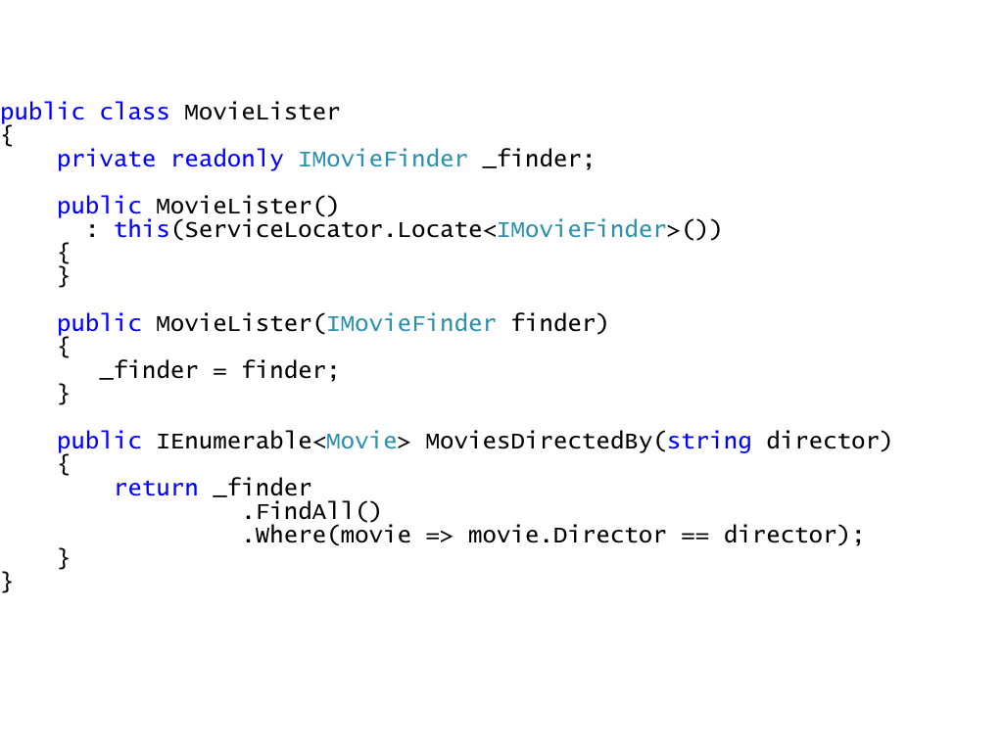
DI
Notes:
PMDI
You can use one version during test (the DI version, so you can mock things) and use another version in production code.
There may be legitimate reasons for doing this, but I can’t think of any…
In the long run, you’ll be better off to have just went without it, and went with a framework/tool instead.

Slide 25
simplicity
WTF?
Notes:
so I originally stated this was all in the name of simplicity…
does it feel like we’ve gotten simpler?
doesn’t really to me.
we’ve created some abstractions (which, arguably, make our system more difficult to understand)
and we’re manually wiring some of these things together.
How, if we don’t do PMDI or service location are our dependencies going to find each other?
Seems like we’ve just relegated ourselves to instantiating our dependencies one level higher, and then passing them down.
That does NOT sound like simplicity. Sounds like the same set of problems, just worse.

Slide 26
inversion of control
IoC
Notes:
Alright, here’s where this starts to get good.
The idea behind the general term is to give control to someone else. A framework, person, process, etc.
Things like RoR, WPF, Nunit are all instances of where you’ve given up control and let someone/something else do the work for you.
An IoC container is one other instance of this.

Slide 27
declarative
IoC
Notes:
What this allows us to do is be declarative… specify what, not how.
WPF allows you to declare your UI and how it interacts with its data.
RoR allows you to declaratively define your routes and URL structure.
This correlates to the hollywood principle. Don’t Call Us, We’ll Call you.
You place hooks into the process, and when it’s time, your hooks will be called.

Slide 28
container
IoC
Notes:
The container is simply that. In its most basic form it’s basically a mapping between interfaces and concrete implementations.
We’ll see soon though, that it’s much more than that.

Slide 29
free your mind
IoC
Notes:
what if I told you that you didn’t have to worry about your dependencies much at all? simply declare your dependencies in your constructors, and you get them for free, whenever you need them. Sound like magic? not really.
There is some well defined Reflection Kung-Fu going on, but nothing you or I couldn’t do given time. However, I don’t want to spend my time or my employer’s time working on this infrastructure stuff. So we’ll just use an existing container.

Slide 30
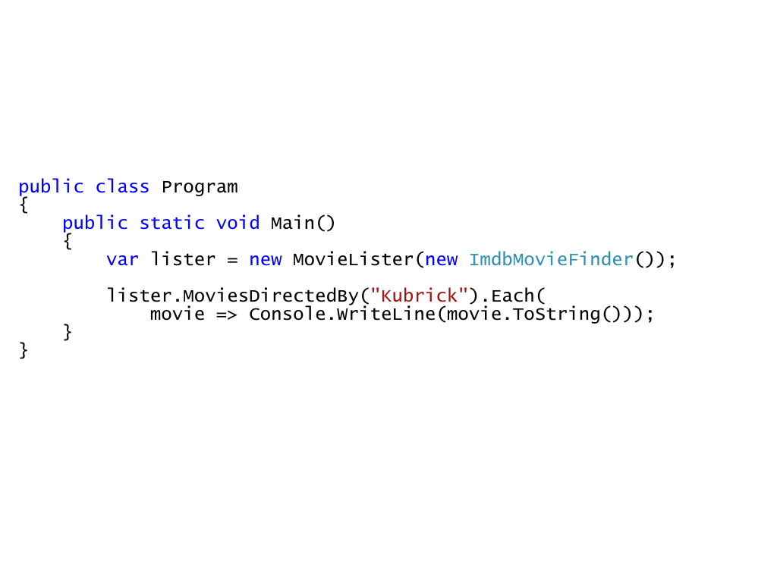
IoC
Notes:
Back to the manual DI example.
So here, we can see the dependency is manually injected.

Slide 31
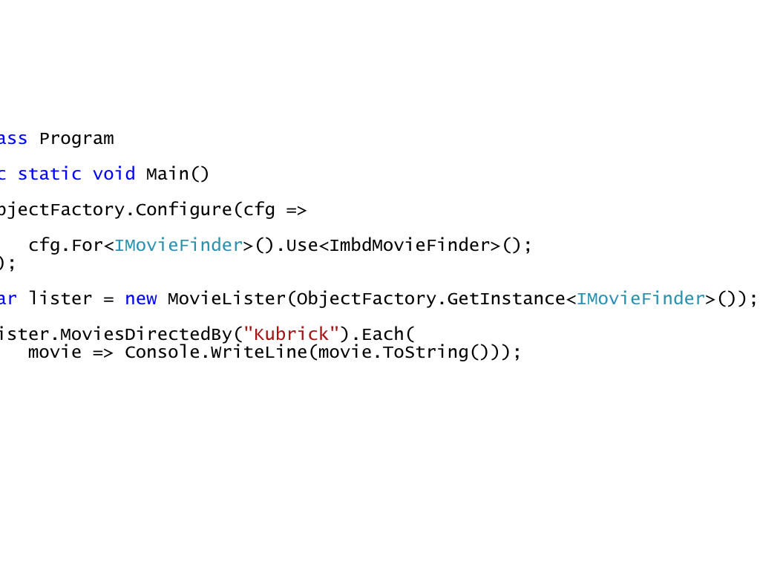
IoC
Notes:
Here’s an example using a container.
Sort of looks like ServiceLocation?
It sort of is, but with the power of a general purpose container behind it.
At this point, it’s really little more than a glorified Service Locator… and I think, though maybe not, this is what most people see, and then either stop using a container, or never take it further.

Slide 32
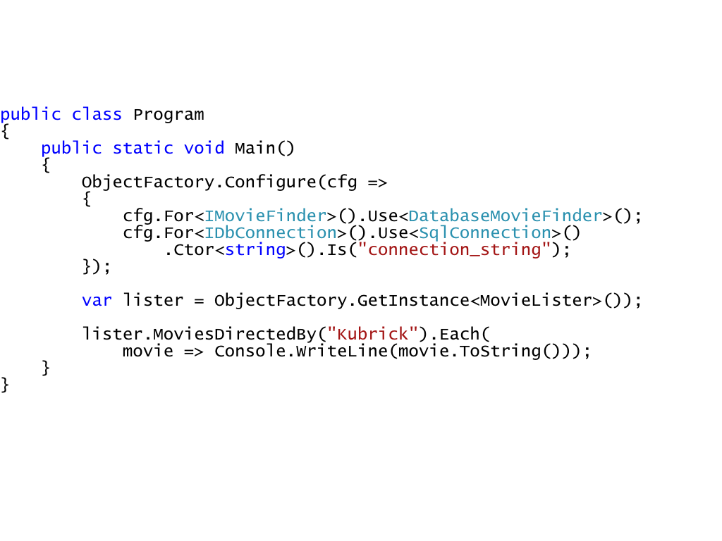
IoC
Notes:
The next major leap to take with the container is autowiring.
This may sound a little magic-y, or “over my head”, but its not really… pretty simple, lets see
CODE
You can start to see now how this code has:
Very low coupling
Reusable (if that’s your thing)
Verifiable
Orthogonal

Slide 33
conventions
Java
.NET
Dynamic
IoC
Notes:
Java guys and containers almost always prefer property setter injection.
The Java guys also LOVE to use XML and they love to use IOC… you’ll see tons of XML and IOC all over java projects.
They’ve been doing this for a long time, so watch out if you start evangelizing this stuff to a java dude.
.NET guys and containers almost always prefer constructor injection.
It also seems like the .NET guys like to configure their stuff in code with a fluent interface or internal DSL… and because we have REAL
generics (unlike Java) we use generics to express type information. And since we can configure things in code, we can do some more powerful
registration type things by default since we don’t have to have special xml handlers to do something out of the ordinary.

Slide 34
lifecycle management
IoC
Notes:
another great feature provided by the container is lifecycle management.
sometimes you might want a singleton, because it grabs a scarce resource handle (physical device), or because it’s expensive to create
sometimes you want something to be created once per web request
… new one every time (called transient, usually)
… X?
let’s look at an example

Slide 35
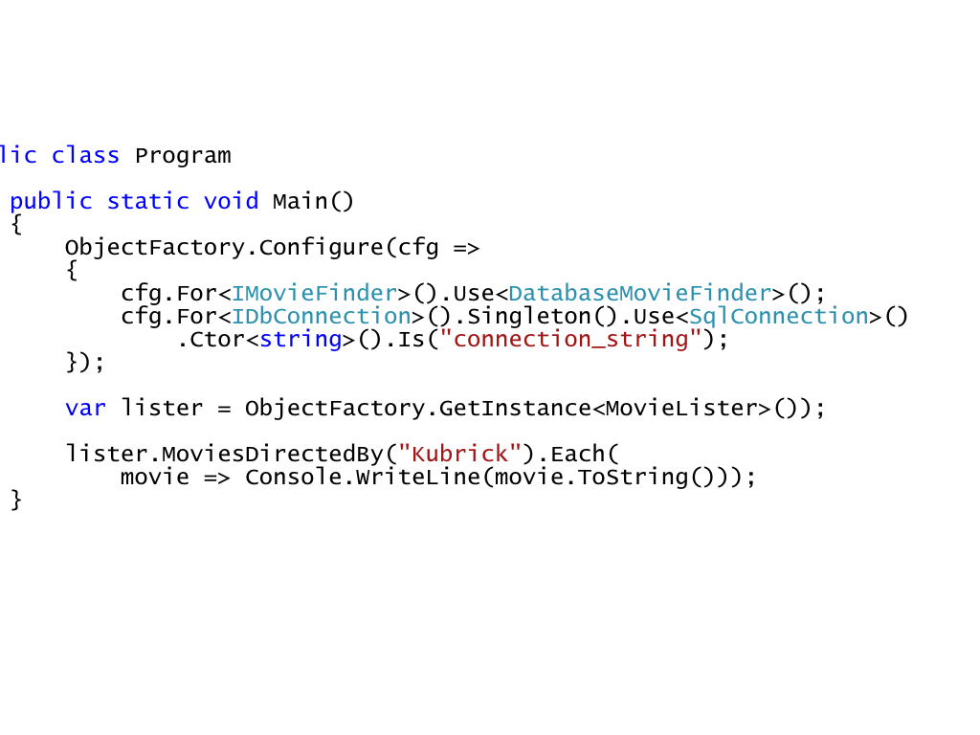
IoC
Notes:
Singleton
so yeah, you could still new up a new one of these things, which the singleton implementation pattern precludes you from doing…
this lets you to have the declarative nature and flexibility of the container, in case you want to change your mind about the whole singleton thing later.
it essentially separates the concerns of the singleton lifecycle and the singleton implementation pattern.

Slide 36
aop/interception
IoC

Slide 37
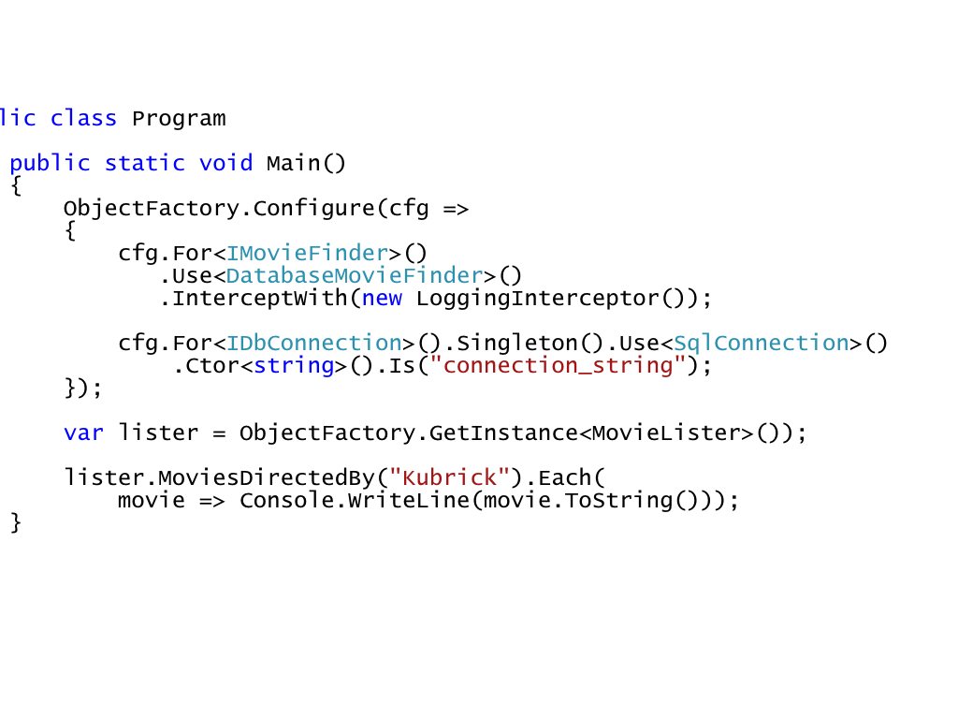
IoC

Slide 38
simplicity
Notes:
when do I use a container? normally.
it might feel overkill at first for simple applications, but it’s not really, once you get used to it, it’s really natural and is difficult to go back to not using one.
that being said, there isn’t really a hard and fast rule, you’ve gotta make the decision within the context of your project/solution/problem.
There is no replacement for critical thought, you’ve gotta think it through.
Usually a container will make things more simple, especially if your app is more than just a few lines long.
Just remember to focus on simplicity and maintainability.

Slide 39
?
@jon_fuller
fullerjc@gmail.com
github.com/jonfuller
Feedback please!
Notes:
when do I use a container? normally.
it might feel overkill at first for simple applications, but it’s not really, once you get used to it, it’s really natural and is difficult to go back to not using one.
that being said, there isn’t really a hard and fast rule, you’ve gotta make the decision within the context of your project/solution/problem.
There is no replacement for critical thought, you’ve gotta think it through.
Usually a container will make things more simple, especially if your app is more than just a few lines long.
Just remember to focus on simplicity and maintainability.

