Slide 1


NetCDF in R
R Working Group
Presented by: Jonathan Gendron
Date: 10/05/2022

Slide 2

Checklist
WSU
What is netCDF Data?
Why should I use netCDF?
How to read netCDF?
How to manipulate netCDF?
How to write netCDF?

Slide 3
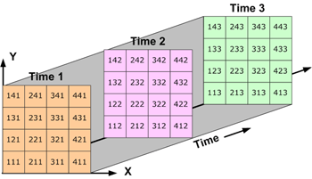
What is NetCDF Data?
WSU
Stores data as a multi-dimensional array (X, Y, Time, …)
Each array element value corresponds to the value of a variable at a certain point in space and time
Like raster format, but more than one time point
https://desktop.arcgis.com/en/arcmap/10.3/manage-data/netcdf/fundamentals-of-netcdf-data-storage.htm

Slide 4

Why NetCDF Data?
WSU
Standard for storing multi-dimensional gridded data.
Typically used in earth science discipline.
More efficient way to store large gridded data-sets than raster or tabular data structures.
Temporal differences are saved in the same file rather than multiple.
https://www.nanowerk.com/nanotechnology-news2/newsid=60843.php

Slide 5

Prerequisites for this lesson
WSU
Two R packages published in the CRAN database are used to read netCDF data:
“ncdf4”
“raster”
R Software Dependencies:
> install.packages("ncdf4", dependencies=T)
> install.packages("raster", dependencies=T)
> install.packges("tidyverse", dependencies=T)
> install.packges("fields", dependencies=T)
> install.packges("lubridate", dependencies=T)
> install.packges("data.table", dependencies=T)
Input Data Requirements:
Parent folder: NCDF_lecture
Ncdf_lecture.R (entire script)
World_vi.nc (practice NetCDF file)
Open RStudio now and do the following:
Load these libraries
Set your working directory to a folder containing the file “world_vi.nc”

Slide 6

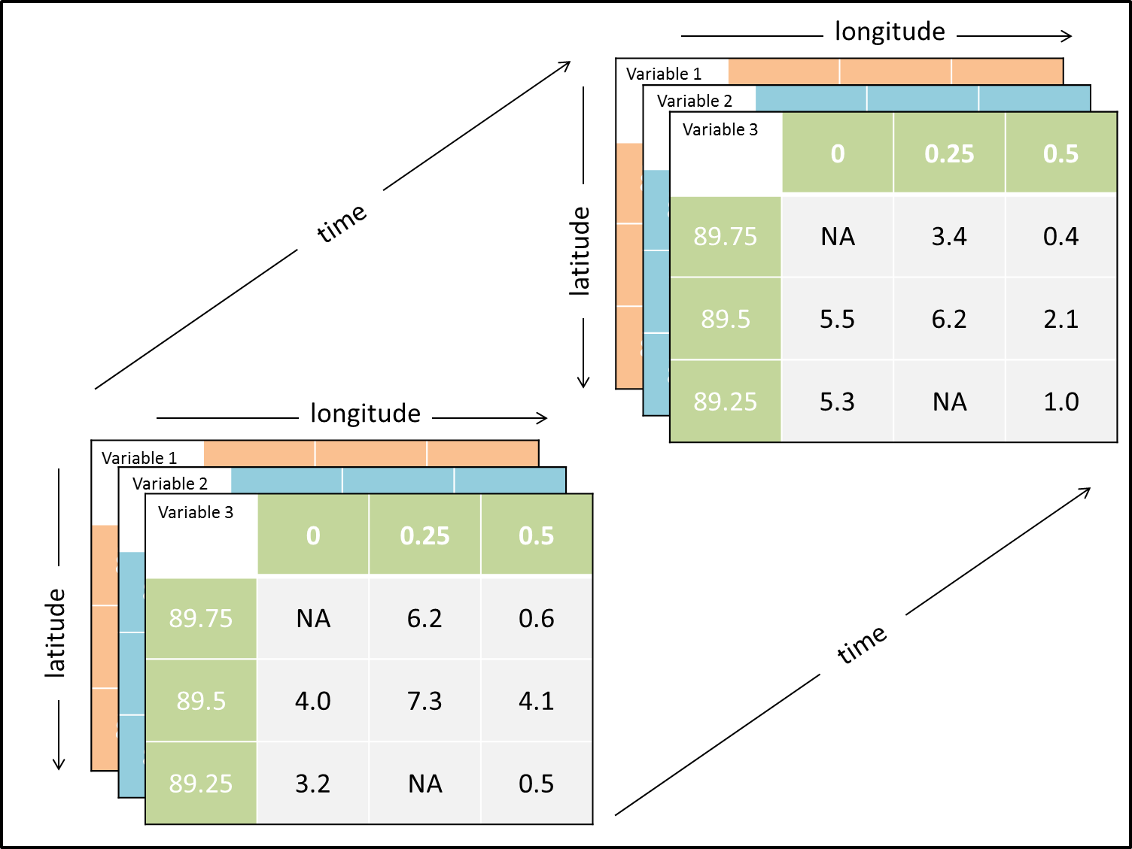
Challenge 1:
WSU
Create your netCDF File
Requirements (Suggested):
Dimensions:
Make your dimensions 3 x 3 x 3 (lon, lat, time) for your gridded array data.
Use arbitrary latitude and longitude coordinates such as 1, 2, 3, or use realistic geospatial coordinates of your choice
Use numbers to express your time dimension rather than a string of dates (doesn’t work)
Variable:
Make a 3x3x3 array of random values (or insert manually)
Attributes:
Use basic attributes such as “creation_date” or “author”
Start by assigning global attributes
https://simulatingcomplexity.wordpress.com/2014/11/17/working-with-netcdf-files-in-an-agent-based-model-skinning-the-model-input-data-cat/

Slide 7
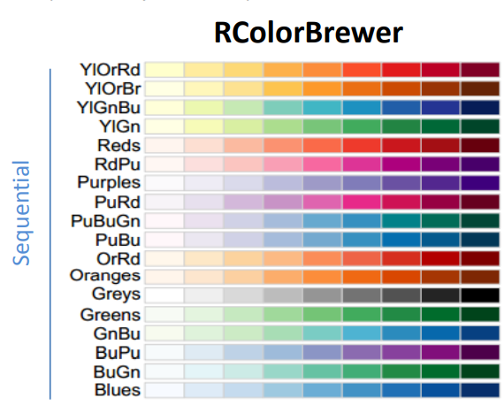
Challenge 2:
WSU
Plot your netCDF File
Requirements (Suggested):
First try to plot your data by manually extracting from the netCDF file, then try extracting data using the raster() package and plotting a raster stack.
First plot a single time slice (i.e. array1[,,1] or raster_stack@layers[[1]]), then trying plotting 3 x 3 plots in a single plotting window.
Experiment plotting with and without a legend (image() vs image.plot)
Experiment with changing the color palette (if you dare)
(hint) > hcl.colors(12, "YlGn", rev = TRUE)
(hint) Look to your right ☺

Slide 8

Challenge 3:
WSU
Manipulate your Data!
Requirements (Suggested):
Get the average of all time points in your netCDF file
Plot this as a single plot
Plot this plot as well as the original 3 time slices of your netCDF to compare
https://executivesupportmagazine.com/data-manipulation-in-microsoft-excel/

Slide 9
Questions?
WSU

