Slide 1

Mapper for Android
IE 5541: Project Presentation
Twin Cities Edition
April 23, 2012
Andrey Bruslavtsev Ian De Silva Jared Swanson Jonathan Lee
Kristin Dahl Sriram Rajendran Usha Kumar Weston Platter
Notes:
Kristin

Slide 2

Overview
The Minneapolis Skyway System and U of M “Gopher Way” can be difficult to navigate.
There are apps for iOS to help navigate the Skyway.
What about Android?
Notes:
Kristin

Slide 3
Project Objective
Video
Notes:
Kristin

Slide 4
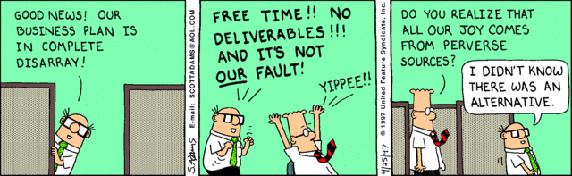
Deliverables
Notes:
Jon

Slide 5
Product Deliverables
Installable Android Application
Marketing & Distribution Materials
Notes:
Jon

Slide 6
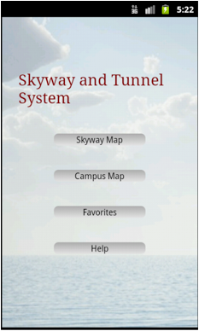
Major Functionalities
Map of Minneapolis Skyway
Map of U of M tunnel system
Search
Search History
Routing
Save Favorites
Help
Notes:
Jon

Slide 7
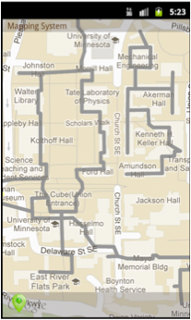
Map of Skyway/Tunnel System
Our app draws the skyway/tunnel system as a map overlay.
How?
Open source libraries and Android API
Google Maps: Provided map images
Google Earth: Tool to extract coordinate data
Notes:
Jon

Slide 8
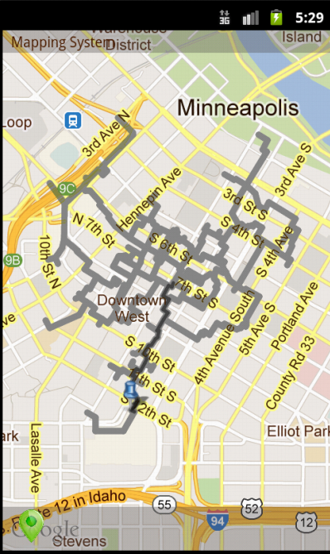

Search & Route
Our app allows users to search for nearby businesses
Yelp API - used to provide business data
Routing
Draw shortest path to destination based on current location
Location is updated via device’s native positioning system
Notes:
Jon

Slide 9
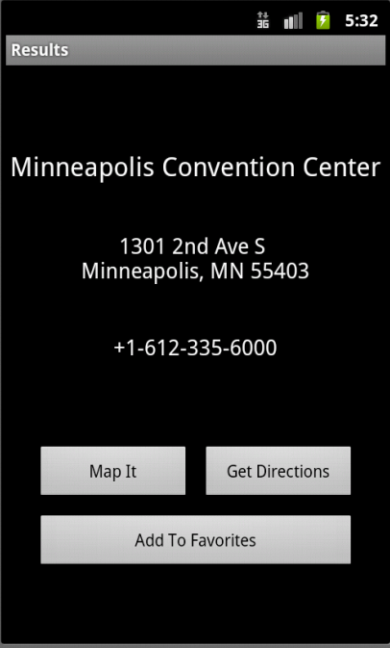
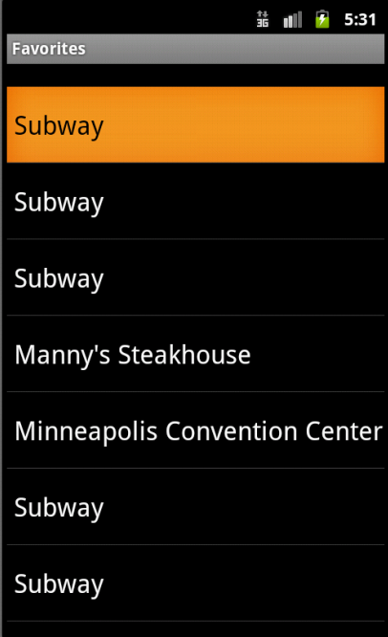
Favorites
Our app allows users to save a business as for quick access
Notes:
Jon

Slide 10
Marketing
Minnesota Daily
Contacted publishers
Interested – want to see additional functionality
Flyers created for campus and downtown Minneapolis
Facebook page
Android Marketplace
Appeal to general public
Notes:
Andrey

Slide 11

Notes:
Andrey

Slide 12

Notes:
Andrey

Slide 13

Project Approach
X
Notes:
Jared

Slide 14
Project Approach
Plan
Process
Risk Analysis
Notes:
Jared

Slide 15
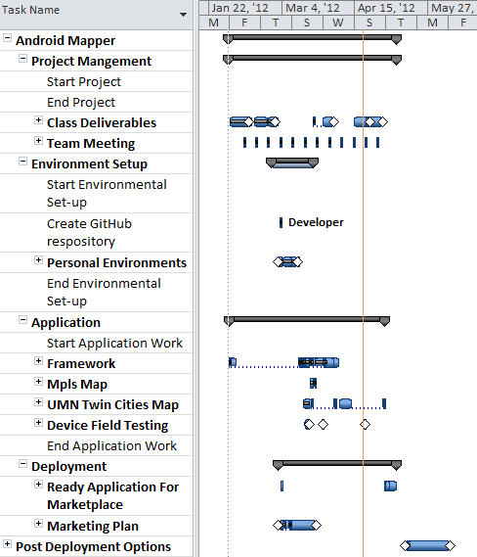
Plan: Baseline
Project Mgt.
Team Prep Work
Software
Development
Deployment & Future Work
Notes:
Jared

Slide 16
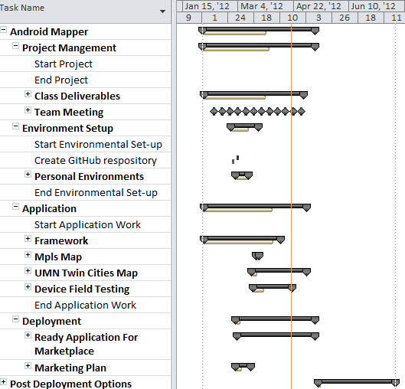
Plan: Current
Project Mgt.
Team Prep Work
Software
Development
Deployment & Future Work
Notes:
Jared

Slide 17
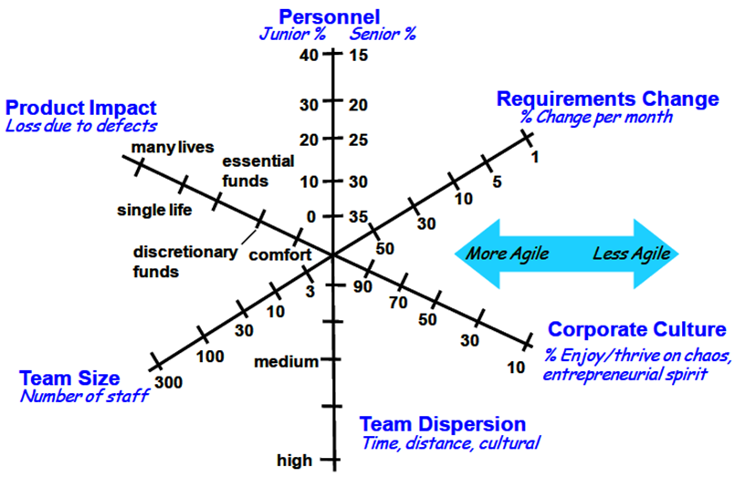
Approach: Processes
Diagram from S. McConnell, “Right-Sizing Agile Development,” 01-Oct-2008.
Notes:
Weston – What do you think our profile is?

Slide 18
Process: SCRUM
Contains Tasks
Scrum Meeting
2 week Sprint
(Iteration)
Sprint Planning Meeting (Kick-off)
Sprint Backlog
Sprint
Wrap-up
Meeting
Shippable
Product
(Prototype)
Req. 3
Req. 1
Contains Stories
Req. 2
Product Backlog
Notes:
Ian
- Product Backlog created from WBS in git.
Iteration planning meeting held to determine scope for iteration (Sprint)
Scrum meeting held weekly with an e-mail “scrum” on Wednesdays (lasted ¾ of the semester)
Sprint Wrap-up: Reflected on last iteration and tried to correct. We merged with planning.

Slide 19
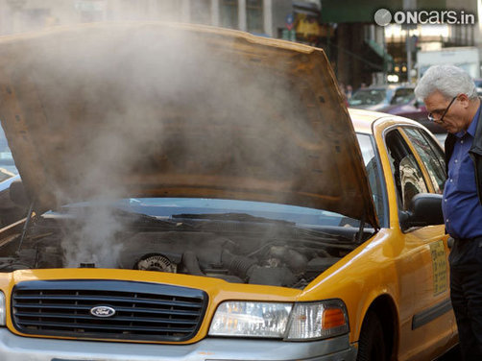
Problems: Process Breakdown
Varying acceptance of process
Time constraints toward end of semester
Resistance to testing in favor of increased functionality
Ineffective communication
Image from:
http://atozautocar.com/car-how-to/3540/solve-overheating-car.jsp
Notes:
Ian
Talk to: We had lots of communication, it was just ineffective.
1) Agreed understanding of the situation, claim responsibility for follow-up.
11) Understood tasks, but did not understand integration.
What was lacking:
Integration tie-in points

Slide 20
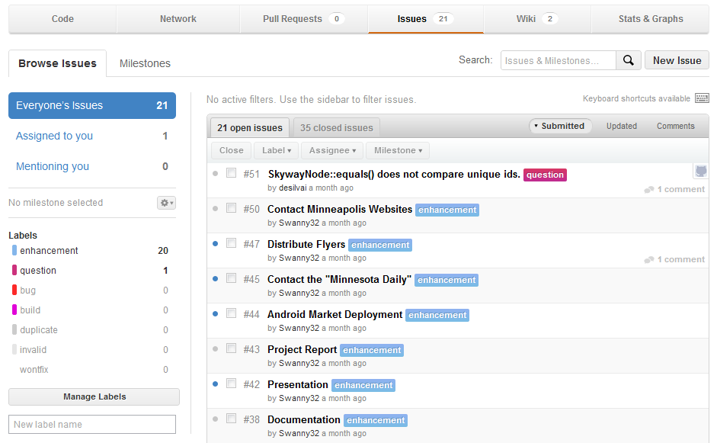
Problems: Process Breakdown
Notes:
Ian
Talk to: We had lots of communication, it was just ineffective.
1) Agreed understanding of the situation, claim responsibility for follow-up.
11) Understood tasks, but did not understand integration.
What was lacking:
Integration tie-in points

Slide 21
Problems: Ineffective Communication
<Picture>
Lack of time
Size of team
Notes:
Weston:
Lack of time
Size of team

Slide 22
Failed Communication
Marketing
Failed to integrate
Team
Technical Work
Software Development
Notes:
Weston

Slide 23

Risk Analysis
Risk – mitigation strategy
Code quality of application – testing
Complexity of project scope – reduce scope
Licensing issues with employers – release
Image from: http://cache.virtualtourist.com/15/4933424-Supja_Stina_tightrope_walking_Sveta_Nedjelja.jpg
Notes:
Weston

Slide 24
Lessons Learned
Notes:
Usha

Slide 25
Lessons Learned
What Worked
Execution
Well-defined processes , helped us to be dynamic
Clear task identification
Good development & co-ordination tools
Timely identification of risk
Team Dynamics
Weekly Team meetings
Motivated & responsible team
Technical
Learned about Android programming
Learned about team dynamics
Notes:
Usha

Slide 26
Lessons Learned
What Didn’t
Execution
Communication plan
Virtual SCRUM
Meeting documentation
Quality was compromised for functionality
No at-a-glance way of tracking
Technical
Coordination tools
Learning curve
Notes:
Usha -- Are you going to talk on what we’d do differently next time?

Slide 27
Lessons Learned
What could have been done
Execution
Close monitoring of task progress
Active use of task tracker, for better utilization of resources.
Team Dynamics
Daily tele scrum
Forum to discuss issues and sharing ideas.
Technical
Knowledge sharing sessions
visual configuration management tool
Notes:
Usha

Slide 28
Future?
Aesthetics
Skyway closures
Indicate floor changes
<More?>
Notes:
Sri

Slide 29

Questions?
Notes:
Sri

