Slide 1
ETL Project Summary(1)
Project 1
Background: Summarize certain NBA players career performances.
Summary:
E (Extraction): 2 open sources,
www.kaggle.com
NBA-API
T (Transform): For each year, summarize the teams they used to play for, personal scores, FG%, FT%, assists and blocks.
L (Load): Define the schema then loaded into SQL database for easily control and readability.

Slide 2
ETL Project Summary(2)
Project 2
Background: Use Census API and get the rent affordability and do web scraping to confirm the rent affordability data is in line with the web scraping data
Summary:
E (Extraction): Using Census API & Web Scraping, gather data including household income and median gross rents by zip code
ACS5 Census API
http://mentalfloss.com/article/85668/11-most-affordable-cities-us
T (Transform): Calculate the Rent Affordability rate(median gross rent/household income) and do data munging (drop NaN and delete Null data etc) and save csv file
L (Load): Define the schema then load into SQL database for easy control and readability.

Slide 3
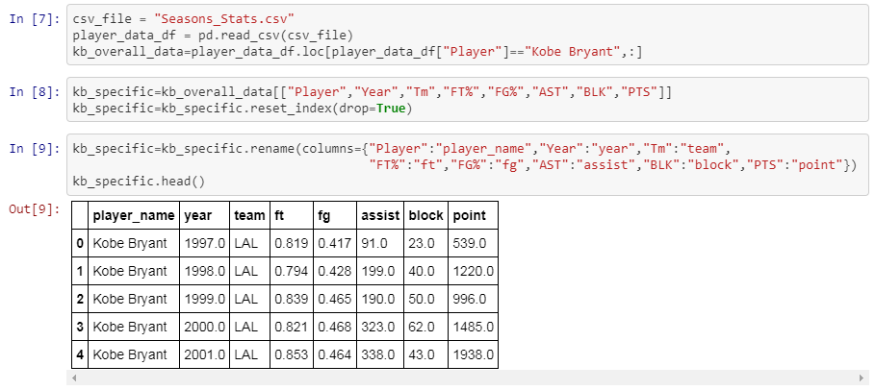
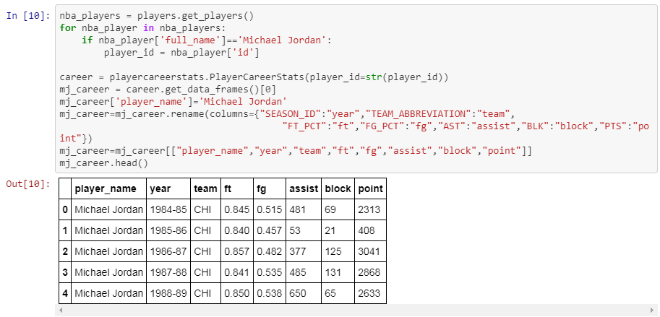
Extract and Transform(project 1)
Get Kobe Bryant’s performance raw data from Kaggle.com while Michael Jordan’s performance raw data from NBA-API.
Reserve year, team, FT%, FG%, assist, block and points.
Kaggle.com
NBA API

Slide 4
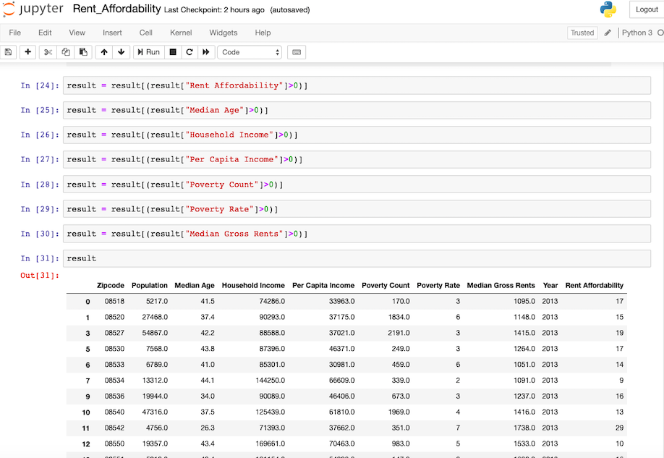
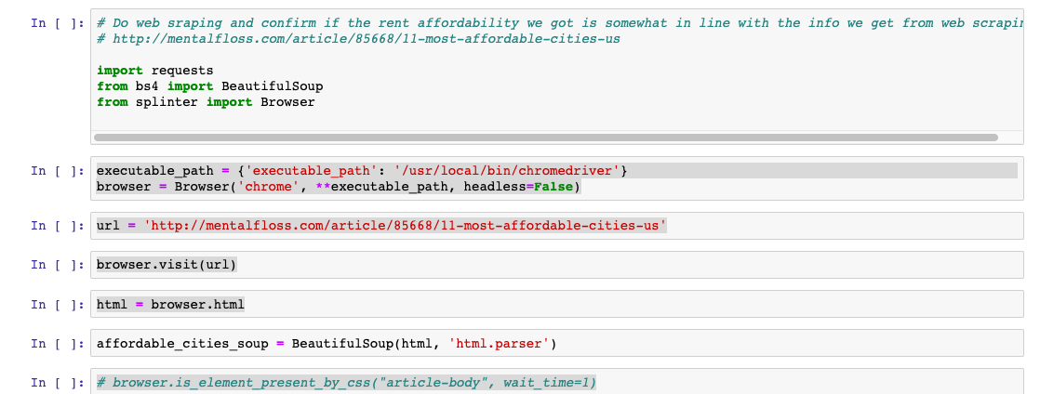
Extract and Transform(project 2)
Get census data from ACS5 Census API for each year during 2013 ~ 2017
Merge the data and calculate the rent affordability and munge the data
Do web scraping and use zip code for the most affordable cities and confirm the rent affordability data relevance
ACS5 Census API
Web Scraping

Slide 5
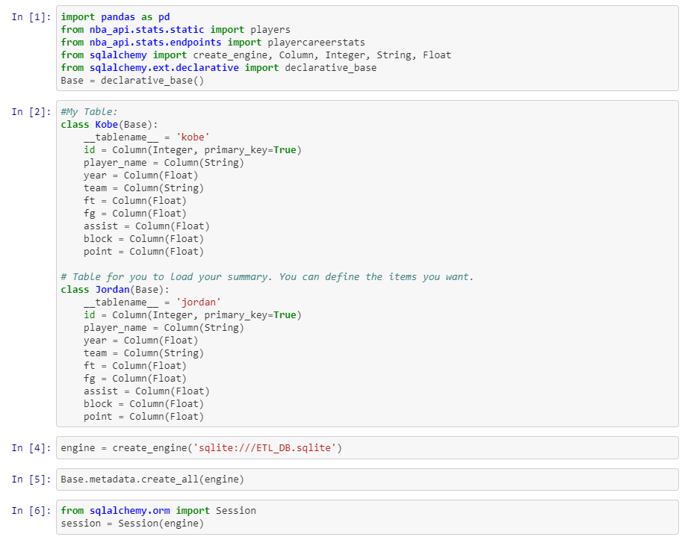
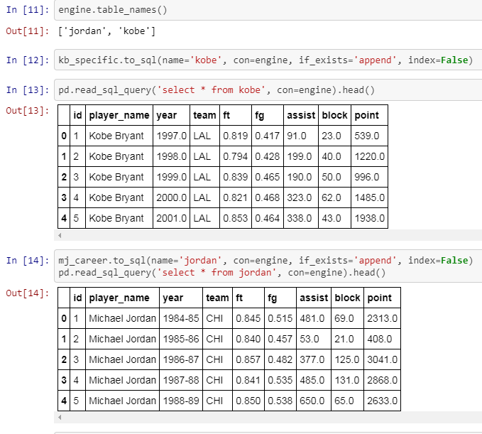
Load(project1)
Load into the SQL database and tables defined at first.
Read to confirm if loaded successfully.

Slide 6
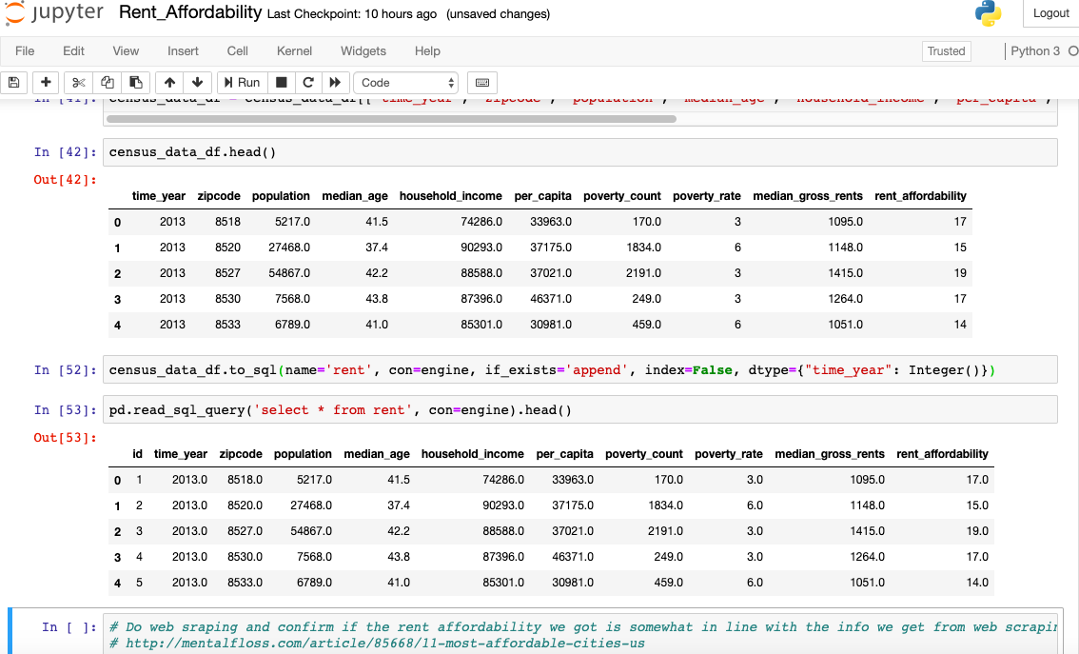
Load(project2)
Load into the SQL database and tables defined at first.
Read the data to confirm if loaded successfully.

