Slide 1
Automatic Test Creation (& Reduction) for Rich Web Applications
Chad Maughan
18 Apr 2012

Slide 2
Code and presentation available at
http://chadmaughan.com

Slide 3
Abstract
Rich Web Applications consume and create data asynchronously (after initial page load) and frequently manipulating the DOM (HTML Document Object Model) to display that data.
Problems often occur on the client-side in the form of Javascript exceptions and transport (network) related errors.

Slide 4
Graph Theory
“In many cases, if you can formulate what you're working on as a graph problem, you're (at least) halfway to a solution. And if your problem instances are in some form expressible as trees, you stand a good chance of having a really efficient solution.”
- Magnus Lie Hetland
Source: Python Algorithms: Mastering Basic Algorithms in the Python Language

Slide 5
Graph It!
Map an application as a graph
each state of the application as a vertex (node)
each link as an edge (relationship)
Use graph to extract potential test suites

Slide 6
State-Space
URLs as a state-space
Fragments
# Hash or #! Hashbang
Example
https://twitter.com/#!/chadmaughan
https://twitter.com/#!/i/connect
Future Problem
Doesn’t work with HTML5 pushState

Slide 7
Technology Used
Selenium
Traverses app
Neo4j
Stores graph
Gephi
Visualizes graph
BrowserMob Proxy
Captures exceptions and transport errors
JgraphT
Calculate URL fragments for reduction

Slide 8
Selenium
Recursively traverses (depth-first) all “state-spaces”
Puts “state-space” attributes in graph database
Examples
Pixel location of link (0,0 top left)
Key parts of URL as attributes
Anchor Text

Slide 9
Neo4j
noSQL graph database
Java based
Embedded (single jar)
Disk-based, native storage manager
Powerful traversal framework
Simple API
Awesome

Slide 10
Gephi
Java based, interactive visualization and exploration platform
“Like Photoshop for graphs”
Neo4j import
Thanks Google Summer of Code!

Slide 11
JgraphT
Java Graph Library
Calculates relationships between URL fragments to identify variables

Slide 12
Project Structure
Broken into two parts
Crawling
Populates graph
Reduces during crawl
Test suite creation
Comprehensive test (re-crawl)
Reduced test suite (single test)
Prioritized testing

Slide 13
Sample Application
Backbone.js based Employee Directory
Live data:
http://coenraets.org/backbone/directory/jquerymobile/#employees/1
Source (for forking):
https://github.com/ccoenraets/backbone-directory
Other example apps:
http://addyosmani.github.com/todomvc/

Slide 14
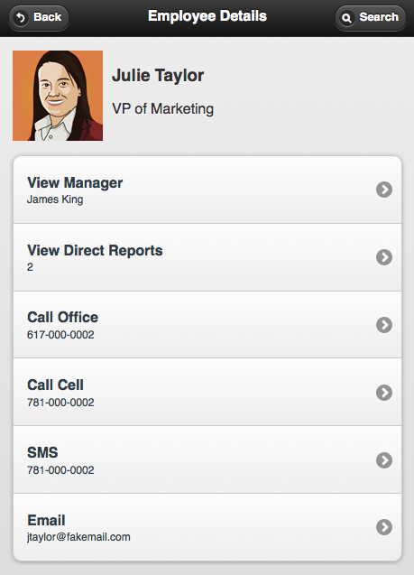
Sample Application

Slide 15
Code
Code walk-through

Slide 16
Reduction
JGraphT
Calculates relationships between URL fragments to identify variables
http://coenraets.org/backbone/directory/jquerymobile/#employees/3
http://coenraets.org/backbone/directory/jquerymobile/#employees/3/reports
http://coenraets.org/backbone/directory/jquerymobile/#employees/1
http://coenraets.org/backbone/directory/jquerymobile/#employees/1/reports
http://coenraets.org/backbone/directory/jquerymobile/#employees/{#}
http://coenraets.org/backbone/directory/jquerymobile/#employees/{#}/reports

Slide 17
Capturing Exceptions
To capture client-side exceptions, we need to extend the browser Console object to store exceptions
Can be done in two ways:
Code it that way
Painful, requires testing code in production code base
Intercept responses and inject Javascript to capture exceptions via BrowserMob Proxy
Better way

Slide 18
BrowserMob Proxy
Utility to help web developers watch and manipulate web app network traffic
http://opensource.webmetrics.com/browsermob-proxy/
Works seamlessly with Selenium
Simulates latency, whitelisting/blacklisting content
Captures performance data in HAR format (great for non 200 HTTP status codes)

Slide 19
Prioritization
Prioritization on Jakob Nielson’s link location attention, closer to pixel location 0,0 the higher
http://www.useit.com/alertbox/horizontal-attention.html
http://www.useit.com/alertbox/scrolling-attention.html

Slide 20
What’s left?
Improve output of Test creation and results
Add additional prioritizations
Allow for custom prioritizations to be passed in
Ex: most integral nodes and their targeted relations are tested first
Add additional reductions
Allow for custom reductions

