Slide 1
Arduino programs
Arduino toolchain
Cross-compilation
Arduino sketches
Classes
Sketch structure
Pins
Input and output
Blink example

Slide 2
Arduino toolchain

Slide 3
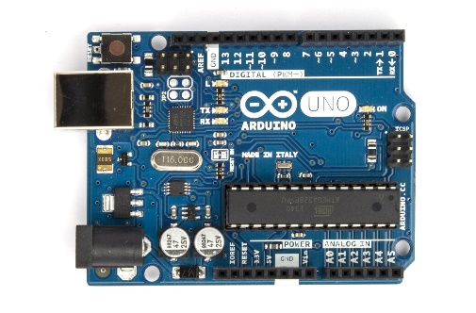
Verify and upload
Libraries
Code
Combine & transform
Compile
Link
HEX file creation
HEX
Upload

Slide 4
Combine and transform
All program files are combined into one
An #include is added to reference basic Arduino libraries
Function prototypes are added
A main() function is created

Slide 5
Cross-compilation

Slide 6
Compile and link
avr-gcc is invoked to cross-compile the code
Resulting code executes on AVR, not on Intel
Generates an object file (.o)
Object file is linked to Arduino library functions

Slide 7
Hex file creation and programming
Avr-objcopy is invoked to change the format of the executable file
A .hex file is generated from the .elf file

Slide 8
Arduino sketches

Slide 9
Arduino programs
A program is called a sketch
C++ program using Arduino library functions
C++ is a superset of C
All C programs are legal C++
C++ also includes classes

Slide 10
Object-oriented programming
Organize your code through encapsulation
Group together data and functions that are related
User-defined type is specific to an application
int type has data (the number) and functions (+, -, *)

Slide 11
Encapsulation example
Specify and operate on 3 points
int x1, y1; point p1;
x1=0; y1=0; p1.setpoint(0,0);
plot(x1,y1); p1.plot();
All data contained in one objects
Reduced number of parameters
Point-specific functions are easily identified

Slide 12
Classes

Slide 13
Classes and members
class X {
public:
int m;
int mf(int v){int old=m; m=v; return old;}
};
X var;
var.m=7;
int z = var.mf(9);

Slide 14
Classes and members
Declaration of a variable creates an object
. operator used to access members
Data and functions
Functions can be defined inside the class

Slide 15
Classes in libraries
We will
not need to know much about classes
not define classes
use classes defined in libraries
Examples
Ethernet.begin(mac)
Serial.begin(speed);
client.print(“Hello”);
Serial.print(“Hello”);

Slide 16
Sketch structure

Slide 17
setup() function
A sketch does not have a main() function
Every sketch has a setup() function
Executed once when Arduino is powered up
Used for initialization operations
Returns no value, takes no arguments
void setup() {
…
}

Slide 18
loop() function
Every sketch has a loop() function
Executed iteratively as long as the Arduino is powered up
loop() starts executing after setup() has finished
loop() is the main program control flow
Returns no value, takes no arguments
void loop() {
…
}

Slide 19
Pins

Slide 20

Pins
Digital I/O
Pins are wires connected to the microcontroller
Pins are the interface of the microcontroller
Pin voltages are controlled by a sketch
Pin voltages can be read by a sketch
Analog inputs

Slide 21
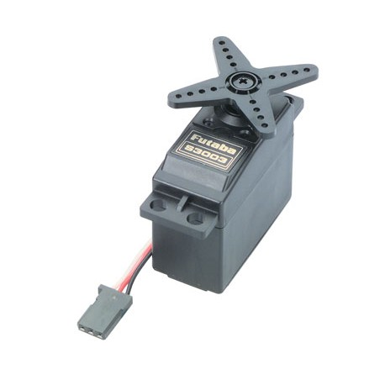
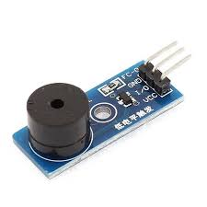
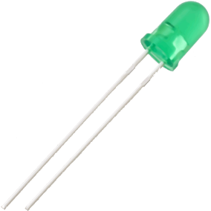

Output pins
Output pins are controlled by the Arduino
Voltage is determined by your sketch
Other components can be controlled through outputs

Slide 22
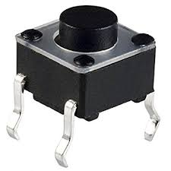
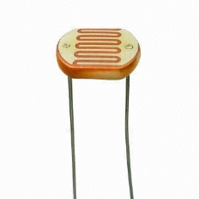
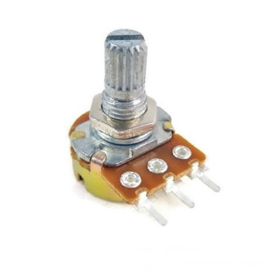
Input pins
Input pins are controlled by other components
Arduino reads the voltage on the pins
Allows it to respond to events and data

Slide 23
Digital vs. analog
Some pins are digital-only
Read digital input, write digital output
0 volts or 5 volts
Some pins can be analog inputs
Can read analog voltages on the pin
Useful for analog sensors
Analog-only pins are clearly labeled
No pins can generate an analog output

Slide 24
Input and output

Slide 25
Input/output (I/O)
These functions allow access to the pins
void pinMode(pin, mode)
Sets a pin to act as either an input or an output
pin is the number of the pin
0-13 for the digital pins
A0-A5 for the analog pins
mode is the I/O mode the pin is set to
INPUT, OUTPUT, or INPUT_PULLUP
INPUT_PULLUP acts as input with reversed polarity

Slide 26
Digital input
int digitalRead(pin)
Returns the state of an input pin
Returns either LOW (0 volts) or HIGH (5 volts)
Example
int pinval;
pinval = digitalRead(3);
pinval is set to the state of digital pin 3

Slide 27
Digital output
void digitalWrite(pin, value)
Assigns the state of an output pin
Assigns either LOW (0 volts) or HIGH (5 volts)
Example
digitalWrite(3, HIGH);
Digital pin 3 is set HIGH (5 volts)

Slide 28
Analog input
int analogRead(pin)
Returns the state of an analog input pin
Returns an integer from 0 to 1023
0 for 0 volts, 1023 for 5 volts
Example
int pinval;
pinval = analogRead(A3);
pinval is set to the voltage on A3 (0 for 0 volts, 1023 for 5 volts)
The pin must be an analog pin

Slide 29
Blink example

Slide 30
Delay
void delay(msec)
Pauses the program for msec milliseconds
Useful for human interaction
Example
digitalWrite(3, HIGH);
delay(1000);
digitalWrite(3,LOW);
Pin 3 is HIGH for 1 second

Slide 31

Blink example
Blink is the generic simple example for embedded systems
Like “hello, world”
File→Examples→01.Basic→Blink
Causes an LED to blink
LED is built-in, so no wiring required
Connected to pin 13

Slide 32
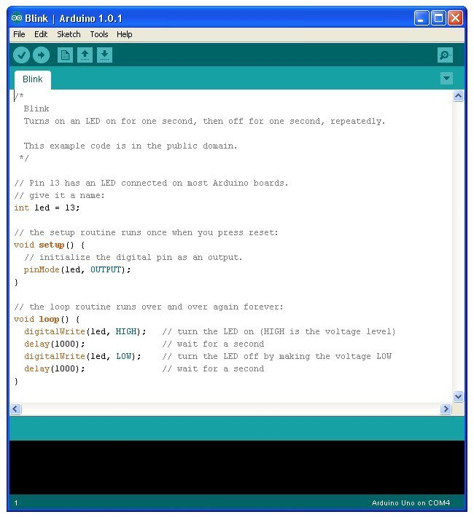
Blink sketch
void setup() {
pinMode(13, OUTPUT);
}
void loop() {
digitalWrite(13, HIGH);
delay(1000);
digitalWrite(13, LOW);
delat(1000);
}

Slide 33
Lab

Slide 34
State change detection example
Connect to Tinkercad at http://tinkercad.com and log-in.
Go to Circuits and click “Create new circuit” button.
Drag-and-drop the State change detection example from “Arduino”→”State change detection”.
Examine the code and guess what it does.
Start simulation to check if your guess was correct.
It counts the number of button press and turns on the built-in LED at every 4 presses.

Slide 35
Neopixel example
Connect to Tinkercad at http://tinkercad.com and log-in.
Go to Circuits and click “Create new circuit” button.
Drag-and-drop the Neopixel example from “Arduino”→”Neopixel”.
Examine the code and guess what it does.
Start simulation to check if your guess was correct.
It sequentially turns on the Neopixel LEDs with randomly varying colors.

Slide 36
Neopixel with a button
Combine “State change detection” and “Neopixel” to have your simulator do the following.
When your Arduino is turned on, the Neopixel is sequentially turned on with random colors.
Neopixel color changes when the number of button press increases (that is when the button status changes from “Released” to “Pushed”).

