Slide 1
Sensors and actuators
Sensors
Resistive sensors
Voltage-controlling sensors
Actuators
Analog actuators
Pulse width modulation
Making sounds

Slide 2
Sensors

Slide 3
Sensors
Allow the microcontroller to receive information about the environment
How bright is it?
How loud is it?
How far is an object?
Is the button being pressed?
Perform operations based on the state of the environment
Turn on a light if it is dark out
Voice-controlled operation

Slide 4
Sensing the environment
Microcontrollers sense voltage
digitalRead(pin) returns state of a digital pin
analogRead(pin) returns the analog voltage on a pin
Sensor logic must convert an environmental effect into voltage

Slide 5
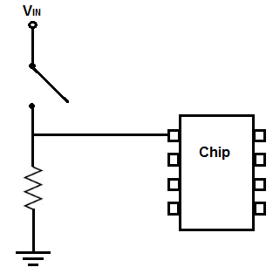
Reading a pushbutton
Make a pin HIGH when the button is pressed, and LOW when it is not pressed
Incorrect
Correct

Slide 6
Resistive sensors

Slide 7
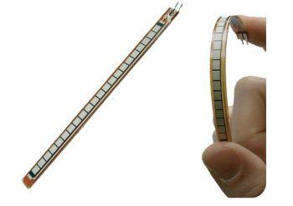
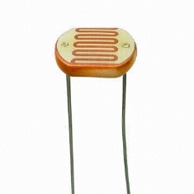
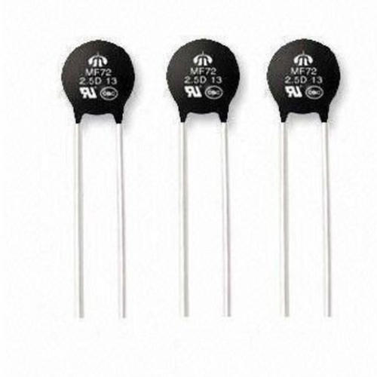
Resistive sensors
Many sensors change resistance
Photoresistors, thermistors, flex sensors, etc.
Connect sensor in a voltage divider
As resistance changes, voltage changes

Slide 8
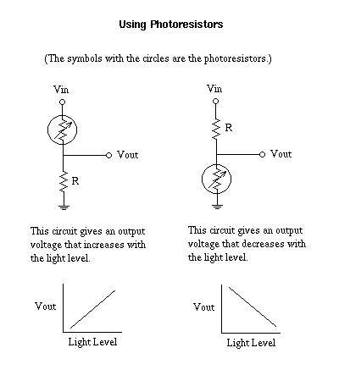
Photoresistor
As brightness increases, resistance decreases
Resistance = 10K ohms, Voltage = 2.5 volts
Resistance = 5K ohms, Voltage = 3.33 volts

Slide 9
Voltage-controlling sensors

Slide 10
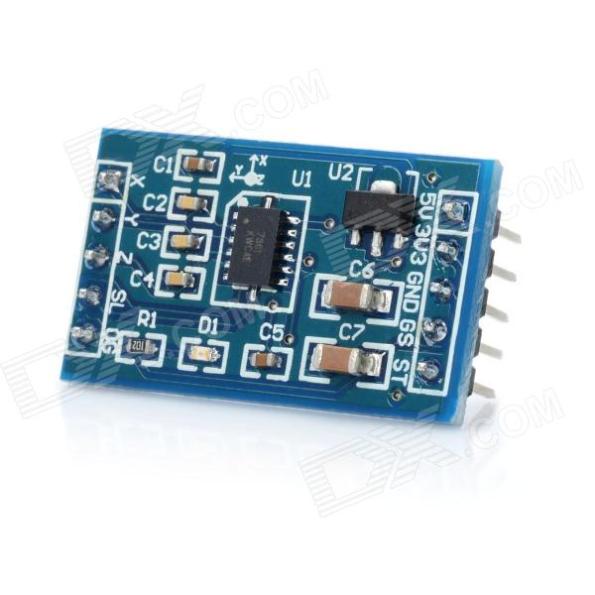
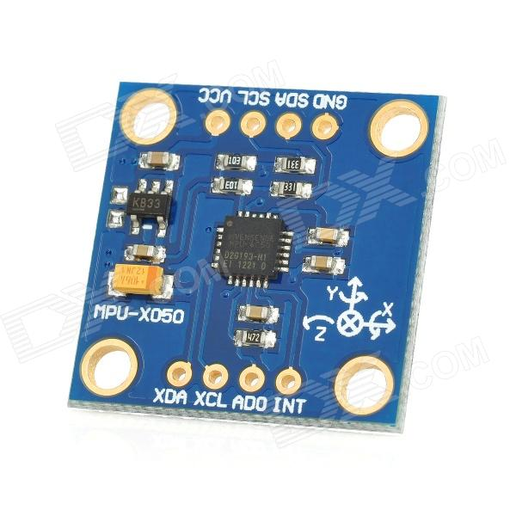
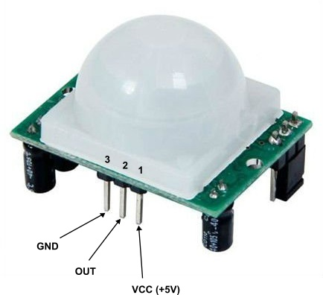
Voltage-controlling sensors
Some sensors control voltage directly
Accelerometer:
Reports acceleration in 3 axes
Gyro:
Reports angular velocity in 3 axes
Passive infrared sensor:
detects motion

Slide 11
Actuators

Slide 12
Actuators
Devices that cause something to happen in the physical world
Outputs of the devices
Visual: LED, LCD, monitor
Audio: buzzer, speaker
Motion: motors, valve, pump
Tactile: heating, cooling

Slide 13
On-off actuation
The only control is power
Even complicated actuators can be controlled via power
LED, buzzer, monitor
Does not use the full potential of the actuator
On-off control may be all that is necessary
Lights in a classroom

Slide 14
Current limits
Watch out for current limits
LED can only handle 20mA
Be sure to use an appropriate resistor
Arduino can only supply 40mA
Cannot drive a motor that requires 10A
May need to use alternate power supply
Arduino can control access to power without providing power directly

Slide 15
Analog voltage control

Slide 16
Analog voltage control
Many actuators need an analog voltage for complete control
DC motor speed controlled by voltage
LED brightness controlled by voltage
Heating element temperature controlled by voltage
Arduino cannot generate analog outputs

Slide 17
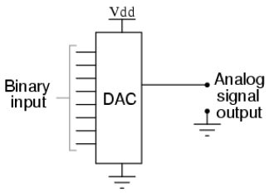
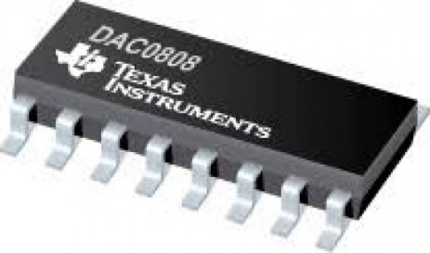
Digital to analog converter (DAC)
DAC will convert digital number to an analog voltage
Most microprocessors do not have a DAC
Can buy one and attach it, but may be costly

Slide 18
Pulse width modulation

Slide 19
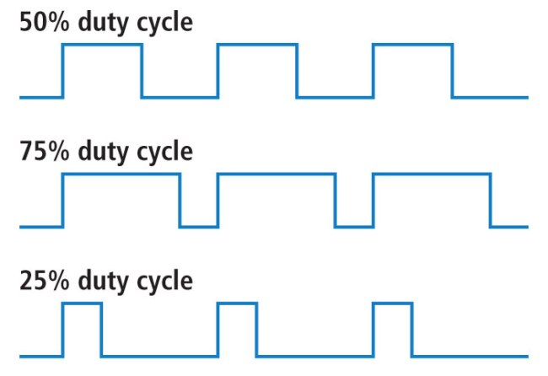
Pulse width modulation
Duty cycle is the percent of time the pulse is HIGH
Increasing duty-cycle increases perceived voltage

Slide 20
analogWrite()
Generates a square wave on a pin, 490Hz
First argument is the pin number
Second argument is the pulse width
0 is 0% duty cycle
255 is 100% duty cycle
Pin number must be a PWM pin
Marked on the Arduino with the “~” symbol
Example:
analogWrite(3,128); will output 2.5V approximately on pin3

Slide 21
Fade example
int brightness=0, fadeAmount=1, led=3;
void setup() {
pinMode(led, OUTPUT);
}
void loop() {
analogWrite(led, brightness);
brightness = brightness + fadeAmount;
if (brightness<=0 || brightness>=255)
fadeAmount = -fadeAmount;
delay(30);
}

Slide 22
Making sounds

Slide 23
tone()
tone() can generate a square wave with an arbitrary frequency
analogWrite() has a fixed frequency
Duty cycle is fixed at 50%
Can be used to drive a speaker or buzzer
Two or three arguments
Pin number
Frequency, in Hz
Duration in milliseconds (optional)

Slide 24
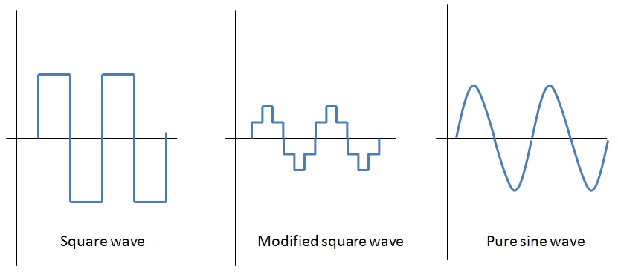
Square waves vs. sine waves
Square waves sound bad
Contains many high-frequency components
Square wave is the best we can do with simple digital outputs

Slide 25
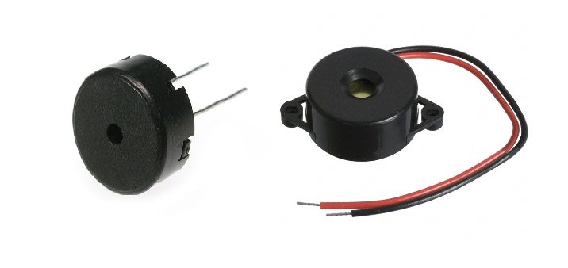
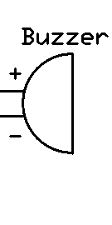
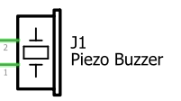
Buzzer
Two inputs: signal and ground
Produces a click when a rising edge is applied
Driving with a square wave produces a pitch

Slide 26
Music system
void setup() {
}
void loop() {
tone(8, 988, 1000);
delay(1000);
tone(8,1047,1000);
delay(1000);
}
Plays two tones, 1 second each
Delay is needed; only one tone at a time

Slide 27
Lab

Slide 28
Windscreen wiper
Get your Arduino ready with a touch sensor, a potentiometer, a servo motor, and a breadboard.
You are making a simplified windscreen wiper.
When your Arduino is powered up, your servo motor should head to the rest position (to 0 degree with an appropriate speed)
Your touch sensor is the switch.
While you put your finger on the touch sensor, the servo motor should swing between 0 degree to 90 degrees.
If you put your finger off, the servo motor should head to the rest position.
Your potentiometer is a speed controller.
Rotating the potentiometer should change the wiper’s swing speed.

