Slide 1
3. Gate-Level Minimization

Slide 2
3.1 Introduction
The complexity of the digital logic gates that implement a Boolean function is implemented.
True Table -> K-map

Slide 3
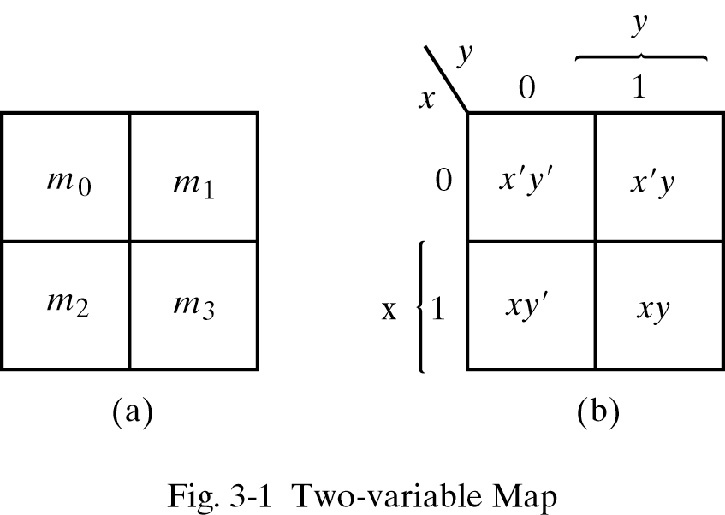
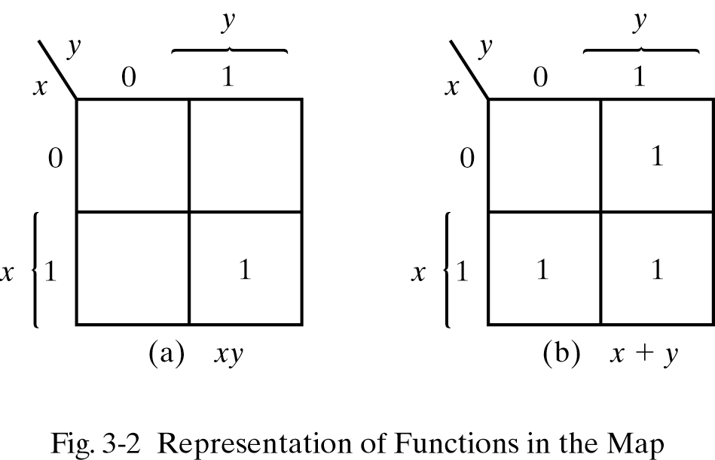
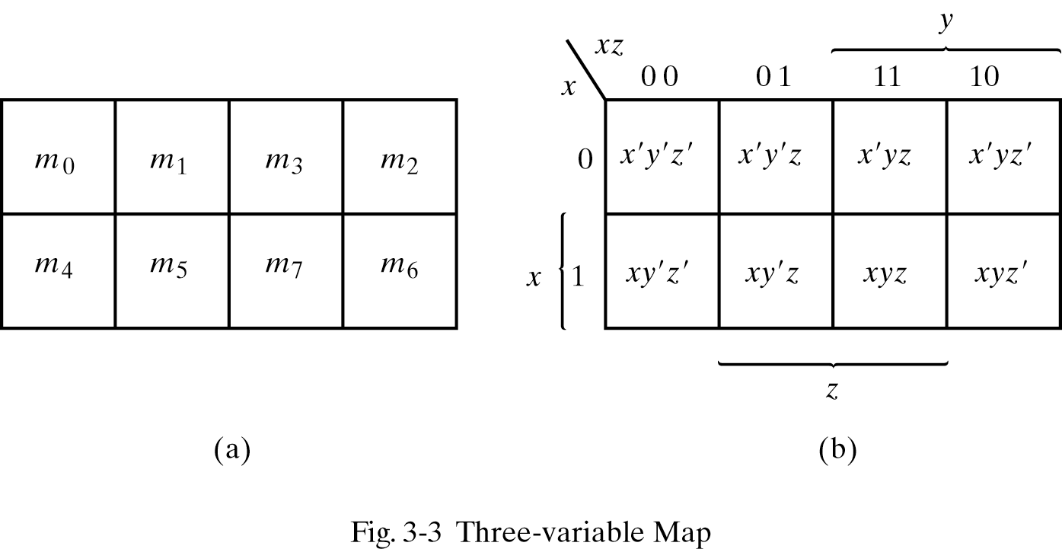
3.2 The Map Method
Two-Variable Map
m1+m2+m3 = x'y +xy' +xy = x +y
Three-Variable Map

Slide 4
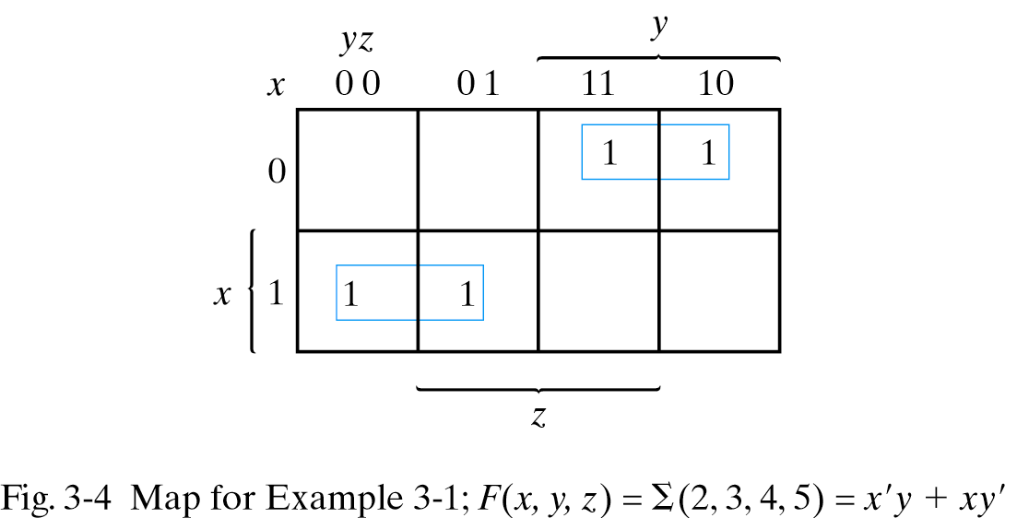
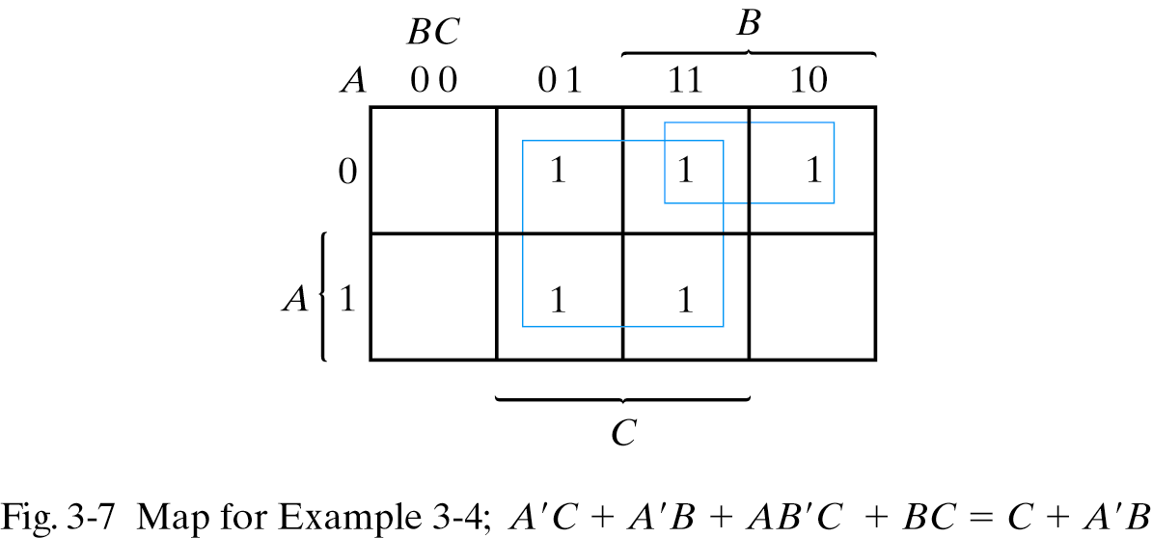
3.2 The Map Method
Ex 3-1) Simplify the Boolean function, F(x, y, z) = Σ(2, 3, 4, 5)
F = x'y + xy'
Ex 3-4) Given Boolean function, F = A'C + A'B +AB‘C +BC
a) express it in sum of minterms
F(x, y, z) = Σ(1, 2, 3, 5, 7)
b) find the minimal sum of products
F = C + A'B

Slide 5
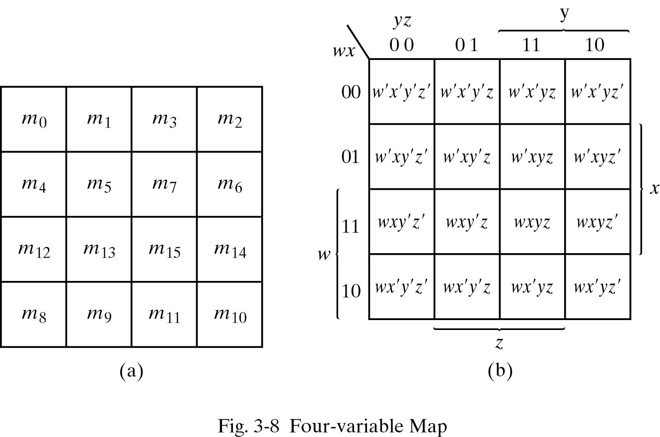
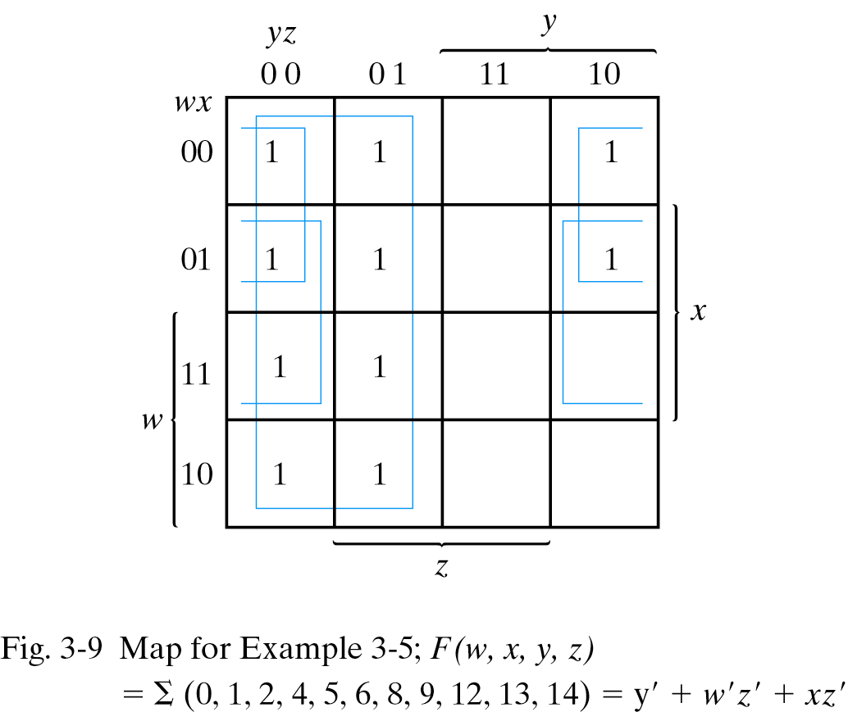
3.3 Four-Variable Map
Ex 3-5) Simplify the Boolean function,
F(w, x, y, z) = Σ(0, 1, 2, 4, 5, 6, 8, 9, 12, 13, 14)
F = y'+ w'z' + xz'

Slide 6
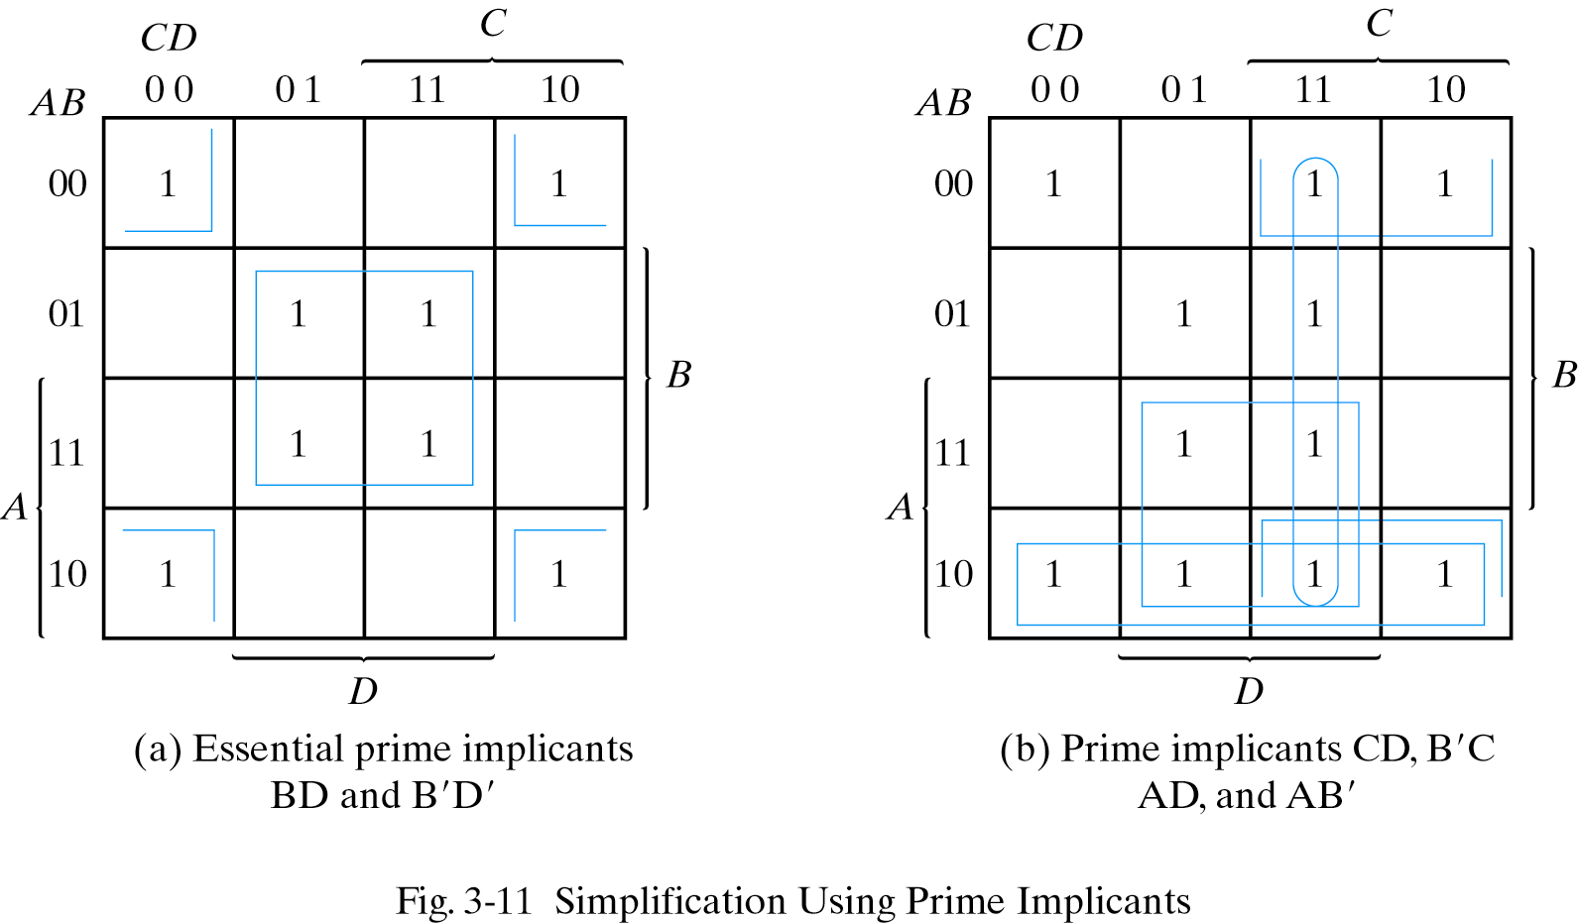
3.3 Four-Variable Map – Prime Implicants
F(A,B,C,D) = Σ(0,2,3,5,7,8,9,10,11,13,15)
F=BD+B'D'+CD+AD
=BD+B'D'+CD+AB'
=BD+B'D'+B'C+AD
=BD+B'D'+CD+AB'

Slide 7
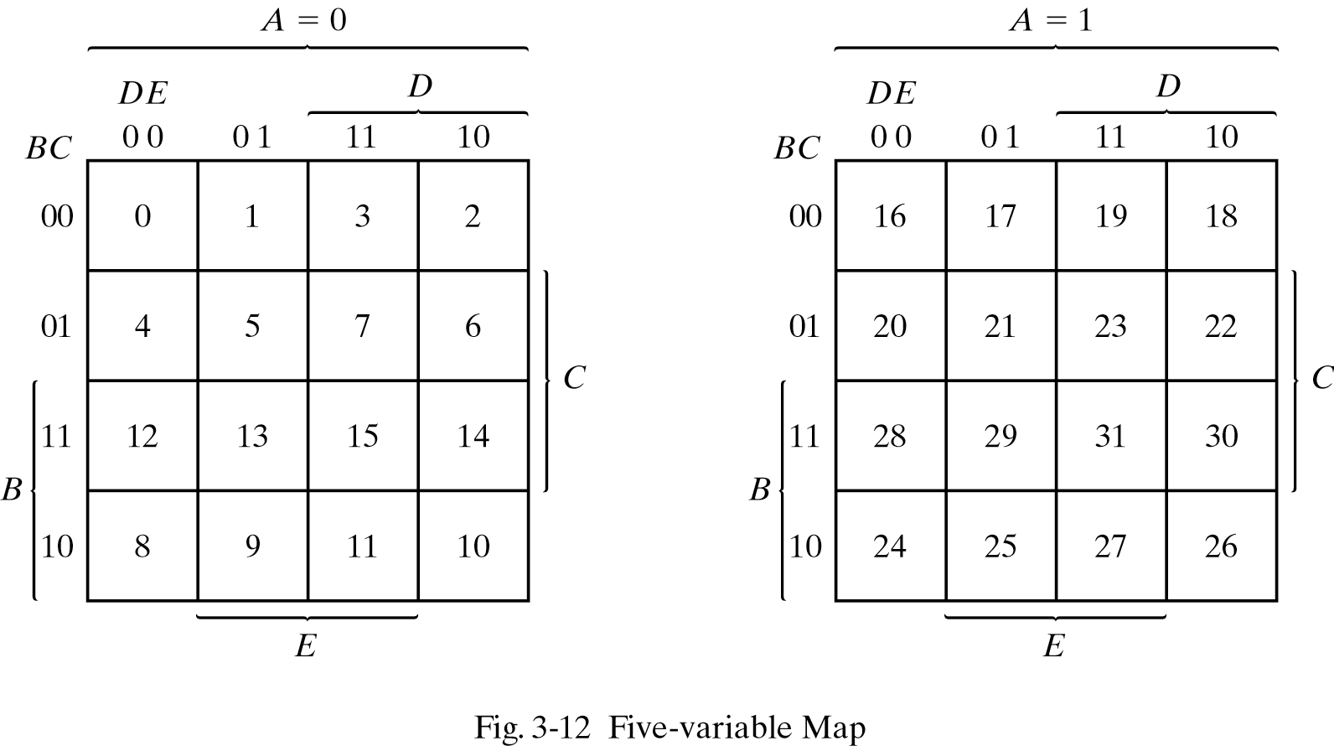
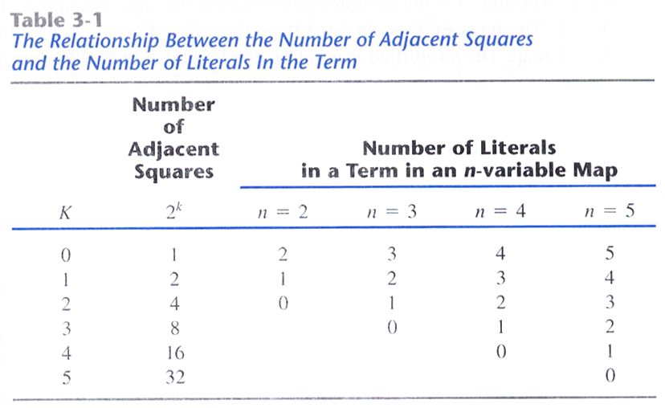
3.4 Five-Variable Map

Slide 8
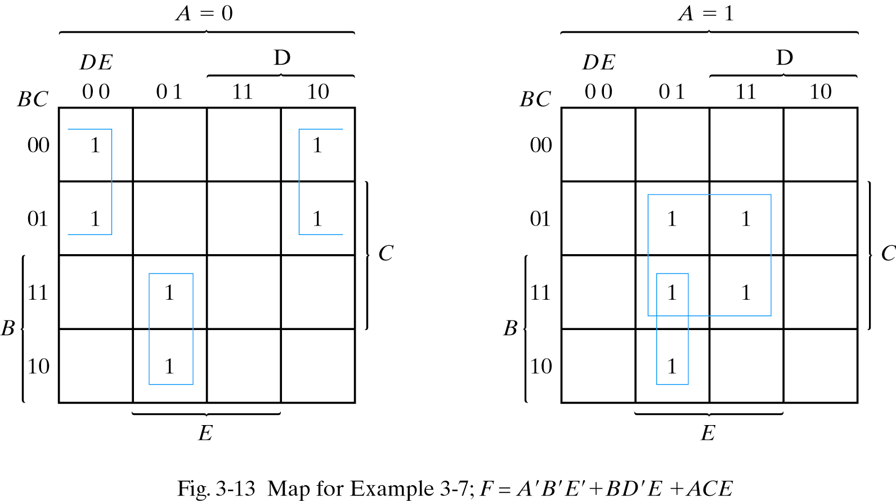
3.4 Five-Variable Map
Ex 3-7) Simplify the Boolean function,
F(A,B,C,D,E)=Σ(0,2,4,6,9,13,21,23,25,29,31)
F = A'B'E' + BD'E + ACE

Slide 9
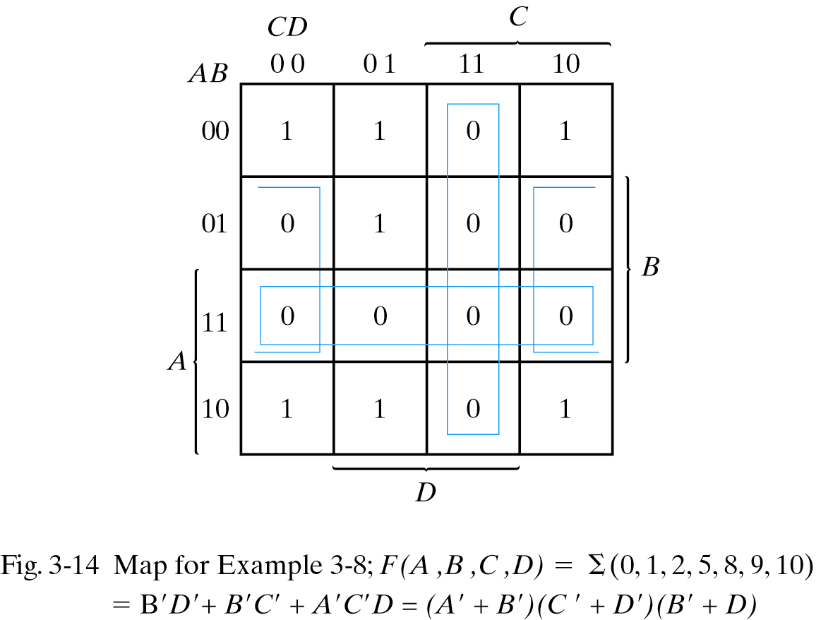
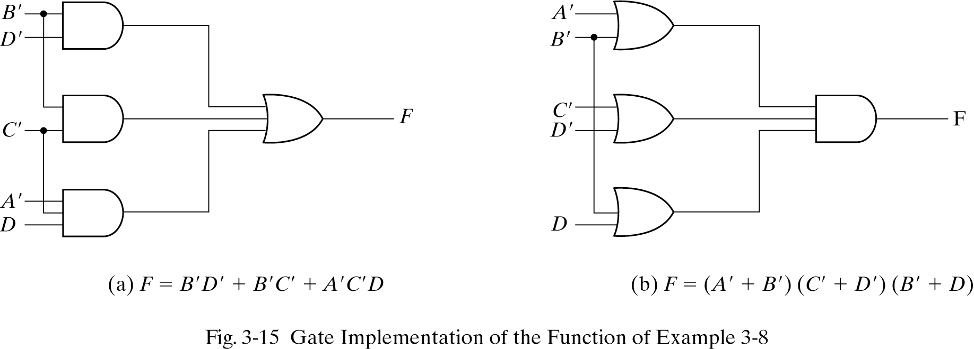
3.5 Product of Sums Simplification
Ex 3-8) Simplify the Boolean function,
F(A, B, C, D) = Σ(0, 1, 2, 5, 7, 9, 10)
a) sum of products
F = B'D' + B'C' +A'C'D
b) product of sum
F' = AB + CD + BD'
F = (A' +B')(C' +D')(B' +D)

Slide 10
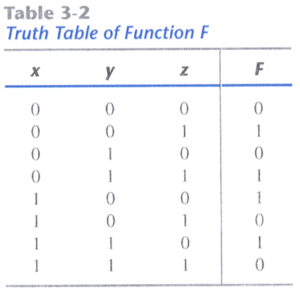
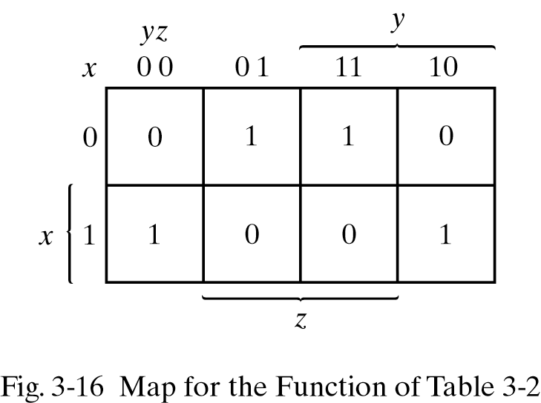
3.5 Product of Sums Simplification
F( x, y, z) = Σ(1, 3, 4, 6) = Π(0, 2, 5, 7)
F = x'z +xz'
F' = xz +x'z'
F = (x'+z)(x + z')

Slide 11
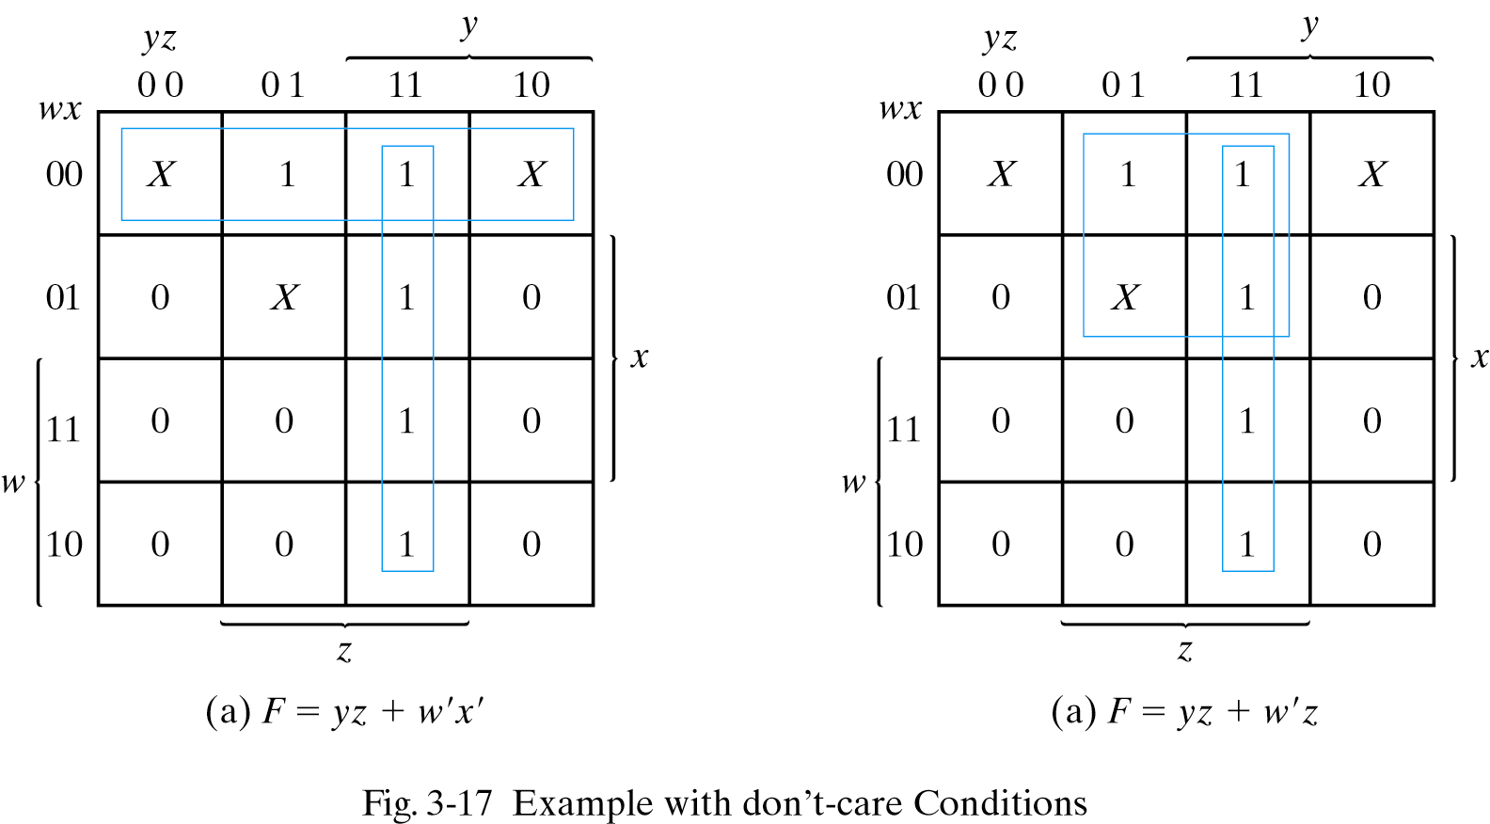
3.6 Don’t-Care Conditions
Ex 3-9) Simplify the Boolean function, F(w, x, y, z) = Σ(1,3,7,11,15)
Don’t-care conditions, d(w, x, y, z) = Σ(0, 2, 5)
F(w, x, y, z) = yz + w'x' = Σ(0, 1, ,2, 3, 7, 11, 15)
F(w, x, y, z) = yz + w'z = Σ(1, 3, 5, 7, 11, 15)

Slide 12
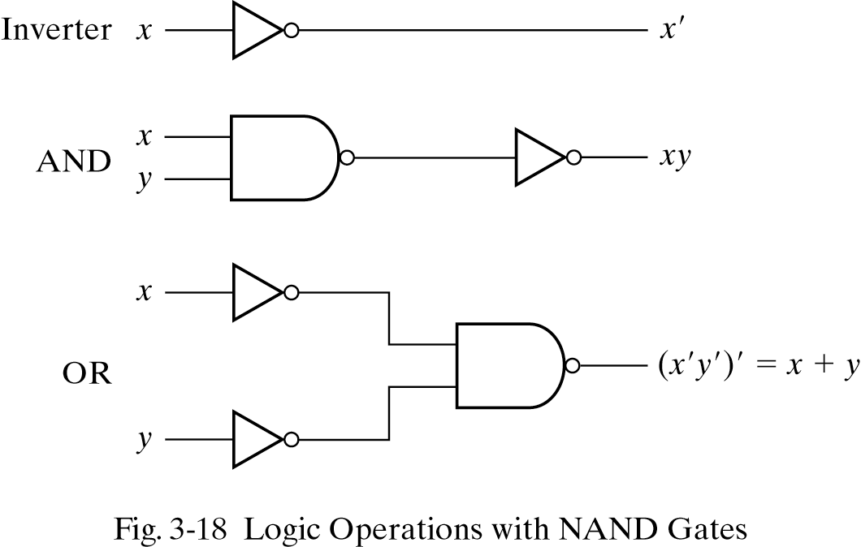
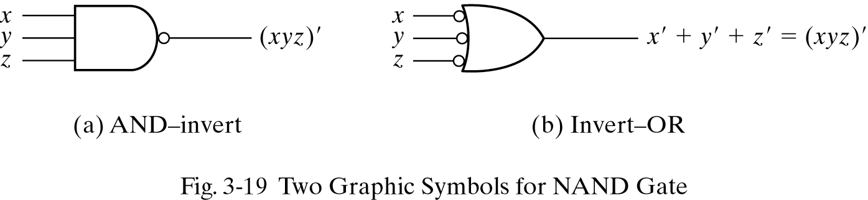
3.7 NAND and NOR Implementation – NAND Circuit

Slide 13
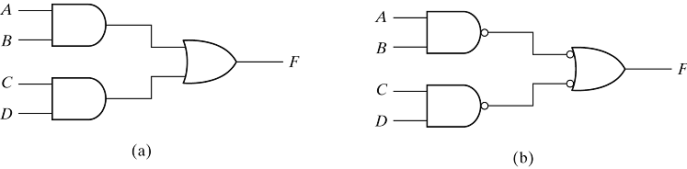
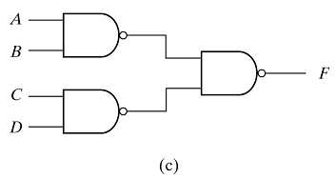
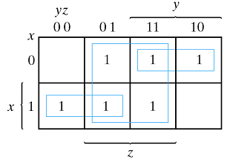
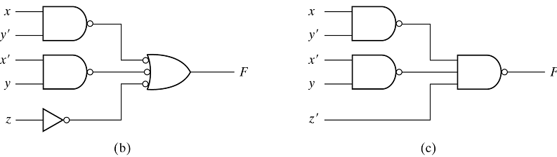
3.7 NAND and NOR Implementation – Two Level Implementation
F = ((AB)'(CD)')' = AB + CD
Ex 3-10) Implement the following Boolean function with NAND gates:
F(x, y, z) = Σ(1, 2, 3, 4, 5, 7) = xy' + x'y + z

Slide 14
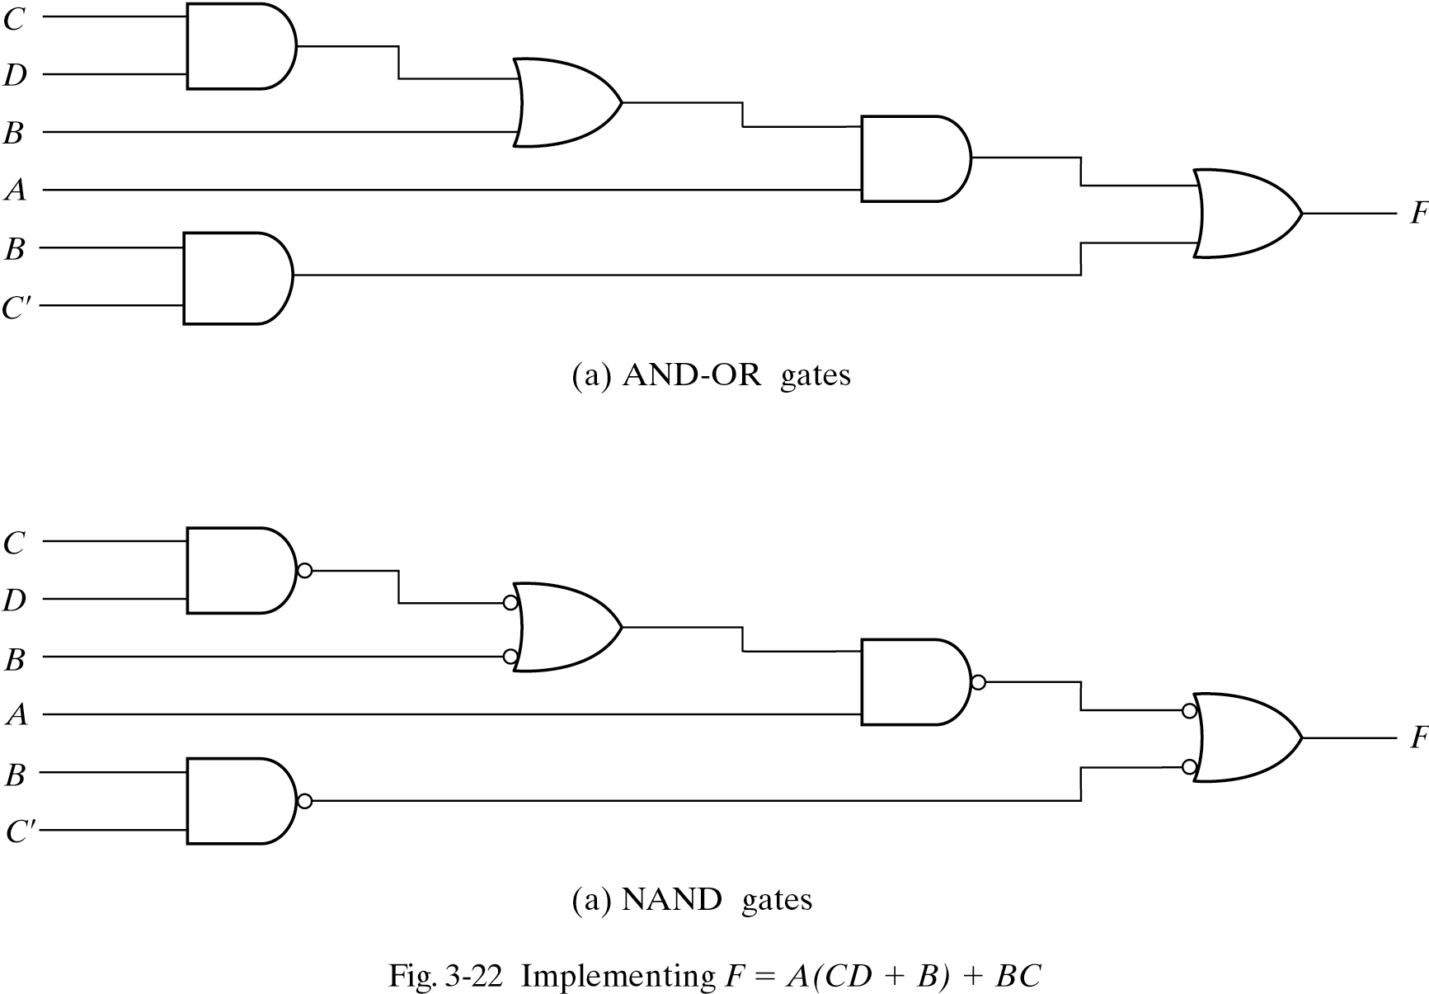
3.7 NAND and NOR Implementation – Multilevel NAND Circuit

Slide 15
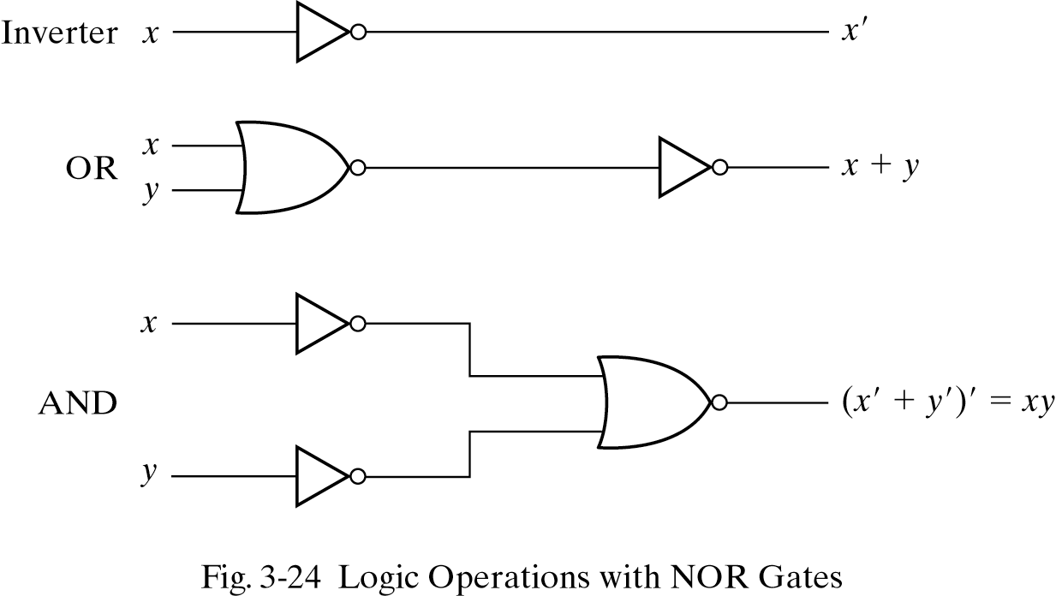
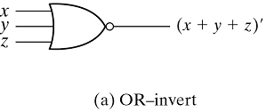
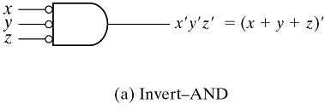
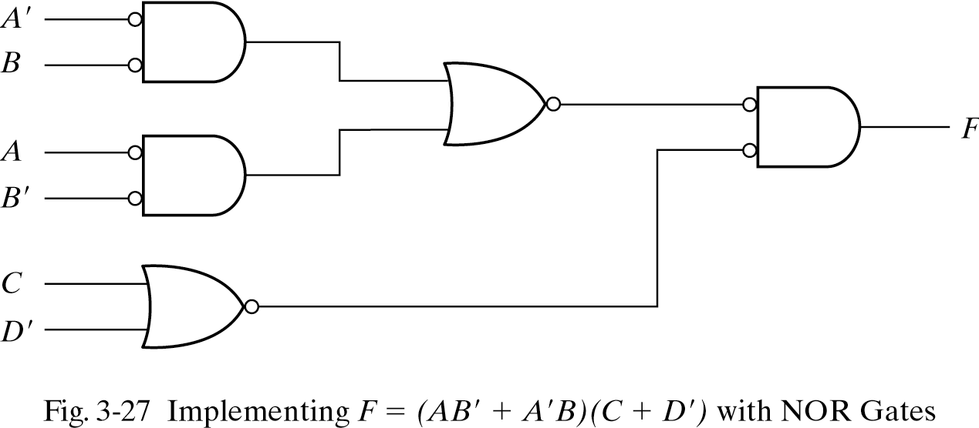
3.7 NAND and NOR Implementation – NOR Implementation
NOR Implementation
F = (AB' + A'B)(C + D')

Slide 16
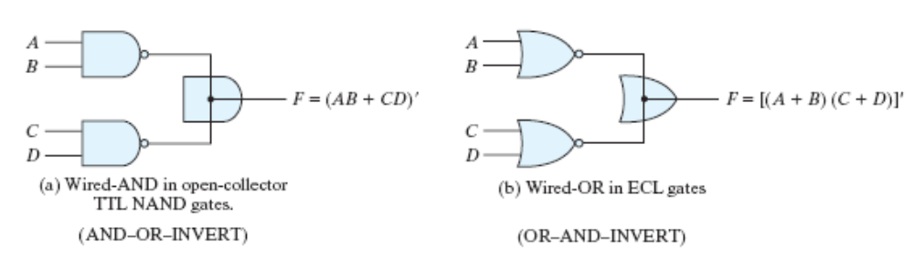
3.8 Other Two-Level Implementation
(a) F = (AB)’·(CD)’ = (AB + CD)’
(b) F = (A + B)’ + (C + D)’ = [(A + B)(C + D)]’

Slide 17
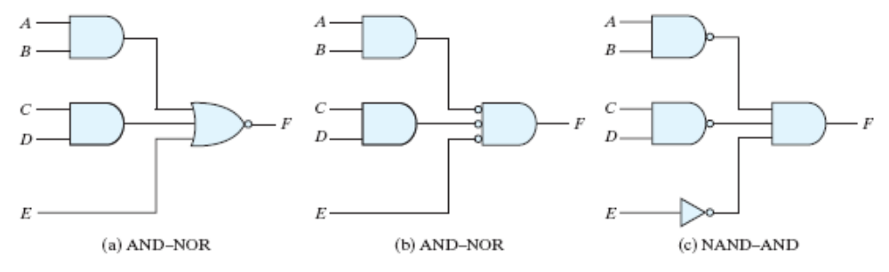
3.8 Other Two-Level Implementation
AND-OR-Invert Circuits
  F = (AB + CD + E)’

Slide 18
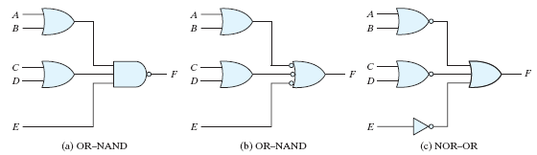
3.8 Other Two-Level Implementation
OR-AND-Invert Circuits
  F = [(A + B)(C + D)E]’

Slide 19
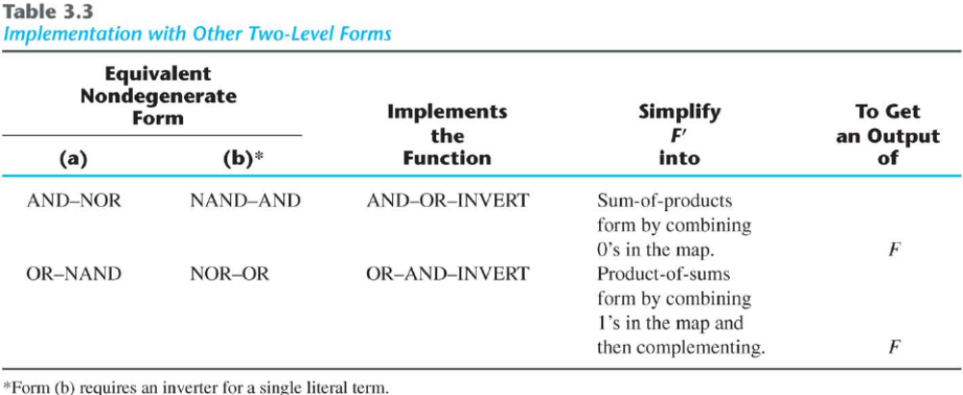
3.8 Other Two-Level Implementation

Slide 20

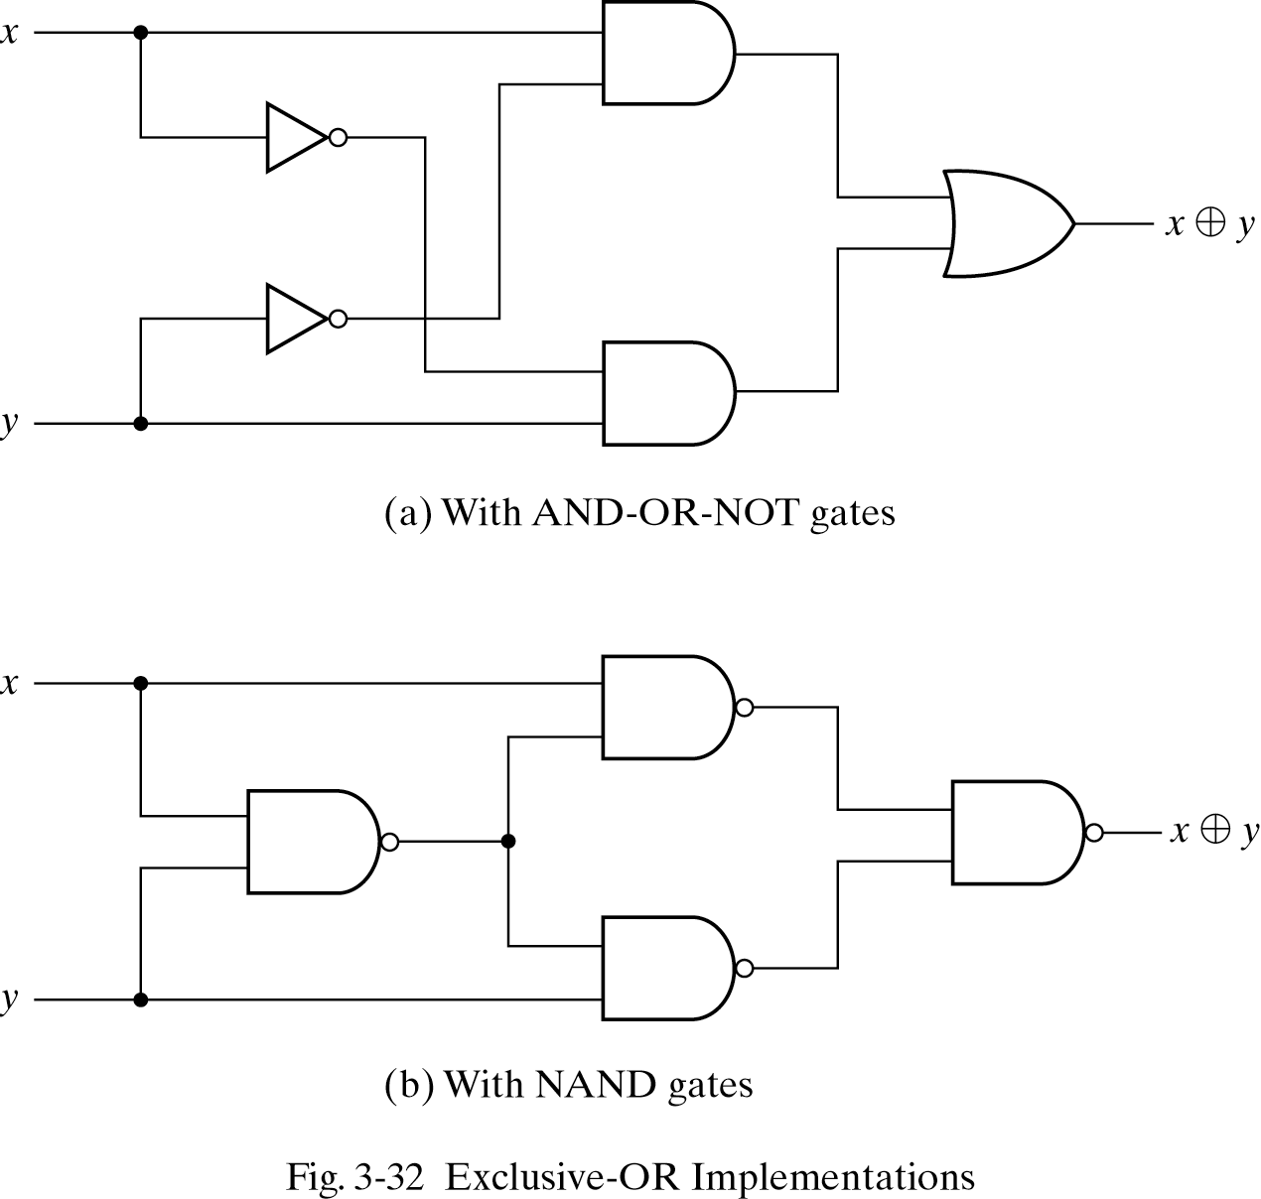
3.9 Exclusive-OR Function
x y = xy' + x'y
(x y)' = (xy' + x'y)' = xy + x'y'
x 0=x x 1=x'
x x=0 x x'=1
x y'=x' y=(x y)‘
A B = B A
(A B) C = A (B C) = A B C

Slide 21
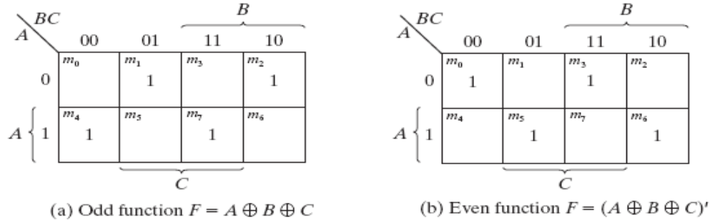
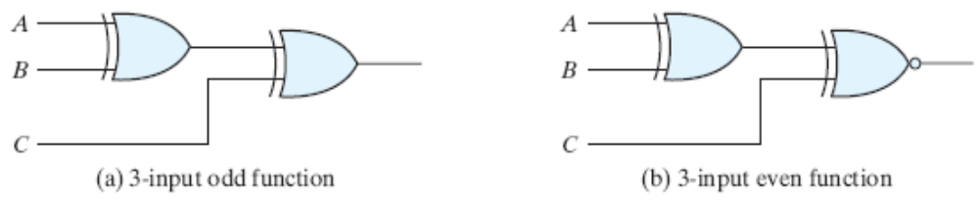
3.9 Exclusive-OR Function
Odd / Even Function

Slide 22
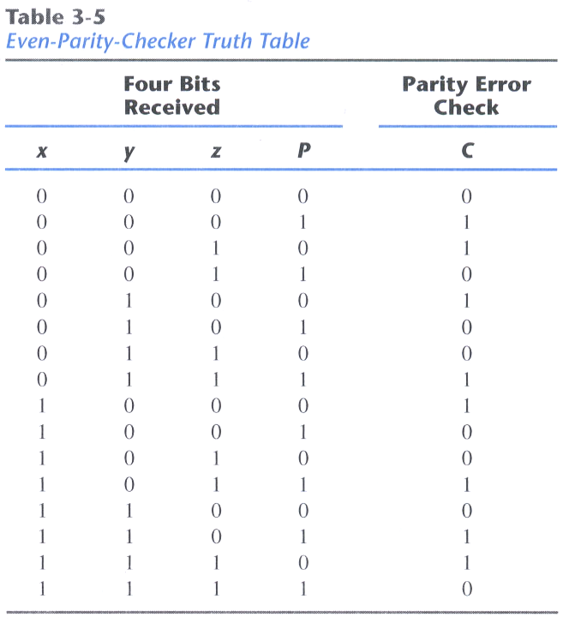
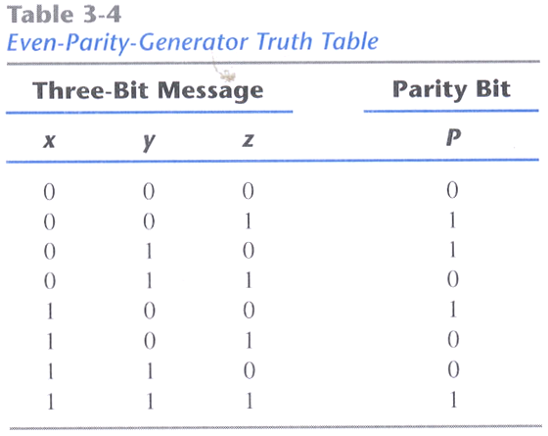
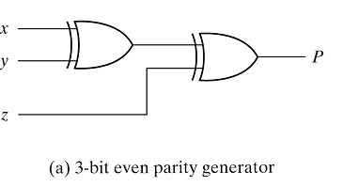
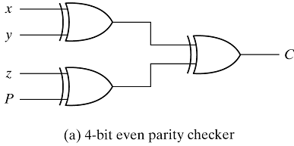
3.9 Exclusive-OR Function - Parity Generation and Checking
Parity Generation and Checking
P = x y z
C = x y z P

