Slide 1
Ch 5. Synchronous sequential logic

Slide 2
5.1 Introduction
In order to perform useful or flexible sequences of operations, we need to be able to construct circuits that can store information between the operations.
latches and Flip-Flops
Sequential circuits consisting of both flip-flop and combinational logic

Slide 3
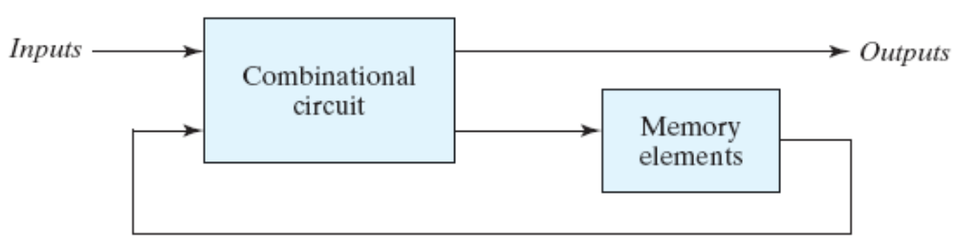
5.2 Sequential circuits
Outputs are function of inputs and present states
Present states are supplied by memory elements

Slide 4
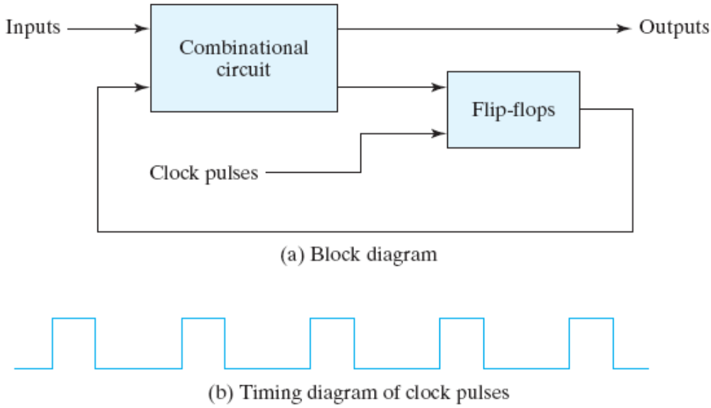
5.2 Sequential circuits
Two types of sequential circuit
Synchronous : behavior depends on the signals affecting storage elements at discrete time
Asynchronous : behavior depends on inputs at any instance of time

Slide 5
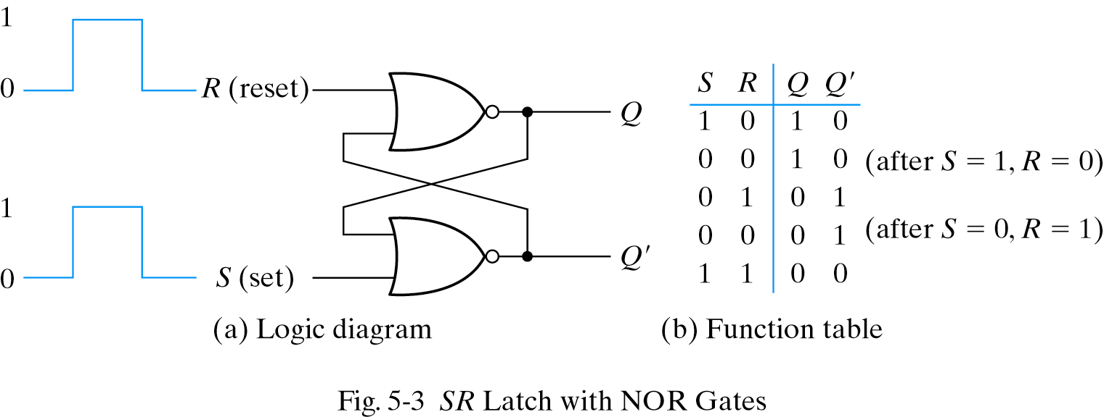
5.3 Latches
SR latch : consist of two cross-coupled NOR gates
S=1,R=0 then Q=1(set)
S=0,R=1 then Q=0(reset)
S=0,R=0 then no change(keep condition)
S=1,R=1 Q=Q′=0 (undefined)

Slide 6
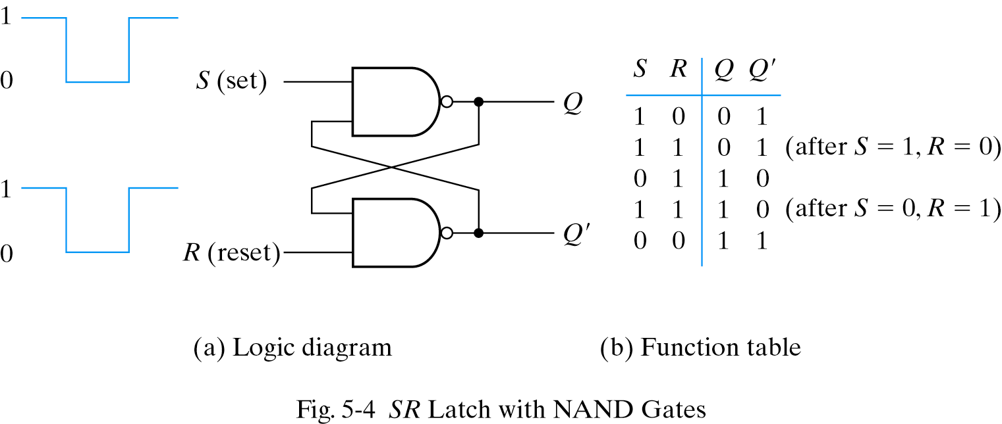
5.3 Latches - SR latch
S′R′ latch with NAND gates
- Require the complement value of NOR latch

Slide 7
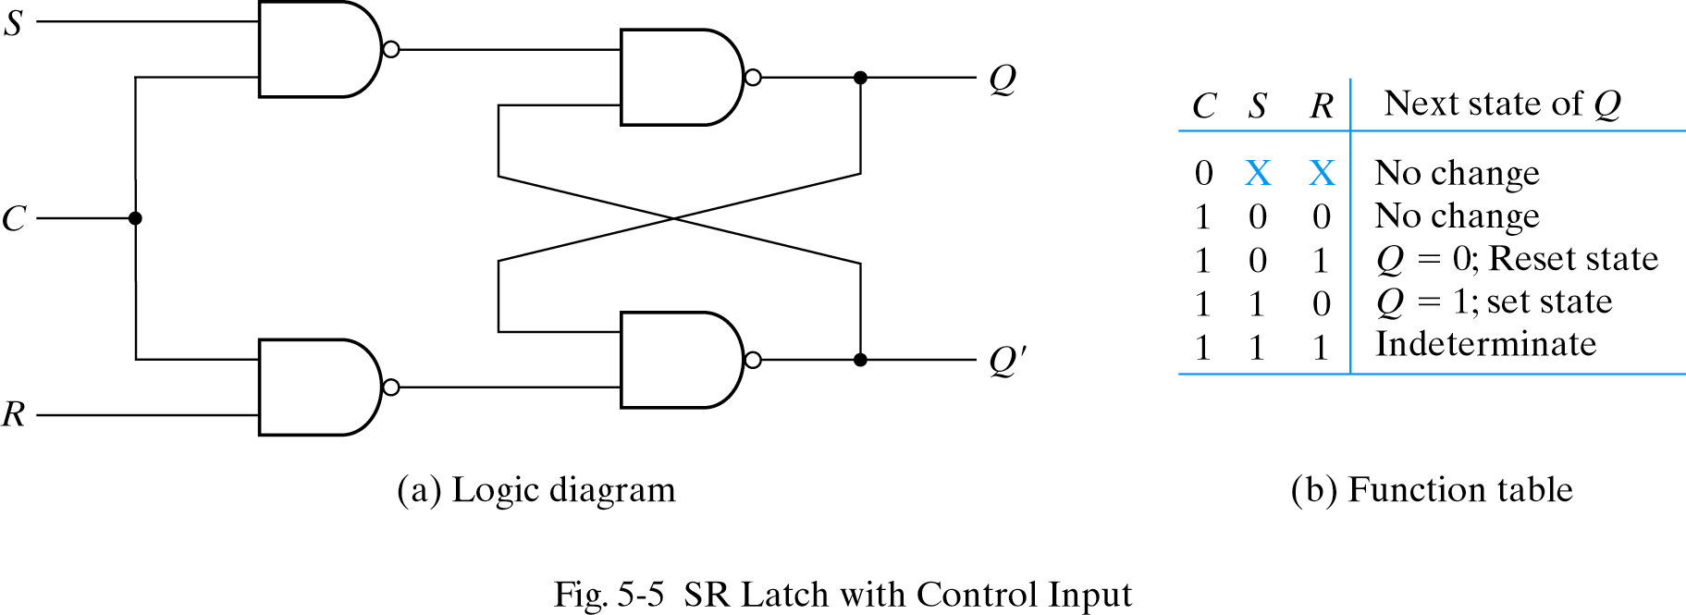
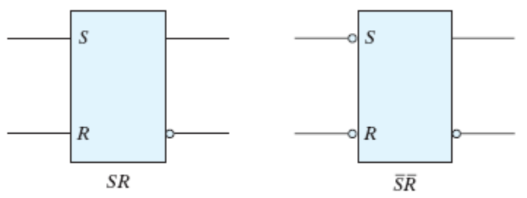
5.3 Latches - SR latch
SR latch with control input
- Add two NAND gate and control signal
- C=0(no action), C=1(act as SR latch)

Slide 8
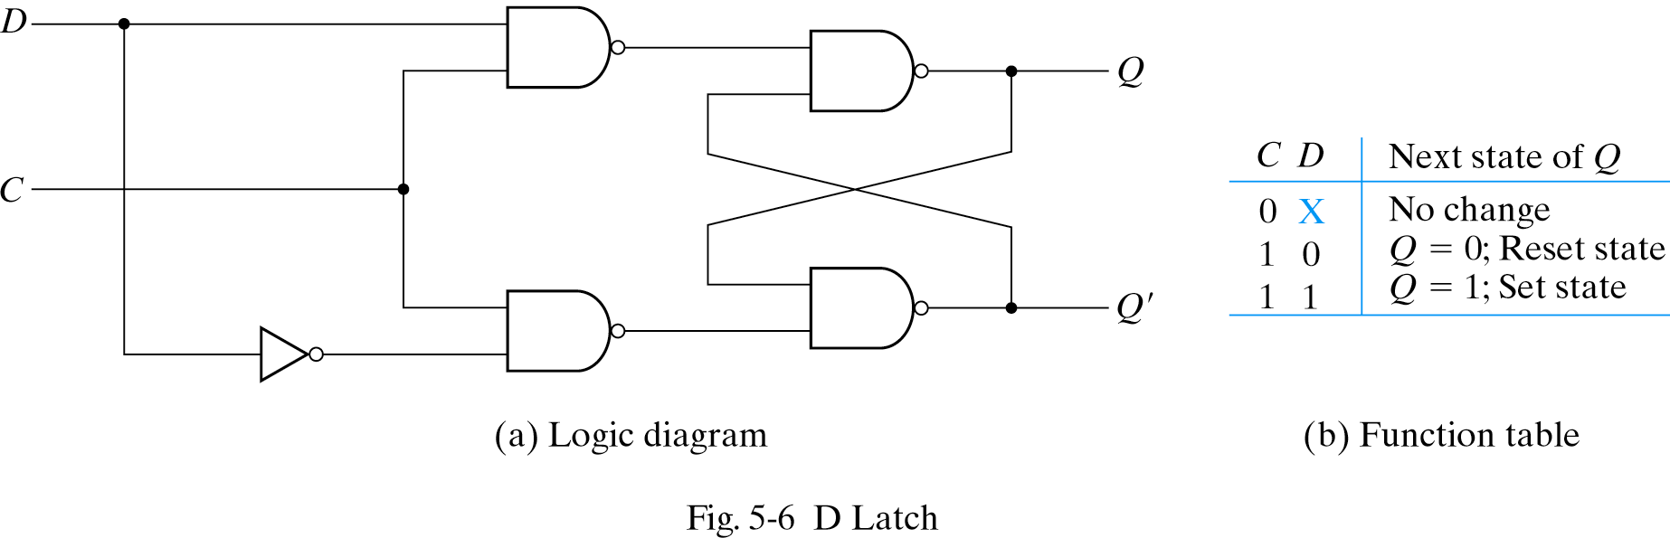
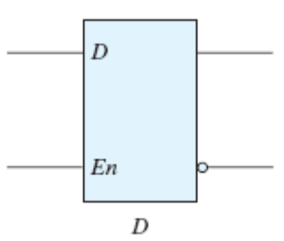
5.3 Latches - D latch
Eliminate indeterminate state in SR latch
- C=1, output value is equal to D

Slide 9
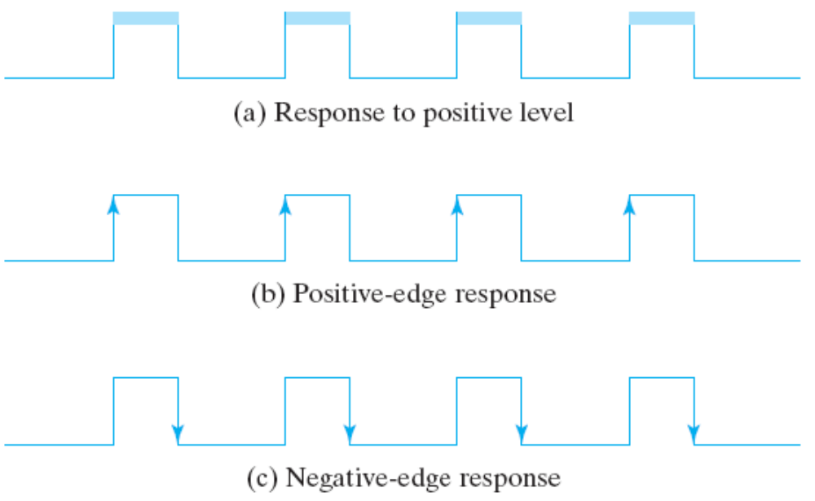
5.4 Flip-Flops
Latch : case (a), output changes as input changes
Flip-flop : output only changes at clock edge

Slide 10
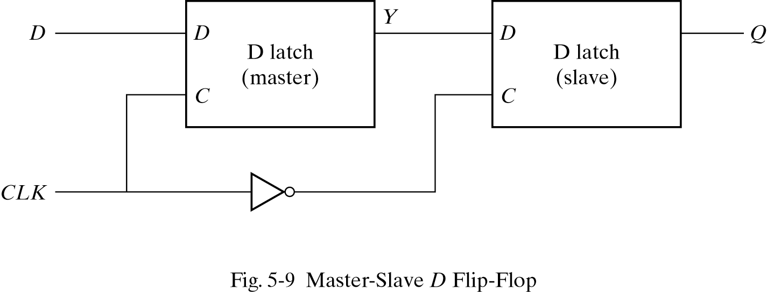
5.4 Flip-flops - Edge-Triggered Flip-Flop
Negative edge triggered D flip-flop
C=0 : master disable, slave enable
Output has no relation with input
C=1 : master enable, slave disable

Slide 11
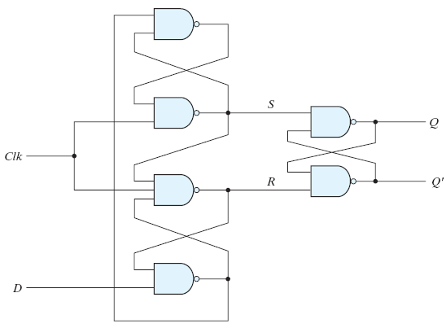
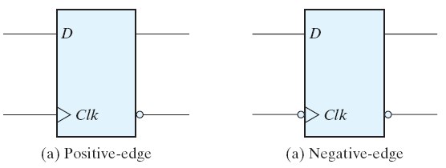
5.4 Flip-flops - Other Flip-Flop
D-type positive edge triggered flip flop
- Consist of 3 SR-latches
- Q changes only when C becomes 0 to 1

Slide 12
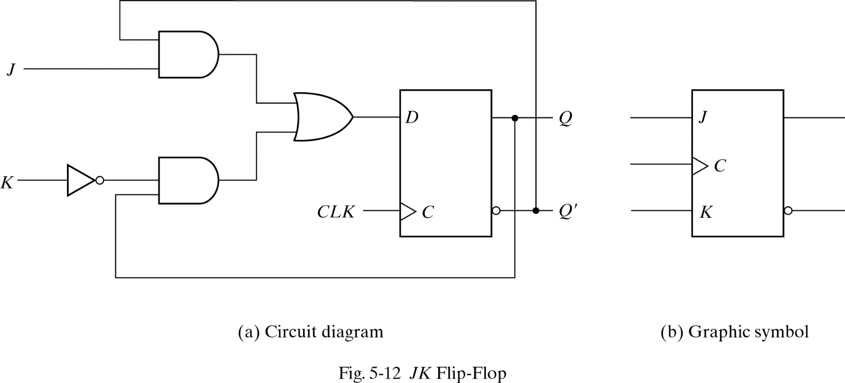
5.4 Flip-flops - Other Flip-Flop
JK flip-flop
- Performs three operations
- Set(J), Reset(K), Complement(J=K=1)
- D=JQ′+K′Q

Slide 13
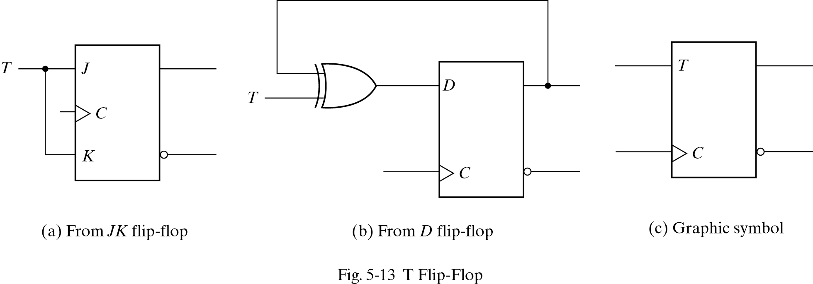
5.4 Flip-flops - Other Flip-Flop
T flip-flop
- Complementing flip-flop
- D=TQ′+T′Q

Slide 14
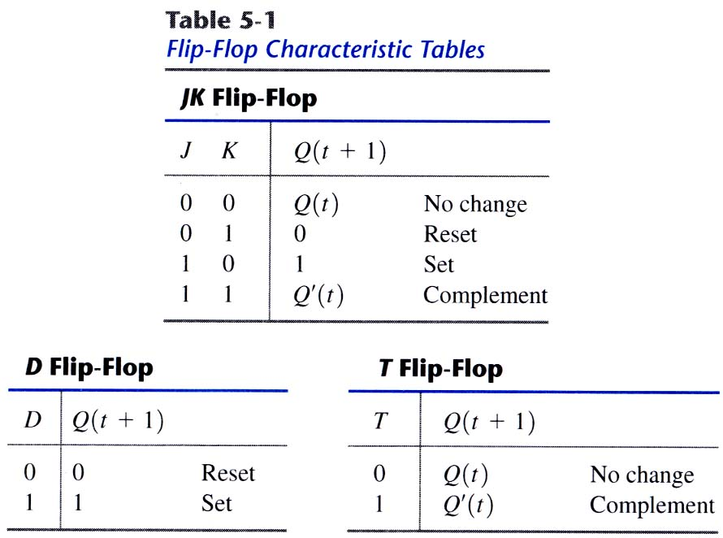
5.4 Flip-flops - Characteristic tables
Flip-flop characteristic tables

Slide 15
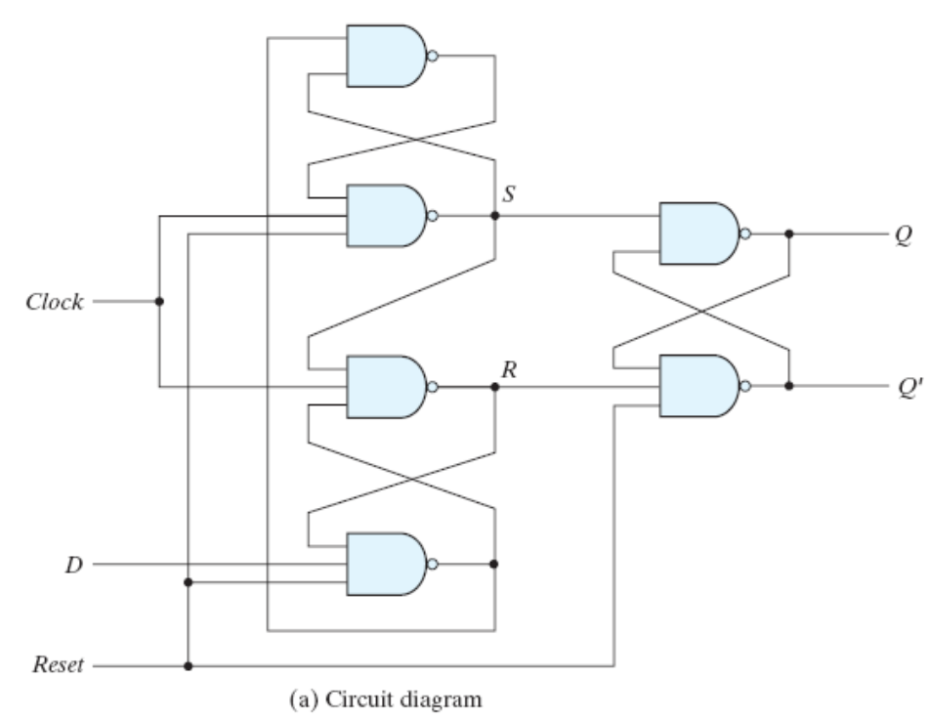
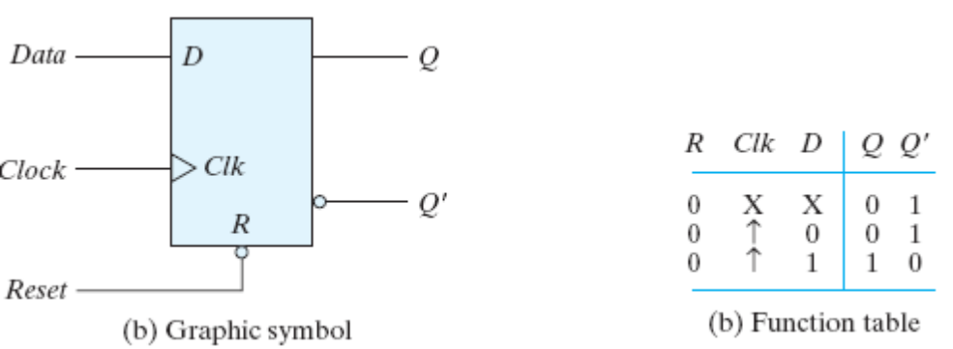
5.4 Flip-flops - Characteristic Equations

Slide 16
5.5 Analysis of clocked sequential circuits
Behavior of clocked sequential circuit is determined from input, output and present state
Output, next state are a function of input and present state

Slide 17
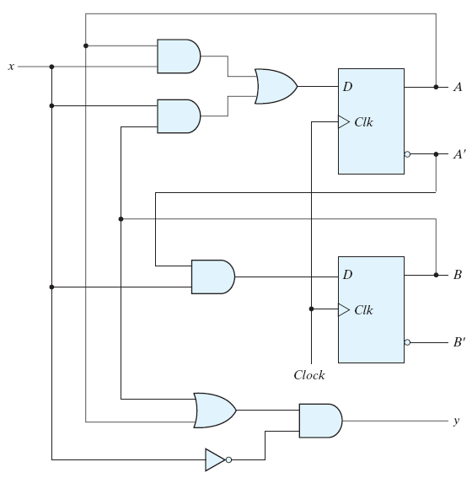
5.5 Analysis of clocked sequential circuits - State equations
Specifies the next state and output as a function of the present state and inputs
A(t+1)=Ax + Bx
B(t+1)=A′x
Y=(A+B)x′

Slide 18
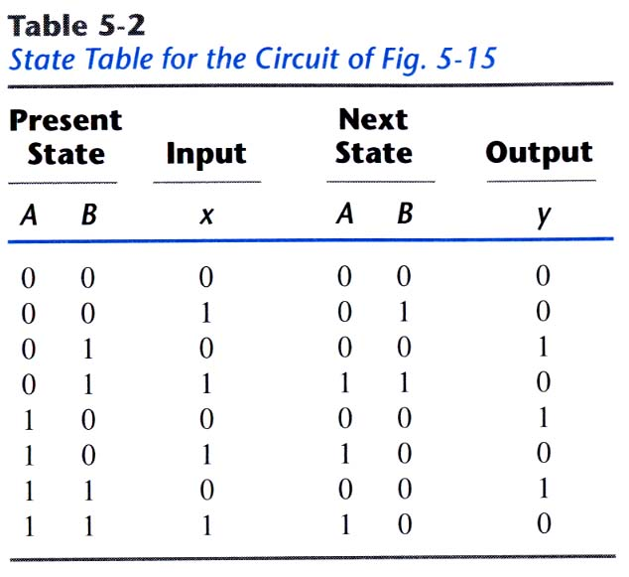
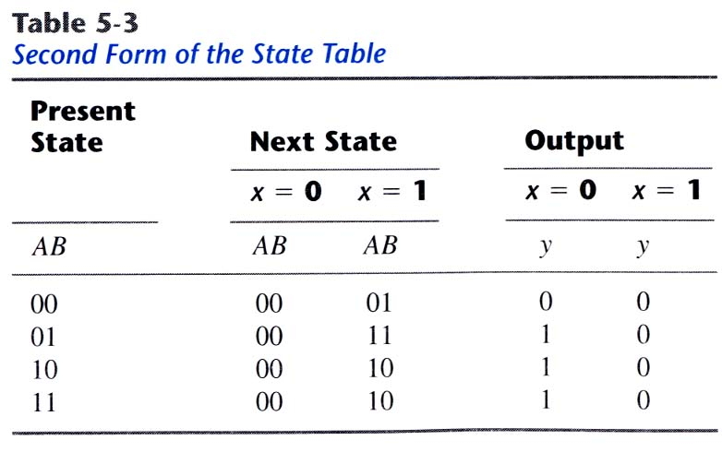
5.5 Analysis of clocked sequential circuits - State table
Time sequence table of inputs, outputs and flip-flop states
two types of state table exist

Slide 19
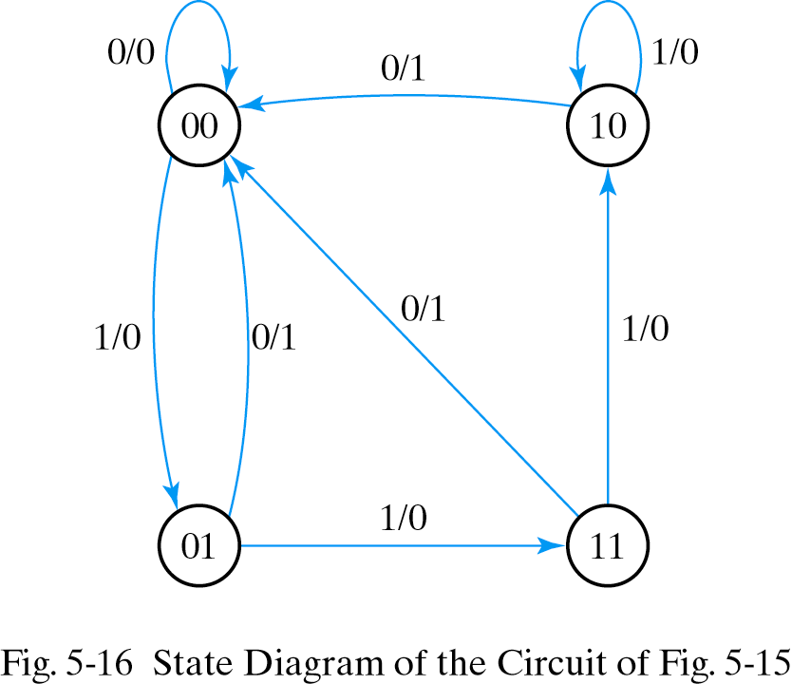
5.5 Analysis of clocked sequential circuits - State diagram
A kind of flow diagram
Can be derived from state table
State-circle, transition-line, I/O

Slide 20

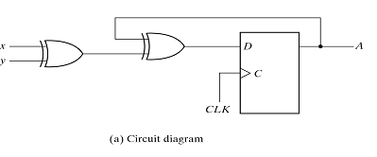
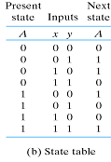
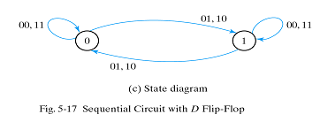
5.5 Analysis of clocked sequential circuits - Analysis with D flip-flops
Input equation :
State equation is equal to input equation

Slide 21
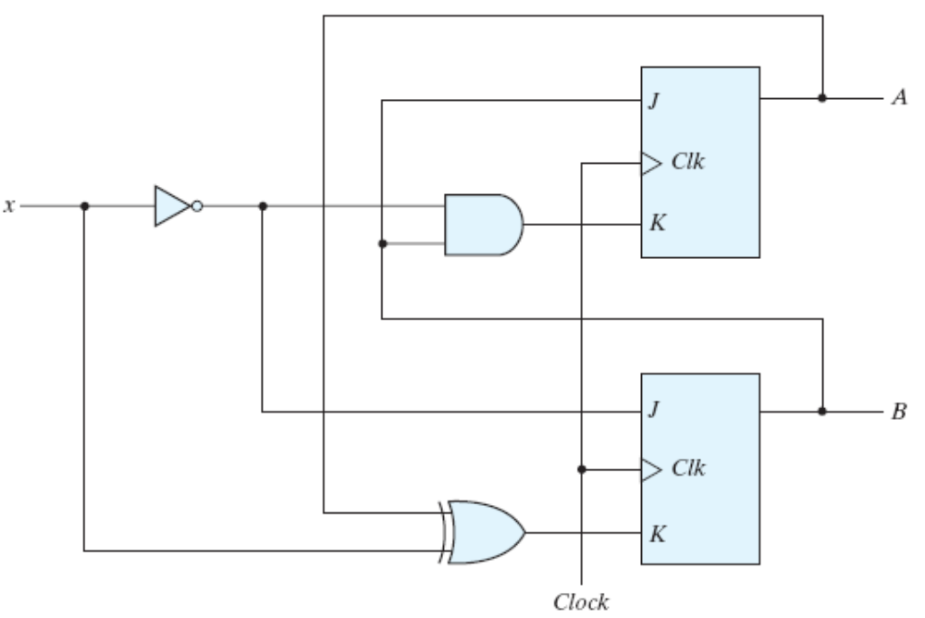
5.5 Analysis of clocked sequential circuits - Analysis with JK flip-flops
State equation is not the same as the input equation
Have to refer characteristic table
or characteristic
equation
Input equations
JA=B KA=Bx′
JB=x′ KB=A′x+Ax′

Slide 22
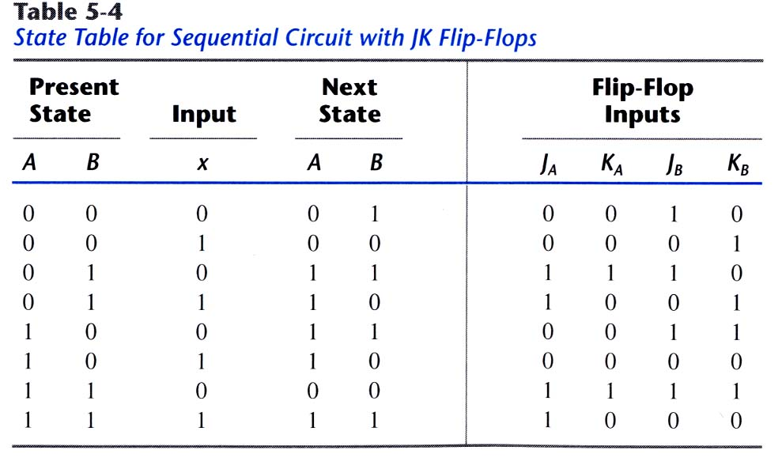
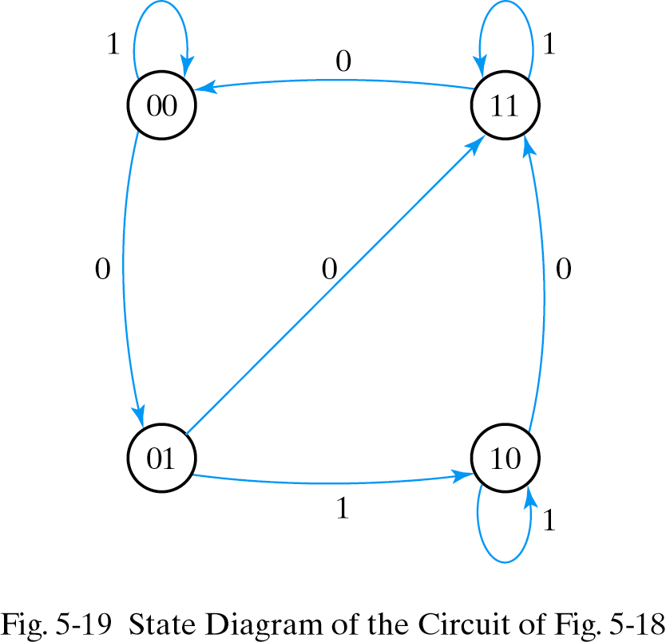
5.5 Analysis of clocked sequential circuits - Analysis with JK flip-flops
State table and state diagram

Slide 23
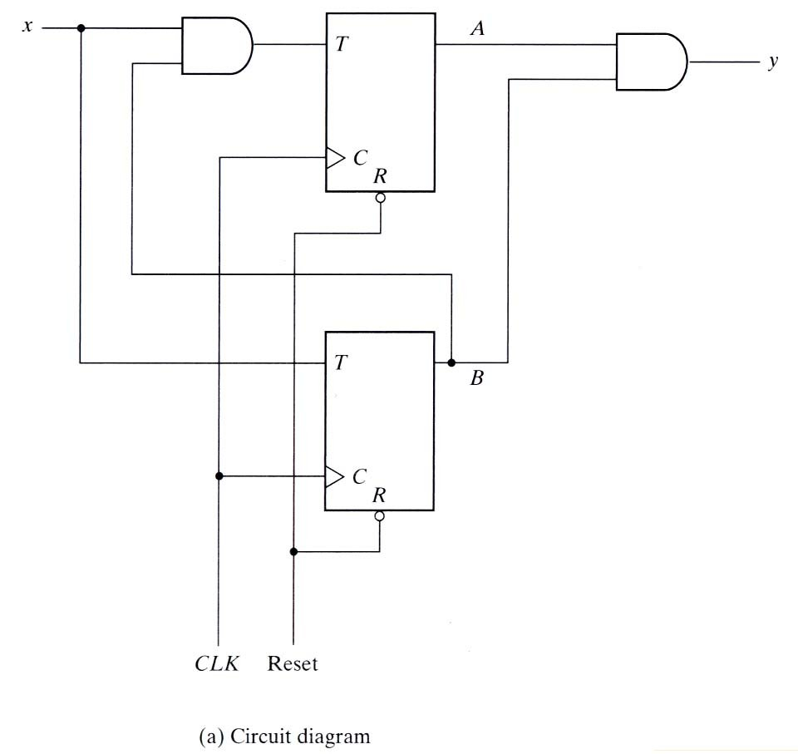
5.5 Analysis of clocked sequential circuits - Analysis with T flip-flops
Input equations and output equation
TA=Bx, TB=x
y=AB
State equations are
derived from
characteristic equation
A(t+1)=TAA′+TA′A
B(t+1)=TBB′+TB′B

Slide 24
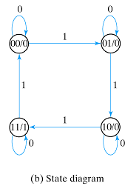
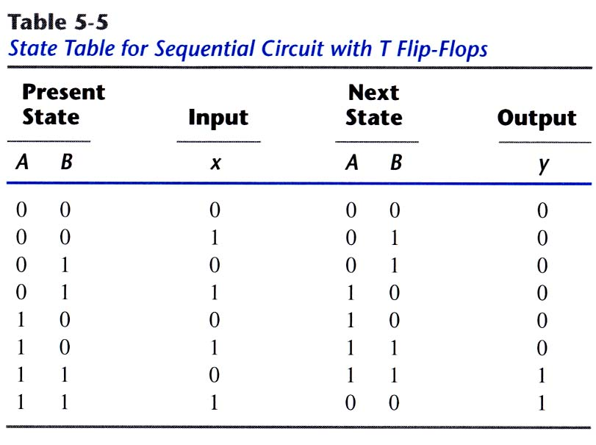
5.5 Analysis of clocked sequential circuits - Analysis with T flip-flops
State/output
Input

Slide 25
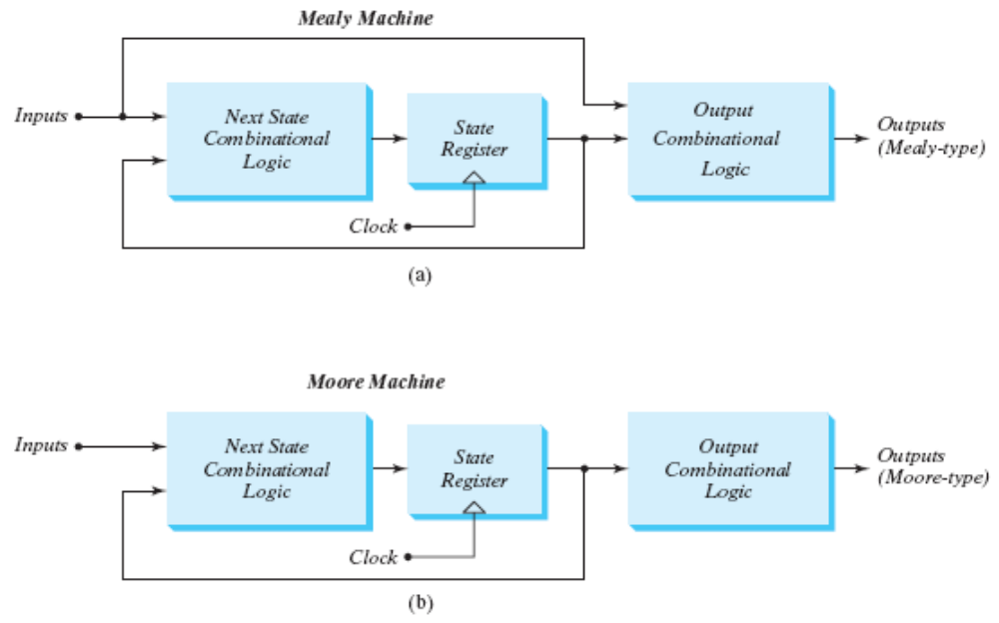
5.5 Analysis of clocked sequential circuits - Mealy and Moore models
Mealy model : output is a function of the present state and input
Inputs must be synchronized with the clock
Outputs must be sampled at the clock edge
Moore model : output is a function of the present state only
Outputs are synchronized with the clock

Slide 26
5.6 HDL for sequential circuits
Two kinds of behavioral statements
Initial : executes only once
Always : executes repeatedly until the simulation terminates

Slide 27
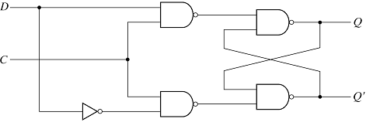
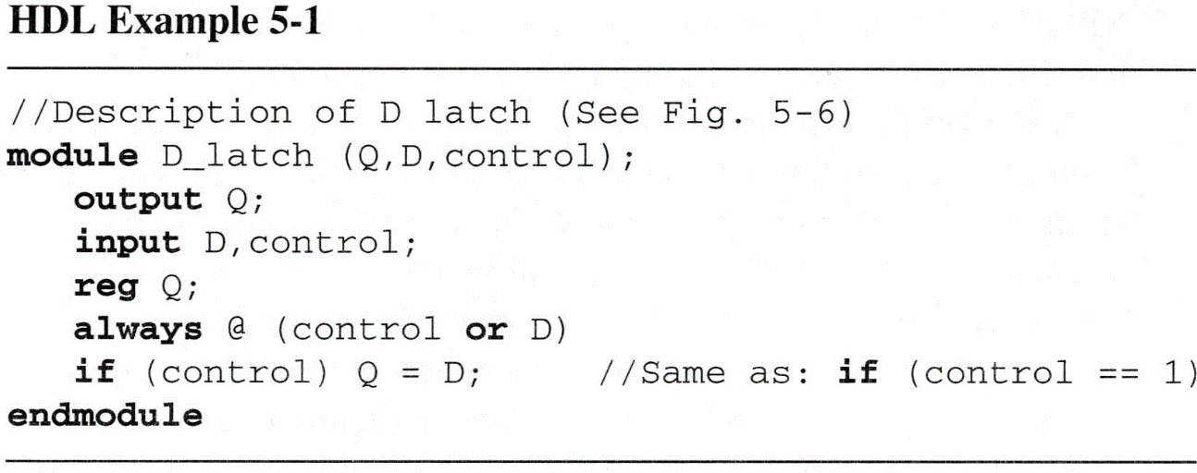
5.6 HDL for sequential circuits - Flip-flops and latches
D-latch

Slide 28
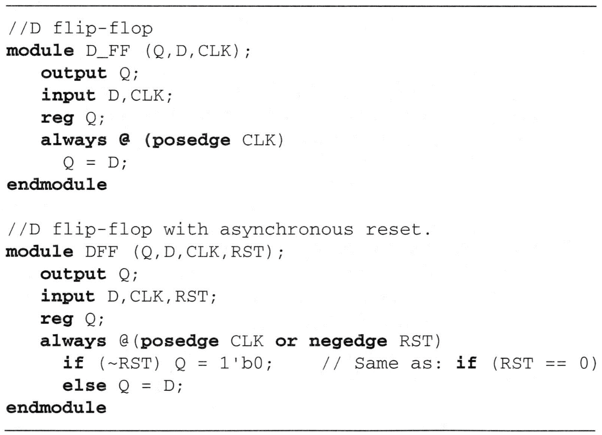
5.6 HDL for sequential circuits - Flip-flops and latches
D flip-flop
- D flip-flop with asynchronous reset

Slide 29
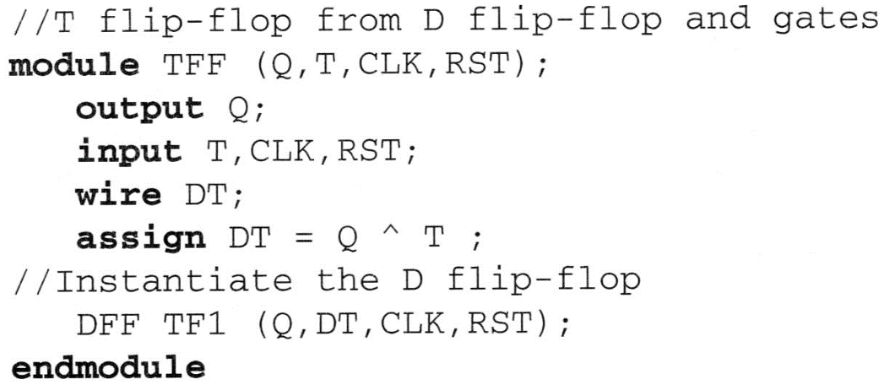
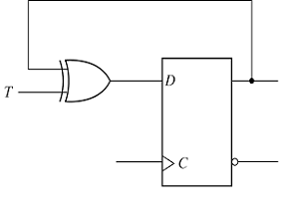
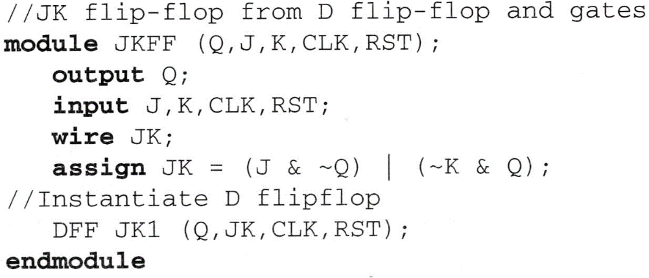
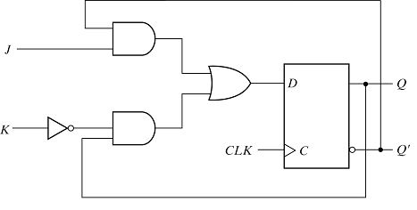
5.6 HDL for sequential circuits - Flip-flops and latches
T flip-flop from D flip-flop

Slide 30
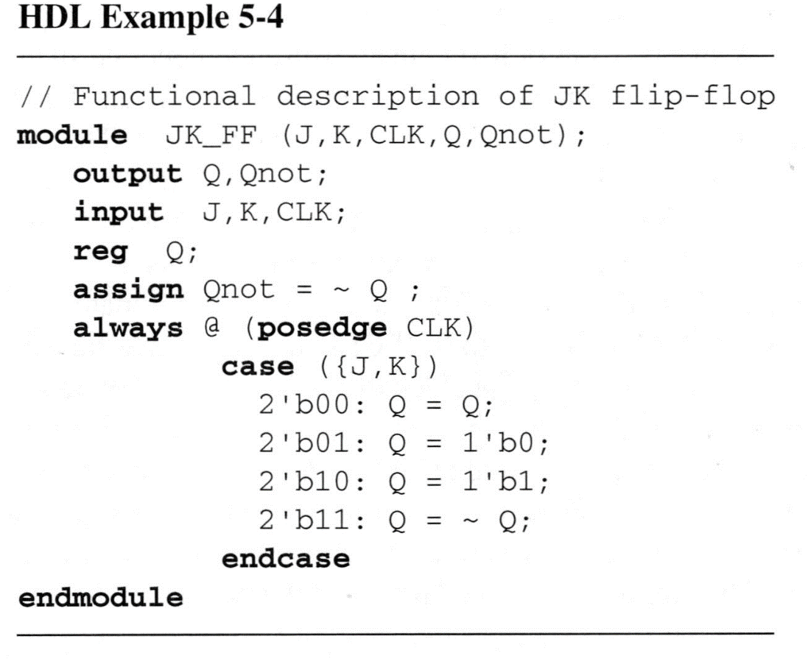
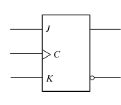
5.6 HDL for sequential circuits - Flip-flops and latches
JK flip-flop

Slide 31
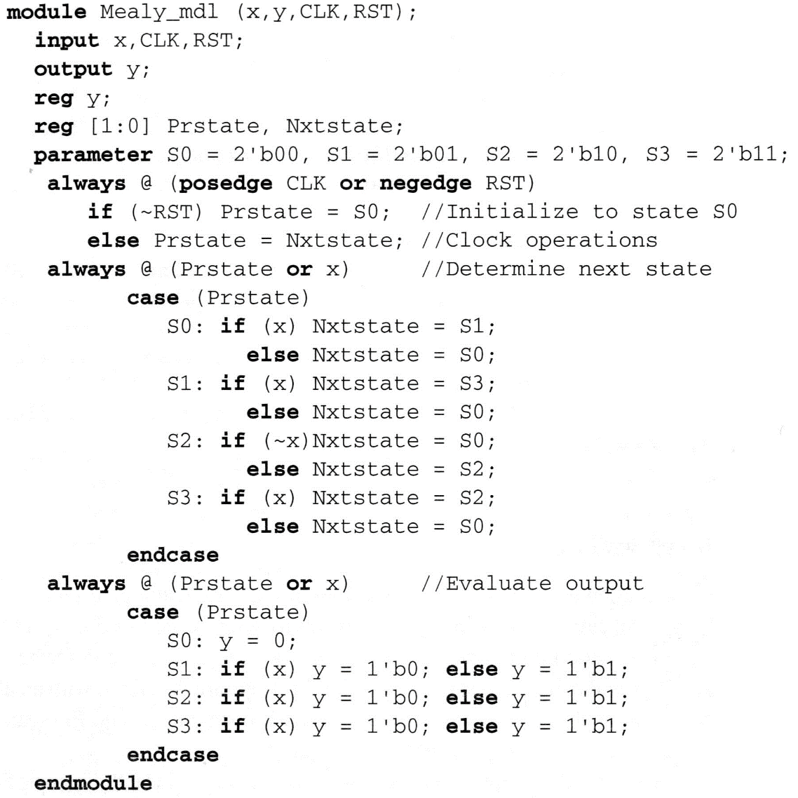
5.6 HDL for sequential circuits - State diagram
(Mealy state diagram)

Slide 32
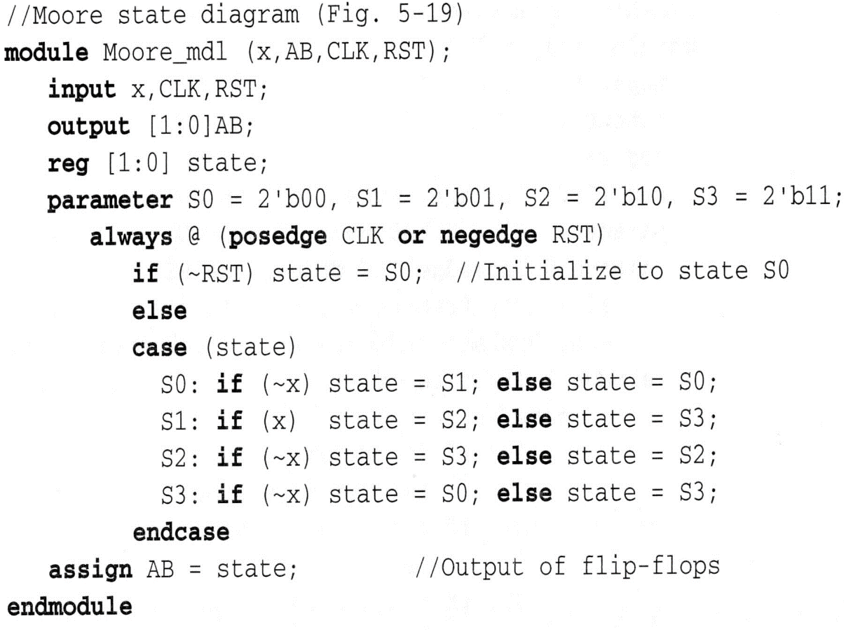
5.6 HDL for sequential circuits - State diagram
(Moore state diagram)

Slide 33
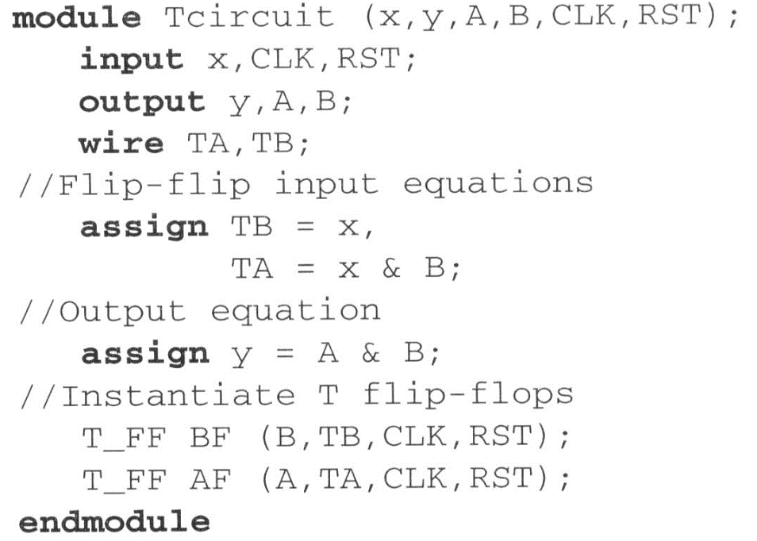
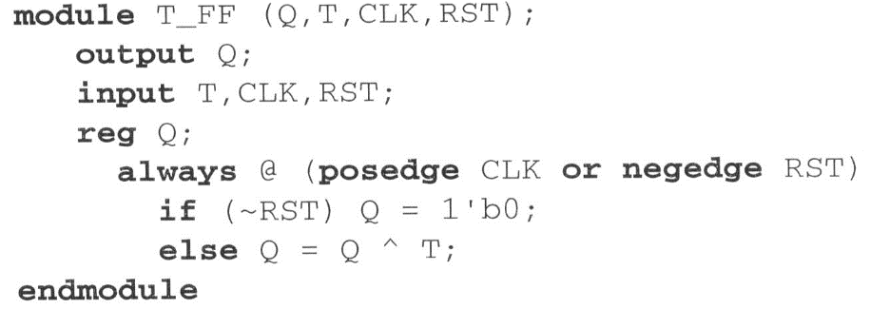
5.6 HDL for sequential circuits - Structural description

Slide 34
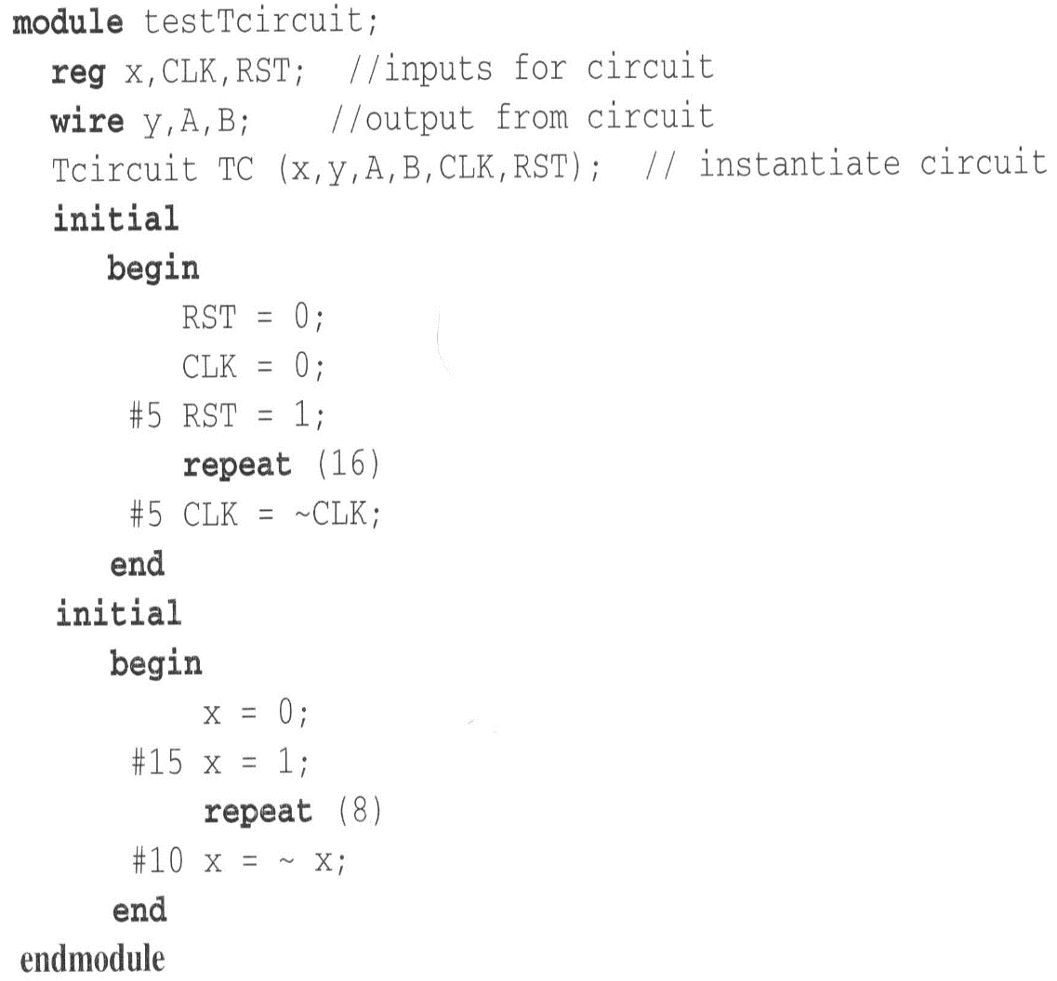
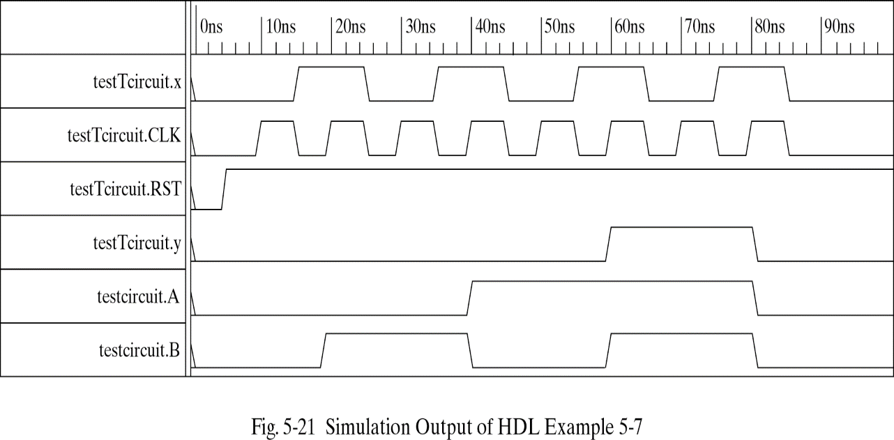
5.6 HDL for sequential circuits - Structural description
(Stimulus and output)

Slide 35
5.6 HDL for sequential circuits
module Mealy_Zero_Detector (
output reg y_out,
input x_in, clock, reset
);
reg [1: 0] state, next_state;
parameter S0 = 2'b00, S1 = 2'b01, S2 = 2'b10, S3 = 2'b11;
always @ (posedge clock, negedge reset) // state transition
if (reset == 0) state <= S0;
else state <= next_state;
always @ (state, x_in) // Form the next state
case (state)
S0: if (x_in) next_state = S1; else next_state = S0;
S1: if (x_in) next_state = S3; else next_state = S0;
S2: if (~x_in) next_state = S0; else next_state = S2;
S3: if (x_in) next_state = S2; else next_state = S0;
endcase
always @ (state, x_in) // Form the output
case (state)
S0: y_out = 0;
S1, S2, S3: y_out = ~x_in;
endcase
endmodule
module t_Mealy_Zero_Detector;
wire t_y_out;
reg t_x_in, t_clock, t_reset;
Mealy_Zero_Detector M0 (t_y_out, t_x_in, t_clock, t_reset);
initial #200 $finish;
initial begin t_clock = 0; forever #5 t_clock = ~t_clock; end
initial fork
t_reset = 0;
#2 t_reset = 1;
#87 t_reset = 0;
#89 t_reset = 1;
#10 t_x_in = 1;
#30 t_x_in = 0;
#40 t_x_in = 1;
#50 t_x_in = 0;
#52 t_x_in = 1;
#54 t_x_in = 0;
#70 t_x_in = 1;
#80 t_x_in = 1;
#70 t_x_in = 0;
#90 t_x_in = 1;
#100 t_x_in = 0;
#120 t_x_in = 1;
#160 t_x_in = 0;
#170 t_x_in = 1;
join
endmodule

Slide 36
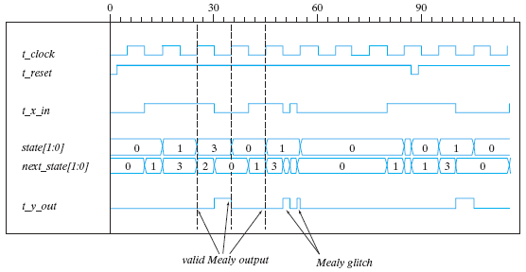
5.6 HDL for sequential circuits

Slide 37
5.7 State reduction and assignment
State reduction is used to reduce the number of flip-flop
Only input/output sequences are important
Interested in present states that go to the same next state and have the same output

Slide 38
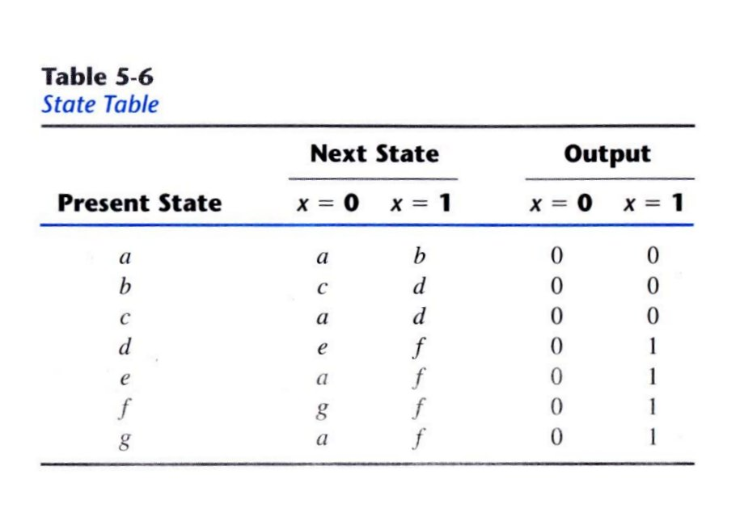
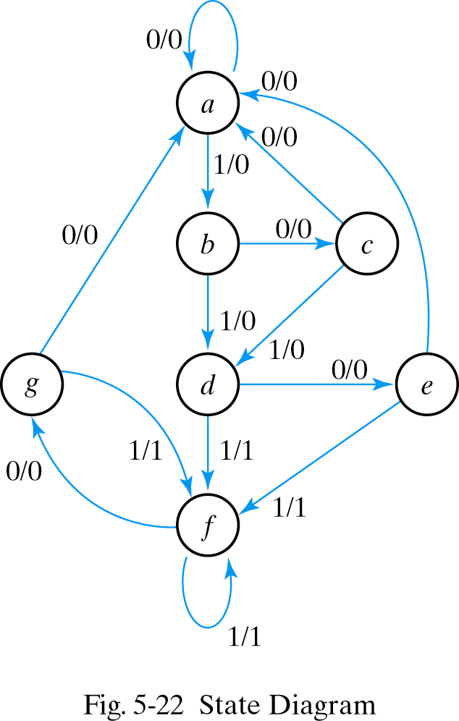
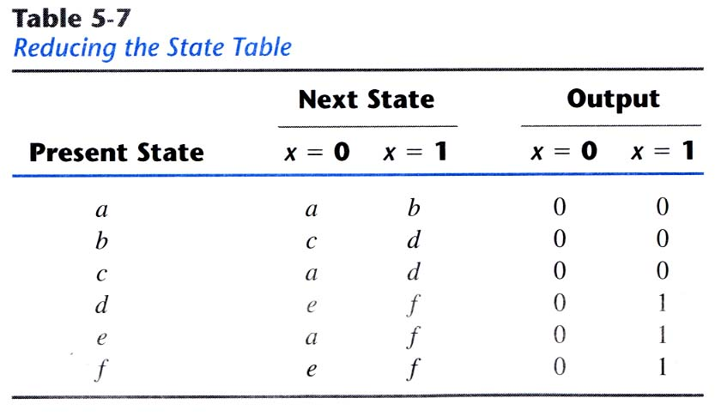
5.7 State reduction and assignment - State reduction

Slide 39


5.7 State reduction and assignment - State reduction

Slide 40

5.7 State reduction and assignment - State assignment
m states circuit, codes must contain n bits where 2ⁿ≥m
Three possible binary state assignments

Slide 41
5.8 Design procedure
Sequential circuit design : requires state table
⇔ Combinational circuit : truth table
The number of flip-flop is determined from the number of states in circuit
If 2ⁿ states exist, there are n flip-flops

Slide 42
5.8 Design procedure
Design steps
  1)Derive a state diagram or state table
  2)Reduce the number of states if necessary
  3)Assign binary code to the state
  4)Choose the type of flip-flops to be used
  5)Derive the flip-flop input equations and output equations
  6)Draw the logic diagram

Slide 43

5.8 Design procedure
Derive a state diagram
- Sequential detector
- Three or more consecutive 1’s in a string of bits coming
through an input line
0

Slide 44

5.8 Design procedure - Synthesis using D flip-flops
Input equations are obtained directly from the next states

Slide 45


5.8 Design procedure - Synthesis using D flip-flops
K-maps and logic diagram

Slide 46

5.8 Design procedure - Excitation table
Excitation Table

Slide 47

5.8 Design procedure - Synthesis with JK flip-flops
Input equations evaluated from the present state to next state transition

Slide 48


5.8 Design procedure - Synthesis with JK flip-flops
K-maps and logic diagram

Slide 49

5.8 Design procedure - Synthesis using T flip-flops
3-bit binary counter
3-bit counter has 3 flip-flops and can count from 0 to
2ⁿ-1(n=3)

Slide 50



5.8 Design procedure - Synthesis using T flip-flops
State table and logic diagram
  TA2=A1A0, TA1=A0, TA0=1
1

